Slide 1

Blame the data, not the system: How data constraints can help explain causes of data-system malfunction Anna Fariha University of Utah
Notes:
Hi everyone. Thank you for giving me the opportunity to give this talk today. I am Anna Fariha, I am an incoming assistant professor at the university of Utah. Before that, I was a Researcher here, at Microsoft. Today I am going to talk about how certain data constraints can reveal causes of malfunction of data systems that learned from the data. In other words, how can we blame the data, or certain properties of data to explain observed system malfunctions.

Slide 2




What are the challenges in
data systems that users face?
Notes:
Let’s first talk a little about what drives my research in general:
A lot of different kinds of users need to work with data. But even though data is now broadly available, working with it effectively can be extremely challenging. There can be
$ barriers of access, where users lack the means or abilities to retrieve the data they need effectively,
$ there can be barriers of understanding, where users struggle to interpret results or debug causes of unexpected failures,
$ and then there can be barriers of trust, where users do not feel equipped and confident to rely on the data systems they use.

Slide 3
What are the challenges in
data systems that users face?
I tried to retrain my old ML model over a new data, but it’s not working! I have no idea why.
Uh oh! I don’t know how to write SQL, how can I get a hold of the data?
Explainability
Usability
Trustworthiness
This AI tool is saying I should invest in this stock! Should I trust it?
Notes:
The goal of my research is to focus on aspects that remove these barriers.
As more concrete examples, think about a user who doesn’t know SQL but still wants to get a hold of some data within a relational database. This is a usability barrier.
Then think about a user who just trained an ML model over a dataset and everything was working fine, but the same model, isn’t working that great for a different dataset. They wonder why?
Finally, there is the issue of trust. When an AI suggests us to do something, such as investing in a certain stock, should we trust it? I recently saw a post in my facebook saying ChatGPT can suggest skincare solutions and it’s correct. On one hand, this would be an amazing technological advancement, on the other hand, I just felt very skeptical before putting anything on my own skin based on what an AI is suggesting? Why because I still don’t trust AI that much!
So the ultimate goal of my research is to meet the users of data systems where they are. I want to bring the data systems closer to their users.

Slide 4






Support for explanation in the design layer
Explaining disconnect between data and systems
Metric vs Imperial
KG vs lbs
Notes:
For instance, with respect to data-driven systems, we all become curious about understanding and repairing bugs that relate to the impact that data has on the system. I am not simply talking about errors in the data, but, rather, cases where data may lead to system malfunction due to a disconnect between properties of the data and the system design.
For example, when a system is designed to handle data in the US format, but the data is formatted in the say Australian format, neither the data is wrong, nor is the system, but there is a mismatch between what the system expects from the data. The goal of this project is to identify such mismatches.

Slide 5







DataPrism: Exposing Disconnect between Data and Systems
Sainyam Galhotra, Anna Fariha, Raoni Lourenço, Juliana Freire, Alexandra Meliou, Divesh Srivastava
[SIGMOD 2022]
Notes:
DataPrism is about investigating where data may lead to system malfunction due to a disconnect between properties of the data and the system design. This is a joint work with Sainyam, Raoni, Juliana, Alexandra, and Divesh.

Slide 6





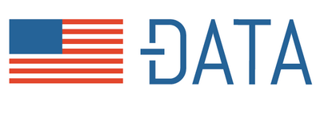
Mismatch between data and systems
Easy access to large amounts of data
Availability of tools to build data-driven systems
Mismatch between pipeline’s assumptions of input data and the actual input data
Input Dataset
Pipeline Implementation

Slide 7


Example of malfunction: predict income of individuals
Age | Sex | Race | Marital Status | zip | Income
32 | Female | White | Unmarried | 14552 | <50K
37 | Female | Black | Married | 94560 | >50K
21 | Male | Black | Married | 01002 | <50K
24 | Male | White | Unmarried | 64533 | >50K
ML Model
8% Unfair
Age | Sex | Race | Marital Status | zip | Income
18 | Female | White | Unmarried | 01004 | <50K
37 | Female | Black | Unmarried | 01014 | <50K
21 | Male | Black | Married | 98052 | >50K
52 | Male | White | Married | ? | >50K
ML Model
95% Unfair
Notes:
Let’s take a closer look on another example. I am using here US census dataset to predict income of individuals. The first dataset looks like this. I use it to train an ML model that can predict Income. Now an important and auxiliary goal of machine learning is to ensure fairness over sensitive attributes, such as race or sex. So during my training, I make sure certain precautions are taken to make sure sensitive attributes are not visible to the model. For example, I can simply omit the attribute “sex” so that the model doesn’t even see individual’s sex. Since the model is completely unaware of the attribute sex, my expectation is that it won’t discriminate against sex, and indeed I see only 8% unfairness in the prediction which is pretty low.
So I am now happy with my strategy to remove the attribute sex altogether from the data and the trained model seems to be working pretty fairly if I do so, right?
Now I have a similar dataset, with a quick look, the distribution looks similar, there are 50% male, 50% female, 50% black, 50% white, 50% married and 50% unmarried. Looks good, right? So I do the exact same thing, drop the sex attribute and train an ML model and try to predict the income. But this time, I fail! My ML model is about 95% unfair!
I dig deeper and this is what I find! Actually, in the first dataset, there were unmarried females and unmarried males, also married females and married males. But in my new dataset, all females happen to be unmarried and all males happen to be married. So what’s going on here is that the model somehow is using marital status as a “proxy” of a person’s sex, and in turn, is using that to predict their income, which turns out to be highly unfair against females.
So what’s really happening here?

Slide 8
Other kinds of system malfunction
Classifier accuracy decline
Bias in prediction
Program crash
System timeout

Slide 9

Blame the data profiles!
Notes:
The key idea here is to blame the data, more specifically, certain data profiles for causing system malfunctions.

Slide 10
Data issues: local vs global
Data issue can be holistic.
Correlation between sex and marital status
can cause classifier unfairness.

Slide 11
Unit of blame: data profiles
Correlation
Fraction of Outliers
Domain
Fraction of Missing Values
Functional Dependencies

Slide 12
DataPrism: solution architecture
Construct a Profile-attribute graph
Identify Discriminative Profiles
Rank Profiles based on their benefit score
Intervene on Profiles

Slide 13
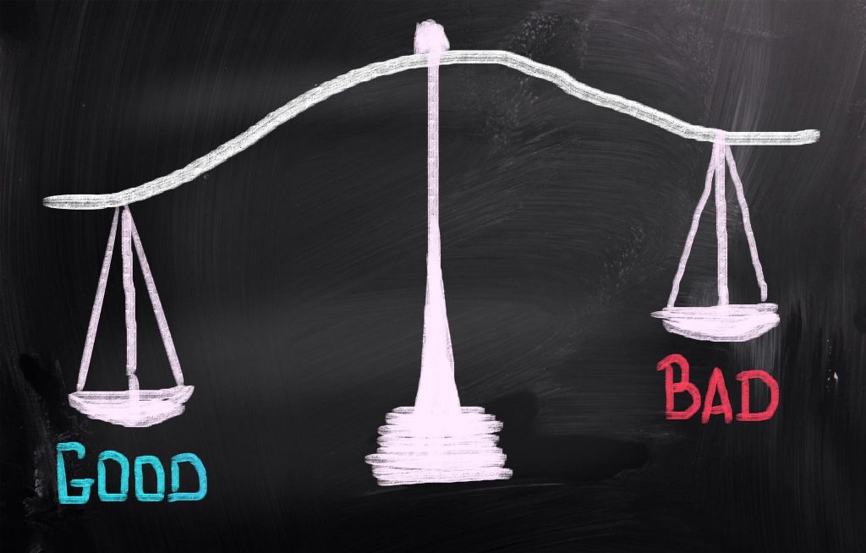
Step 1: Identify discriminating profiles
Start with a good and a bad dataset

Slide 14
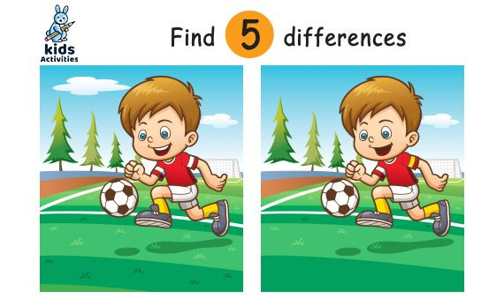
Step 1: Identify discriminating profiles
Find out discriminative profiles between the good and the bad datasets
Discriminative Profiles
Type | Attribute(s) | Value
Domain | Age | [18, 52]
Correlation | Sex, Marital Status | 97%
Correlation | Marital Status, Income | 95%

Slide 15
DataPrism: solution architecture
Construct a Profile-attribute graph
Identify Discriminative Profiles
Rank Profiles based on their benefit score
Intervene on Profiles

Slide 16
Step 2: Construct a profile-attribute graph
Construct a bipartite graph connecting Profiles to the corresponding Attributes
Intuition: Attributes with issues connect to multiple discriminative Profiles.
Attributes
Age
Discriminative Profiles
Sex
Type | Attribute(s) | Value
Domain | Age | [18, 52]
Correlation | Sex, Marital Status | 97%
Correlation | Marital Status, Income | 95%
Marital Status
Income
Notes:
The high level intuition of constructing this graph is that attributes some issues such as incorrect format or mistakes generally have multiple discriminative profiles connected to it. Therefore, profiles that are connected to a high degree attributes in this graph are considered as possible culprits first.

Slide 17
DataPrism: solution architecture
Construct a Profile-attribute graph
Identify Discriminative Profiles
Rank Profiles based on their benefit score
Intervene on Profiles

Slide 18
Step 3: Rank profiles based on expected benefit
Benefit of a Profile P = Violation X Tuple coverage when P is intervened on
How far is the profile from an ideal profile?
What fraction of tuples need to be altered to make sure the violation is acceptable?
Type | Attribute(s) | Value
Correlation | Sex, Marital Status | 97%
Correlation | Marital Status, Income | 95%
Benefit score
0.67
0.34
Notes:
Now the third stage ranks the discriminative profiles based on a benefit score.
This score captures the likelihood that malfunction score would change if a profile is intervened. Specifically, the benefit of a profile is the violation score of the failing dataset times the fraction of tuples that are transformed by the PVTs transformation.
We show the benefit scores of different PVTs in this table.
In the subsequent stage, highest scoring PVT which is Correlation between sex and income is considered for intervention.

Slide 19
DataPrism: solution architecture
Construct a Profile-attribute graph
Identify Discriminative Profiles
Rank Profiles based on their benefit score
Intervene on Profiles

Slide 20

Step 4: Data profile intervention
Notes:
To verify whether some data profile indeed causes system malfunction, we take an interventional approach.

Slide 21
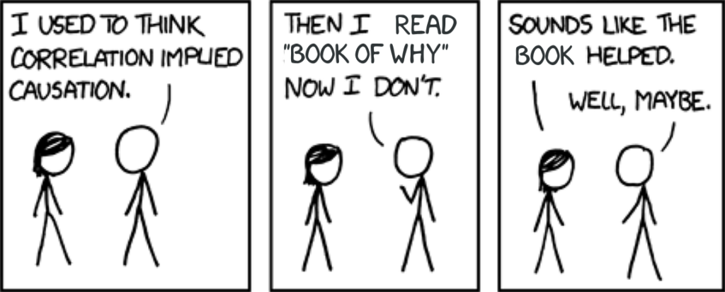
Step 4: Key ideas of data intervention
Alter (intervene) profiles of the bad dataset,
one-by-one, to move it closer to the good dataset,
to expose cause-effect relationships

Slide 22
Evaluation results: 7 case studies
[Accuracy drop] Sentiment prediction:
inconsistent data domain for target attribute
[Unfairness] Income prediction:
correlation between attributes
[Accuracy drop] Cardiovascular-disease prediction
unit mismatch for attribute height

Slide 23
Evaluation results: number of interventions
DataPrism requires fewer interventions than all baselines
Requires too many interventions
Fails to identify the cause of malfunction in some cases
Case Study | DataPrism | BugDoc | Anchors | GroupTesting
Sentiment | 4 | 4 | 303 | 4
Income | 2 | 20 | 103 | 10
Cardiovascular | 5 | 100 | 3503 | -
Flights | 5 | 78 | 601 | -
Amazon | 2 | 8 | 303 | 4
Open data | 8 | 14 | 102 | -
Physicians | 30 | 46 | 104 | 47

Slide 24
Key takeaways
(Violation of) data constraints help expose the mismatch between data and systems.
DataPrism produces a causally verified explanation of malfunction
DataPrism requires fewer interventions than group testing and other debugging techniques

