Slide 1





DataPrism: Exposing Disconnect between Data and Systems
Sainyam Galhotra
, Anna Fariha, Raoni Lourenço, Juliana Freire, Alexandra Meliou, Divesh Srivastava

Slide 2



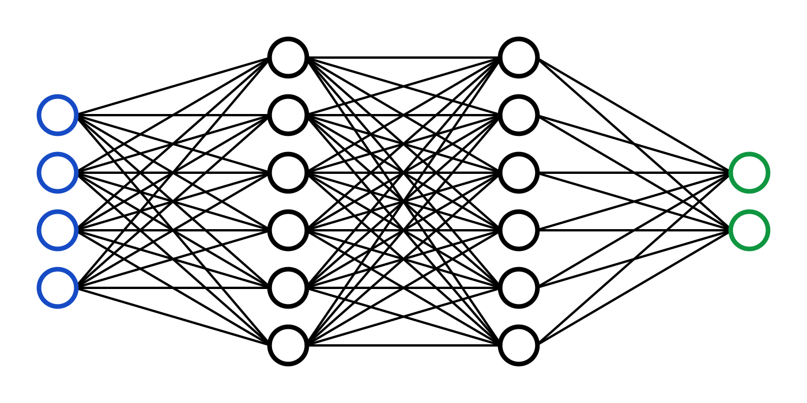
Data-based decision making

Slide 3





Ease of development
Easy access to large amounts of data
Availability of tools to help build such systems
Mismatch of pipeline’s assumptions/expectations of input and the actual input data can cause malfunction
500k lines of code 500 lines of dataflow
Input Dataset
Pipeline Implementation
Notes:
It has become extremely easy to develop such systems because of easy access to large amounts of data from various data repositories like google dataset search, data.gov and so on.
On the implementation side of things, ML libraries have made it simple to code these applications in less than 500 lines of code which traditionally required 500 thousand lines of code.
This is all great but one of the common challenges faced in this development is that the pipeline has some specific assumptions or expectations which the dataset does not satisfy. This mismatch of assumptions and reality causes the system to crash or have poor performance. We refer to this deteriorated performance as malfunction.

Slide 4




Mismatch between data and systems
90% Accuracy
Metric vs Imperial
KG vs lbs
30% Accuracy
Notes:
Let us look at an example. Suppose you have built a health monitoring and recommendation system in the US. It is doing really well because it demonstrated highly accurate results. Now you get a chance to collaborate with a hospital in Australia and when you deploy the algorithm achieves embarrasingly low accuracy.
You are confused to see such a stark difference in performance of the system.
After a close investigation you notice that all individuals are entering weight in kilograms which is causing this problem. The software which was designed in the US was assuming that all individuals enter weight in pounds. The moment you change the units of weight in the Australian data, the accuracy improves to over 0.9.
In this case, neither the data was wrong nor the system was wrong. BUT there was a mismatch between system’s expectation and the input dataset.

Slide 5
Example of Malfunction
Age | Sex | Race | Marital Status | zip | Income
32 | Female | White | Unmarried | 14552 | <50K
37 | Female | Black | Married | 94560 | >50K
24 | Male | Black | Married | 01002 | <50K
24 | Male | White | Unmarried | 64533 | >50K
ML Model
Unfairness score
0.13
The correlation of Male married individuals with high income causes unfairness in the ML model
Fewer married females in second dataset cause ML model to ignore those tuples
Age | Sex | Race | Marital Status | zip | Income
45 | Female | Black | Unmarried | 01004 | <50K
33 | Male | Black | Married | 01014 | >50K
23 | Male | Black | Married | ? | >50K
? | Male | White | ? | 94523 | >50K
ML Model
Unfairness score
0.95
Notes:
Let us look at another examples of malfunction. In this case, you train an ML model to predict income of individuals and ensure that it does not discriminate against sex.
[hit]
Now when you use the same pipeline to train it on another dataset, it is highly biased against women.
[hit]
After a close investigation you observe that there are two main causes of bias:
First more male individuals have higher salary than female individuals
Second, females with higher income are fewer in the dataset, because of which the system ignores such individuals.
Now, let us try to see how we can explain such mismatch between data and systems.

Slide 6
Data Profile-Violation-Transformation (PVT)
Profile: A property or a set of constraints that are satisfied by the tuples
Age | Sex | Race | Marital Status | zip | Income
45 | Female | Black | Unmarried | 01004 | <50K
33 | Male | Black | Married | 01014 | >50K
23 | Male | Black | Married | ? | >50K
? | Male | White | Married | 94523 | >50K
Domain (Marital Status) = {Married, Unmarried}
Correlation(Sex, Income) = 0.63
Notes:
For this purpose, we define a PVT which is a tuple of three components: data profile, violation function and transformation function. Hence the name PVT
Firstly, a profile is a data property which is satisfied by the tuples For example, given this dataset, the domain profile of marital status is the set married and unmarried. Similarly correlation data profile of sex and income shows that the correlation of columns is 0.63

Slide 7
Data Profile-Violation-Transformation (PVT)
Profile: A property or a set of constraints that are satisfied by the tuples
Violation Function: Quantifies violation of a dataset wrt a profile
Age | Sex | Race | Marital Status | zip | Income
45 | Female | Black | Unmarried | 01004 | <50K
33 | Male | Black | Married | 01014 | >50K
23 | Male | Black | Married | ? | >50K
? | Male | White | ? | 94523 | >50K
Domain (Marital Status) = {Married, Unmarried}
Violation score = 0.25
Notes:
In addition to a profile, a PVT consists of a violation function which characterizes the violation of any input dataset with respect to the profile. The violation score is considered to be within the range 0 to 1.
In this example, one tuple out of the four does not satisfy the input domain of married or unmarried. Therefore the violation score is 1/4

Slide 8
Data Profile-Violation-Transformation (PVT)
Profile: A property or a set of constraints that are satisfied by the tuples
Violation Function: Quantifies violation of a dataset wrt a profile
Transformation Function: Alter tuples to reduce violation
Transformation Function: < 50K 0 AND > 50K 1
Age | Sex | Race | Marital Status | zip | Income
45 | Female | Black | Unmarried | 01004 | <50K
33 | Male | Black | Married | 01014 | >50K
23 | Male | Black | Married | ? | >50K
? | Male | White | ? | 94523 | >50K
Age | Sex | Race | Marital Status | zip | Income
45 | Female | Black | Unmarried | 01004 | 0
33 | Male | Black | Married | 01014 | 1
23 | Male | Black | Married | ? | 1
? | Male | White | ? | 94523 | 1
Notes:
Third, a PVt consists of a transformation function which modifies the dataset to reduce the violation. For example, if we want to change domain of the income colum to 0 and 1 then this transformation can be applied.

Slide 9

Data Profile Intervention
Notes:
We use PVTs as the key ingredient to explain the cause of malfunction. In order to identify the set of PVTs that are the cause of malfunction, we take an interventional approach. What we mean by that is we forcefully modifying the input dataset and then evaluate its effect on the performance of the downstream task.

Slide 10
DataPrism: Using interventions to validate causality
Age | Sex | Race | Marital Status | zip | Income
45 | Female | Black | Unmarried | 01004 | <50K
33 | Male | Black | Married | 01014 | >50K
23 | Male | Black | Married | ? | >50K
? | Male | White | ? | 94523 | >50K
Age | Sex | Race | Marital Status | zip | Income
45 | Female | Black | Unmarried | 01004 | 0
33 | Male | Black | Married | 01014 | 1
23 | Male | Black | Married | ? | 1
33 | Male | White | ? | 94523 | 1
ML Model
Malfunction score: 0.73
Malfunction score: 0.85
Transforms the failing dataset according to PVTs to validate the cause

Slide 11

Problem Setup
D_{pass} (Malfunction score = 0.13)
Age | Sex | Race | Marital Status | zip | Income
32 | Female | White | Unmarried | 14552 | <50K
37 | Female | Black | Married | 94560 | >50K
24 | Male | Black | Married | 01002 | <50K
24 | Male | White | Unmarried | 64533 | >50K
ML Model
What are the minimal set of PVTs that such that the transformed failing dataset T(D_{fail}) has malfunction score less than 0.2?
Malfunction
score
D
Age | Sex | Race | Marital Status | zip | Income
45 | Female | Black | Unmarried | 01004 | <50K
33 | Male | Black | Married | 01014 | >50K
23 | Male | Black | Married | ? | >50K
? | Male | White | ? | 94523 | >50K
D_{fail} (Malfunction score = 0.95)
Notes:
Now that we understand what data profiles and PVTs are, let us look at the problem setup. We are given two datasets, one of which is a passing dataset ie. it performs well with respect to the system implementation and the other one is a failing dataset which does not work well with the system. Given these 2 datasets and access to the downstream task, we want to identify a minimal set of PVTs such that transforming the failing dataset wrt these PVTs fixes it!

Slide 12
DataPrism: Solution Architecture
Construct a PVT-attribute graph
Identify Discriminative PVTs
Rank PVTs based on their benefit score
D_{fail}
D_{pass}
Intervene to observe the effect of transformation
Notes:
To solve this problem, we propose Data Prism which operates in four main steps. Let us go over these steps on by one.

Slide 13
Step 1: Identify Discriminative PVTs
D_{pass}
Age | Sex | Race | Marital Status | zip | Income
32 | Female | White | Unmarried | 14552 | <50K
37 | Female | Black | Married | 94560 | >50K
24 | Male | Black | Married | 01002 | <50K
24 | Male | White | Unmarried | 64533 | >50K
Type | Attribute(s) | Value
Domain | Age | [24,32]
Domain | Sex | {Male, Female}
Correlation | Sex, Income | 0.07
D_{fail}
Age | Sex | Race | Marital Status | zip | Income
45 | Female | Black | Unmarried | 01004 | <50K
33 | Male | Black | Married | 01014 | >50K
23 | Male | Black | Married | ? | >50K
? | Male | White | ? | 94523 | >50K
Type | Attribute(s) | Value
Domain | Age | [23,45]
Domain | Sex | {Male, Female}
Correlation | Sex, Income | 0.67
Notes:
First, it identifies a set of discriminative PVTs i.e. the PVTs which are not the same in the failing and passing datasets. For example, we calculate PVTs for the passing dataset as shown here.

Slide 14
Step 1: Identify Discriminative PVTs
D_{pass}
Age | Sex | Race | Marital Status | zip | Income
32 | Female | White | Unmarried | 14552 | <50K
37 | Female | Black | Married | 94560 | >50K
24 | Male | Black | Married | 01002 | <50K
24 | Male | White | Unmarried | 64533 | >50K
Type | Attribute(s) | Value
Domain | Age | [24,32]
Domain | Sex | {Male, Female}
Correlation | Sex, Income | 0.07
D_{fail}
Age | Sex | Race | Marital Status | zip | Income
45 | Female | Black | Unmarried | 01004 | <50K
33 | Male | Black | Married | 01014 | >50K
23 | Male | Black | Married | ? | >50K
? | Male | White | ? | 94523 | >50K
Type | Attribute(s) | Value
Domain | Age | [23,45]
Domain | Sex | {Male, Female}
Correlation | Sex, Income | 0.67
Notes:
Then we identify the PVTs of the failing dataset and identify the intersection. We then remove the intersection of those and keep the remaining PVTs of the passing dataset.

Slide 15
Step 1: Identify Discriminative PVTs
D_{fail}
Age | Sex | Race | Marital Status | zip | Income
45 | Female | Black | Unmarried | 01004 | <50K
33 | Male | Black | Married | 01014 | >50K
23 | Male | Black | Married | ? | >50K
? | Male | White | ? | 94523 | >50K
Type | Attribute(s) | Value
Domain | Age | [24,32]
Correlation | Sex, Income | 0.07
Correlation | Zip, Income | 0.17
Discriminative PVTs
Notes:
These PVTs of the passing dataset are used for analysis by the subsequent stages of the pipeline.

Slide 16
DataPrism: Solution Architecture
Construct a PVT-attribute graph
Identify Discriminative PVTs
Rank PVTs based on their benefit score
D_{fail}
D_{pass}
Intervene to observe the effect of transformation
Notes:
The second stage organizes the discriminative PVTs in the form of a bipartite graph. This bipartite graph consists of PVTs on one side and attributes on the other side. A PVT is connected to an attribute A if the corresponding profile depends on the attribute A. For example, Domain of age is connected to the attribute Age in the graph shown here.

Slide 17
Step 2: Construct a PVT-attribute graph
Construct a bipartite graph connecting PVT to corresponding attributes
Intuition: Attributes in incorrect format or mistakes generally have multiple discriminative PVTs
Attributes
Age
Discriminative PVTs
Sex
Type | Attribute(s) | Value
Domain | Age | [24,32]
Correlation | Sex, Income | 0.07
Correlation | Zip, Income | 0.17
Zip
Income
Income
Notes:
The high level intuition of constructing this graph is that attributes with incorrect format or mistakes generally have multiple discriminative PVTs. Therefore, the PVTs connected to higher degree attributes in this graph are considered for intervention before other PVTs.

Slide 18
DataPrism: Solution Architecture
Construct a PVT-attribute graph
Identify Discriminative PVTs
Rank PVTs based on their benefit score
D_{fail}
D_{pass}
Intervene to observe the effect of transformation

Slide 19
Step 3: Rank PVTs based on benefit
Benefit of a PVT P = Violation (D_{fail}, P) x Coverage of P’s transformation
Type | Attribute(s) | Value
Domain | Age | [24,32]
Correlation | Sex, Income | 0.07
Correlation | Zip, Income | 0.17
Type | Attribute(s) | Value
Domain | Age | [24,32]
Correlation | Sex, Income | 0.07
Correlation | Zip, Income | 0.17
Benefit score
-
0.53
0.34
Benefit score
-
0.53
0.34
Notes:
After constructing this graph, the third stage ranks shortlisted PVTs based on a benefit score. This score captures the likelihood that malfunction score would change if a profile is intervened. Specifically, the benefit of a PVT is the violation score of the failing dataset times the fraction of tuples that are transformed by the PVTs transformation.
We show the benefit scores of different PVTs in this table.
In the subsequent stage, highest scoring PVT which is Correlation between sex and income is considered for intervention.

Slide 20
DataPrism: Solution Architecture
Construct a PVT-attribute graph
Identify Discriminative PVTs
Rank PVTs based on their benefit score
D_{fail}
D_{pass}
Intervene to observe the effect of transformation

Slide 21
Step 4: Intervene
Type | Attribute(s) | Value
Correlation | Sex, Income | 0.07
Benefit score
0.53
D_{fail}
Age | Sex | Race | Marital Status | zip | Income
45 | Female | Black | Unmarried | 01004 | <50K
33 | Male | Black | Married | 01014 | >50K
23 | Male | Black | Married | ? | >50K
? | Male | White | ? | 94523 | >50K
Notes:
The fourth step of the pipeline is the intervention procedure which applies the transformation and then runs the pipeline to calculate its malfunction score. In this example, breaking correlation between sex and income reduces malfunction to below 0.2 and therefore the pipeline stops searching over other PVTs.

Slide 22

Step 4: Intervene
Type | Attribute(s) | Value
Correlation | Sex, Income | 0.07
Benefit score
0.53
Minimality Test: Remove one PVT at a time to check if it is necessary
Transformed dataset
Age | Sex | Race | Marital Status | zip | Income
45 | Female | Black | Unmarried | 01004 | <50K
33 | Male | Black | Married | 01014 | >50K
23 | Male | Black | Married | ? | <50K
? | Male | White | ? | 94523 | >50K
ML Model
Malfunction score: 0.15
Notes:
As a last step, Data Prism also ensures that the solution set is minimal. To test minimality, dataprism removes one pvt at a time and keeps it only if it is necessary to reduce malfunction.

Slide 23
DataPrism in Practice: Studied applications
Runtime error in entity linking application
System crash of a data visualization tool
Functional dependency violation in a data integration pipeline
Data representation mismatch in sentiment analysis pipeline
Data unit mismatch in a ML model
Correlation of attributes in a fairness based application
Notes:
Now let us look at some of the evaluation results of DataPrism. We tested our approach on six different application domains spanning classification, entity linking, sentiment prediction, data integration and data visualization. All these applications were tested on real-world datasets and each pipeline failed due to a different cause of mismatch with the data.

Slide 24
DataPrism in Practice: Baselines
BugDoc [Lourenço et al., SIGMOD’20]: Primarily designed to debug the system implementation
Anchors [Ribeiro et al., AAAI’18]: Rule-based Explainable AI technique
Group Testing: Traditional group testing approach to intervene on a combination of discriminative PVTs
Notes:
In terms of baselines, there is no prior technique that exposes mismatch between data and systems. Therefore, we adapted state-of-the-art debugging and explainable AI techniques to explain the cause of mismatch. Specifically, we adapted Bugdoc which is designed to debug pipeline implementations and Anchors which is a rule based technique to explain ML models. Additionally, we implemented a group testing approach to intervene multiple PVTs at a time.

Slide 25
Prior Techniques vs DataPrism
DataPrism requires fewer interventions than all baselines
Requires the maximum number of interventions
Does not identify the cause of malfunction in some cases
Case Study | DataPrism | BugDoc | Anchors | GroupTesting
Sentiment | 4 | 4 | 303 | 4
Income | 2 | 20 | 103 | 10
Cardiovascular | 5 | 100 | 3503 | -
Flights | 5 | 78 | 601 | -
Amazon | 2 | 8 | 303 | 4
Open data | 8 | 14 | 102 | -
Physicians | 30 | 46 | 104 | 47
Notes:
In this result, we show the number of interventions required by each technique to expose the cause of malfunction. We observe that DataPrism is highly effective and requires the least number of interventions. Other baselines are not very effective. Even though group testing does not require a lot of interventions, it does not identify the true cause of malfunction in half of the cases.

Slide 26
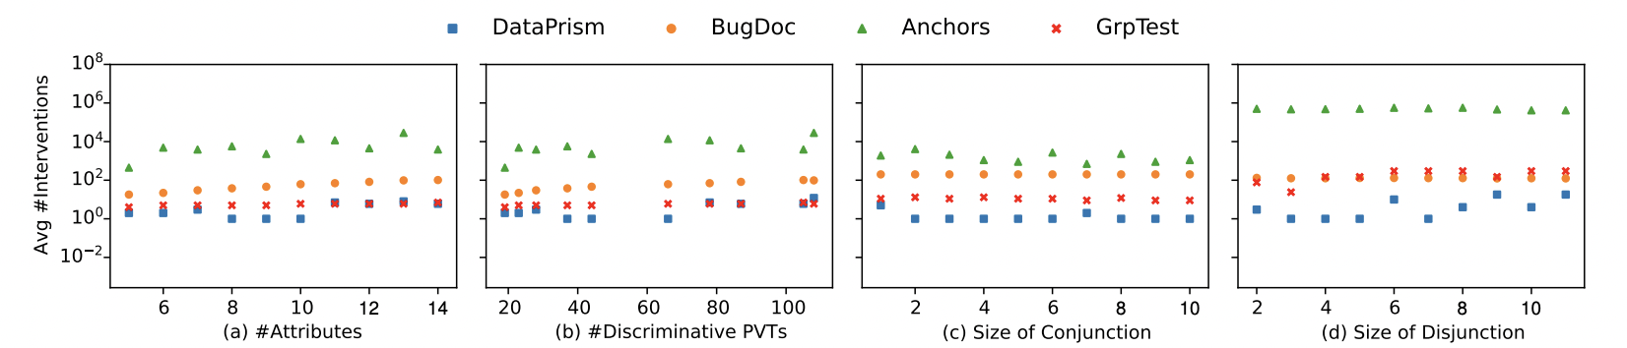
Effect of parameters
DataPrism grows sub-linearly with increase in number of discriminative PVTs
Notes:
We further tested the effect of different parameters on the number of required interventions. We can observe that dataprism requires the least number of interventions across all settings and the growth rate of the interventions is sublinear in the number of discriminative PVTs.

Slide 27
Takeaways
Studied a novel problem of explaining mismatch between data and systems
DataPrism explains mismatch in the form of data profiles
DataPrism produces a causally verified explanation of malfunction
DataPrism requires fewer interventions than group testing and other debugging techniques
Notes:
In summary, we studied a novel problem of exposing the disconnect between data and systems. We proposed data prism approach to explain the cause of malfunction in the form of data profiles. Interventional approach of data prism helps to produce causally verified explanations. Empirical evaluation of dataprism on various systems demonstrates its effectiveness to identify the ground truth cause while requiring the least number of interventions.

Slide 28
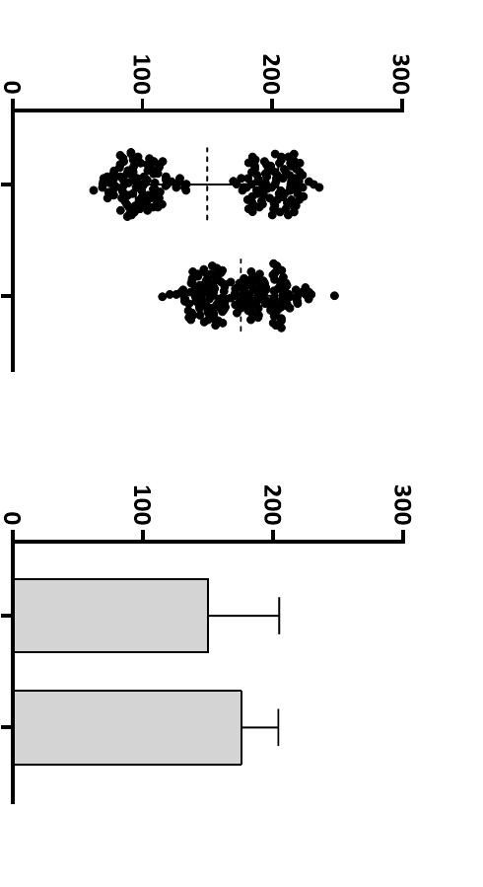

Example of Malfunction
Provider id | Name | Phone | Address
0042100226 | Robert K FUN | 3373128564 | 28062 BAXTER RD, CA
0042104311 | WARREN | 3213124371 | 71 PROSPECT AVE, Boston, MA
0042100111 | Jason Morris | 4135437856 | 11100 EUCLID AVE, CLEVELAND,OH
67478456 | DOUGLAS | 9875635696 | 824 E CARSON ST, CO
Visualization Tool
The tool assumes each phone number is a 10-digit number and crashes because some values contain country code and symbols like +,-.
Provider id | Name | Phone | Address
0042100046 | Peter | 3237280655 | 101 E BEVERLY BLVD
0042100117 | DAVID GRIFFIN | 8086973300 | 501 GOPHER DR
0042100273 | Allan Wu | +1-4196266161 | 8755 KILLIANS GREENS
NULL | CHRISTOPHER | 014196266161 | 824 E CARSON ST
Visualization Tool
Notes:
Replace with hospital example

