Slide 1

CLARRISON KIPTIKEN C025-01-2425/2019
Innovation Abstract: Advanced Technologies for Environmental Change Tracking and Prediction

Slide 2
i). Harnessing Data Integration for Environmental Change Tracking and Prediction:
Data integration is a critical component in tracking and predicting environmental changes, enabling the synthesis of diverse datasets to generate comprehensive insights. By consolidating data from various sources—such as satellite imagery, sensor networks, and historical records—researchers and decision-makers can achieve a more holistic understanding of environmental dynamics.

Slide 3
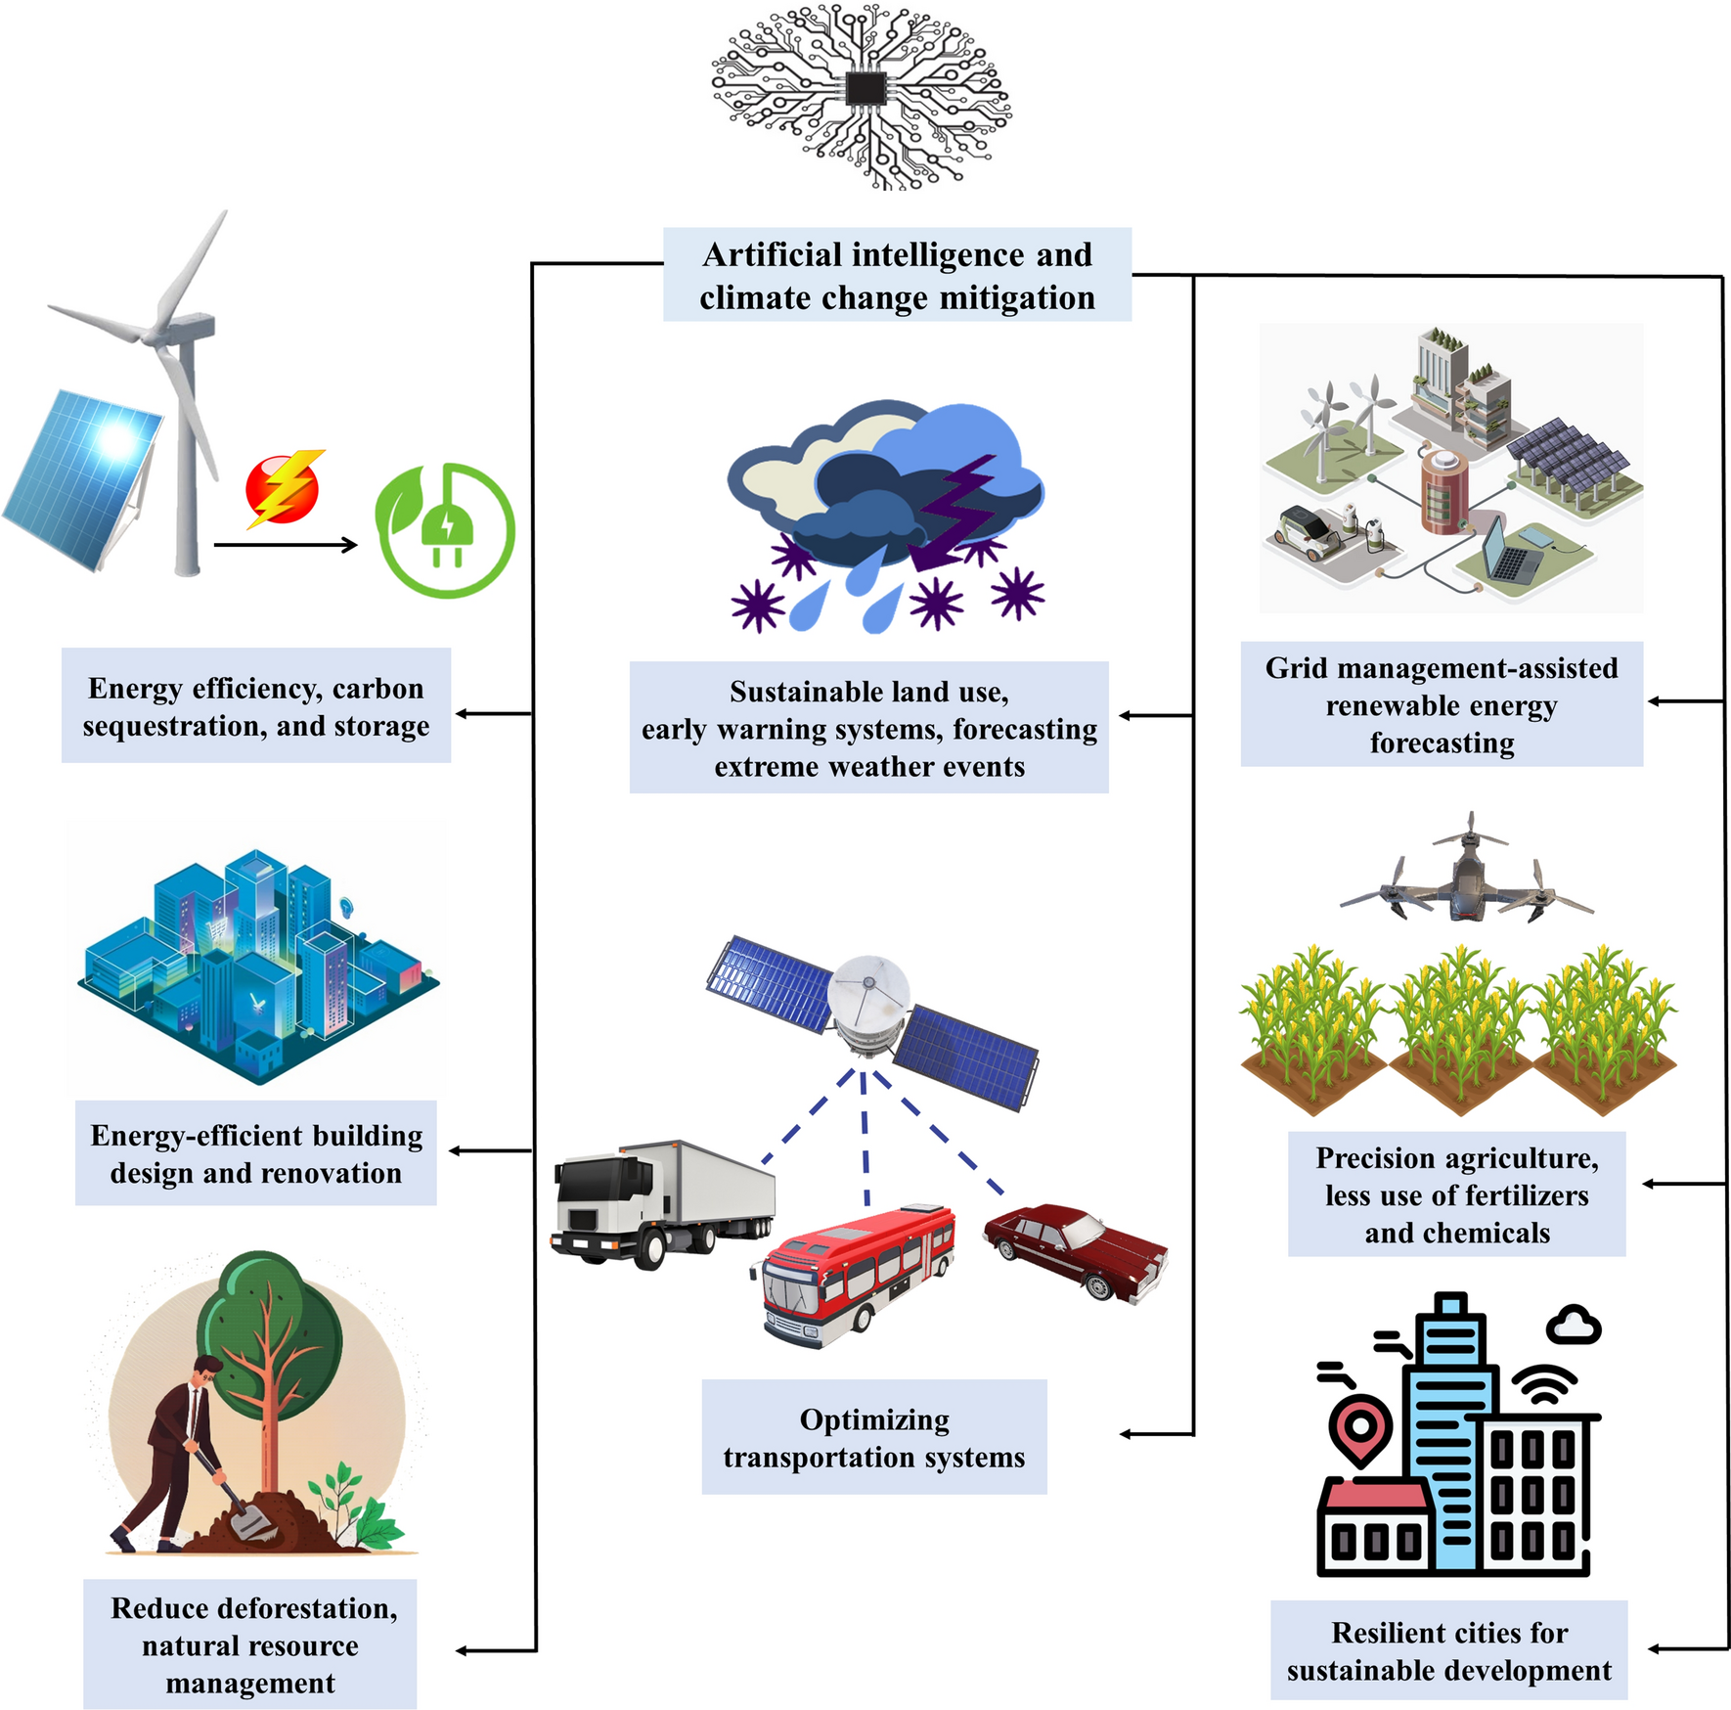

Slide 4
ii). Advanced Environmental Monitoring for Precise Change Detection
Environmental monitoring is essential for detecting and analyzing changes in our environment. Leveraging modern technologies, we can achieve more accurate and timely assessments of environmental conditions, facilitating proactive management and response strategies.

Slide 5
iii). Enhancing Disaster Response Through Innovative Technology :
Effective disaster response hinges on timely and accurate information. By integrating advanced technologies into disaster management frameworks, we can improve coordination, resource allocation, and overall effectiveness in mitigating the impacts of environmental crises.
Key Points:
Real-Time Data Utilization:
Live Data Feeds: Integration of real-time data from monitoring systems, social media, and emergency reports for situational awareness.
Dynamic Mapping: Use of GIS and remote sensing data to create up-to-date maps of affected areas and infrastructure.
Decision Support Systems:
Predictive Analytics: Leveraging machine learning models to predict the trajectory and impact of disasters, such as hurricanes or wildfires.
Scenario Planning: Simulation tools to assess different response strategies and their potential outcomes

Slide 6
Communication and Coordination:
Emergency Communication Networks: Implementation of resilient communication systems for coordination among responders and agencies.
Public Alerts: Automated alert systems to inform and guide the public during crises.
Resource Management:
Logistics and Supply Chain Management: Tools for tracking and optimizing the distribution of resources such as food, medical supplies, and personnel.
Asset Tracking: Real-time tracking of equipment and resources to ensure efficient deployment.

Slide 7
Post-Disaster Analysis and Improvement:
Impact Assessment: Tools for assessing damage and recovery needs using data collected during and after the disaster.
Lessons Learned: Analyzing response effectiveness to improve future disaster management practices.
Visuals:
Flowchart of disaster response process with technology integration.
Screenshots of decision support systems and real-time mapping tools.
Examples of emergency communication alerts and resource management dashboards.

Slide 8
iv). Optimizing Resource Management Through Technology :
Effective resource management is crucial for disaster response and long-term environmental sustainability. By leveraging advanced technologies, we can optimize the allocation, tracking, and utilization of resources, ensuring that critical needs are met efficiently and equitably.

Slide 9
Real-Time Resource Tracking:
Asset Management Systems: Use of RFID and GPS technologies to monitor the location and status of equipment and supplies.
Inventory Management: Real-time tracking of inventory levels to prevent shortages and surplus.
Data-Driven Decision Making:
Demand Forecasting: Predictive analytics to estimate resource needs based on historical data and real-time conditions.

Slide 10
v). Leveraging Predictive Analytics for Environmental and Disaster Management :
Predictive analytics is a transformative tool in environmental and disaster management, enabling the anticipation of future events based on historical and real-time data. By applying advanced statistical techniques and machine learning models, organizations can forecast environmental changes and potential disaster scenarios, allowing for proactive planning and response.

Slide 11
Data Collection and Preparation:
Data Sources: Aggregation of historical data, current observations, and sensor inputs.
Data Cleaning and Processing: Ensuring data quality and consistency through preprocessing techniques. Model Development and Training:
Machine Learning Models: Development of models, including regression analysis, decision trees, and neural networks, tailored to specific prediction needs.
Algorithm Selection: Choosing appropriate algorithms based on data characteristics and desired outcomes.
Applications in Environmental Monitoring:
Weather and Climate Forecasting: Predicting weather patterns, climate changes, and extreme weather events.
Ecosystem Health Monitoring: Forecasting changes in ecosystems, such as deforestation, desertification, and biodiversity loss.

Slide 12
vi). Future Innovations in Environmental and Disaster Management Technologies
As technology continues to evolve, the field of environmental and disaster management is poised for significant advancements. Emerging trends and innovations promise to enhance our ability to monitor, predict, and respond to environmental changes and disasters, paving the way for a more sustainable and resilient future. Advanced Artificial Intelligence and Machine Learning:
Deep Learning Techniques: Enhanced capabilities for complex pattern recognition and predictive modeling.
AI-Driven Decision Support: Automated systems that can recommend actions and strategies in real-time based on vast datasets.

Slide 13
Enhanced Remote Sensing and Satellite Technologies:
High-Resolution Imaging: Next-generation satellites providing finer spatial and temporal resolution for
detailed environmental monitoring.
Miniaturized and Cost-Effective Satellites: Increased accessibility to satellite data through the proliferation
of small, affordable satellites.
Integration of Big Data and Cloud Computing:
Scalable Data Storage and Processing: Cloud infrastructure to handle large volumes of data from various sources.
Real-Time Analytics: Real-time processing capabilities to support immediate decision-making and response
Internet of Things (IoT) Expansion:
Smart Sensor Networks: Expansion of IoT networks for comprehensive environmental monitoring, including in remote or inaccessible areas.
Wearable Technology: Devices for personal monitoring of environmental conditions, aiding public health and safety

Slide 14
THANK YOU

