Slide 1
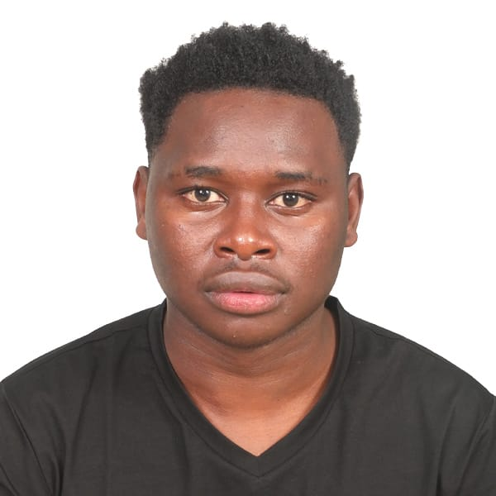
CLARRISON KIPTIKEN
C025-01-2425/2019
EARLY CHILDHOOD
In the quiet village of silaa, nestled within the lush landscapes of Baringo County, I came into this world on a radiant august day18 in 2001. The scent of earth after a gentle rain, the symphony of birdsong in the early morning, and the ever-present warmth of a closeknit family greeted my senses as I took my first breath.
As the firstborn of six children, three boys and three girls, my life was marked by the joyous chaos of siblings, each with their own quirks and dreams. Our home, a modest yet lovingly crafted abode.
My family, a tapestry of personalities and dreams, has always been my anchor in life. First, there's my father, Jackson Kiptiken, a steadfast and wise man whose hands bear the marks of hard work and whose laughter fills our home with warmth. My mother, Hellen Paul is the heart and soul of our family, her gentle words carrying a quiet strength that keeps us together.

Slide 2
MY PRIMARY EDUCTION
My early education was a voyage into a world of wonder, where each school day held the promise of discovery and growth. It all began at Churo Primary School, a place that would become the foundation of my academic journey. The school stood like a sentinel on the hill, its white walls gleaming in the morning sun. The sound of children's laughter echoed through the yard, and the smell of freshly sharpened pencils lingered in the air.
My teachers at Kokwet were not just educators; they were the architects of my young mind. Mr.Tikodak my kindergarten teacher, had the patience of a saint as he guided us through our first lessons in numbers and letters. Mr. Njima, my third-grade teacher, ignited my curiosity with his tales of far-off lands and the wonders of science.
Among the classmates that surrounded me, friendships flourished. Jacob, my desk partner in second grade, was my partner in mischief and adventure. And Lochilit, my best friend, was a constant companion in the journey of discovering the world through the pages of our textbooks.

Slide 3
Among my siblings, there's a blend of personalities and ambitions. Evans Kibet, my younger brother, is a bundle of energy, always ready for adventure. Faith the eldest of my four sisters, is a source of inspiration with her dedication to education. The two other sisters, Blessing and Beryl are like two peas in a pod, sharing secrets and dreams. Kennedy my jovial and happy brother with his enticing smile and funny jokes that always makes our family alive with her jokes that she almost breaks our ribs with laughter each and every day.
Throughout this intense period, the support of my teachers and the unwavering encouragement of my family were my pillars of strength. Their belief in me fueled my determination and provided the emotional support I needed to face this formidable ordeal.
Mr. Tikodak, with his salt-and-pepper beard and the twinkle in his eyes that mirrored the enthusiasm of a lifelong learner, was more than just a teacher. He was a torchbearer of knowledge, igniting the flames of curiosity within each of his students.
In his classroom, equations transformed into puzzles waiting to be solved, and the enigmatic world of algebra unraveled its secrets. Mr. Tikodak had the unique ability to make complex concepts accessible, a magician who could turn abstract theorems into tangible wisdom.

Slide 4
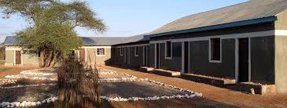
In the heart of Churo, I laid the foundation for my academic journey. Later, I embarked on a new adventure, transferring to Churo for my upper primary education. These were the formative years, a time of transition, discovery, and growth. It was during this period that I was bestowed with the honor of serving as the school chair from class seven to class eight. Leadership, it seemed, was a path that chose me.
These early school days held challenges and triumphs, but they were the crucible where my character began to take shape. Through the guidance of teachers and the camaraderie of friends, I discovered the magic of learning, the power of leadership, and the beauty of embracing new horizons.
Extracurricular activities played a vital role in shaping my high school journey. My involvement in the science club, where we conducted experiments and explored the wonders of the natural world, sparked a passion for scientific inquiry. The annual school debates and music festivals were events that brought the entire school together, igniting a sense of unity and shared pride. I sat for KCPE in the year 2014 and got 326 which made me get admission at AIC Ebenezer Academy Highschool.

Slide 5
SECONDARY EDUCATION
Throughout my high school years, the rituals and traditions of AIC Ebenezer Academy High School became cherished memories. From the annual prize-giving ceremony to the spirited sports day, these events wove a sense of continuity and belonging into the fabric of my life.
High school was a time of transformation, where dreams evolved, friendships blossomed, and academic aspirations began to take shape. It was a journey of self-discovery, where I learned that each challenge was an opportunity for grow than every relationship a chance to enrich my understanding of the world. These were the years that sowed the seeds of the future, a testament to the power of perseverance, friendships, and the pursuit of knowledge.
AIC Ebenezer Academy High School was not just an institution of learning; it was a place where friendships were forged, values were instilled, and dreams were nurtured. The day I completed my form four education marked the end of an important chapter in my life, one that had set the stage for my future endeavors.

Slide 6
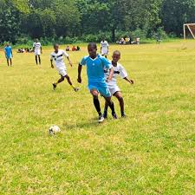
My experience at AIC Ebenezer Academy High School was a chapter of personal growth, academic exploration, and the formation of lasting friendships. It was a place where I discovered my potential, embraced leadership, and learned the values of resilience and perseverance. It was a journey that set the stage for the next chapters in my educational adventure.
The remarkable KCSE grade of B became a milestone in my life, a stepping stone to future aspirations, and a testament to the boundless potential that exists within each of us when we dare to dream and work diligently to turn those dreams into reality. "Joining Dedan Kimathi University of Technology marked the beginning of a new chapter in my life, a chapter that had been nurtured through years of hard work and unwavering determination. As I packed my bags and left for the university, a mixture of excitement and apprehension filled my heart.

Slide 7
UNIVERSITY EDUCATION
In the fall of 2020 the decision to join Dedan Kimathi University of Technology was a pivotal moment in my life, driven by a combination of passion, ambition, and careful consideration. It marked the next step in my educational journey and the pursuit of a field that had ignited my curiosity – Information Technology.
My fascination with the intersection of computer, technology, and Mathematics had been nurtured throughout my early years in Baringo County. The rolling hills and vibrant ecosystems of my hometown provided an early introduction to the importance of understanding the advancing technology and its influence on people's lives. It was in these landscapes that the seeds of my passion were sown.
What truly fueled my decision to join Dedan Kimathi University and pursue a degree in Information Technology was the realization that this field was not just about academic study; it was about a commitment to making a difference. It was a field where my passion for the Technology, my fascination with technology, and my desire to make a positive impact all converged.

Slide 8
What made BSc in Information Technology especially appealing was its ability to merge my passions seamlessly. It brought together my deep-rooted love for the technology, my fascination with cutting-edge technology, and my desire to contribute to a better world. It was not just a degree; it was a purpose.
My choice to pursue this field was not solely about earning a degree; it was about committing to make a difference. It was a decision to use my education to leave a positive mark on the world, to tackle real-world problems, and to inspire change. It was about recognizing the potential within myself to effect transformation.
As a Information Technology specialist, I am not just embarking on a career; I am following a profound passion and mission. The world of technology is not just a field of study for me; it's a commitment to understanding and improving our world.
My ambition is clear: I want to make a significant impact as a IT specialist. I see this field as the linchpin for addressing some of the most pressing challenges of our time. Whether it's environmental conservation, urban planning, disaster management, or sustainable development, I am dedicated to contributing my expertise to create innovative and practical solutions.

Slide 9
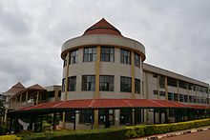
From a young age, I was drawn to the intricate tapestry of the Earth’s advancing technology and how it influenced the lives of people. The realization that IT could be the tools to make sense of this complexity was a pivotal moment. It was more than a career choice; it was a calling.
What made BSc in Information Technology especially appealing was its ability to merge my passions seamlessly. It brought together my deep-rooted love for the environment, my fascination with cutting-edge technology, and my desire to contribute to a better world. It was not just a degree; it was a purpose.
My choice to pursue this field was not solely about earning a degree; it was about committing to make a difference. It was a decision to use my education to leave a positive mark on the world, to tackle real-world problems, and to inspire change. It was about recognizing the potential within myself to effect transformation.

Slide 10
CURRICULUM ACTIVITIES
My journey into the world of football as an extracurricular activity at Dedan Kimathi University was a chapter that would significantly shape my time in higher education. From the moment I joined the university's football team, the experiences and lessons were as invaluable as they were unforgettable.
The camaraderie within the team quickly became a cornerstone of my university life. The shared passion for the game, the adrenaline that surged through our veins during practices and games, and the moments of victory or defeat forged unbreakable bonds with my teammates. In the face of challenges, we found strength in each other, and the lessons of teamwork and collaboration became ingrained in my character.
As I became more involved, I had the privilege of taking on a leadership role within the team. It was a position that demanded discipline and responsibility, as I had to not only perform on the field but also ensure the cohesion of the team. The experience taught me the importance of leadership, clear communication, and the power of leading by example.

Slide 11
Dedan Kimathi University of Technology, I am committed to completing my BSc in Information Technology with distinction. I see my education as the foundation upon which I can build a successful and impactful career. Additionally, I aim to pursue further studies and certifications to stay updated with the latest technologies in my field.
My career aspirations go beyond personal success. I aspire to make a significant impact as a IT wizard. I envision myself as a pioneer in this field, leading research and innovation that leads to tangible, positive changes in society. Whether it's addressing environmental challenges, urban planning, or disaster management, I am determined to contribute my expertise to create innovative and practical solutions. My future goals involve collaborating with experts and organizations to share knowledge and resources, as I understand that complex challenges require diverse expertise.

Slide 12
MY ATTACHMENT AT PIXOL ARC ITD
As a Information Technology student, my academic journey reached new heights during my tnternal attachment within the university. This experience was not just a professional endeavor; it was a transformative chapter that expanded my understanding of It applications in real-world scenarios. From the moment I stepped into this school, I knew I was about to embark on a unique adventure that would shape my career.
During my attachment, I was exposed to cutting-edge technologies and methodologies in IT , further honing my skills in Artificial Intelligent and Machine learning. Working alongside my favorite Professors who provided me with invaluable insights into the practical aspects IT offering a bridge between theory and application.

Slide 13
The hands-on experience allowed me to apply classroom knowledge to actual projects, contributing to the development of innovative solutions for various challenges.
THANK YOU

