Slide 1
Autonomous Target-Tracking Controller for a Drone using a STM32 Microcontroller
Group Members:
Adil Farooq
Dimitris Ttofi
Eleni Sotirou
Auditing Members:
Muhammad Shahid Noman Siddiqui
Panayiotis Aristodemou

Slide 2
Motivation
To develop a target tracking controller for a drone quadcopter
Able to track a moving target e.g. a car or pedestrian location obtained from the bounding box of camera video feed
To follow it keeping a safe distance, on a stm32 microcontroller board

Slide 3
Objectives
The objective of our work are as follows:
To develop a controller algorithm that is able to follow the movement of the target through the image’s coming from the drone camera
Verify and test the performance of the algorithm on a virtual open-source simulator

Slide 4
Bounding Box Coordinates
The drone camera videos frames are passed through a DroNet model (made by George Plastiras), for the detection, that was trained (by Panayiotis Aristodemou) with his own custom data-set
A simple python script was written to save the bounding box coordinates in a text file

Slide 5
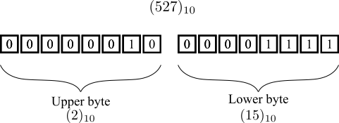
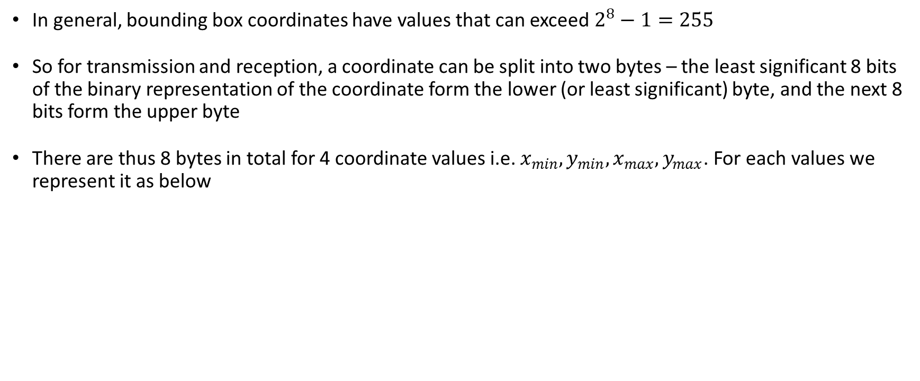
Bounding Box Information
In general, bounding box coordinates have values that can exceed $2^{8}−1=255$
So for transmission and reception, a coordinate can be split into two bytes – the least significant 8 bits of the binary representation of the coordinate form the lower (or least significant) byte, and the next 8 bits form the upper byte
There are thus 8 bytes in total for 4 coordinate values i.e. $x_{min},y_{min},x_{max},y_{max}$. For each values we represent it as below
BB Coordinates Representation

Slide 6
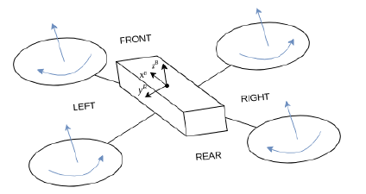
Quadcopter Basics
A quadcopter is a multirotor helicopter with four actuators (propellers), each providing a force in the body-fixed z-direction and a torque to the body
Movements are obtained by changing the roll (x-axis), pitch(y-axis) and yaw angles(z-axis), and by changing the vertical speed
Quadcopter Movement

Slide 7
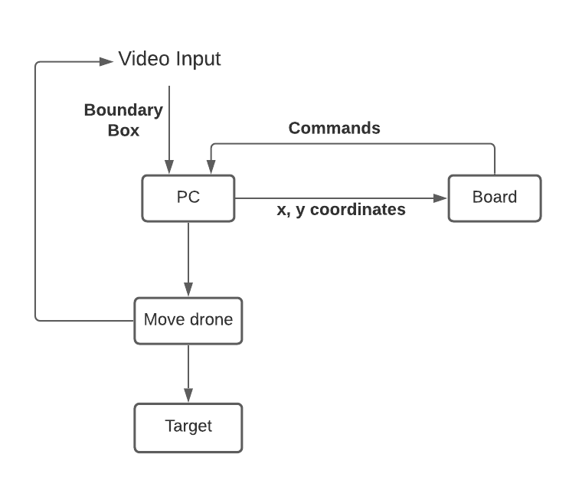
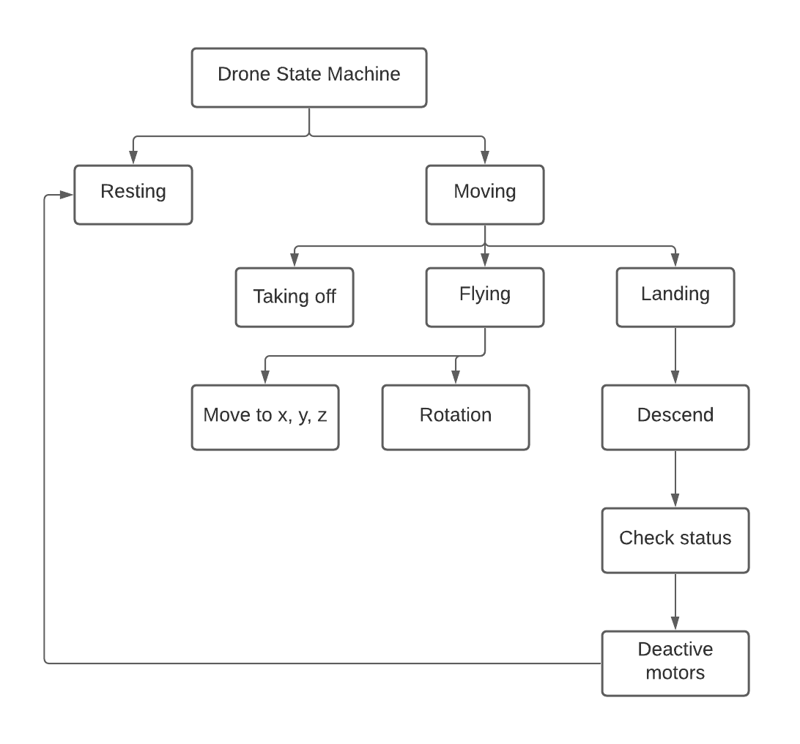
Block Diagram and Framework

Slide 8
The STM32 Main file
It is the main.c file
Automatically generated by the STM32CubeIDE once selecting the board and setting the peripherals
Suppose to contains the function we want to execute e.g blinking an LED
for (int i = 0; i < 20; i++)// blink yellow led few times
{
HAL_GPIO_TogglePin(LD2_GPIO_Port, LD2_Pin);
HAL_Delay(200);
}

Slide 9
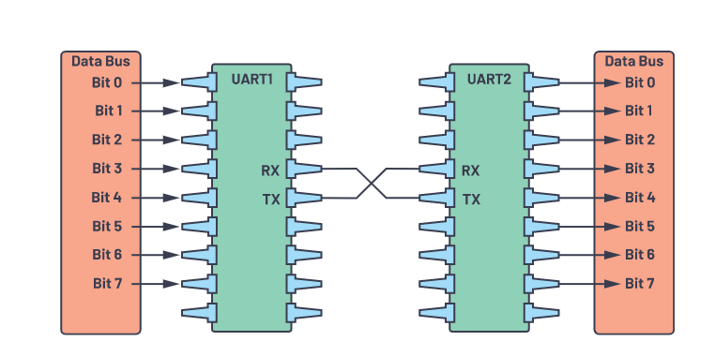
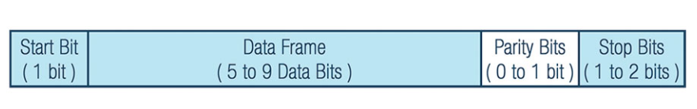
UART Communication
Universal Asynchronous Receiver-Transmitter (UART) is a device-to-device hardware communication protocol
UART works with many different types of serial protocols like polling, interrupts and DMA
UART Packet
UART with data bus

Slide 10
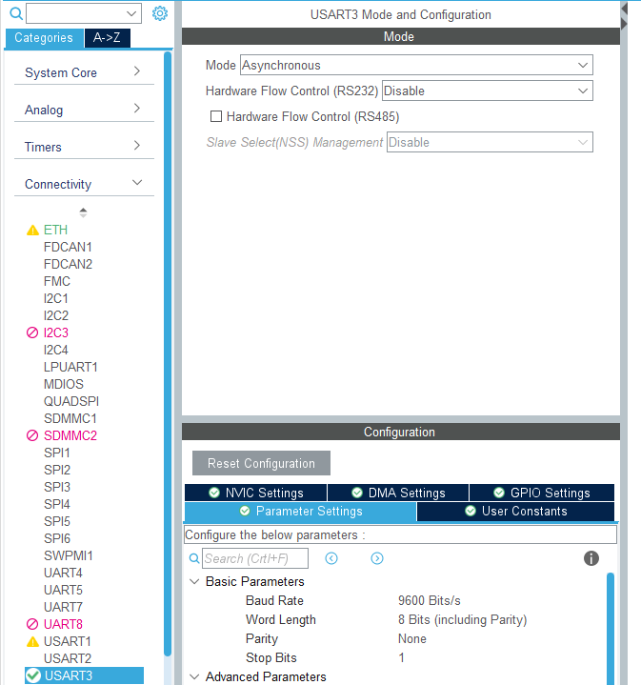
UART configuration in our project

Slide 11
Serial Communication by standard HAL functions
Basic Interrupt structure:
HAL_UART_Receiver_IT(&huart3, rxBuffer, 1) to active receiver interrupts
HAL_UART_RxCpltCallback() calling interrupt sub-routine when the buffer receives the complete data
{
HAL_GPIO_TogglePin(LD2_GPIO_Port, LD2_Pin); to execute our function
HAL_Delay(200);
}
Issues encountered:
Doesn’t always get activated and receive data properly
Worked for few time and then this function gets stuck
Need to reset the board to go back to normal state
Hardware Abstraction library (HAL)

Slide 12
Our way to enable interrupts
Initialized interrupt using the sub routine HAL_MSP from the file named stm32h7xx_hal_msp.c
In STM32CubeMX MSP stands for MCU Support Package
The HAL_xxx_MspInit() callback performs the low level initialization such as (Clock, GPIOs, DMA, interrupts)
In our case it is HAL_UART_MspInit(UART_HandleTypeDef* huart)
Inside the above function we added:
__HAL_UART_ENABLE_IT(huart, UART_IT_RXNE); to enable the interrupt sub-routine
Replacing the HAL_UART_Receiver_IT() function in main.c

Slide 13
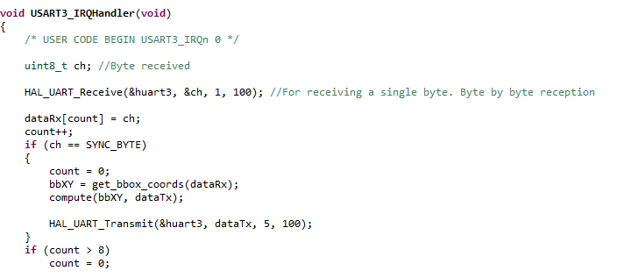
Calling the Interrupt Service Routines
IRS are called from the file named stm32h7xx_it.c
All modification and user defined functions are done inside the function USART3_IRQHandler(), replacing the HAL_UART_RxCpltCallback()
We receive the 8 bytes of the coordinates to regenerate the bounding box values and then compute the 5 integer array drone commands

Slide 14
Drone command array scheme
Array Index | Integer Value | Commands
0 | 0 | No movement in X-axis
 | 1 | Move Forward at V_{x}
 | 2 | Move Backward at -V_{x}
1 | 0 | No movement in Y-axis
 | 1 | Move Right at V_{y}
 | 2 | Move Left at -V_{y}
2 | 0 | No movement in Z-axis
 | 1 | Move Down at V_{z}
 | 2 | Move Up at -V_{z}
3 | 0 | No Rotation
 | 1 | Roll Right at Dº
 | 2 | Roll Left at - Dº
4 | 0 | Ascending
 | 1 | Landing

Slide 15
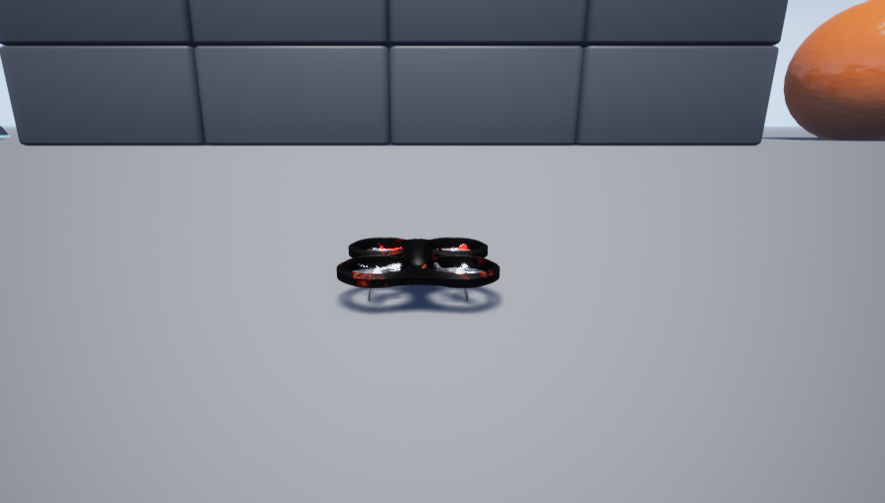
Simulation Performance
We have chosen the AirSim simulator by Microsoft where we can see how the drone is moving corresponding to the target bounding box coordinates

Slide 16
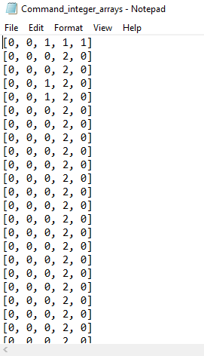
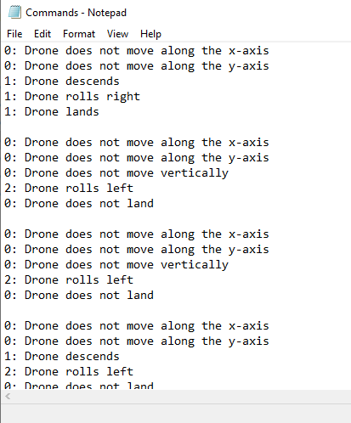
Output saved log file

Slide 17
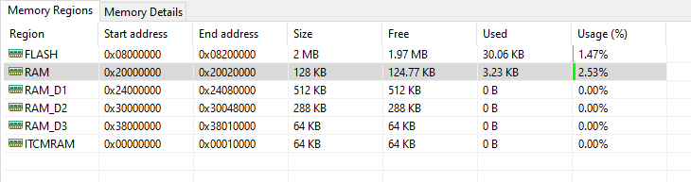
STM32 Memory Utilization
We can see the memory region of the STM32 board. Our project uses 30KB of FLASH and 3.23KB of RAM which is computationally inexpensive just under 5% of total available usage. Hence, we can further incorporate additional features using artificial intelligence (AI) to map and run a small pre-trained artificial neural network (ANN) on the STM32 microcontroller and make the system more robust. However, we need to keep in mind the computation and memory resource allocation
Memory footprint

Slide 18
Conclusion
We have implemented a target-tracking controller algorithm for a quadcopter drone on an embedded STM32 Nucelo board plaform. Moreover, an implementation of the software designed controller has been developed to follow the target while keeping a safe distance. The target-tracking quadcopter presented is able to track a target through the bounding box coordinates in an indoor space or an outdoor space with a safety threshold for obstacle clearance.
In the proposed framework, we have developed the high-level calculations on the STM32 microcontroller board for generating commands to fly the drone.
In order to have the low level visualization of drone flight, we have tested our embedded controller performance on an AirSim simulator on different dataset video feed collected from real drone.
Our strategy, shows good agreement and can be implemented on a real drone.

Slide 19
Improvement and Future work
Implementing error handling capability, to include possible failure error incident and avoid malfunction of our system and making it more robust
An improved protocol scheme can be devised for negative coordinate values (when target is outside or the bounding box or at the edge)
Fail safe mode for any disconnection between the STM32 board and the main drone flight controller

