Slide 1

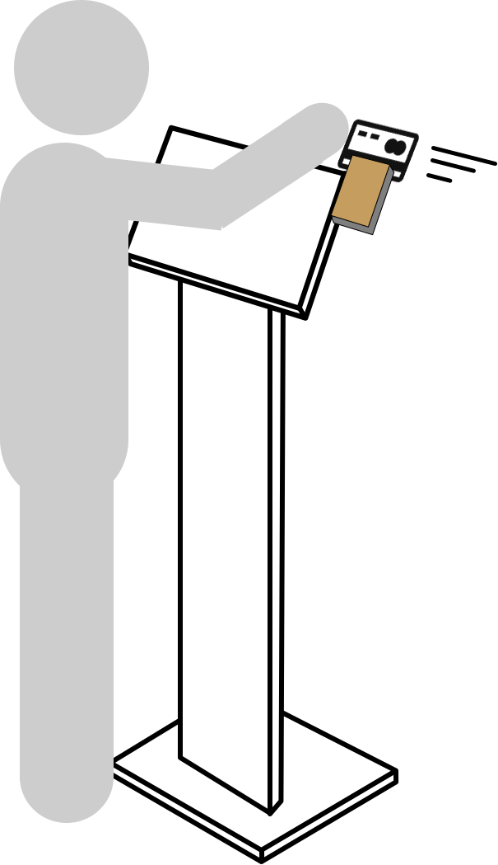
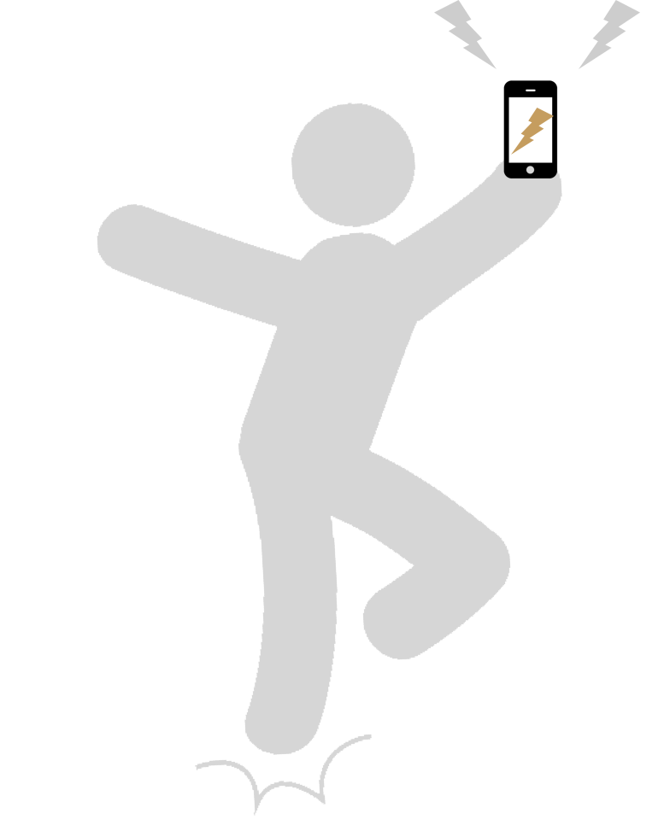












Customer gets promotions via
Email/Text/Social Media
Option 1
(Custom options available, these
are just samples)
Text #828282
Order
Customer sees loyalty and check-in rewards…
Table-top Self-Service
Order
Owner/manager
creates promotion on POS
Coupons
Specials
Waste Avoidance sales
Option 2
Owner/manager
creates loyalty on POS
….on credit card
swipe
…on old receipt
scan
Floor stand
without printer
kitchen monitor
Option 3
Re-Order
from mobile receipts
Self-Service kiosk
Full Service POS
Floor stand with printer
kitchen monitor

Slide 2
Customer gets promotions via
Email/Text/Social Media
Option 4
Text #828282
Order
Customer sees loyalty and check-in rewards…
Multiple kiosks,
single kitchen monitor
Order
Owner/manager
creates promotion on POS
Coupons
Specials
Waste Avoidance sales
Owner/manager
creates loyalty on POS
….on credit card
swipe
…on old receipt
scan
Re-Order
from mobile receipts
Self-Service kiosk
Full Service POS

