Slide 1
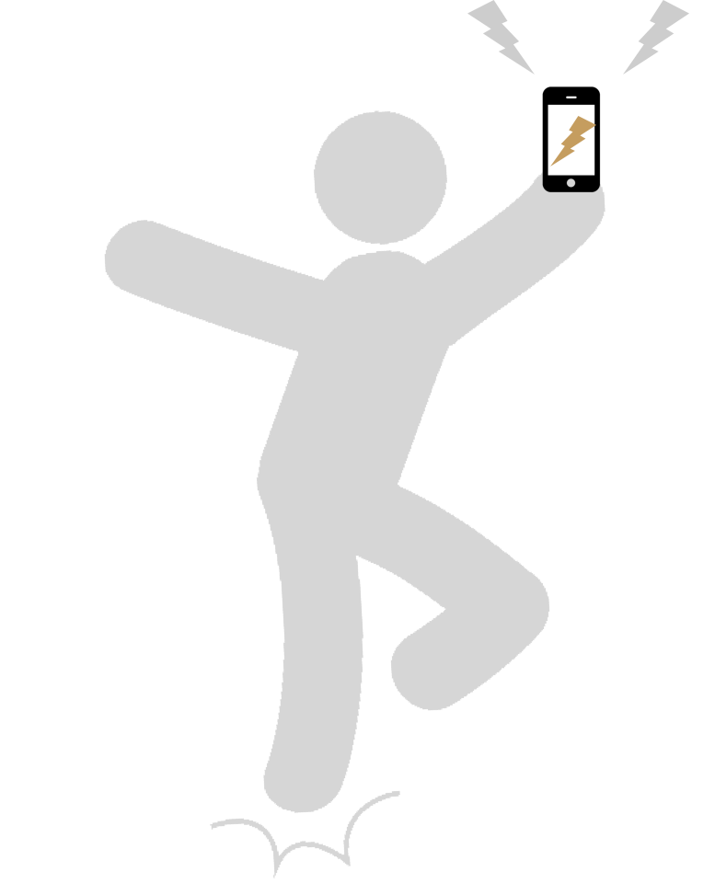




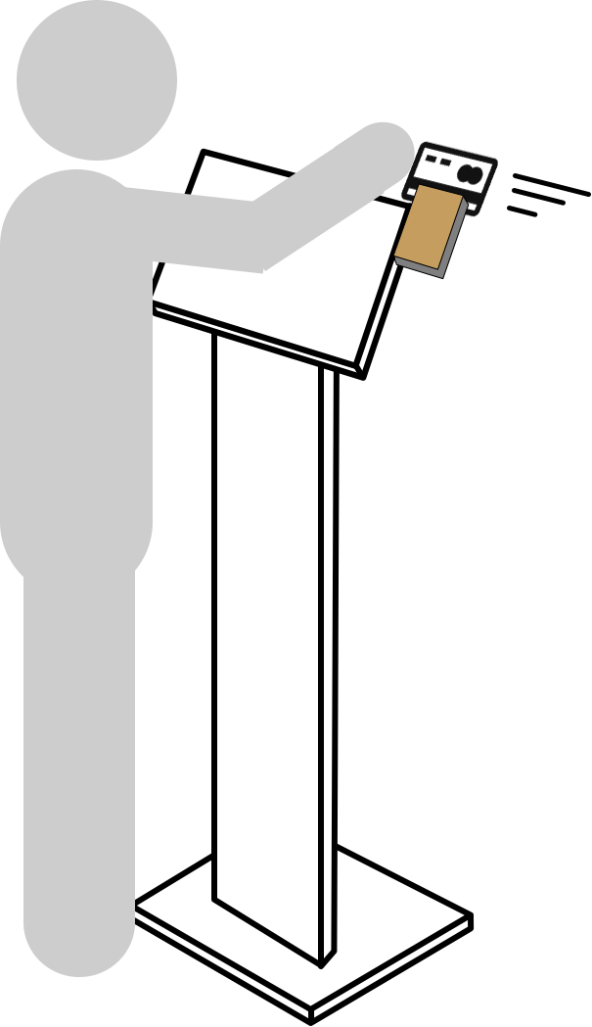








Customer gets promotions via
Email/Text/Social Media
Order
Customer sees loyalty and check-in rewards…
Order
Owner/manager
creates promotion on POS
Coupons
Specials
Waste Avoidance sales
Owner/manager
creates loyalty on POS
….on credit card
swipe
…on old receipt
scan
Mobile, web, self-service, or full service,
are fully integrated into one system
Text #828282
Re-Order
from mobile receipts
Self-Service kiosk
Full Service POS

