Slide 1

Predicting Volatility
Daryush Ray
Afet Ibadova

Slide 2
Introduction
Data | Models | Metrics
S&P500 [2002/01/01 - 2022/01/01] | Linear Regression | Mean Squared Error (MSE)
 | Long Short-Term Memory (LSTM) | Root Mean Squared Error (RMSE)
 | Prophet | Mean Absolute Error (MAE
 | XGBoost | R2

Slide 3
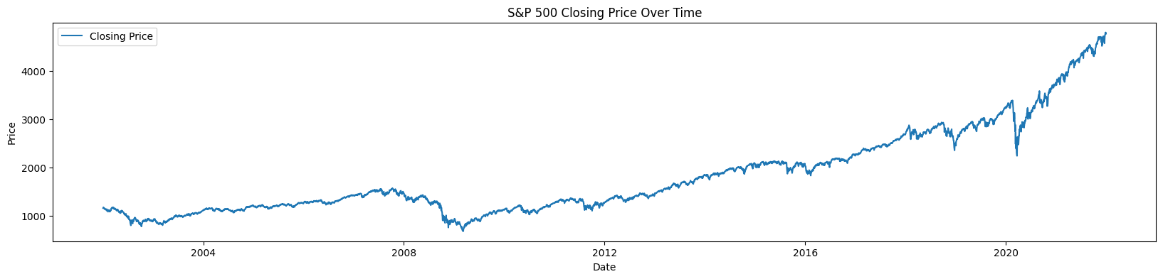
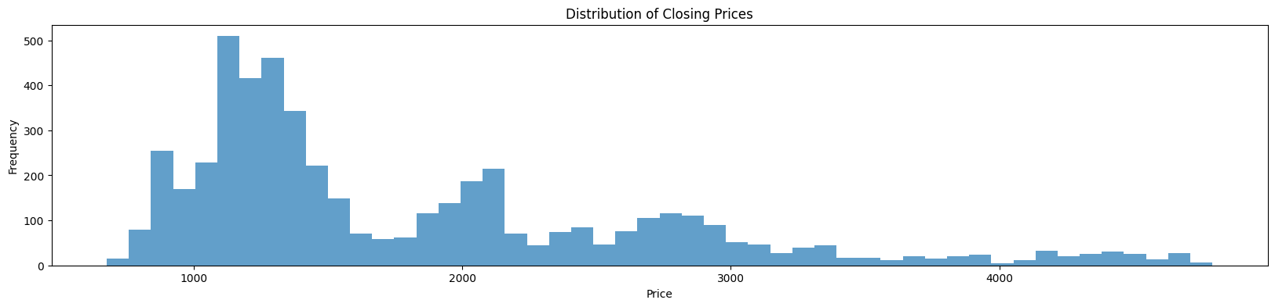
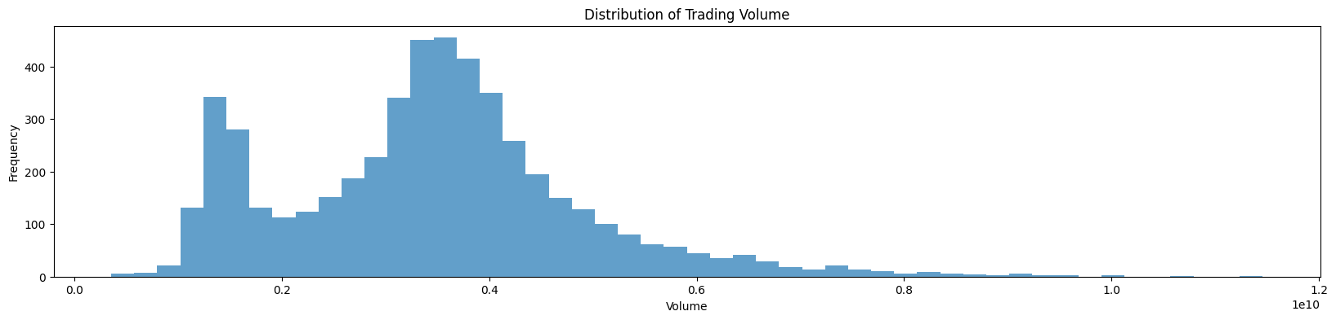
EDA

Slide 4
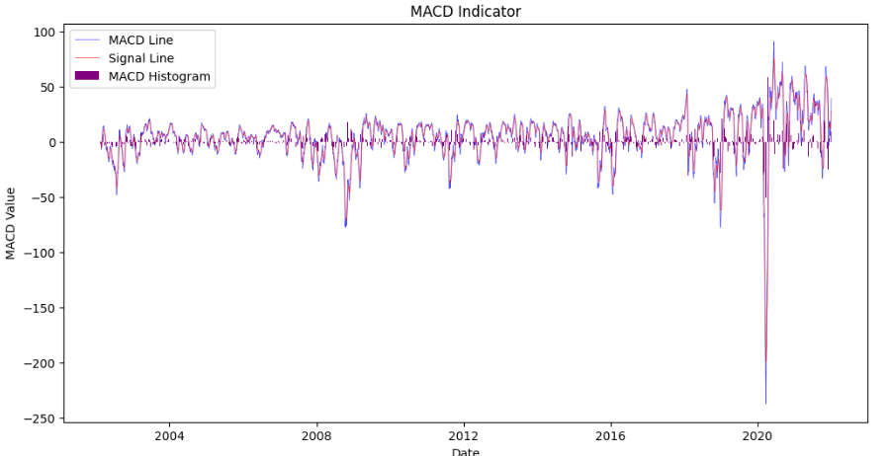
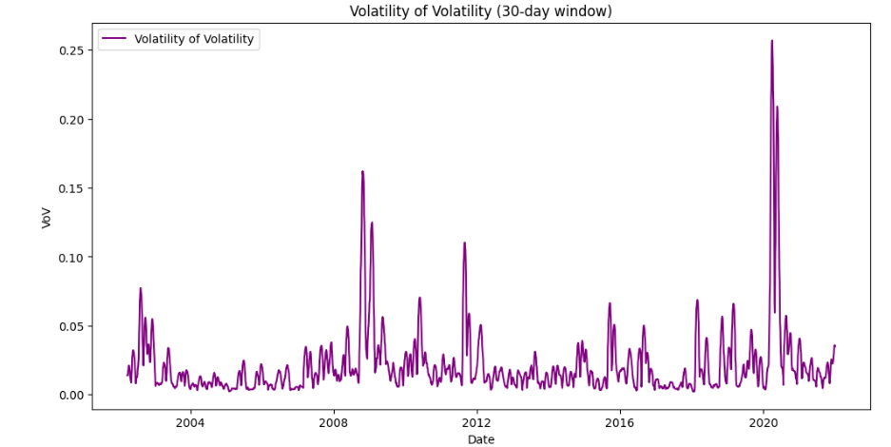
EDA

Slide 5
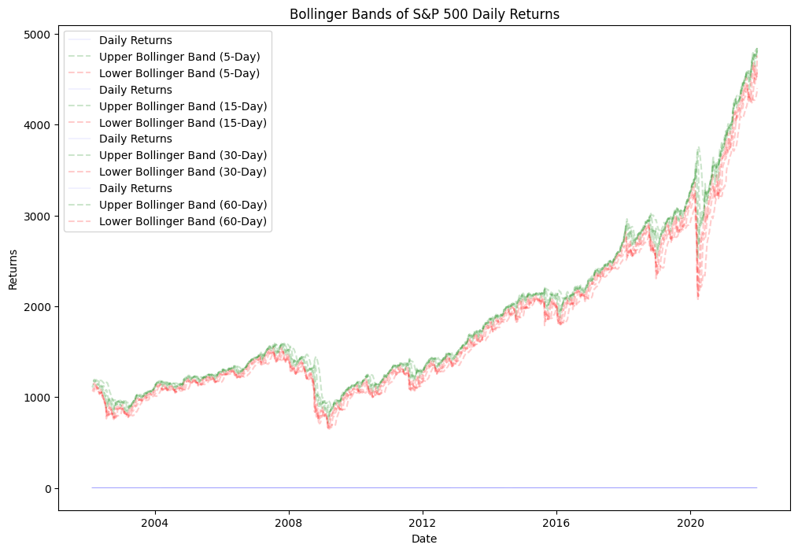
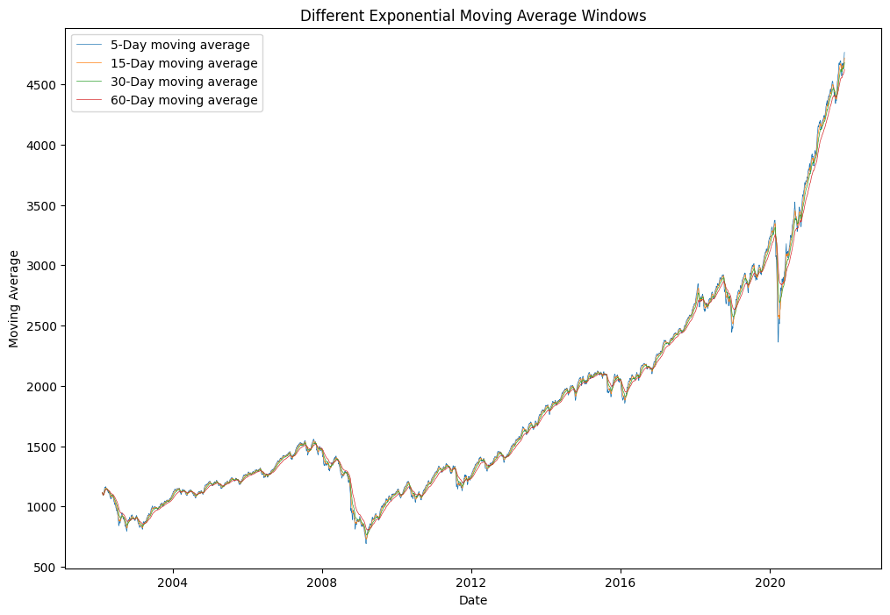
EDA - Feature Engineering
Deriving features from daily returns and etc. Such as:
Moving Average
Exponential Moving Average
Bollinger Bands
RSI
MACD
ROC
VoV
And run feature importance and selection methods, and experiment.
Basic Correlation Analysis
Feature Importance with Random Forest
Recursive Feature Elimination (RFE) with Lasso

Slide 6
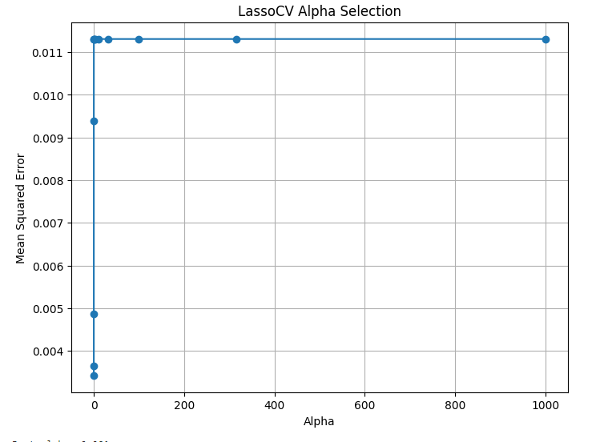
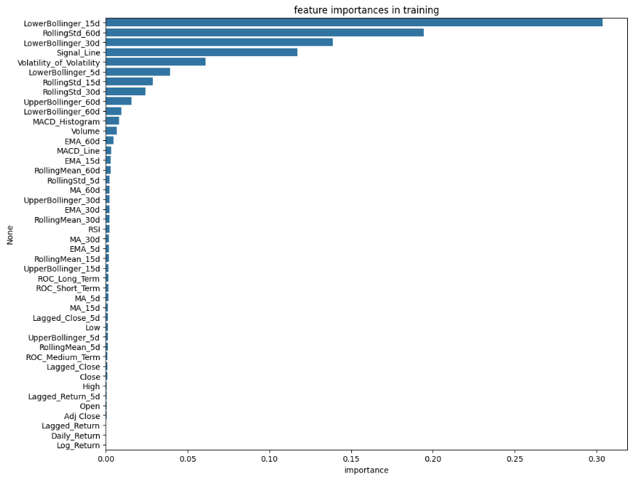
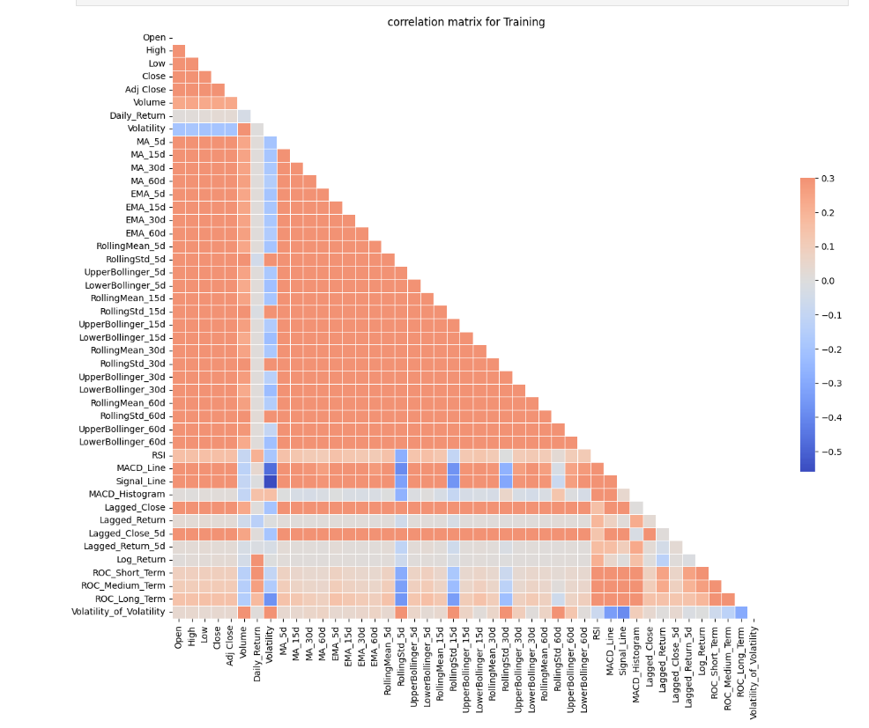
Feature Selection
Basic correlation analysis
Top 15 correlated
['Open', 'High', 'Low', 'Close', 'Adj Close', 'Volume', 'Daily_Return', 'Volatility', 'MA_5d', 'MA_15d', 'MA_30d', 'MA_60d', 'EMA_5d', 'EMA_15d', 'EMA_30d']
RandomForestRegressor
Top 8 Important
['LowerBollinger_15d', 'RollingStd_60d', 'LowerBollinger_30d', 'Signal_Line', 'Volatility_of_Volatility', 'LowerBollinger_5d', 'RollingStd_15d', 'RollingStd_30d']
RFE with Lasso
Top 15 best alpha
['Volume', 'RollingStd_5d', 'LowerBollinger_5d', 'RollingStd_15d', 'RollingStd_30d', 'LowerBollinger_30d', 'RollingStd_60d', 'RSI', 'Signal_Line', 'MACD_Histogram', 'Lagged_Return', 'ROC_Short_Term', 'ROC_Medium_Term', 'ROC_Long_Term', 'Volatility_of_Volatility']
And we use these 3 techniques for each model, and compare the results.

Slide 7
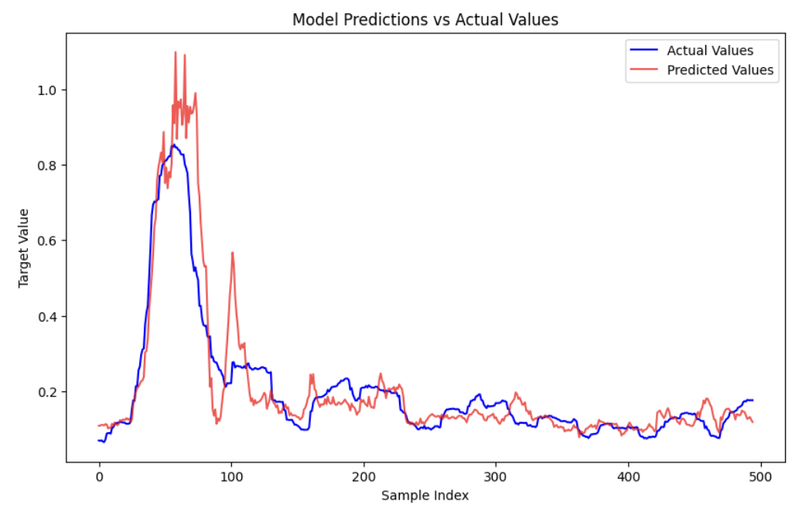
LSTM
The LSTM model is capturing the general pattern of the actual volatility.
Overall shape and peaks are quite similar.
The most noticeable discrepancies appear to occur at the peaks, where the model either underestimates or overestimates the true volatility spikes.

Slide 8
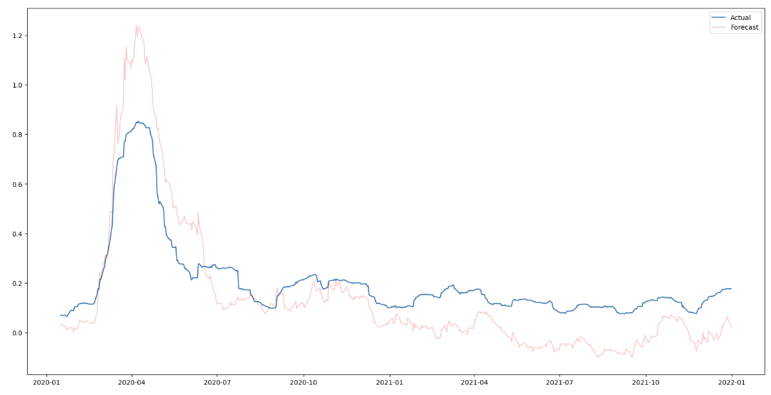
Prophet
Trend - Good
Problem - Capturing Peaks
Some lag between predicted and actual values
Notes:
Capture the general trend of the actual volatility, but there are noticeable deviations, particularly in capturing the peak values.
The model tends to underpredict the highest volatility spikes, which are critical events in financial markets.
After the peak in early 2020, which likely corresponds to the market reaction to the COVID-19 pandemic, both the actual and predicted volatility values trend downward, with the predicted values closely following the actual trend but with some lag and less pronounced movements

Slide 9
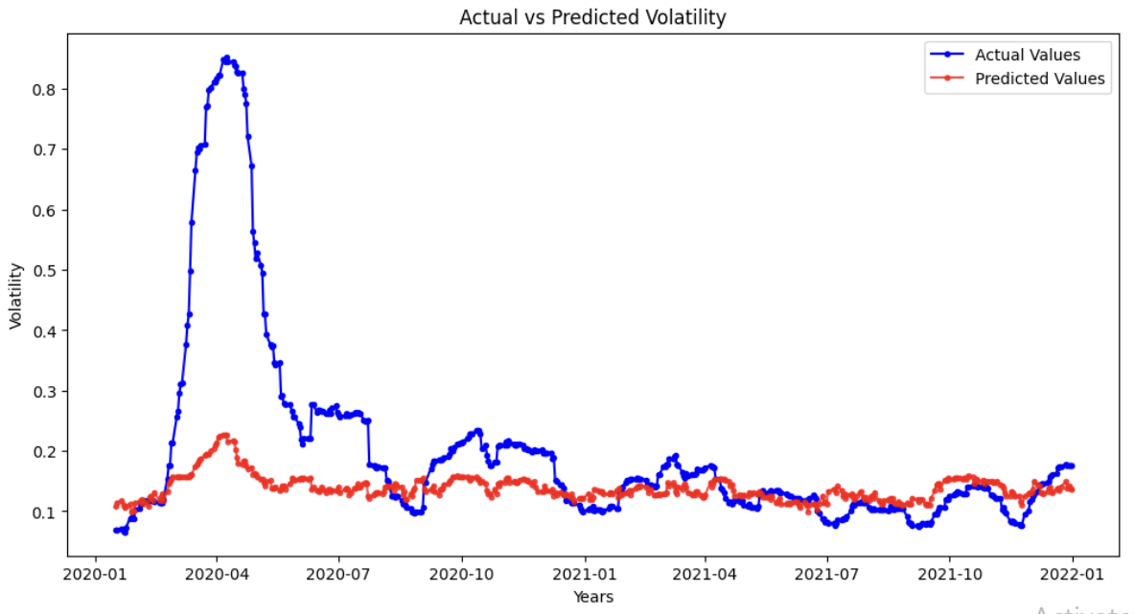
XGBoost
Model does not capture the sharp rise and subsequent fall in volatility
Model doesn’t capture the finer fluctuations accurately
Notes:
There are noticeable periods where the model's predictions diverge from the actual values. This is particularly evident around the peak, where the model does not capture the sharp rise and subsequent fall in volatility.
Post the peak period, the predicted values tend to follow the actual trend but do not capture the finer fluctuations accurately. This could indicate that the model may be smoothing over some of the volatility.

Slide 10
Result
Metrics | LSTM | Linear Regression | Prophet | XGBoost
MAE | 0.0451 | 0.1179 | 0.1202 | 0.0827
MSE | 0.0057 | 0.0216 | 0.0193 | 0.0272
RMSE | 0.0755 | 0.1471 | 0.1389 | 0.1648
R2 | 0.7998 | 0.2389 | 0.3218 | 0.0446
Notes:
LSTM -
R-squared (R2) - 0.7998: An R2 score of nearly 0.80 is quite high for financial time series prediction, indicating that about 80% of the variance in the actual volatility is explained by the model.

Slide 11
Conclusion
LSTM Model: The LSTM model showed the best performance with the lowest MAE, MSE, and RMSE, and the highest R-squared value.
Prophet Model: The Prophet model did not perform as well as the LSTM, with all error metrics being higher and an R-squared value significantly lower, but better than other models. .
The Linear Regression: The model has performed better than XGBoost models in terms of MSE and RMSE but worse than the LSTM model. Its R-squared value is also lower than the LSTM but higher than that of the XGBoost model.
XGBoost Model: The XGBoost model had a lower MAE than the Prophet model but performed worse in terms of MSE and RMSE, and it had the lowest R-squared value.

Slide 12

Thanks for your attention!

