Slide 1

Scaling Apex and LWC with Apex Cursors
Andrew Fawcett, AndyInTheCloud Consulting Ltd
andy@andyinthecloud.com
https://www.linkedin.com/in/andyfawcett/
Notes:
Why Apex Cursors?

Slide 2
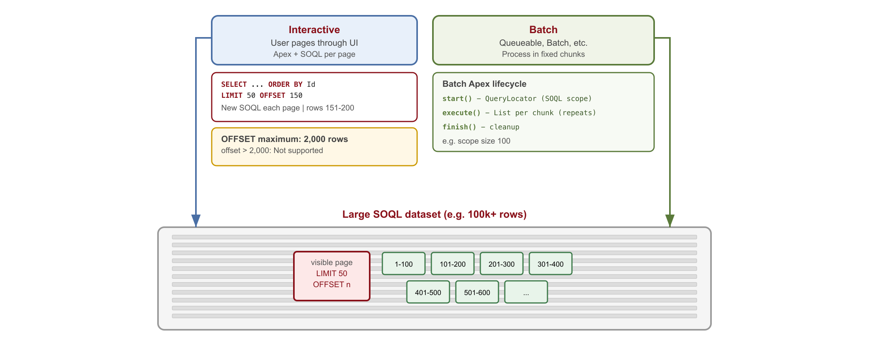
Accessing and processing datasets today in SOQL
UI paging with OFFSET/LIMIT vs async processing in fixed-size chunks.

Slide 3
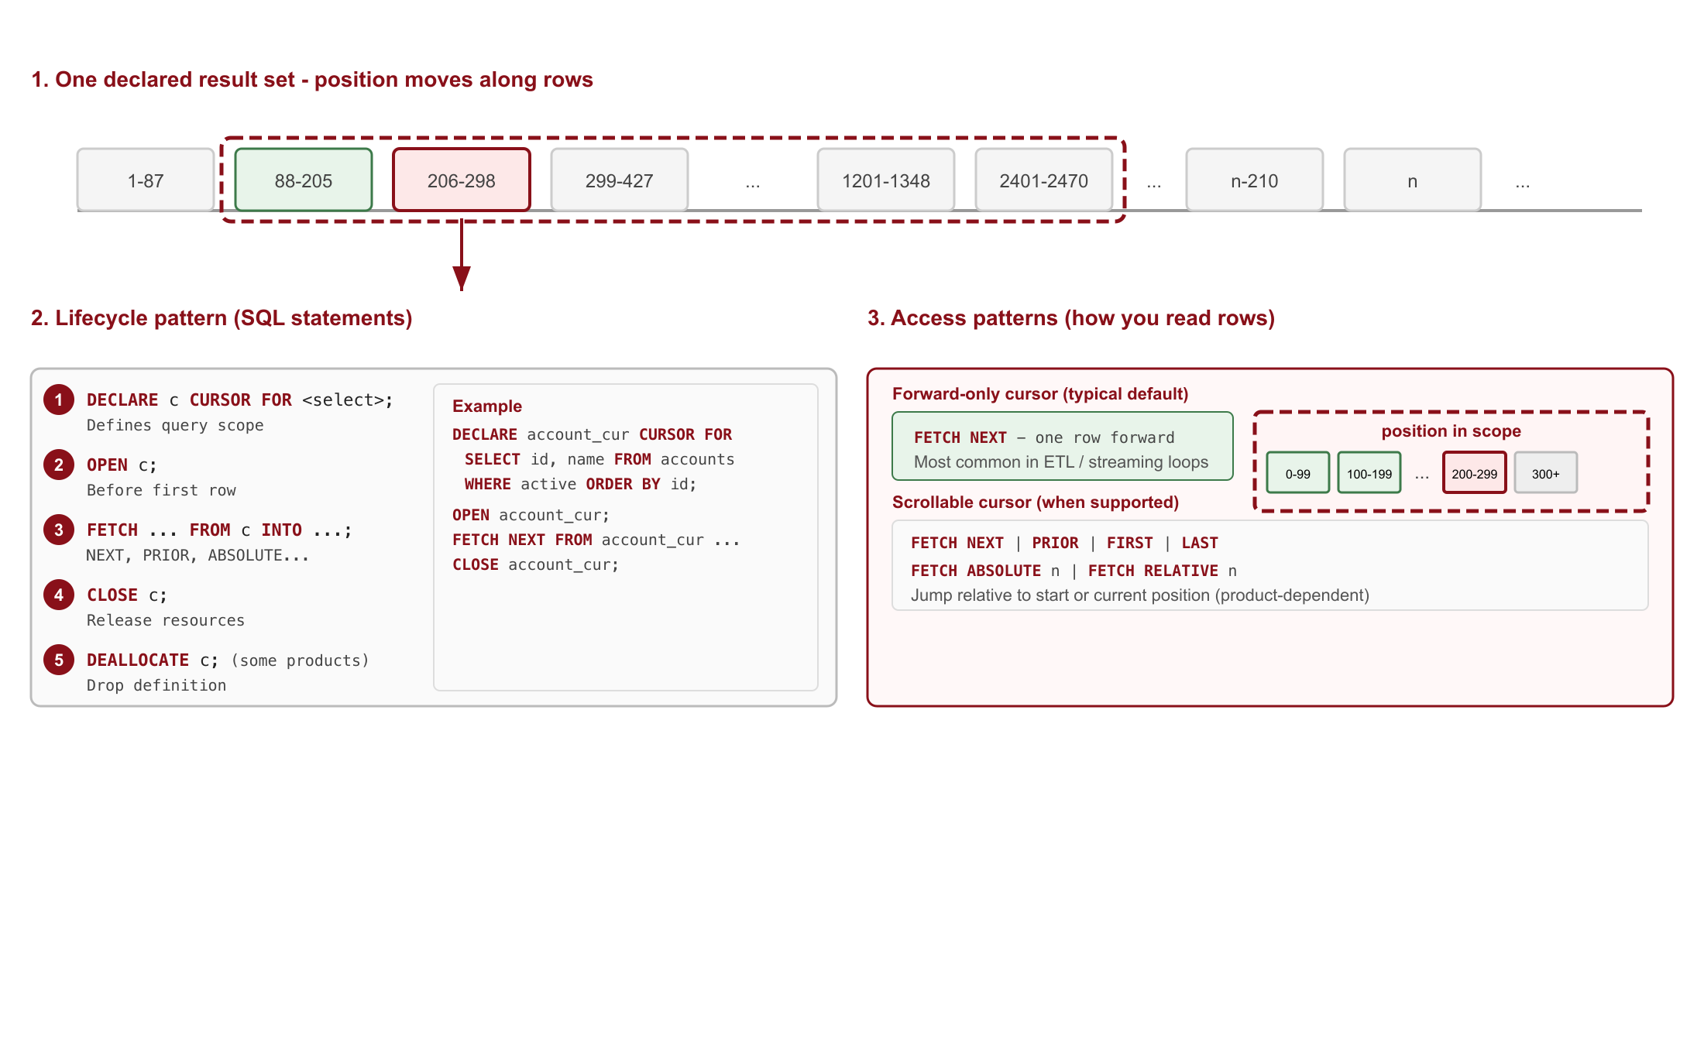
What is a SQL Cursor?
Traverse a query result incrementally instead of returning the full set at once.

Slide 4
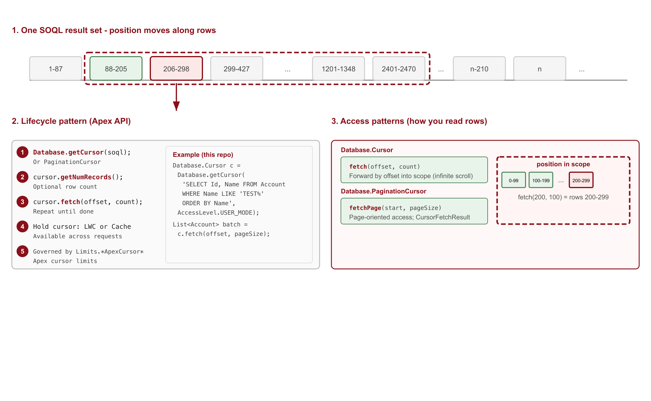
What is a SOQL Cursor?
SQL cursor concepts on Salesforce: Database.getCursor(SOQL) and incremental fetch in Apex.

Slide 5
Usecases for Apex Cursors
Optimial handling of larger data volumes
Interactive
Data Analyst tools and views
End user list views, reporting and drilldown
Preview job records to process
Batch
Orchestrate process execution
Look ahead to optimize within limits
Safer immutable record set
apex>
Database.PaginationCursor c =
Database.getPaginationCursor(
soql, AccessLevel.USER_MODE);
Database.CursorFetchResult r =
c.fetchPage(start, pageSize);
apex>
Database.Cursor c =
Database.getCursor(
soql, AccessLevel.USER_MODE);
List<Account> batch =
c.fetch(offset, pageSize);
Architecture
24hr cached large record sets | Scalable replacement to SOQL OFFSET | Bidirectional navigation

Slide 6
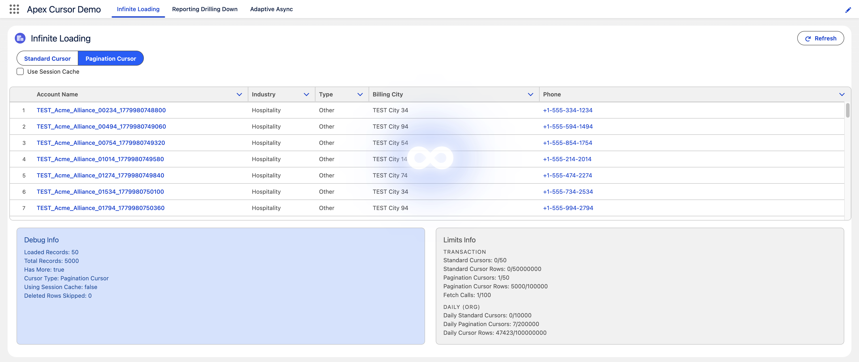
Demo 1: Virtual Data Table

Slide 7
Demo 1: Virtual Data Table Summary
1
2
3
apex>
cursor = Database.getCursor(
ACCOUNT_SOQL,
AccessLevel.USER_MODE);
pageCursor =
Database.getPaginationCursor(
ACCOUNT_SOQL,
AccessLevel.USER_MODE);
apex>
if (pageCursor == null) {
pageCursor = Database.getPaginationCursor(
ACCOUNT_SOQL, AccessLevel.USER_MODE);
Cache.Session.put(
SESSION_PAGINATION_CURSOR_KEY,
pageCursor);
}
apex>
Integer remaining = totalRecords - start;
Integer fetchSize = remaining > 0
? Math.min(pageSize, remaining) : 0;
fetchResult = fetchSize > 0
? pageCursor.fetchPage(start, fetchSize)
: null;
Standard Cursor or PaginationCursor — same ACCOUNT_SOQL, different paging APIs
Cache.Session keeps the pagination cursor between requests; session cache and cursors are per user
Page size is capped to remaining rows in the result set
Limits panel shows cursor, fetch, and daily governor usage

Slide 8
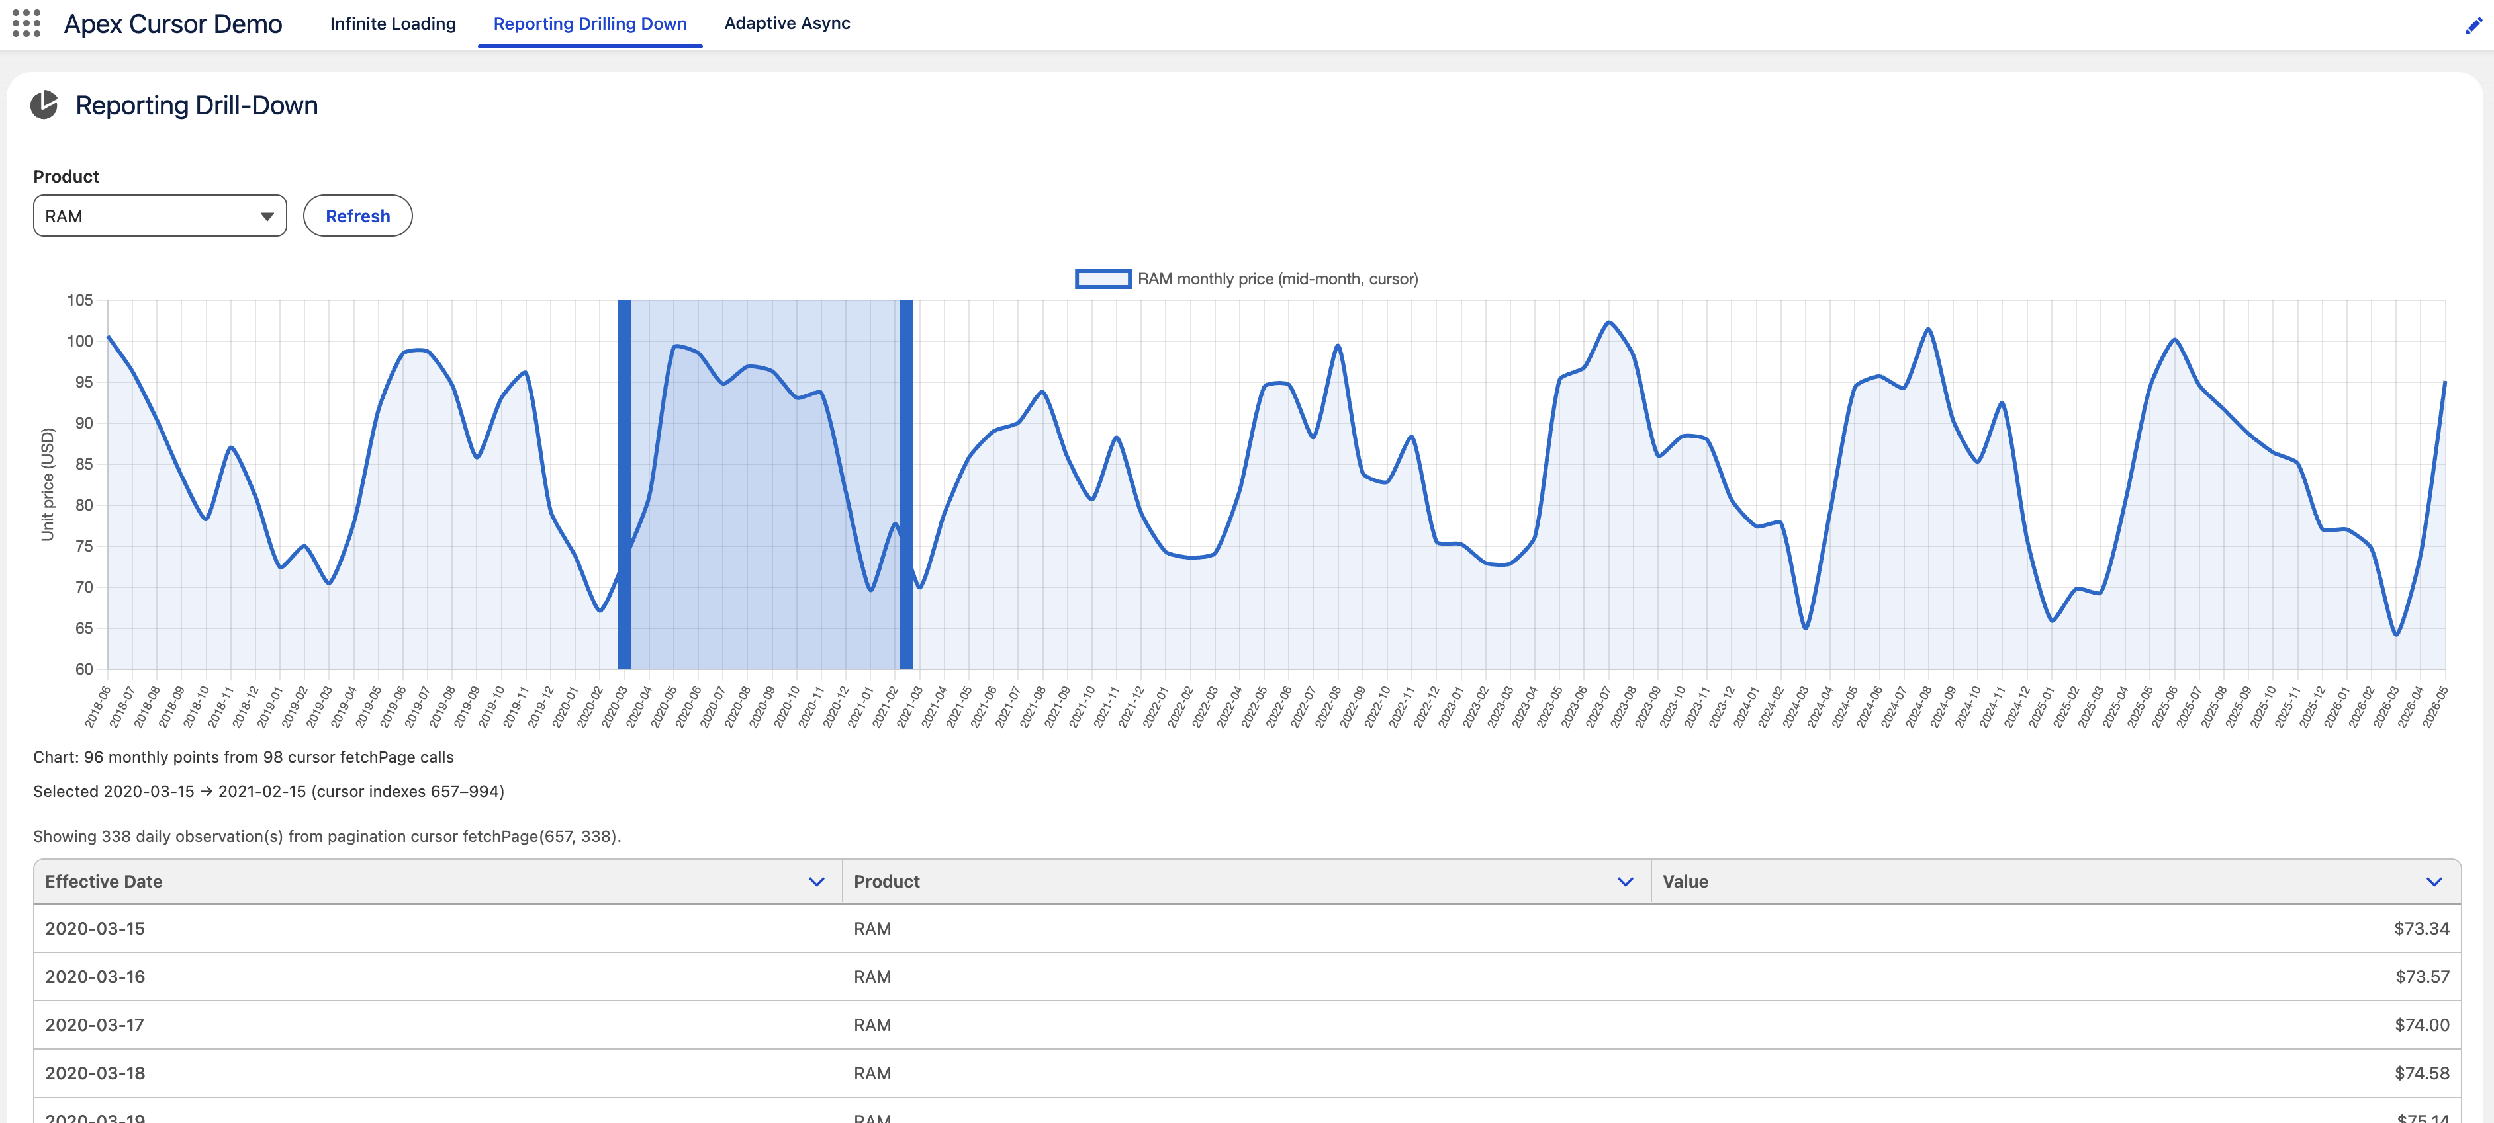
Demo 2: Interactive Reporting and Drilldown

Slide 9
Demo 2: Interactive Reporting and Drilldown Summary
1
2
3
soql>
SELECT Id, EffectiveDate__c,
Value__c, Product__c
FROM UnitPriceObservation__c
WHERE Product__c = :product
ORDER BY EffectiveDate__c ASC
apex>
Database.CursorFetchResult
midChunk =
pageCursor.fetchPage(dayIndex, 1);
apex>
Database.CursorFetchResult
drilldownRecords =
pageCursor.fetchPage(
drillStart, drillSize);
PaginationCursor builds the monthly chart with one fetchPage per month
Session cache keeps the cursor for brush-selection drill-down
Index-based fetchPage maps chart range to daily observation rows
fetchPage reports deleted rows when underlying data changes

Slide 10
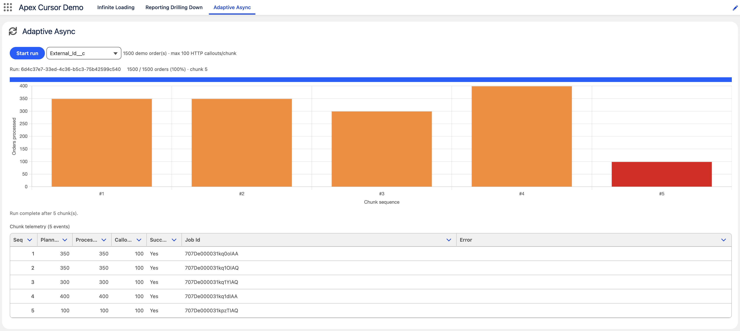
Demo 3: Adaptive Async

Slide 11
Demo 3: Adaptive Async Summary
1
2
3
apex>
Database.Cursor cursor =
Database.getCursor(
soql,
AccessLevel.USER_MODE);
System.enqueueJob(
new AdaptiveOrderWorkerQueueable(
runId, cursor, 1), options);
apex>
Integer rowCalloutsRequired =
rowCalloutsFor(row);
Boolean canProcessRow =
rowCalloutsRequired == 0 ||
scope.predictedCallouts +
rowCalloutsRequired <= calloutBudget;
apex>
if (Limits.getFetchCallsOnApexCursor() >=
Limits.getLimitFetchCallsOnApexCursor()) {
return scope;
}
One cursor opened in Apex and passed through chained queueable jobs
Chunk size adapts to remaining HTTP callout budget per transaction
Track fetch limits dynamically via Limits.getFetchCallsOnApexCursor
Cursor position travels on the job state

Slide 12
Usage Best Practices
Stable ORDER BY
Guard number of records
Cap fetchPage size
soql>
'SELECT ... FROM Account
WHERE Name LIKE 'TEST%'
ORDER BY Name',
AccessLevel.USER_MODE);
apex>
if (cursor.getNumRecords() == 0) {
return result;
}
apex>
pageSize = Math.min(
PAGE_SIZE,
pc.getNumRecords()
- startIndex);
pc.fetchPage(start, pageSize);
Sort on a unique, stable key.
Keeps offsets and page indexes predictable.
Exit early when the result set is empty.
fetch(0, 0) can throw a GACK.
Do not request rows past the result set end.
Critical for partial last pages.
Retry transient errors
Cursor returns to LWC
Check for latest security changes
apex>
} catch (System.
TransientCursorException e) {
if (++retries <= MAX)
return retry();
throw e;
apex>
@AuraEnabled
public static Result load(...) {
result.cursor = cursor;
return result;
}
apex>
[SELECT Id FROM Account
WHERE Id IN :ids
WITH USER_MODE];
cursor = Database.getCursor(
soql, AccessLevel.USER_MODE);
TransientCursorException may be retried.
Do not retry FatalCursorException.
Cursors are Aura-serializable.
Return on @AuraEnabled result.
Fetch does not re-evaluate security, per Batch Apex. If critical requery changes.

Slide 13
Limits
Limit
Pagination
Standard
Per transaction (each Apex request)
Cursor instances open
50
50
Rows across all cursors in txn
100,000
50,000,000
Fetch calls (shared)
100
100
Per pagination fetchPage call
Max rows per page
2,000
—
Per org (rolling 24 hours)
Cursor instances opened
200,000
10,000
New rows fetched (shared)
100,000,000
100,000,000
Transaction limits apply to each Apex request; daily limits roll per org over 24 hours.
Fetch calls and daily row counts are shared across standard and pagination cursors.
Cursors expire like API query cursors — see API Query Cursor Limits in Salesforce Help.
Aggregate, subselect and virtual object queries are not supported.

Slide 14
Other Use Cases
Cursor patterns beyond the three demos
Records to Process Adjustment
Present records to process and let users deselect rows. Pass the cursor and row indexes to ignore into the job.
Repeatable Datasets
Retry processing against the exact original record set.
☑️
🔁
Point in Time Reporting
Snapshot a record-set selection for the user session.
Simple Queue
Create task records and delete when complete — until cursor rows reach zero.
📸
📋

Slide 15

Q&A
Andrew Fawcett
andy@andyinthecloud.com | LinkedIn
View Session Resources

Slide 16
Thank You
Andrew Fawcett
andy@andyinthecloud.com | LinkedIn

