Slide 1


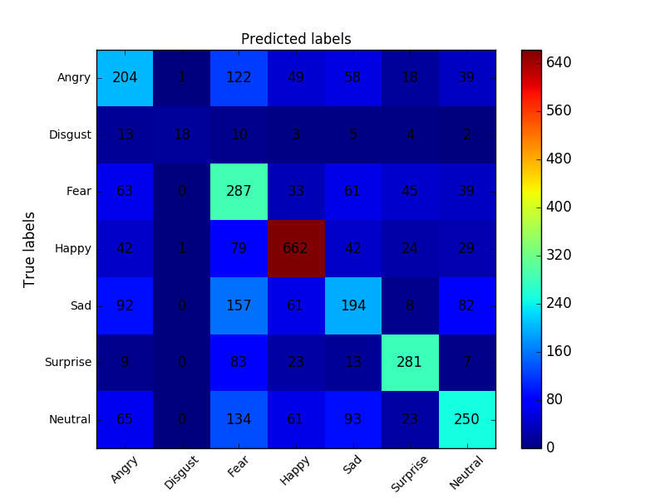
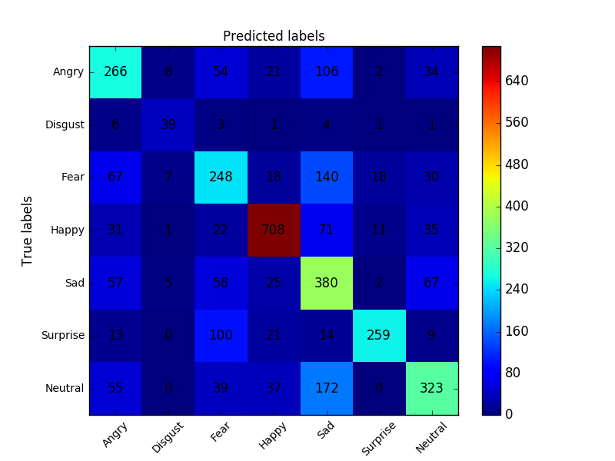










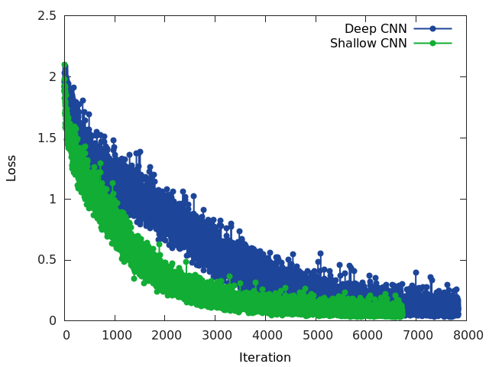
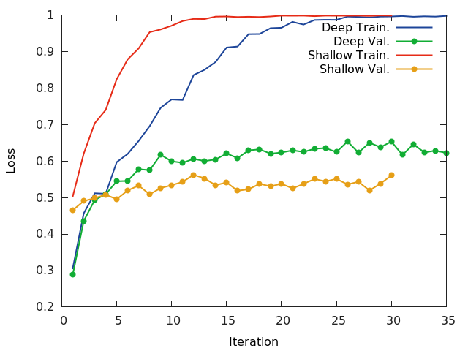
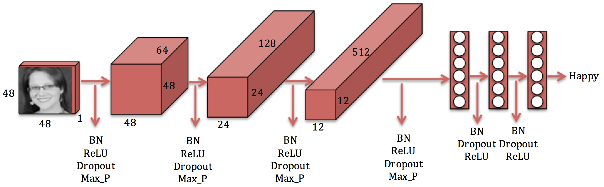
Convolutional Neural Networks for Facial Expression Recognition
Shima Alizadeh, Azar Fazel
Stanford University
Introduction
Model performance
Activation Map Visulaization
Motivation:
The automatic recognition of facial expressions has been an active research topic since the early nineties.
Several applications in computer science, psychology and neuroscience.
Development of an automated system to accomplish the expression classification task with high accuracy is challenging.
Dataset:
Provided by Kaggle website
Consists of ~37000 well-structured 48x48$ pixel grayscale images of faces.
Each image is categorized in one of the seven classes that express different facial emotions (Angry, Disgust, Fear, Happy, Sad, Surprise, and Neutral)
Goal:
Develop a Convolutional Neural Networks (CNN) model to classify facial expressions into 7 different classes.
Compare 2 models(shallow and deep net): training history, accuracy
Confusion matrix for deep model
Results of cross validation:Table for the parameters of the best model
Hybrid feature model(HOG), compare the results with shallow net
Visualize activation maps for different layers
Visualize weights for first layer
conv
BN
ReLU
pooling
Angry : 0.0
Disgust : 0.0
Fear : 0.0
Happy: 0.987
Sad: 0.0
Surprise: 0.003
Neutral: 0.01
(a) Angry
(a) Neutral
(a) Sad
(d) Happy
(e) Surprise
(f) Fear
(g) Disgust
dropout
Methodology
Confusion matrix for shallow CNN model
Confusion matrix for deep CNN model
conv
Data Preprocessing:
Normalizing images by subtracting the mean
Data Augmentation:
Increasing the size of the training set by flipping images randomly
Features:
Raw pixel data
Extracting Histogram of Oriented Gradient (HOG) features for each image and using them along with raw pixels. For this part, we built two separate networks, one convolutional network and one fully connected network. Then before feeding the output of the convolutional network to fully connected network, we concatenated the HOG features to the features extracted form the last layer of the convolution network and used it as a new features vector for the fully connected network.
Additional Techniques:
Using batch normalization to achieve high accuracy in fewer training steps
Using dropout to prevent our network from overfitting.
GPU Computation:
Make the model training process faster by using CUDA and GPU in Torch
BN
conv
BN
conv
BN
Summary and Future Work
References
[1]. Nicu Sebe, Michael S. Lew, Ira Cohen, Yafei Sun, Theo Gevers, Thomas S. Huang (2007) Authentic Facial Expression Analysis. Image and Vision Computing 25.12: 1856-1863
[2]. Bettadapura, Vinay (2012). Face expression recognition and analysis: the state of the art. arXiv preprint arXiv:1203.6722
[3]. Lonare, Ashish, and Shweta V. Jain (2013). A Survey on Facial Expression Analysis for Emotion Recognition. International Journal of Advanced Research in Computer and Communication Engineering 2.12
[4]. Dalal, Navneet, and Bill Triggs (2005). Histograms of oriented gradients for human detection. Computer Vision and Pattern Recognition (CVPR), IEEE Computer Society Conference on. Vol. 1

