Slide 1
FOSS Gbg
Singularity container platform
optimized for high performance
computing, enterprise and security

Slide 2
HPC (High Performance Computing)
Multiple users per server
Shared network home folder
No privileged user access
Strict security requirements
Typically older system versions
Very high needs for performance (CPU, I/O, etc)
Access to specialized hardware (GPU, MPI, etc)

Slide 3

Docker
“ This is a Linux system, I know this!”
Let’s run Docker (find docker client, docker run)
Let’s start it then (sudo systemctl start docker)
“ Dear Security Staff, I would like to be able to
run a server that lets me run random programs
from the Internet - as root, with network access.
Thanks in advance /L. User“
Cannot connect to the Docker daemon at unix:///var/run/docker.sock. Is the docker daemon running?
user1234 is not in the sudoers file. This incident will be reported.

Slide 4
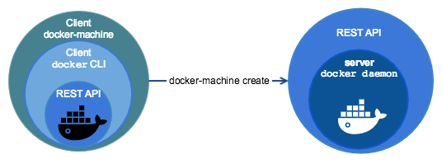
Virtual Machines
Docker Machine to the rescue
But...
  Why is it so small ? And slow ?
  And where are all my files now
  How can I access my tools on NFS
  What about those special devices
  And I still can’t access Docker Hub
$ docker-machine create default
$ eval $(docker-machine env)

Slide 5
Rootless
It is possible to run Linux containers without root
If you have a new enough host kernel, that is (4.19)
Requires some system support to map the uid/gid
You might have some lower performance, though
  Filesystem
  Network
And it would still run as root within the container
My files, tools and devices are still “ gone” and so on

Slide 6


Singularity
Singularity 3.5
  Linux container platform optimized for
  High Performance Computing (HPC) and
  Enterprise Performance Computing (EPC)
Version 1.0 in 2016, version 3.0 in 2018
Written in the Go programming language
Developed at the University of California,
Lawrence Berkeley National Laboratory (LBNL)
Licensed under the 3-Clause BSD License

Slide 7
Singularity Image Format
Single compressed .sif file
Executable (singularity run)
Immutable (r/o) by default
Cryptographically signed
Built automatically from docker image or hub
Or build .sif file on demand (singularity build)
Custom .def definition file, including bootstrap

Slide 8

Demo - Singularity

Slide 9
Possible to do some of this with Docker
If you really really like to use your old Big Fat Daemon
Custom image entrypoint
  Mirror uid / gid
  Create user
  Volume mount
Best practices for image
  No /root or /home
  No /run or /tmp
  Read-only /
docker run --read-only --tmpfs /run --tmpfs /tmp

Slide 10
Runtime Options
Writable
Contain
Fakeroot
-w, --writable by default all Singularity containers are
available as read only. This option makes
the file system accessible as read/write.
-c, --contain use minimal /dev and empty other
directories (e.g. /tmp and $HOME) instead
of sharing filesystems from your host
-C, --containall contain not only file systems, but also
PID, IPC, and environment
-f, --fakeroot run container in new user namespace as uid 0

Slide 11
Additional Projects
Singularity CRI (beta)
  Kubernetes Container Runtime Interface (CRI) support
Singularity Desktop (beta)
  Native support for macOS and Windows (coming soon)
SingularityPRO
Sylabs.io Cloud
  Container Library
  Remote Builder

Slide 12
Questions?
Anders F Björklund
github.com/afbjorklund
For more info on singularity:
https://sylabs.io/singularity/

