Slide 1
Programming Education in Elementary Schools Vision 2020
Jean Marie Cimula

Slide 2
Outline
Overview
Objectives
Age Discussion
Recommendation
Problem-Solving Skill Development
From Thinking to Programming
Workflow
Getting started

Slide 3
Overview
Promote social contribution activities to build up an amazing society
Emphasize on support educational activities for helping next generation and participating in the development of the local society

Slide 4
Objectives
Instilling programming skills in early age
Developing designated skills and prepare them for innovation
Demystifying what may become brain teaser for them later
Activating curiosity of children to perceive their own dream
Activating entrepreneurial spirit in them

Slide 5
Age Discussion
With more than five courses at school…
Will this initiative jeopardize the regular program? Is it too demanding?

Slide 6
Recommendation
Identify Appropriate Toolkits (MySoftCut Concept)
MySoftCut can be a cheatsheet that clearly describes the overview of selected
programming languages and examples of applications that can be built using
these programming languages.

Slide 7
Problem-Solving Skill Development
Idea
Code
X
Description
Reformulation
Approach
Thinking skill
Reasoning skill
Selected points
Adjustment
Processed Information
Improvement
Result
Test
Interpretation skill
Communication skill
Provisional
Judgment skill

Slide 8
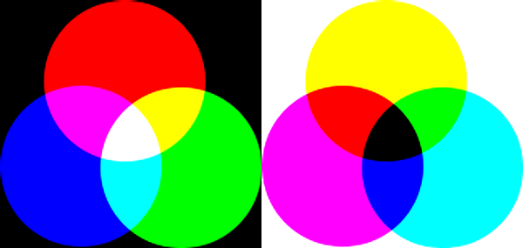
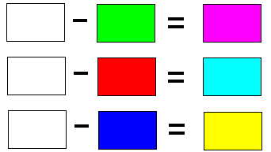
From Thinking to Programming
Is it a Riddle?
https://terpconnect.umd.edu/~toh/ColorLesson/
This Venn is still easier to memorize, right?
Does it require Programming to do so?
When it comes to combine many colors, How to make it easier for a Textile company to produce alluring and enticing colors on T-shirt?
How to solve up this tangle?
https://www.csun.edu/science/books/sourcebook/chapters/9-graphic-organizers/files/venn-colors.html
Based on three main colors, namely Blue, Yellow and Red

Slide 9





From Thinking to Programming…
Idea
I would like to make Cyan
Description
Assumptions : I may need
and
Begin
setTarget = ‘Cyan’;
StartingLine:
col1 = getInput (‘Type first color’);
col2 = getInput (‘Type second color’);
comb = col1 + col2;
If comb$name <> setTarget
print(‘bad result’);
call StartingLine;
else printColor(‘Yes, you got it!’, comb);
End
Approach
Color mixture based Venn diagram
Code
Let’s compute it
Result
Test
Is it Cyan? No, it isn’t
Back to assumptions and tweak them
Description
Assumptions : I may need
and
Approach
Color mixture based Venn diagram
Code
Let’s compute it
Result
Test
Is it Cyan?

Slide 10
Workflow
Programming Logic
Required
Gentle Introduction of Programming Languages, including its advantages and limits
Required
Basic Linear Algebra and Probability
Required
Choice of Type App
Console
Web
Game
Mobile
Focus
Traditional or NoSQL Database
Academia
Introductory Data Science
AI, Machine Learning, Big Data
Insight
Professional
Orientation for future commitment
Highly recommended
Startup

Slide 11
Getting Started
JM4ESG (Japan Meetup for Elementary School Geeks)
# Arranging some meetup opportunities for ES students who are interested in developing software to talk and share ideas between them.
# Communicating in group is very important.
# They can easily convey thoughts and befriend for working on common projects
iJESCup (i Japan Elementary School Cup)
# Organizing award events for encouraging brilliant business ideas (or software) made by ES students.
# This can incite them to work hard and propose some bold ideas and breakthrough.

Slide 12
Thank You

