Slide 1

Extracting Minimal Non-Redundant Association Rules from QCIL

Slide 2
1. Introduction
The association rule is usually extracted from the frequent itemsets(FIs), but the number of FIs is enormous. In order to reduce the number of FIs without loss any useful information, Frequent closed itemsets(FCIs) are adopted to extract association rules.
The rule is described as the relation between intension (attribute) sets, and reveals the inclusion relation between extension (object) sets.
Notes:
关联规则通常是从频繁项集中提取的，但是数目是巨大的。（而且存在一些频繁项集他们的交易集是相同，所以挖掘出来的规则中存在大量的冗余规则）。为了减少频繁项集的数目但是不丢失有用的信息，采用了频繁封闭项集。
规则本身是用内涵(特征、属性)集之间的关系来描述的，而体现于相应外延(对象)集之间的包含关系。

Slide 3
In concept lattice, the node : intension + extension, generalization & specialization, the inherent closure properties
Frequent closed itemset lattice is formed by denoting the relationship of FCIs using concept lattice.
Quantitative Closed Itemset Lattice(QCIL)
Notes:
在概念格中，节点是由内涵和外延两部分组成，节点之间的关系反映了概念之间的泛化和例化关系，另外由于概念格中概念对象和属性间固有的封闭性，它也很适合于表示封闭项集间的关系。因此概念格非常适合作为规则提取的基础性数据结构。
频繁封闭项集格，是使用概念格来表达FCI之间的关系。
我们采用渐进的方式来构格，并且修改的格节点结构。称为QCIL
a node corresponds to the set of itemsets with the same tidset and the least itemset in this set corresponds to a minimal non-redundant rule.
节点对应于同交易项集。其中的最小项集（SLIT）对应于最小无冗余规则。
这篇文章就是提出了使用SLIT来直接从QCIL中提取出最小无冗余规则。

Slide 4
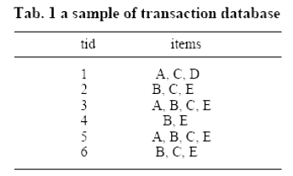
2. Basic Notions of Association rule
Let I={i1,i2,…,im} be a set of items, D be a transaction database. A transaction T contains a set of items in I, and has an unique identifier called TID or tid.
sup(X) : the proportion of transactions in D
an itemset X is frequent : sup(X) ≥ minsup
Notes:
I为项的集合，D为事务数据库，一个事务T包含一个项集和一个唯一标识TID。
在整个事务数据库D中出现项集X的比例(频率)称为项集X的支持度，记为sup(X)。项集X是频繁的是指其支持度达到用户设定的最小阈值minsup，即sup(X)≥minsup。

Slide 5
An association rule R : X⇒ Y, where X,Y ∈ I and X ∩ Y= Φ .
sup(R) is defined as sup(X ∪ Y)
conf(R) is computed as the ratio sup(X ∪ Y)/sup(X).
A rule R is confident when conf(R) ≥ minconf.
The association rule is valid rule if its sup(R) ≥ minsup and conf(R)≥ minconf .
Notes:
对于一个形如XY的关联规则R来说， X、YI且X∩Y=Φ。规则R的支持度sup(R)定义为sup(X∪Y)，规则R的置信度(可信度)，记为conf(R)，可表示为sup(X∪Y)/sup(X)。P(Y|X)
A rule R is confident when conf(R) reaches at least a user-specified minimum threshold minconf.
The association rule extracted from D is valid rule if its support and confidence is more than or equal to a userspecified minsup and minconf.

Slide 6
Exact association rules have 100% confidence.
Approximate association rules are those with confidence less than 100%.
Minimal non-redundant rule is that with minimal antecedent and maximal consequent.
For example, ab ⇒ cde, ab ⇒ c, ab⇒ d, abc⇒ d, abcd ⇒ e, abde⇒ c are six valid rules with the same support and confidence. But compared with the first rule, the other five rules don’t give additional information. they are redundant to the first rule ab ⇒ cde. and the rule ab⇒ cde is that with minimal antecedent and maximal consequent.
Notes:
According to the confidence, association rules can be classified into exact and approximate.
There exist many redundant rules during rules are extracted from context.
最小无冗余规则是那些具有最小前件和最大后件的规则。and other rules can be deduced from these rules.
这边可以举个例子：说一下什么是Minimal non-redundant rule

Slide 7
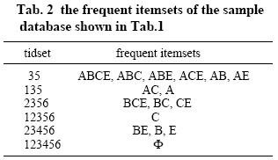
Definition 1 Let X,Y be two FIs, X,Y ⊆ I, and their supports be sup(X) and sup(Y) respectively.
The approximate rule can be defined as : AR={Y ⇒ X-Y | Y ⊂ X,Y ≠ Φ ∧ sup(X) ≠ sup(Y) ∧ sup(X)/sup(Y) ≥ minconf}
the exact rule can be defined as : ER={Y⇒ X-Y | Y ⊂ X,Y ≠ Φ ∧ sup(X) =sup(Y)}.
Sample: minsup=2/6
Notes:
挖掘关联规则最主要的步骤是找出所有的频繁项集（类似Apriori的）。
从事务数据库中提取有效的关联规则就是提取满足用户设定的最小支持度(minsup)和最小置信度(minconf)的规则。其中，重要的步骤是找出存在于事务数据库中的所有频繁项集。
对于表1的数据库来说，若minsup＝2/6，则所有的频繁项集如表2所示。表中的交易集Tidset中的35实际上表示{3,5}，同样地，项集中的abce实际上表示{a,b,c,e}。

Slide 8
3. Frequent Closed Itemset and
Quantitative Closed Itemset Lattice
Definition 2 Let X be the corresponding tidset of a frequent itemset, then the set of all frequent itemsets with the tidset X is refered to as the Set of Frequent Itemsets with the Same Tidset ,denoted as SFIST. It is a SFIST in one row of Tab.2.
Definition 3 Let Y be a itemset of SFIST, If there isn’t another itemset Y’ such that Y’ ⊃ Y, then Y is defined as the largest frequent itemset in the SFIST; similarly ,If there isn’t another element Y’ such that Y’ ⊂ Y, then Y is defined as the least frequent itemset.
SFIST35 ={ABCE,ABC,ABE, ACE,AB,AE}.
ABCE : a largest frequent itemset;
AB and AE : least frequent itemsets
Notes:
For example, there is a SFIST with the same tidset 35( it actually stands for {3,5}, and similarly, ABC for {A,B,C}),the SFIST with the tidset 35 is denoted as SFIST35, and SFIST35 ={ABCE,ABC,ABE, ACE,AB,AE}.
The itemset Y in a SFIST and corresponding same tidset X form (X,Y),a pair of tidset and itemset.

Slide 9
Theorem 1 If Y is the largest frequent itemset in a SFIST, then it is unique.
Proof:
suppose there are another largest frequent itemset Y’ in the SFIST besides Y. let Y=Y1Y2…YkYk+1…Ym and Y’=Y1Y2…YkY’k+1…Y’n, let their corresponding same tidset be X, then X contains the itemset Y1Y2…YkYk+1…Ym and Y1Y2…YkY’k+1…Y’n in the transaction database, therefore, X contains the itemset Y1Y2…YkYk+1…YmY’k+1…Y’n ⊃ Y1Y2…YkYk+1…Ym. The result conflicts with that Y is a largest pair.
Notes:
Not only these FIs with same tidset can’t convey new useful information but also they are unfavorable to find the valid rules. Therefore, the frequent closed itemset is adopted.
同交易集的频繁项集不仅没有新的有用的信息，而且也不利于找出有效的规则，所以我们采用频繁封闭项集

Slide 10
D=(O,A,R) oRa
The object set X ∈ P(O) and the attribute set Y∈P(A) are connected with relation as follows:
f(X)={y∈A | ∀ x∈X, xRy },
g(Y)={x∈O | ∀ y∈Y, xRy }.
As for a binary tuple (X,Y), X=g(Y) is the tidset which contain the itemset Y and Y=f(X) is the itemset that is contained in all the transactions in X.
A pair (X,Y) is known as a itemset concept.
If itemset concepts C1=(X1,Y1), C2=(X2,Y2) satisfy Y1 ⊆ Y 2, then (X1,Y1) is called sub-concept or child concept and (X2,Y2) is called super-concept or parent concept, and the sub-super relation can be denoted by (X1,Y1) ≤ (X2,Y2). If there is no C3=(X3,Y3) such that (X1,Y1)<(X3,Y3)<(X2,Y2),then (X1,Y1) is direct child concept and (X2,Y2) is direct parent concept.
Notes:
O为对象的集合，对应于事物数据库中的tids；A为属性的集合，对应于items； R ⊆ O× A is a binary relation, For an object o∈O, an attribute a∈A, then oRa means that object o possesses attribute a or transactions o has item a.
事务数据库很容易表示为形如D=(O,A,R)的三元组的形式背景，其中O对象集，对应于事务数据库中交易的集合；A是属性，对于事务数据库中的项集； R ⊆ O× A 是二值关系，(o,a) ∈ R表示对象o ∈ O和属性a∈A间存在关系，表示为oRa。
在交易集的幂集和项集的幂集之间可定义如下映射关系：
f(X)={y∈A | ∀ x∈X, xRy },g(Y)={x∈O | ∀ y∈Y, xRy }.
它们被称为O的幂集P(O)和A的幂集P(A)间的Galois连接（伽罗瓦连接）。对于来自P(O) × P(A)的二元组(X,Y)来说，X=g(Y)表示所有包含项集Y的交易集合；Y=f(X)表示在所有的交易X中所共有的项集Y。交易项集对(X,Y)就形成了一个项集概念(Itemset Concept)。
若项集概念C1=(X1,Y1)、C2=(X2,Y2)，满足X1 ⊆ X2 或Y2 ⊆ Y1，则称( X1，Y1)为子概念，( X2，Y2)为父概念，记为：(X1,Y1)≤(X2,Y2)。若不存在C3=(X3,Y3)，满足(X1,Y1)<(X3,Y3)<(X2,Y2)，则(X1,Y1)为直接子概念，(X2,Y2)为直接父概念。

Slide 11
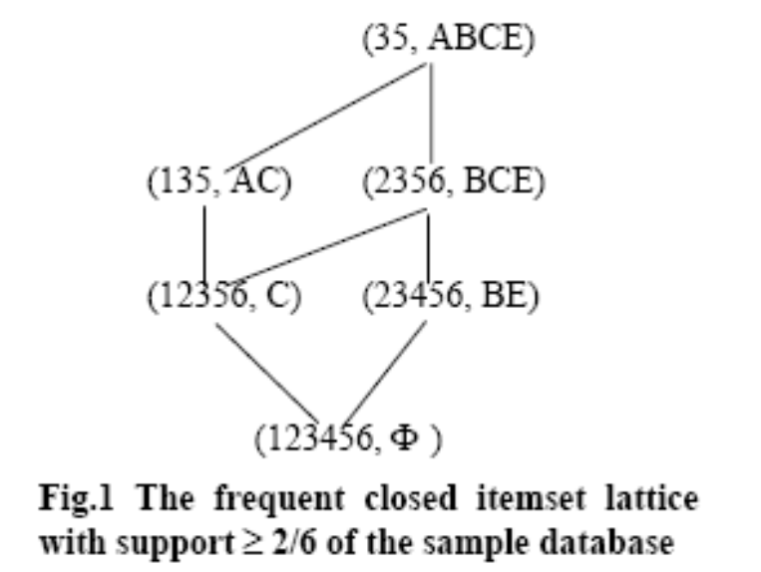
Definition 4 Let D=(O,A,R) be a formal context ,Y is a itemset and Y∈A, then Y is referred to as closed itemset denoted as CI if Y=f(g(Y)) and its support sup(Y)=| g(Y)|/| O |.
Definition 5 If Y is a closed itemset, and its support isn’t less than minsup, then Y is referred to as frequent closed itemset denoted as FCI.
A pair (g(Y),Y) ： itemset concept
frequent closed itemset lattice.
Notes:
定义1 设D=(O,A,R)是事务数据库所形成的形式背景，Y是一个项集，Y ∈ A，那么当Y=f(g(Y))时，则称该项集Y是封闭项集(Closed Itemset)，记为CI。其支持度sup(Y)=|g(Y)|/| O |。
定义2 对于D=(O,A,R)中的封闭项集Y来说，若其支持度不小于minsup，则称Y为频繁封闭项集(Frequent Closed Itemset)，简记为FCI。
A pair (g(Y),Y) is a itemset concept composed of a frequent closed itemset Y and its corresponding tidset g(Y). These Pairs of FCI and its corresponding tidset can consist of the frequent closed itemset lattice.
For example,such lattice of the sample database is shown in Fig.1 where minsup=2/6. It can be found out that the number of FCIs is much smaller than the number of FIs. Actually, a SFIST corresponds to one FCI, and that, the pair of this FCI and its corresponding tidset is the largest pair of tidset and itemset of the SFIST.

Slide 12
Theorem 2 Let Y be a largest frequent itemset in a SFIST, then it is certainly a frequent closed itemset, and vice versa.
For example, two pairs ( 35, ABCE),( 35, ABC) in SFIST35,
Notes:
Proof: Let (X,Y) be a largest pair of tidset and itemset of a SFIST where X is the same tidset and Y is the largest FI, then g(Y)={x ∈ O| ∀ y ∈ Y, xRy } denotes the tidset which contain the itemset Y ,i. e., X=g(Y). and f(X)={y ∈ A| ∀ x ∈ X, xRy } denotes the itemset that is contained in all the transactions in X, the f(X)=Y is satisfied for Y is the largest FI contained in X, so f(g(Y))=Y, i.e., Y is closed.
In reverse, a FCI is certainly associated with the largest FI in a SFIST. The proof is omitted.
although g(ABC) =g(ABCE) =35,but f(35)= ABCE ≠ ABC, so that ( 35, BCE) is closed but ( 35,ABCE) isn’t.

Slide 13
Quantitative Closed Itemset Lattice(QCIL)
the node structure
Itemset is the itemset contained in the node
Tid_count is the cardinality of tidset
Dirt_parent and Dp_count are the node’s direct parent concepts and their number
Dirt_child and Dc_count are the direct child concepts and their number
Notes:
Since the transaction database is frequently updated, there is a need to keep the whole set of CIs including those which are not frequent. It is due to the fact that some infrequent CIs may become frequent while some FCIs may become infrequent after insertion of new transactions. The closed itemset lattice can be built incrementally. While database is updated, it is only to make the parts of nodes in the lattice update. For extracting rules conveniently, the node structure in the lattice is modified and it includes some components as follows:
The closed itemset lattice with these node structure is known as Quantitative Closed Itemset Lattice, denoted as QCIL, and its building algorithm is similar to that in our previous work reported in [9],and the algorithm is described as follows :

Slide 14
Algorithm 1: the incremental construction of QCIL
INPUT: a QCIL L, a new transaction Tn
OUTPUT: the updated lattice L’
BEGIN
CIn= Φ
In=Itemset(Tn)
FOR each node C of lattice L
in ascending |Itemset(C)| DO
Ic= Itemset(C)
IF Ic ⊆ In THEN
Tid_count(C)= Tid_count(C)+1,add C to CIn
IF Ic=In THEN exit FOR ENDIF
ELSE
Y= Ic ∩ In
IF no such Ck in CIn that Itemset(Ck)=Y THEN
Create new node N with Itemset(N)=Y,
Tid_count(N)=Tid_count(C)+1 and add N to CIn
add C to Dirt_ parent (N),add N to Dirt_ child (C)
Dp_count(N)=Dp_count(N)+1
Dc_count(C)=Dc_count(C)+1
FOR each node Ca∈CIn DO
IF Ca is a direct child of node N THEN
IF Ca∈Dirt_ child (C) THEN
Delete Ca from Dirt_ child (C)
Delete C from Dirt_ parent (Ca)
Dc_count(C)= Dc_count(C)-1
Dp_count(Ca)= Dp_count(Ca)-1
ENDIF
Add Ca to Dirt_ child (N),add N to Dirt_ parent (Ca)
Dc_count(N)= Dc_count(N)+1
Dp_count(Ca)= Dp_count(Ca)+1
ENDIF
ENDFOR
ENDIF
ENDIF
ENDFOR
END
Notes:
CIn为更新的节点集
可以举些例子

Slide 15
4. Extraction of Minimal Non- redundant Association Rules
Dirt_parent(C)
X= Itemset(Dirt_parent(C))
C
Y is an itemset in the SFISTc
The approximate rule Y⇒ X-Y exists with confidence Tid_count(Dirt_parent(C))/Tid_count(C).
The exact rule Y⇒ X-Y certainly exists with 100% confidence where X , Y are itemsets in a SFIST and Y ⊂ X, Y ≠ Φ .
Notes:
之前我们已经说了什么是最小无冗余规则，就是那种类似于ab->cde的那种
It can be made out from definition 1 and node structure of QCIL that the approximate rules certainly exist between node C and its direct parent node Dirt_parent(C). Suppose Y is an itemset in the SFISTc which is the corresponding SFIST of node C, and if the Dirt_parent(C) exists and let X be the itemset of the Dirt_parent(C), i.e. X= Itemset(Dirt_parent(C)),then the approximate rule Y⇒ X-Y exists with confidence Tid_count(Dirt_parent(C))/Tid_count(C).

Slide 16
Defnition 6 An association rule X⇒Y is a minimal non-redundant rule if there doesn’t exist another rule X’⇒ Y’ with sup(X)=sup(X’) , X’ ⊆ X and Y ⊆ Y’.
Evidently, if Y is a least frequent itemset in the SFISTc, and if the Dirt_parent(C) exists and its support sup(Dirt_parent(C)) ≥ minsup and let X= Itemset(Dirt_parent(C)), then Y ⇒ X-Y induced by itemsets X and Y is certainly a minimal non-redundant approximate rule . there is a condition Itemset(C) ≠ Φ which is guaranteed to extract the rule with non-null antecedent.
If Y is a least frequent itemset and X a largest frequent itemset in the SFISTc, then Y ⇒ X-Y is certainly a minimal non-redundant exact rule.

Slide 17
C(2356, BCE)
SFIST2356: BCE, BC, CE
Dirt_parent(C)(35, ABCE)
SFIST35: ABCE, ABC, ABE, ACE, AB, AE
minimal non-redundant approximate rules :
BC ⇒ AE, CE ⇒ AB
minimal non-redundant exact rules:
AB⇒ CE, AE⇒ BC
Notes:
For example, the node C=( 2356,BCE) have two least FIs BC and CE in its SFISTC, and node (35,ABCE) is its direct parent, so there exist two minimal non-redundant approximate rules BC ⇒ AE, CE ⇒ AB.
For example, ABCE is the largest FI and AB, AE are two least FIs in SFIST35, so there exist two minimal non-redundant exact rules AB⇒ CE, AE⇒ BC.
According to theorem 2, the node C in QCIL is the largest pair of tidset and itemset of its corresponding SFISTC if sup(C)=Tid_count(C)/|O| ≥ minsup and |Itemset(C)| ≥ 2, and if only the C’, least pair of tidset and itemset of SFISTC is found out,the minimal non redundant exact rule can be obtained.The condition |Itemset(C)| ≥ 2 is guaranteed to extract the rule where its consequent isn’t null.（这个就是上面的第二点）

Slide 18
Theorem 3 Let node C in QCIL be frequent, then the other itemset Pk in the SFISTC satisfies Pk ⊂ Itemset(C) and Pk ⊄ Itemset(Dirt_child(C)).
The Set of the Least ITemsets ( SLIT) :
suppose the itemset Pk in SLIT is obtained previously, Diff is the differences between the itemsets of node C and its Dirt_child (C).
the Combn is obtained by combining the Pk and Elem
If Pk ∩ Diff ≠ Φ , the Pk keep unchanged
Else the Combn=Pk ∪ Elem , then examined Combn in SLIT or not. if no exists, the Combn must be added into SLIT.
Notes:
Proof: Since node C is frequent and closed,it is a largest pair of tidset and itemset of its SFISTC,and then the itemset Pk in the SFISTC is contained by the itemset of node C,i.e., Pk ⊂ Itemset(C).Suppose a itemset Pk’ is in the SFISTC and satisfies Pk’ ⊂ Itemset(Dirt_child(C)),then Pk’ certainly is certainly in the SFIST of Dirt_child(C) or their child node,it conflicts with the supposition that Pk’∈SFISTC
后面一个定理
The least itemsets among the corresponding SFISTC of node C in QCIL can be obtained by combining the elements of the differences between the itemsets of node C and its Dirt_child (C). To combine the elements of the differences between Itemset(C) and Itemset(Dirt_child (C)) can guarantee that the results satisfy the Theorem 3.
The differences are handled one by one, suppose the itemset Pk in SLIT is obtained previously, when the new difference Diff is handled, the Combn is obtained by combining the Pk and Elem, a element of the Diff. if Pk ∩ Diff ≠ Φ , the Pk keep unchanged, otherwise, the Combn=Pk ∪ Elem , and then it is examined whether there is the subset of the Combn in SLIT. if no exists, the Combn must be added into SLIT.

Slide 19
Theorem 4 Let Pk be a itemset of the SLIT of node C, Diff be a new difference between node C and new direct child node Dirt_child(C). If Pk ∩ Diff ≠ Φ , the Pk keep unchanged.
C(35, ABCE)
SLIT: B, E
BE
A
SLIT: AB, AE
Dirt_child(C)((135, AC)
Dirt_child(C)(2356, BCE)
Notes:
Proof: if Elem1=Pk ∩ Diff ≠ Φ , |Elem1|=1,then Combn1=Pk ∪ Elem1=Pk, suppose other element Elem2∈Diff, Combn2= Pk ∪ Elem2 ⊃ Combn1=Pk, i.e, Combn1=Pk is the least itemset after add new direct child node. Similarly, if |Pk ∩ Diff|>1, Pk is the least itemset too.
The Theorem 4 can reduce remarkably the time for updating the SLIT.
The Theorem 4 can reduce remarkably the time for updating the SLIT.
For example in Fig.1,the node (35,ABCE) has two direct child nodes (135,AC) and (2356,BCE), the differences are BE=ABCE\AC and A=ABCE\BCE. When BE is handled, the SLIT={B , E },and A is handled, the SLIT={ AB , AE }.加图

Slide 20
Algorithm 2:extracting the minimal non-redundant association rule
INPUT: the quantitative closed itemset lattice L, minimal support and confidence minsup , minconf
OUTPUT:the set of minimal non-redundant approximate rules (MAR) and minimal non-redundant exact rules(MER)
MAR= Φ , MER= Φ
FOR each node C in L in ascending |Itemset(C)| DO
IF |Itemset(C)| ≠ Φand sup=Tid_count(C) /|O| ≥ minsup THEN
SLIT= Φ
FOR each Ck∈ Dirt_ child (C) DO
Diff=Itemset (C)\ Itemset(Ck)
CALL combine(SLIT,Diff)
ENDFOR
IF |itemset(C)| ≥2 THEN
FOR each itemset Pk∈SLIT DO
MER=MER∪ { Pk⇒ Itemset (C)\ Pk,sup }
ENDFOR
ENDIF
FOR each Cp∈Dirt_parent( C) DO
conf=Tid_count(Cp)/Tid_count(C)
IF Tid_count(Cp)/|O| ≥ minsup.and.conf ≥ minconf THEN
FOR each itemset Pk∈SLIT DO
MAR=MAR ∪ {Pk⇒ Itemset (Cp)\ Pk,sup,conf}
ENDFOR
ENDIF
ENDFOR
ENDIF
ENDFOR

Slide 21
PROCEDURE combine(SLIT,Diff)
SLIT_new= Φ ,SLIT_keep= Φ
FOR each itemset Pk∈SLIT DO
IF Pk ∩ Diff ≠ Φ THEN
SLIT_keep = SLIT_keep ∪ { Pk } ENDIF
ENDFOR
SLIT_updt=SLIT \ SLIT_keep
FOR each elememt Elem∈Diff DO
FOR each itemset Pk∈SLIT_updt DO
Combn= Pk ∪ Elem
IF no such Pk’ in SLIT_keep that Pk’ ⊂ Combn THEN
SLIT = SLIT ∪ { Combn } ENDIF
ENDFOR
ENDFOR
SLIT= SLIT_new ∪ SLIT_keep
RETURN SLIT

Slide 22
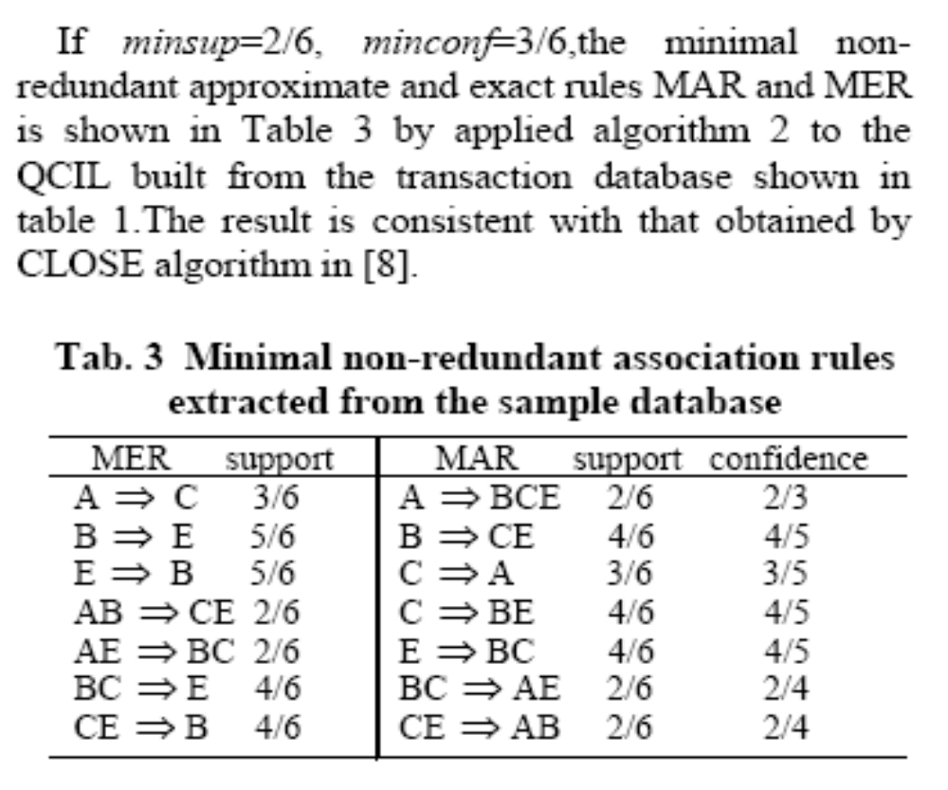

Slide 23
5. Conclusion
CI 、 FCI 、 FI
QCIL
The minimal non-redundant rules correspond to SLIT of the nodes in QCIL.
Notes:
The CI is the subset of itemset, and the FCI is the subset of the CI, its number is much less than that of the FI and without reducing any useful information.
To extract the rule from the FCIs will decrease the search space and benefit to reduce the complexity of the rule extraction. The frequent closed itemset lattice is formed by denoting the relationship of FCIs using concept lattice, but other algorithms such as CLOSE,CHARM, CLOSET don’t fit for the dynamic databases. In this paper, A scheme of quantitative closed itemsets lattice extracted incrementally from database is adopted, which takes only one pass over the database and only parts of the nodes in this lattice need updated when the new transaction is inserted into the database.
The minimal non-redundant rules are that with minimal antecedent and maximal consequent, and they correspond to SLIT of the nodes in QCIL. An innovative approach to extract the association rule by using the SLIT is presented, which can directly extract minimal non-redundant association rules from QCIL.

Slide 24
Thanks～

