Slide 1
DSE 203
Day 2: “Matching” – a fundamental construct

Slide 2
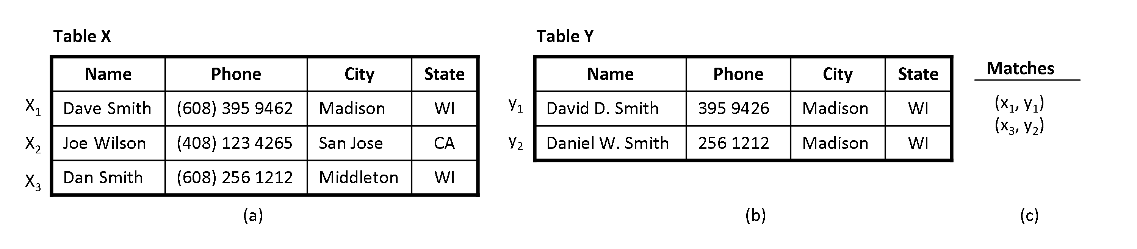
The Problem
Other variations
Tables X and Y have different schemas – we will see this
Match tuples within a single table X – finding near-duplicates
The data is not relational, but XML or RDF – cross model matches

Slide 3
What is “Matching”?
A match is a correspondence or association between individual structures in different data sources
Value matching
Tuple matching
Schema matching
The goal of matching is to find correspondences and not to “clean”/rectify

Slide 4
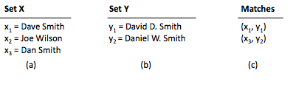
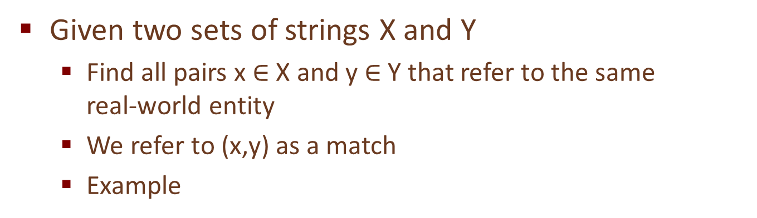
Problem Description
Given two sets of strings X and Y
Find all pairs x $∈$ X and y $∈$ Y that refer to the same real-world entity
We refer to (x,y) as a match
Example
Two major challenges: accuracy & scalability

Slide 5
Accuracy Challenges
Matching strings often appear quite differently
Typing and OCR errors: David Smith vs. Davod Smith
Different formatting conventions: 10/8 vs. Oct 8
Custom abbreviation, shortening, or omission: Daniel Walker Herbert Smith vs. Dan W. Smith
Different names, nick names: William Smith vs. Bill Smith
Shuffling parts of strings: Dept. of Computer Science, UW-Madison vs. Computer Science Dept., UW-Madison

Slide 6
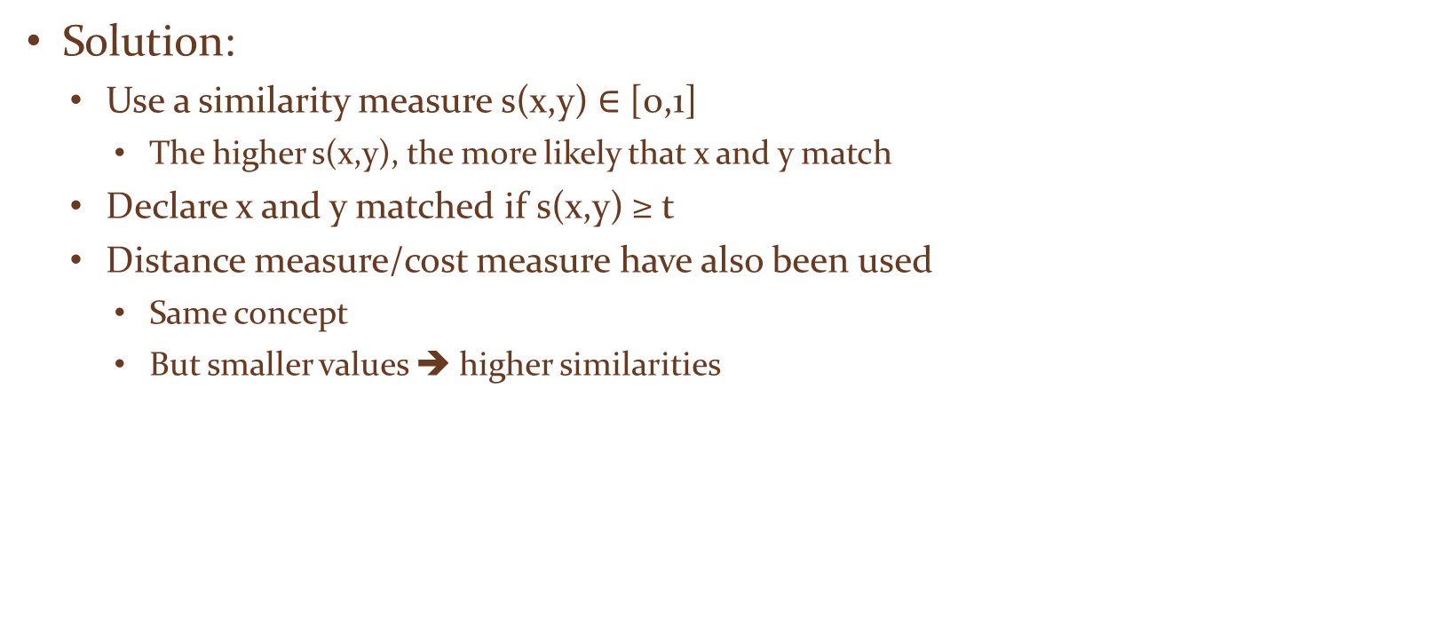
Accuracy Challenges
Solution:
Use a similarity measure s(x,y) $∈$ [0,1]
The higher s(x,y), the more likely that x and y match
Declare x and y matched if s(x,y) ≥ t
Distance measure/cost measure have also been used
Same concept
But smaller values ➔ higher similarities

Slide 7
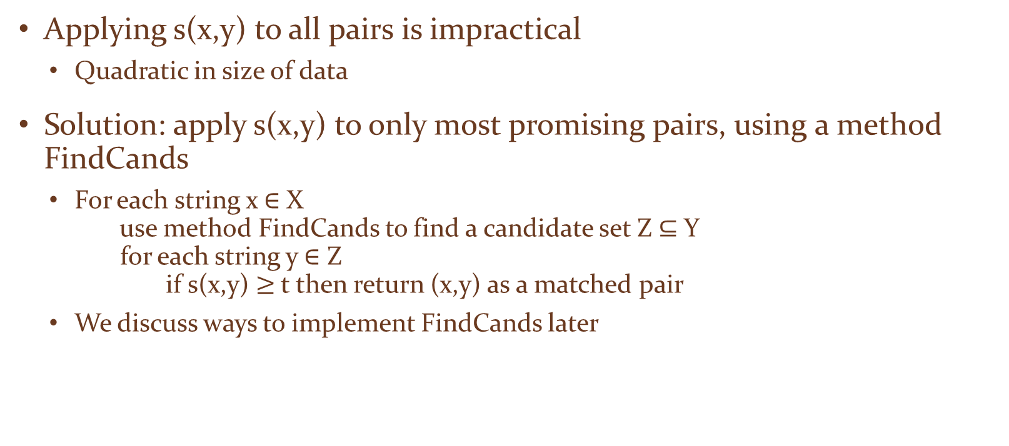
Scalability Challenges
Applying s(x,y) to all pairs is impractical
Quadratic in size of data
Solution: apply s(x,y) to only most promising pairs, using a method FindCands
For each string x $∈$ X use method FindCands to find a candidate set Z $⊆$ Y for each string y $∈$ Z if s(x,y) $≥$t then return (x,y) as a matched pair
We discuss ways to implement FindCands later

Slide 8
Outline
Problem description
Similarity measures
Sequence-based: edit distance, Needleman-Wunch, affine gap, Smith-Waterman, Jaro, Jaro-Winkler
Set-based: Jaccard, TF/IDF
Hybrid: soft TF/IDF
Scaling up string matching
Inverted index, size filtering, prefix filtering, position filtering, bound filtering

Slide 9
Edit Distance
Also known as Levenshtein distance
d(x,y) computes minimal cost of transforming x into y, using a sequence of operators, each with cost 1
Delete a character
Insert a character
Substitute a character with another
Example: x = David Smiths, y = Davidd Simth, d(x,y) = 4, using following sequence
Inserting a character d (after David)
Substituting m by i
Substituting i by m
Deleting the last character of x, which is s

Slide 10
Edit Distance
Models common editing mistakes
Inserting an extra character, swapping two characters, etc.
So smaller edit distance ➔ higher similarity
Can be converted into a similarity measure
s(x,y) = 1 - d(x,y) / [max(length(x), length(y))]
Example
s(David Smiths, Davidd Simth) = 1 – 4 / max(12, 12) = 0.67

Slide 11
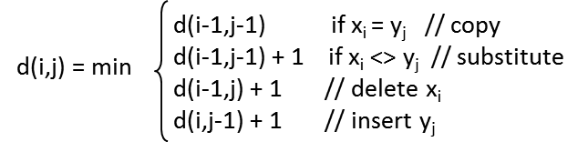
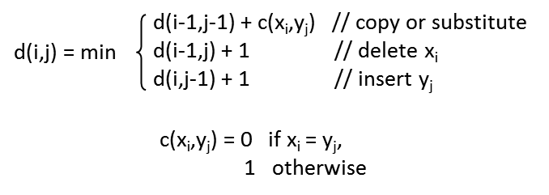
Computing Edit Distance using Dynamic Programming
Define x = x₁x₂☹ x_{n}, y = y₁y₂☹ y_{m}
d(i,j) = edit distance between x₁x₂☹ x_{i} and y₁y₂☹ y_{j}, the i-th and j-th prefixes of x and y
Recurrence equations

Slide 12
Example
x = dva, y = dave
y0 y1 y2 y3 y4
y0 y1 y2 y3 y4
 |  | d | a | v | e
 | 0 | 1 | 2 | 3 | 4
d | 1 | 0 | 1
v | 2
a | 3
 |  | d | a | v | e
 | 0 | 1 | 2 | 3 | 4
d | 1 | 0 | 1 | 2 | 3
v | 2 | 1 | 1 | 1 | 2
a | 3 | 2 | 1 | 2 | 2
x = d – v a
y = d a v e
x0
x0
x1
x1
substitute a with e
insert a (after d)
x2
x2
x3
x3
Cost of dynamic programming is O(|x||y|)

Slide 13
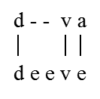
Needleman-Wunch Measure
Generalizes Levenshtein edit distance
Basic idea
defines notion of alignment between x and y
assigns score to alignment
return the alignment with highest score
Alignment: set of correspondences between characters of x and y, allowing for gaps

Slide 14
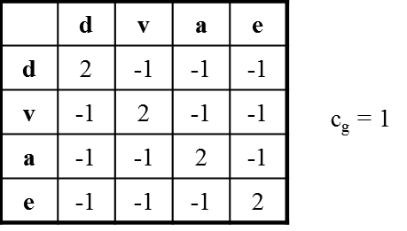
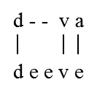
Scoring an Alignment
Use a score matrix and a gap penalty
Example
alignment score = sum of scores of all correspondences - sum of penalties of all mismatches and gaps
e.g., for the above alignment, it is 2 (for d-d) + 2 (for v-v) -1 (for a-e) -2 (for gap) = 1
This is the alignment with the highest score, it is returned as the Needleman-Wunch score for dva and deeve.

Slide 15
Needleman-Wunch Generalizes Levenshtein in Three Ways
Computes similarity scores instead of distance values
Generalizes edit costs into a score matrix
allowing for more fine-grained score modeling
e.g., score(o,0) > score(a,0)
Generalizes insertion and deletion into gaps, and generalizes their costs from 1 to C_{g}

Slide 16
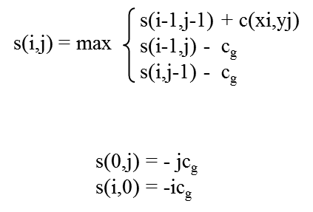
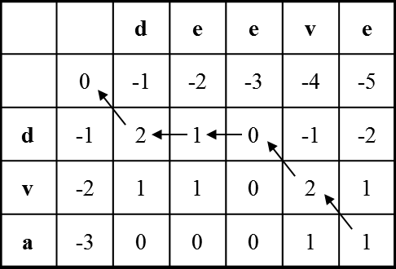

Computing Needleman-Wunch Score with Dynamic Programming

Slide 17
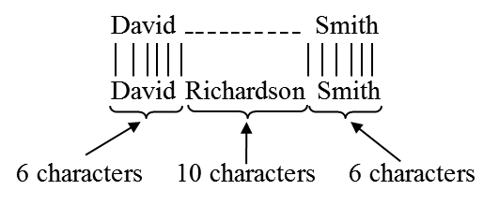
The Affine Gap Measure: Motivation
An extension of Needleman-Wunch that handles longer gap more gracefully
E.g., “David Smith” vs. “David R. Smith”
Needleman-Wunch well suited here
opens gap of length 2 right after “David”
E.g.,
Needlement-Wunch not well suited here, gap cost is too high
If each char corrspondence has score 2, c_{g} = 1, then the above has score 6*2 – 10 = 2

Slide 18
The Affine Gap Measure: Solution
In practice, gaps tend to be longer than 1 character
Assigning same penalty to each character unfairly punishes long gaps
Solution: define cost of opening a gap vs. cost of continuing the gap
cost (gap of length k) = c₀ + (k-1)c_{r}
c₀ = cost of opening gap
c_{r} = cost of continuing gap, c₀ > c_{r}
E.g., “David Smith” vs. “David Richardson Smith”
c₀ = 1, c_{r} = 0.5, alignment cost = 6*2 – 1 - 9*0.5 = 6.5

Slide 19
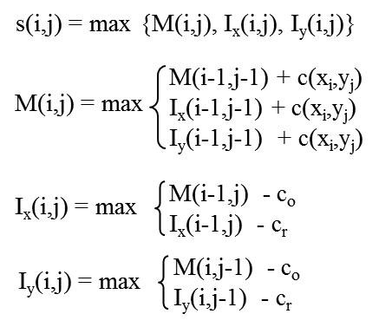
Computing Affine Gap Score using Dynamic Programming
M(i,j)
Best score between x₁…x_{i} and y₁…y_{j} given that x_{i} is aligned with y_{j}
I_{x}(i,j)
Best score given that x_{i} is aligned with a gap
I_{y}(i,j)
Best score given that y_{j} is aligned with a gap
Assumption: insertion not directly followed by deletion
The book shows how these equations are derived

Slide 20
The Smith-Waterman Measure: Motivation
Previous measures consider global alignments
attempt to match all characters of x with all characters of y
Not well suited for some cases
e.g., “Prof. John R. Smith, Univ of Wisconsin” and “John R. Smith, Professor”
similarity score here would be quite low
Better idea: find two substrings of x and y that are most similar
e.g., find “John R. Smith” in the above case ➔ local alignment

Slide 21
The Smith-Waterman Measure
Find the best local alignment between x and y, and return its score as the score between x and y
Makes two key changes to Needleman-Wunch
allows the match to restart at any position in the strings (no longer limited to just the first position)
if global match dips below 0, then ignore prefix and restart the match
after computing matrix using recurrence equation, retracing the arrows from the largest value in matrix, rather than from lower-right corner
this effectively ignores suffixes if the match they produce is not optimal
retracing ends when we meet a cell with value 0 ➔ start of alignment

Slide 22
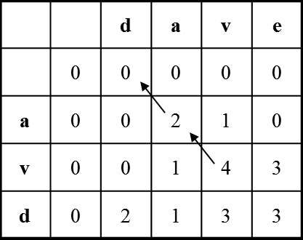
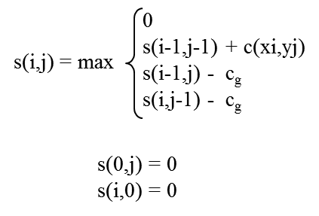
Computing Smith-Waterman Score using Dynamic Programming

Slide 23
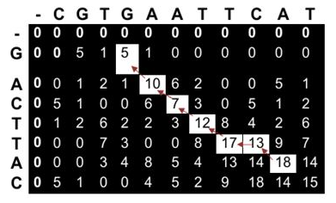
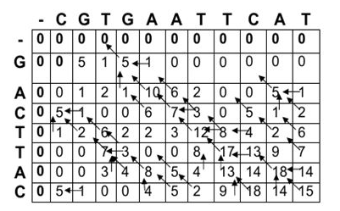
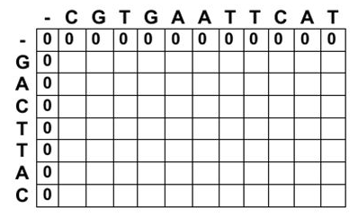

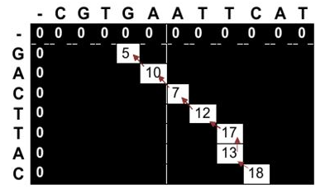


Example 2
Match score = 5
Mismatch score = -3
Gap penalty score = -4
CGTGAATTCAT (sequence#1) GACTTAC (sequence #2)

Slide 24
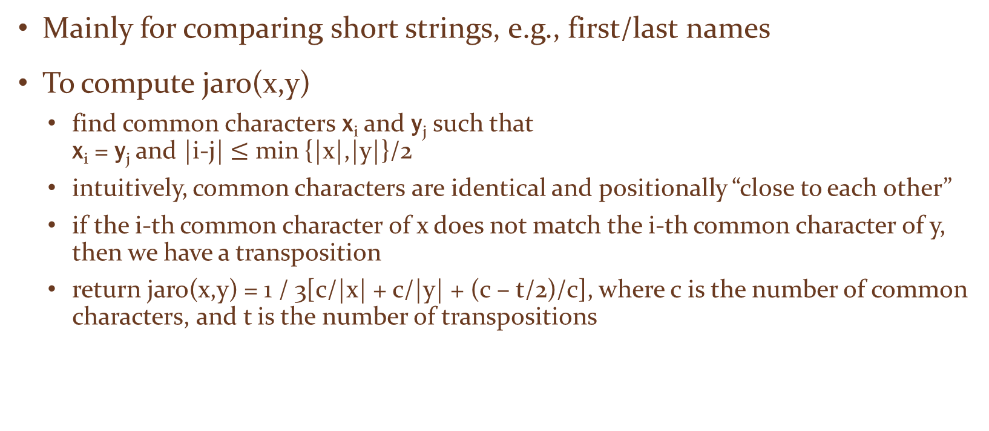
The Jaro Measure
Mainly for comparing short strings, e.g., first/last names
To compute jaro(x,y)
find common characters x_{i} and y_{j} such that x_{i} = y_{j} and |i-j| $≤$ min {|x|,|y|}/2
intuitively, common characters are identical and positionally “close to each other”
if the i-th common character of x does not match the i-th common character of y, then we have a transposition
return jaro(x,y) = 1 / 3[c/|x| + c/|y| + (c – t/2)/c], where c is the number of common characters, and t is the number of transpositions

Slide 25
The Jaro Measure: Examples
x = jon, y = john
c = 3 because the common characters are j, o, and n
t = 0
jaro(x,y) = 1 / 3(3/3 + 3/4 + 3/3) = 0.917
contrast this to 0.75, the sim score of x and y using edit distance
x = jon, y = ojhn
common char sequence in x is jon
common char sequence in y is ojn
t = 2
jaro(x,y) = 0.81

Slide 26
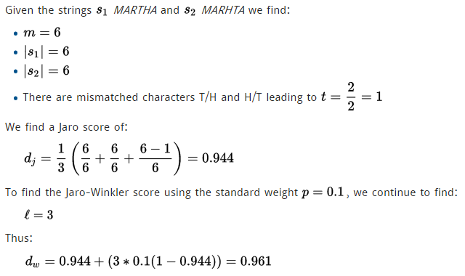
The Jaro-Winkler Measure
Captures cases where x and y have a low Jaro score, but share a prefix ➔ still likely to match
Computed as
jaro-winkler(x,y) = (1 – PL*PW)*jaro(x,y) + PL*PW
PL = length of the longest common prefix
PW is a weight given to the prefix

Slide 27
The Jaccard Measure
J(x,y) = |B_{x} Å B_{y}|/|B_{x} [ B_{y}|
E.g., x = dave, y = dav
B_{x} = {#d, da, av, ve, e#}, B_{y} = {#d, da, av, v#}
J(x,y) = 3/6
Very commonly used in practice

Slide 28
The TF/IDF Measure: Motivation
uses the TF/IDF notion commonly used in IR
two strings are similar if they share distinguishing terms
e.g., x = Apple Corporation, CA y = IBM Corporation, CA z = Apple Corp
s(x,y) > s(x,z) using edit distance or Jaccard measure, so x is matched with y ➔ incorrect
TF/IDF measure can recognize that Apple is a distinguishing term, whereas Corporation and CA are far more common ➔ correctly match x with z

Slide 29
Term Frequencies and Inverse Document Frequencies
Assume x and y are taken from a collection of strings
Each string is coverted into a bag of terms called a document
Define term frequency tf(t,d) = number of times term t appears in document d
Define inverse document frequency idf(t) = N / N_{d}, number of documents in collection devided by number of documents that contain t
note: in practice, idf(t) is often defined as log(N / N_{d}), here we will use the above simple formula to define idf(t)

Slide 30
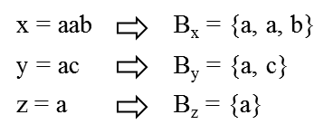
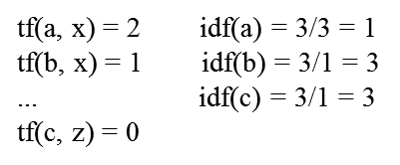
Example

Slide 31
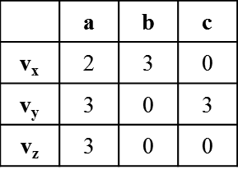
Feature Vectors
Each document d is converted into a feature vector v_{d}
v_{d} has a feature v_{d}(t) for each term t
value of v_{d}(t) is a function of TF and IDF scores
here we assume v_{d}(t) = tf(t,d) * idf(t)
1
1

Slide 32
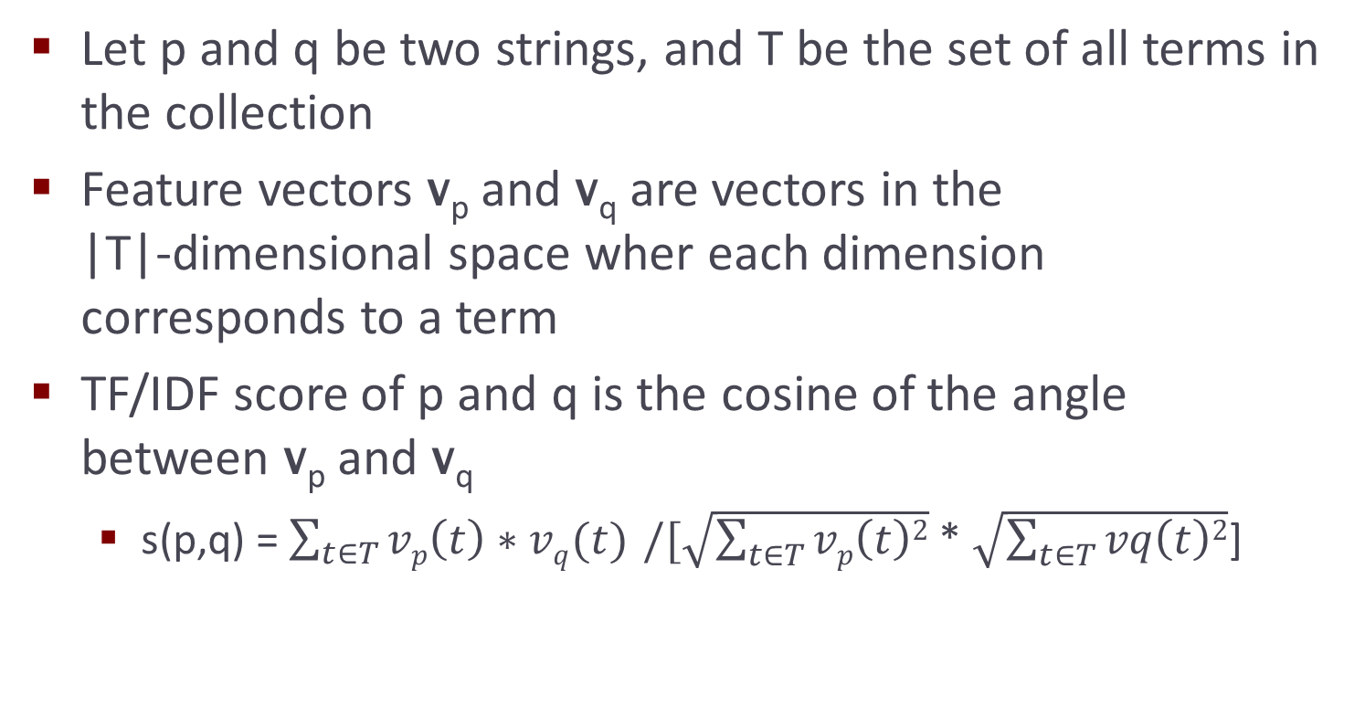
TF/IDF Similarity Score

Slide 33
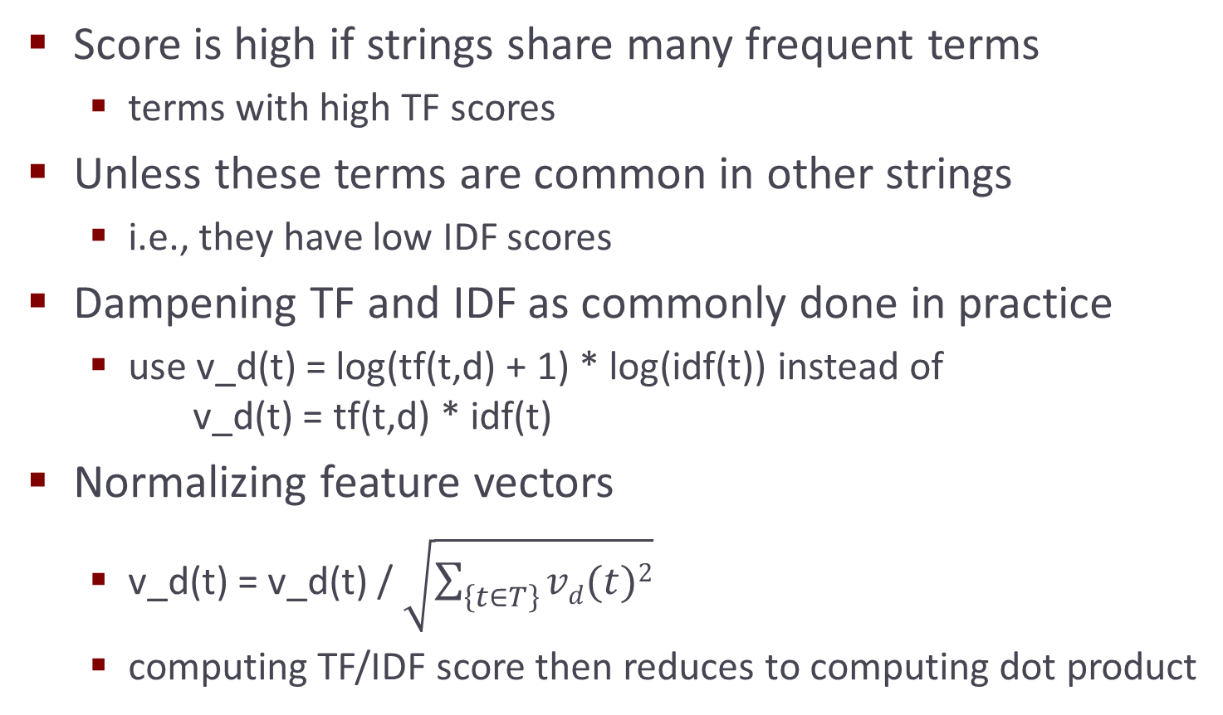
TF/IDF Similarity Score

Slide 34
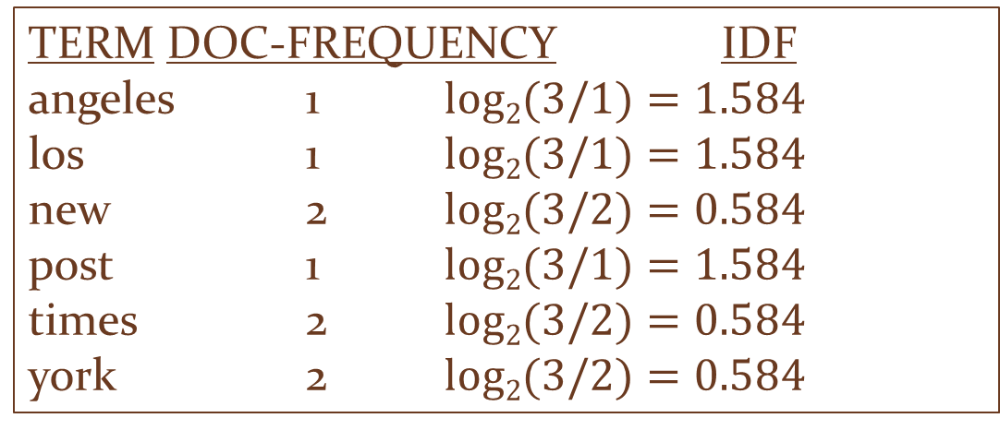
Example: Document Vector
d1: “new york times”
d2: “new york post”
d3: “los angeles times”
3 documents
Inverse document frequency
TERM DOC-FREQUENCY IDF
angeles 1 $log2(3/1)=1.584$
los 1 $log2(3/1)=1.584$
new 2 $log2(3/2)=0.584$
post 1 $log2(3/1)=1.584$
times 2 $log2(3/2)=0.584$
york 2 $log2(3/2)=0.584$
Notes:
Now that we have created the term frequency matrix, which we call tf in short, we will create a new vector called the inverse document frequency for each term.
**********
The number of documents N is 3. The term “new” occurs twice in the collection is 2. So, the inverse document frequency or idf of the term “new” is log2(N/term-count), i.e., log2(3/2) = 0.584. We show the idf score for all 6 terms here.
**********
Let’s understand this number one more time. The document frequency of a term is the count of the term in the whole collection divided by the number of documents. That is the document frequency of a term. Here, we take the inverse of the document frequency so that N, the number of documents, is in the numerator.
**********

Slide 35
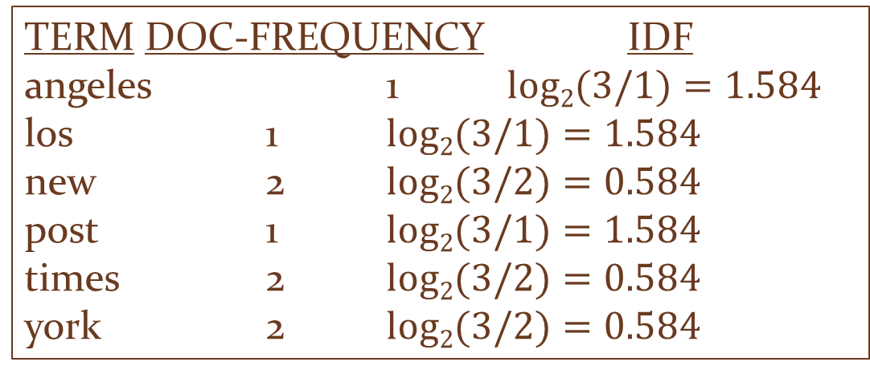
Example: The tf-idf matrix
TERM DOC-FREQUENCY IDF
angeles 1 $log2(3/1)=1.584$
los 1 $log2(3/1)=1.584$
new 2 $log2(3/2)=0.584$
post 1 $log2(3/1)=1.584$
times 2 $log2(3/2)=0.584$
york 2 $log2(3/2)=0.584$
 | angeles | los | new | post | times | york
d1 | 0 | 0 | 1 | 0 | 1 | 1
d2 | 0 | 0 | 1 | 1 | 0 | 1
d3 | 1 | 1 | 0 | 0 | 1 | 0
Notes:
Now we will multiply the tf numbers with the idf numbers, giving us this.
*********

Slide 36
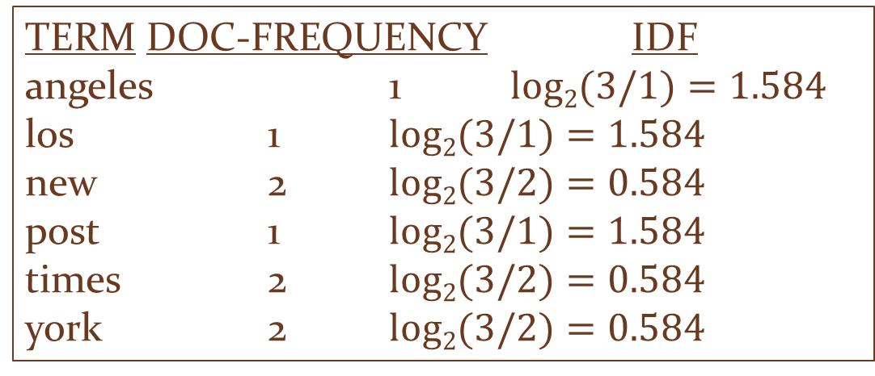
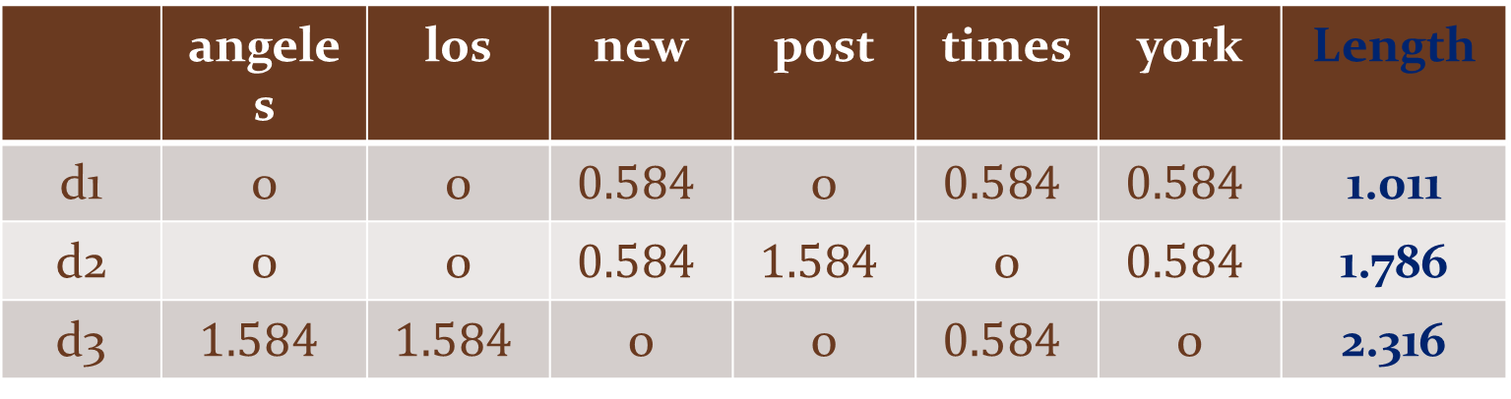
The tf-idf matrix
TERM DOC-FREQUENCY IDF
angeles 1 $log2(3/1)=1.584$
los 1 $log2(3/1)=1.584$
new 2 $log2(3/2)=0.584$
post 1 $log2(3/1)=1.584$
times 2 $log2(3/2)=0.584$
york 2 $log2(3/2)=0.584$
 | angeles | los | new | post | times | york | Length
d1 | 0 | 0 | $$0.584$$ | 0 | $$0.584$$ | $$0.584$$ | 1.011
d2 | 0 | 0 | $$0.584$$ | $$1.584$$ | 0 | $$0.584$$ | 1.786
d3 | $$1.584$$ | $$1.584$$ | 0 | 0 | $$0.584$$ | 0 | 2.316
Length of d1 = sqrt(0.584^2+0.584^2+0.584^2)=1.011
Notes:
Now we will perform a columnwise multiplication of the tf numbers with the idf numbers, giving us this tf-idf matrix. Thus for each document, we have a vector, represented here as a row
*********
representing the relative importance of each term in the vocabulary, i.e., the collection of all words that appear in the collection. So, if the vocabulary has 3 million entries, then the vector can get quite long. Also, if the number of documents grows to, say, 1 billion, this becomes a big data problem. The last column after each document vector is the “length” of the document vector
**********
which is really the square root of the sum of squares of the individual term scores, as shown in the formula.
**********

Slide 37
Searching in Vector Space
query
q: new new york
Max frequency of a term (“new”) = 2
Create the query vector
Q [0 0 (2/2)*0.584=0.584 0 (1/2)*0.584=0.292 0 ] length(q)=0.652
Notes:
To perform a search in the vector space, we write a query just like we type in terms in Google. Here the number of terms is 3, out of which the term “new” appears 2 times. In fact, this is the maximum frequency out of all terms in the query. So we take the document vector of the query and multiply each term by the number of occurrences, divided by 2, the maximum term frequency. In this case it gives us two non-zero terms, 0,584 and 0.292. Now, we compute the length of the query vector just like we did for the document vectors in the previous slide. Next, we will compute the similarity between the query vector and each document with the idea that we will measure how “far” the query vector is from each document.
**********

Slide 38
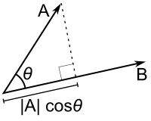
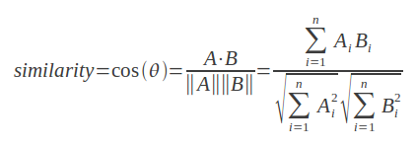
Similarity Function
Many possible functions
Cosine distance
cos (d1,q) = (0.584*0.584+0.584*0.292) / (1.011*0.652) = 0.776
cos (d2,q) = (0.584*0.584) / (1.786*0.652) = 0.292
cos (d3,q) = (0.584*0.292) / (2.316*0.652) = 0.112
Documents can now be sorted according to this score
Notes:
There are many similarity functions defined and used for different purposes. A popular similarity measure is the cosine function, which measures the cosine function of the “angle” between the two vectors. The mathematical formula for computing the function is given here. The intuition is that if the vectors are identical, then the angle between them is 0 and the cosine function evaluates to 1. If they are further apart, the angle increases and so does the value of the cosine function. The way of compute the function is to multiply the corresponding elements of the two vectors, i.e., the first element of one with the first element of the other etc., and sum of these products. This sum is then divided by product of the document length and the query length that we computed earlier. Look at the result of the distance function, and notice that document 1 is much more similar to the query than the others.
**********

Slide 39
Query Term Weighting
Every query term may optionally be associated with a weighting term
Q= York times^2 post^5
wt(York) = 1/(1+5+2)=1/8= 0.125
wt(times) = 2/8 = 0.25
wt(post)= 5/8 = 0.625
Multiply the query vector with these weights
“new york post” ranks first
Notes:
While the similarity scoring and the document ranking process works effectively, the method is a little cut and dry. More often than not, users would like a little more control over the ranking of terms. One way of accomplishing this is to put different weights on each query term. In this example, the query term “York” has the default weight of 1, times has a weight of 2 and post has a weight of 5. So, relatively speaking, York has a weight of 1/ (1+5+2) = 0.125, times has a weight of 0.25 and post has a weight of 0.625. Now the scoring method we showed before will change a bit. The query vector and its length are computed as before. However, now each term in the query vector is further multiplied by these relative weights. In our case, the term York now has a much higher weight. As expected, this will change the ranking of the documents and new York pos will have the highest rank.
**********

Slide 40
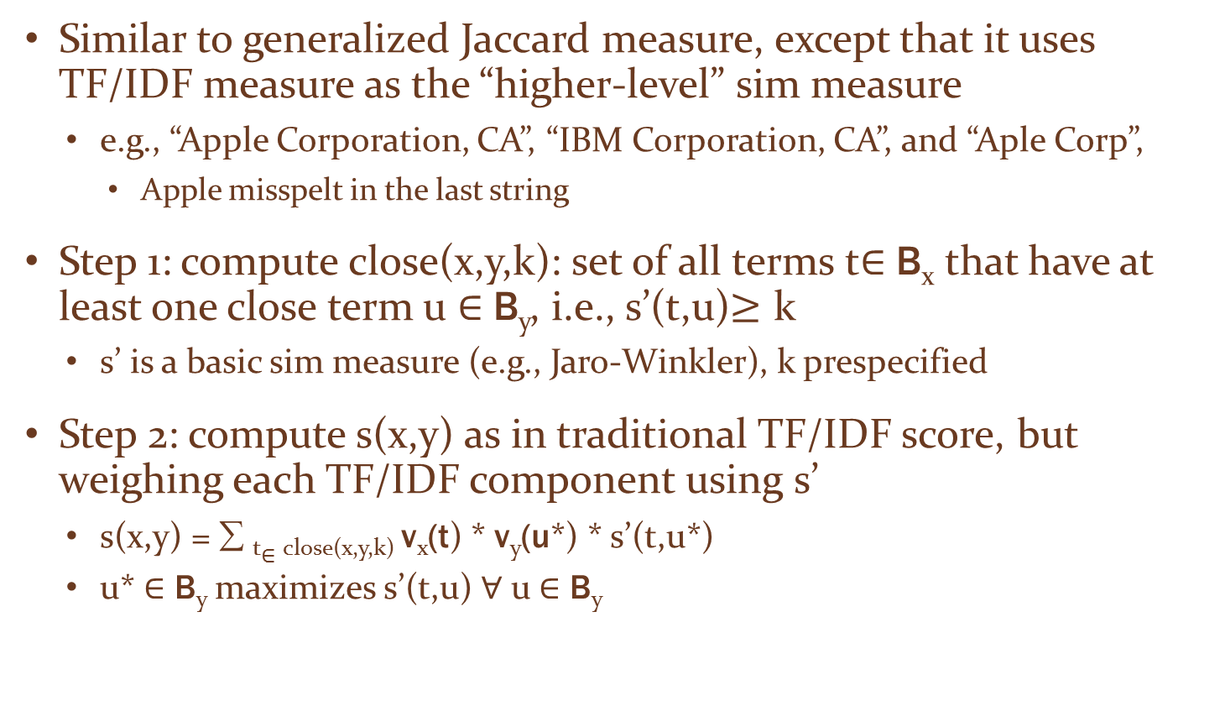
The Soft TF/IDF Measure
Similar to generalized Jaccard measure, except that it uses TF/IDF measure as the “higher-level” sim measure
e.g., “Apple Corporation, CA”, “IBM Corporation, CA”, and “Aple Corp”,
Apple misspelt in the last string
Step 1: compute close(x,y,k): set of all terms t$∈$ B_{x} that have at least one close term u $∈$ B_{y}, i.e., s’(t,u)$≥$ k
s’ is a basic sim measure (e.g., Jaro-Winkler), k prespecified
Step 2: compute s(x,y) as in traditional TF/IDF score, but weighing each TF/IDF component using s’
s(x,y) = ∑ _{t}$∈$ _{close(x,y,k)} v_{x}(t) * v_{y}(u*) * s’(t,u*)
u* $∈$ B_{y} maximizes s’(t,u) $∀$ u $∈$ B_{y}

Slide 41
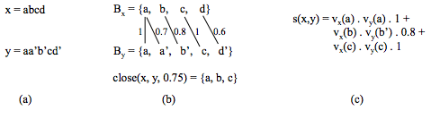
An Example

Slide 42
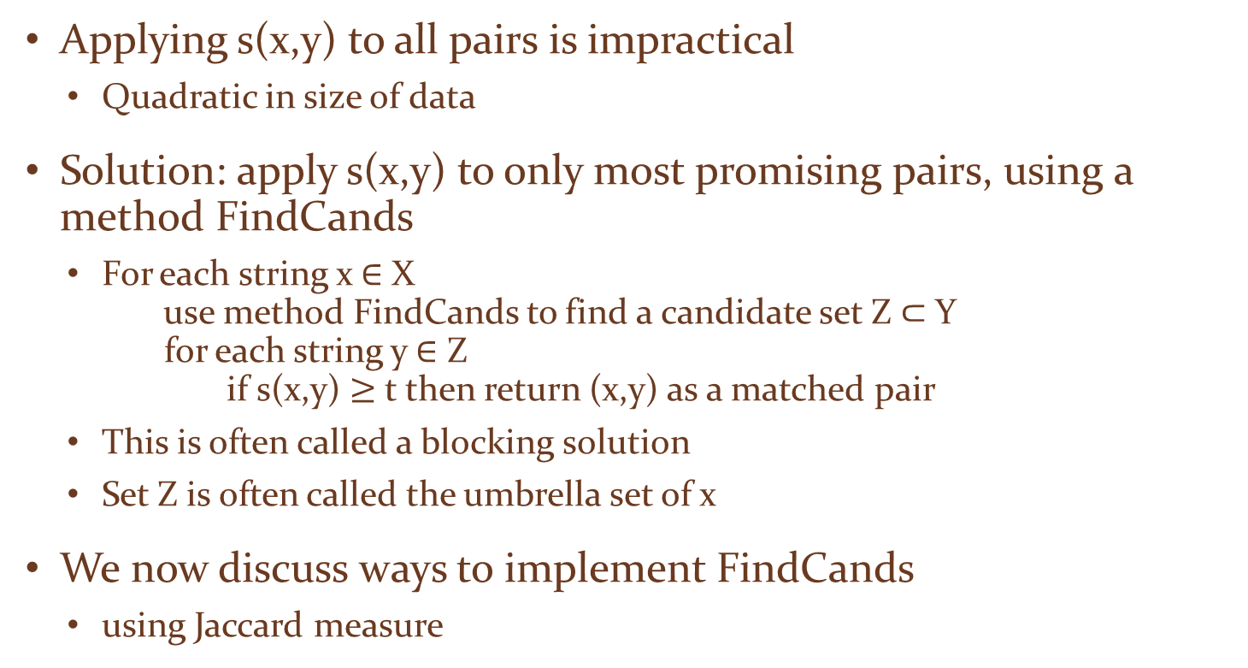
Scalability Challenges
Applying s(x,y) to all pairs is impractical
Quadratic in size of data
Solution: apply s(x,y) to only most promising pairs, using a method FindCands
For each string x $∈$ X use method FindCands to find a candidate set Z $⊂$ Y for each string y $∈$ Z if s(x,y) $≥$ t then return (x,y) as a matched pair
This is often called a blocking solution
Set Z is often called the umbrella set of x
We now discuss ways to implement FindCands
using Jaccard measure

Slide 43

Inverted Index over Strings
Converts each string y$∈$ Y into a document, builds an inverted index over these documents
Given term t, use the index to quickly find documents of Y that contain t

Slide 44
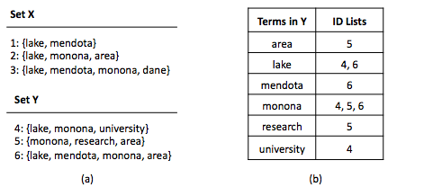
Example

Slide 45
Limitations
The inverted list of some terms (e.g., stop words) can be very long ➔ costly to build and manipulate such lists
Requires enumerating all pairs of strings that share at least one term. This set can still be very large in practice.

Slide 46
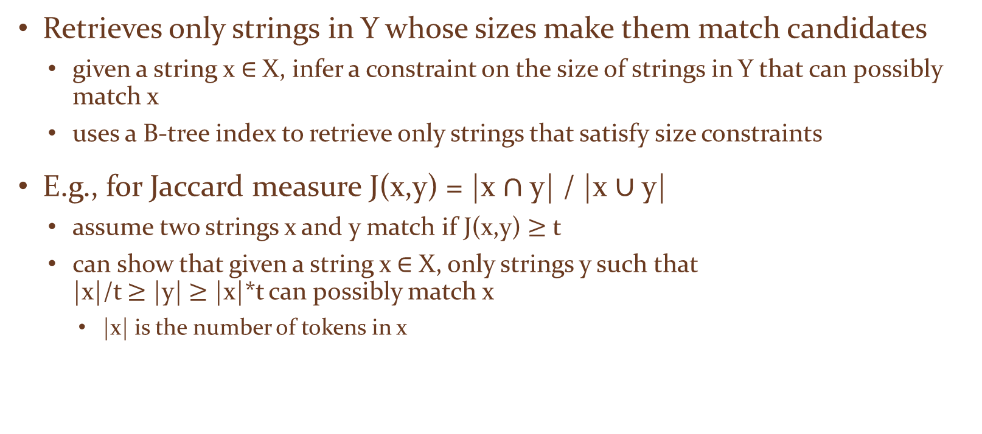
Size Filtering
Retrieves only strings in Y whose sizes make them match candidates
given a string x $∈$ X, infer a constraint on the size of strings in Y that can possibly match x
uses a B-tree index to retrieve only strings that satisfy size constraints
E.g., for Jaccard measure J(x,y) = |x $∩$ y| / |x $∪$ y|
assume two strings x and y match if J(x,y) $≥$ t
can show that given a string x $∈$ X, only strings y such that |x|/t $≥$ |y| $≥$ |x|*t can possibly match x
|x| is the number of tokens in x

Slide 47
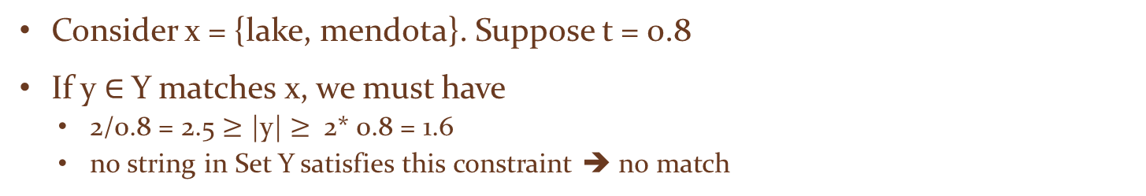
Example
Consider x = {lake, mendota}. Suppose t = 0.8
If y $∈$ Y matches x, we must have
2/0.8 = 2.5 $≥$ |y| $≥$ 2* 0.8 = 1.6
no string in Set Y satisfies this constraint ➔ no match

Slide 48
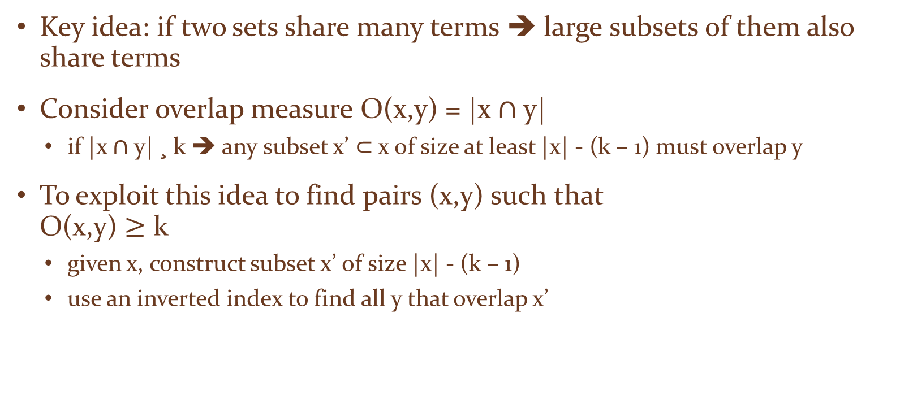
Prefix Filtering
Key idea: if two sets share many terms ➔ large subsets of them also share terms
Consider overlap measure O(x,y) = |x $∩$ y|
if |x $∩$ y| ¸ k ➔ any subset x’ $⊂$ x of size at least |x| - (k – 1) must overlap y
To exploit this idea to find pairs (x,y) such that O(x,y) $≥$ k
given x, construct subset x’ of size |x| - (k – 1)
use an inverted index to find all y that overlap x’

Slide 49
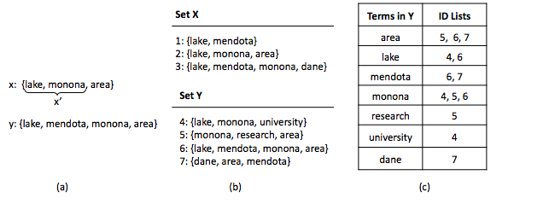
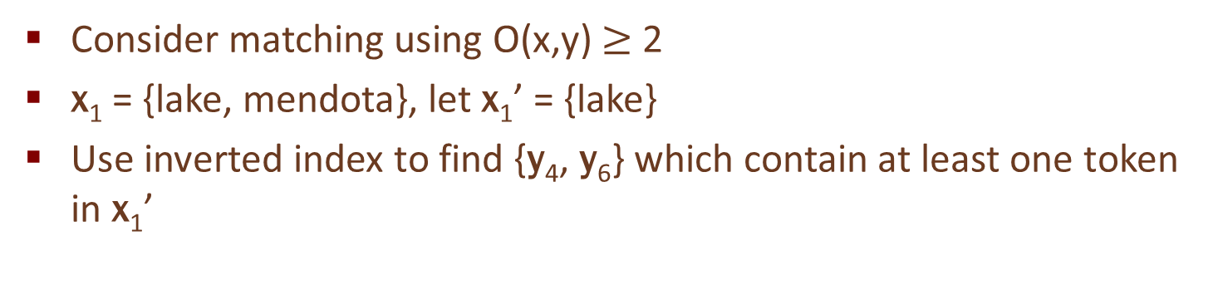
Example
Consider matching using O(x,y) $≥$ 2
x₁ = {lake, mendota}, let x₁’ = {lake}
Use inverted index to find {y₄, y₆} which contain at least one token in x₁’

Slide 50
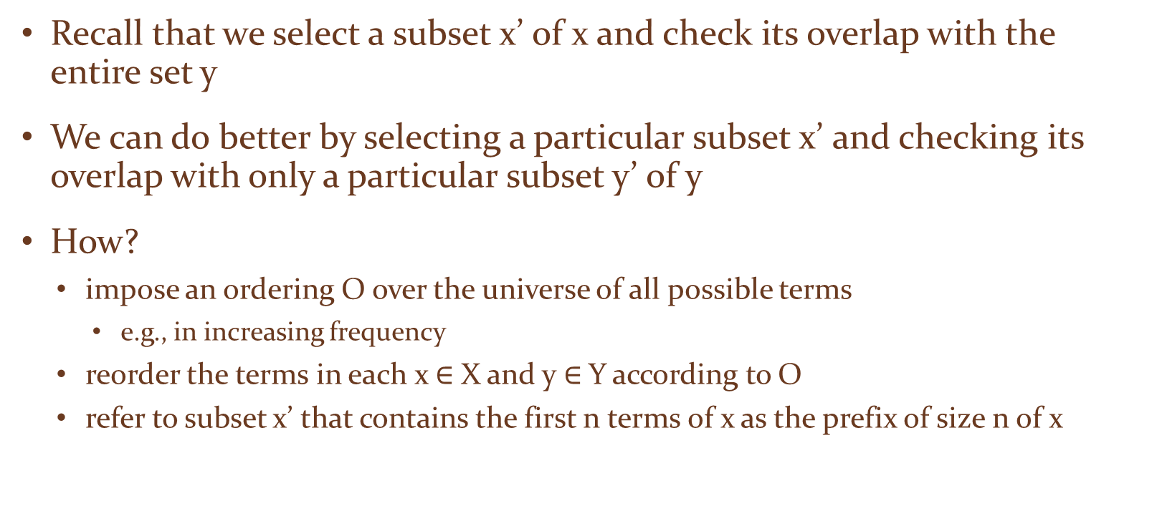
Selecting the Subset Intelligently
Recall that we select a subset x’ of x and check its overlap with the entire set y
We can do better by selecting a particular subset x’ and checking its overlap with only a particular subset y’ of y
How?
impose an ordering O over the universe of all possible terms
e.g., in increasing frequency
reorder the terms in each x $∈$ X and y $∈$ Y according to O
refer to subset x’ that contains the first n terms of x as the prefix of size n of x

Slide 51
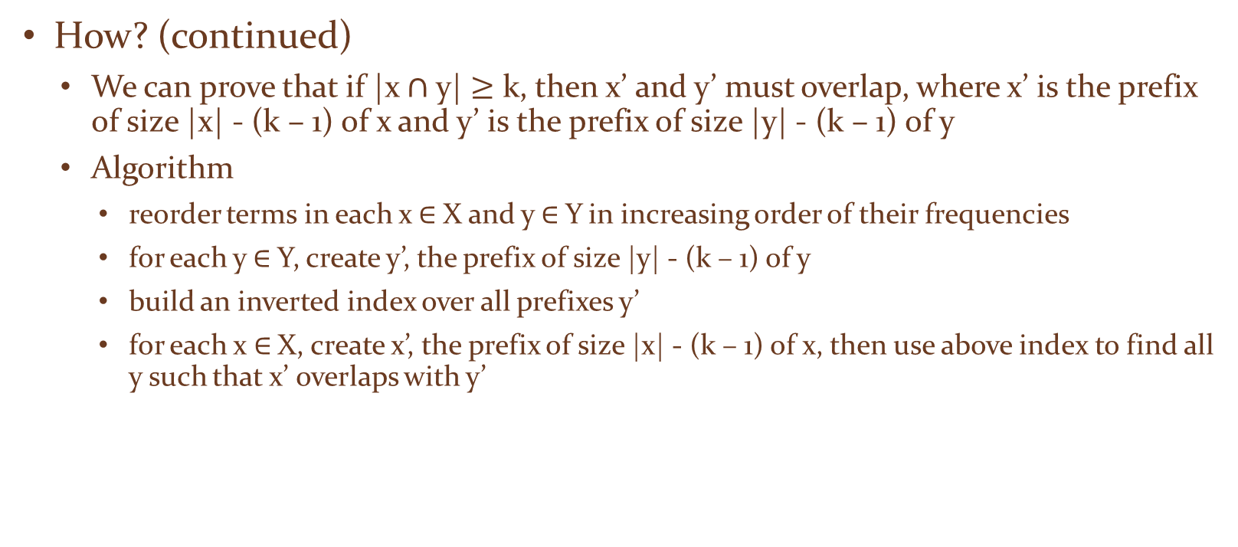
Selecting the Subset Intelligently
How? (continued)
We can prove that if |x $∩$ y| $≥$ k, then x’ and y’ must overlap, where x’ is the prefix of size |x| - (k – 1) of x and y’ is the prefix of size |y| - (k – 1) of y
Algorithm
reorder terms in each x $∈$ X and y $∈$ Y in increasing order of their frequencies
for each y $∈$ Y, create y’, the prefix of size |y| - (k – 1) of y
build an inverted index over all prefixes y’
for each x $∈$ X, create x’, the prefix of size |x| - (k – 1) of x, then use above index to find all y such that x’ overlaps with y’

Slide 52
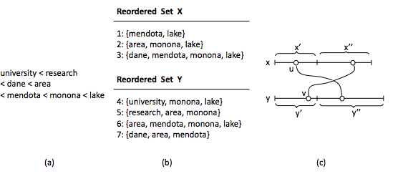
Example
x = {mendota, lake} ➔ x’ = {mendota}

Slide 53
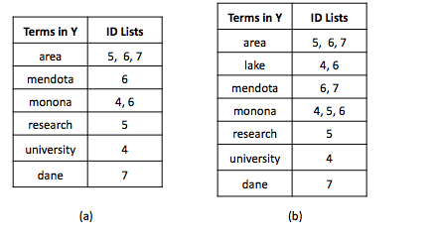
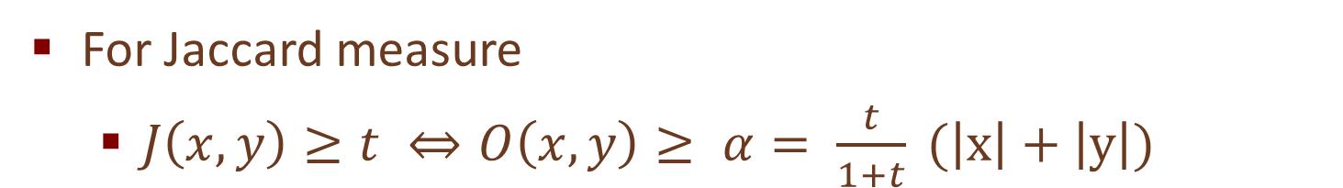
Example
For Jaccard measure
$J\left(x,y\right)≥t ⇔O\left(x,y\right)≥ α= \frac{t}{1+t} (\left|x\right|+\left|y\right|)$

Slide 54
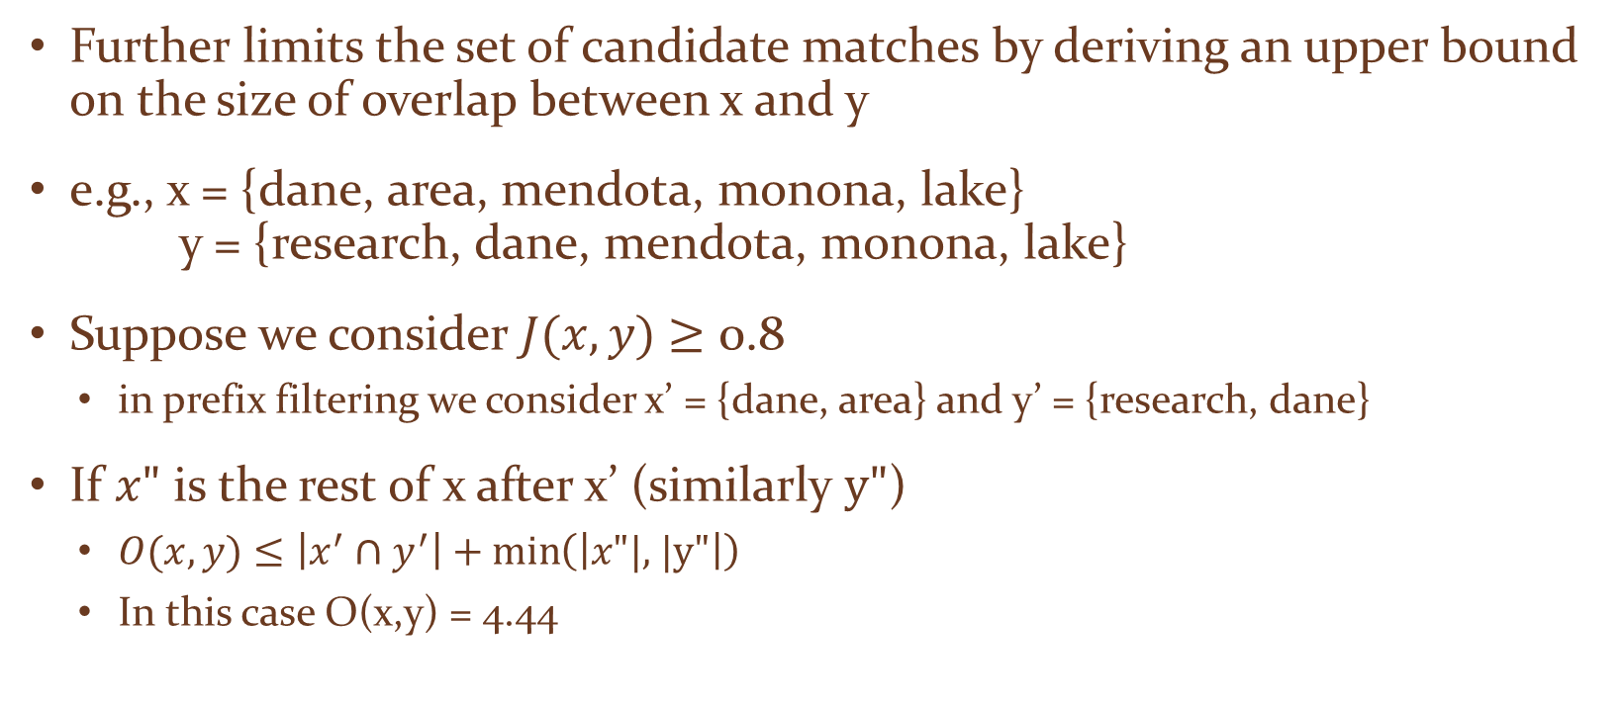
Position Filtering
Further limits the set of candidate matches by deriving an upper bound on the size of overlap between x and y
e.g., x = {dane, area, mendota, monona, lake} y = {research, dane, mendota, monona, lake}
Suppose we consider $J(x,y)$ $≥$ 0.8
in prefix filtering we consider x’ = {dane, area} and y’ = {research, dane}
If $x\text{"}$ is the rest of x after x’ (similarly $\text{y}\text{"}$)
$O(x,y)$ $≤\left|x^{′}∩y^{′}\right|+\min\left(\left|x\text{"|, |}\text{y}\text{"}\right|\right)$
In this case O(x,y) = 4.44

Slide 55
Tuple Matching
Problem definition
Rule-based matching
Learning- based matching
Matching by clustering
Probabilistic approaches to matching
Collective matching
Scaling up data matching

Slide 56
Rule-based Matching
The developer writes rules that specify when two tuples match
typically after examining many matching and non-matching tuple pairs, using a development set of tuple pairs
rules are then tested and refined, using the same development set or a test set
Many types of rules exist
linearly weighted combination of individual similarity scores
logistic regression combination
more complex rules

Slide 57
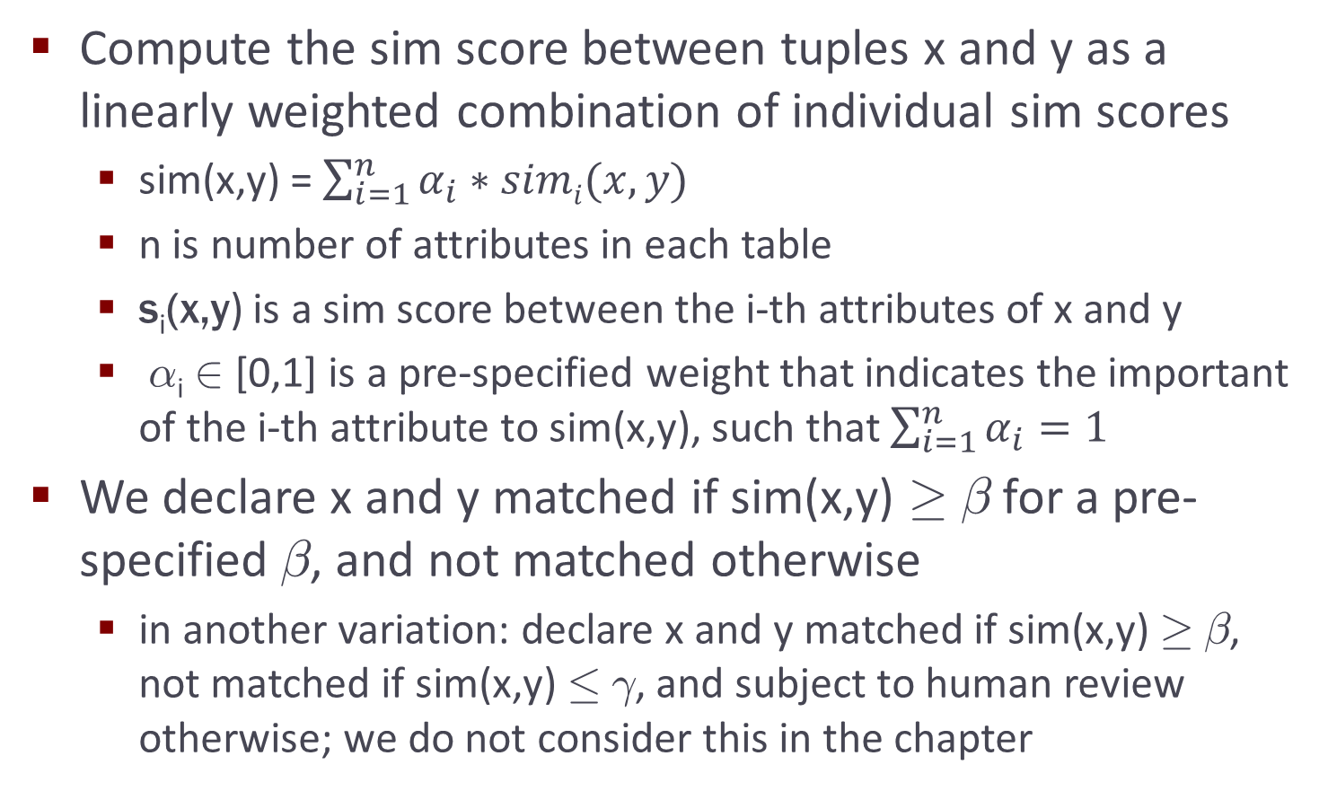
Linearly Weighted Combination Rules

Slide 58
Example
sim(x,y) = 0.3s_{name}(x,y) + 0.3s_{phone}(x,y) + 0.1s_{city}(x,y) + 0.3s_{state}(x,y)
s_{name}(x,y): based on Jaro-Winkler
s_{phone}(x,y): based on edit distance between x’s phone (after removing area code) and y’s phone
s_{city}(x,y): based on edit distance
s_{state}(x,y): based on exact match; yes ➔ 1, no ➔ 0

Slide 59

Pros and Cons
Pros
conceptually simple, easy to implement
can learn weights $αi$ from training data
Cons
an increase $δ$ in the value of any s_{i} will cause a linear increase $αi$ * $δ$ in the value of s
in certain scenarios this is not desirable,
after a certain threshold, an increase in s_{i} should count less (i.e., “diminishing returns” should kick in)
e.g., if s_{name}(x,y) is already 0.95 then the two names already very closely match
so any increase in s_{name}(x,y) should contribute only minimally

Slide 60


Logistic Regression Rules

Slide 61
Logistic Regression Rules
Are also very useful in situations where
there are many “signals” (e.g., 10-20) that can contribute to whether two tuples match
we don’t need all of these signals to “fire” in order to conclude that the tuples match
as long as a reasonable number of them fire, we have sufficient confidence
Logistic regression is a natural fit for such cases
Hence is quite popular as a first matching method to try

Slide 62
More Complex Rules
Appropriate when we want to encode more complex matching knowledge
e.g., two persons match if names match approximately and either phones match exactly or addresses match exactly
If s_{name}(x,y) < 0.8 then return “not matched”
Otherwise if e_{phone}(x,y) = true then return “matched”
Otherwise if e_{city}(x,y) = true and e_{state}(x,y) = true then return “matched”
Otherwise return “not matched”

Slide 63
Pros and Cons of Rule-Based Approaches
Pros
easy to start, conceptually relatively easy to understand, implement, debug
typically run fast
can encode complex matching knowledge
Cons
can be labor intensive, it takes a lot of time to write good rules
can be difficult to set appropriate weights
in certain cases it is not even clear how to write rules
learning-based approaches address these issues

Slide 64
Learning-based Matching
Here we consider supervised learning
learn a matching model M from training data, then apply M to match new tuple pairs
will consider unsupervised learning later
Learning a matching model M (the training phase)
start with training data: T = {(x₁,y₁,l₁), … (x_{n},y_{n},l_{n})}, where each (x_{i},y_{i}) is a tuple pair and l_{i} is a label: “yes” if x_{i} matches y_{i} and “no” otherwise
define a set of features f₁, …, f_{m}, each quantifying one aspect of the domain judged possibly relevant to matching the tuples

Slide 65
Learning-based Matching
Learning a matching model M (continued)
convert each training example (x_{i},y_{i},l_{i}) in T to a pair (<f₁(x_{i},y_{i}), …, f_{m}(x_{i},y_{i})>, c_{i})
v_{i} = <f₁(x_{i},y_{i}), …, f_{m}(x_{i},y_{i})> is a feature vector that encodes (x_{i},y_{i}) in terms of the features
c_{i} is an appropriately transformed version of label l_i (e.g., yes/no or 1/0, depending on what matching model we want to learn)
thus T is transformed into T’ = {(v₁,c₁), …, (v_{n},c_{n})}
apply a learning algorithm (e.g. decision trees, SVMs) to T’ to learn a matching model M

Slide 66
Learning-based Matching
Applying model M to match new tuple pairs
given pair (x,y), transform it into a feature vector
v = <f₁(x,y), …, f_{m}(x,y)>
apply M to v to predict whether x matches y

Slide 67


Example: Learning a Linearly Weighted Rule
s₁ and s₂ use Jaro-Winkler and edit distance
s₃ uses edit distance (ignoring area code of a)
s₄ and s₅ return 1 if exact match, 0 otherwise
s₆ encodes a heuristic constraint

Slide 68


Example: Learning a Linearly Weighted Rule

Slide 69


Example: Learning a Decision Tree
Now the labels are yes/no, not 1/0

Slide 70
The Pros and Cons of Learning-based Approach
Pros compared to rule-based approaches
in rule-based approaches must manually decide if a particular feature is useful ➔ labor intensive and limit the number of features we can consider
learning-based ones can automatically examine a large number of features
learning-based approaches can construct very complex “rules”
Cons
still require training examples, in many cases a large number of them, which can be hard to obtain
clustering addresses this problem

Slide 71
Matching by Clustering
Many common clustering techniques have been used
agglomerative hierarchical clustering (AHC), k-means, graph-theoretic, …
here we focus on AHC, a simple yet very commonly used one
AHC
partitions a given set of tuples D into a set of clusters
all tuples in a cluster refer to the same real-world entity, tuples in different clusters refer to different entities
begins by putting each tuple in D into a single cluster
iteratively merges the two most similar clusters
stops when a desired number of clusters has been reached, or until the similarity between two closest clusters falls below a pre-specified threshold

Slide 72


Example
sim(x,y) = 0.3s_{name}(x,y) + 0.3s_{phone}(x,y) + 0.1s_{city}(x,y) + 0.3s_{state}(x,y)

Slide 73

Computing a Similarity Score between Two Clusters
Let c and d be two clusters
Single link: s(c,d) = min_{xi}$∈$_{c, yj} $∈$_{d} sim(x_{i}, y_{j})
Complete link: s(c,d) = max_{xi} $∈$_{c, yj} $∈$_{d} sim(x_{i}, y_{j})
Average link: s(c,d) = [∑_{xi} $∈$_{c, yj} $∈$_{d} sim(x_{i}, y_{j})] / [# of (x_{i},y_{j}) pairs]
Canonical tuple
create a canonical tuple that represents each cluster
sim between c and d is the sim between their canonical tuples
canonical tuple is created from attribute values of the tuples
e.g., “Mike Williams” and “M. J. Williams” ➔ “Mike J. Williams”
(425) 247 4893 and 247 4893 ➔ (425) 247 4893

Slide 74
Key Ideas underlying the Clustering Approach
View matching tuples as the problem of constructing entities (i.e., clusters)
The process is iterative
leverage what we have known so far to build “better” entities
In each iteration merge all matching tuples within a cluster to build an “entity profile”, then use it to match other tuples ➔ merging then exploiting the merged information to help matching
These same ideas appear in subsequent approaches that we will cover

Slide 75
Collective Matching
Matching approaches discussed so far make independent matching decisions
decide whether a and b match independently of whether any two other tuples c and d match
Matching decisions hower are often correlated
exploiting such correlations can improve matching accuracy

Slide 76


An Example
Goal: match authors of the four papers listed above
Solution
extract their names to create the table above
apply current approaches to match tuples in table
This fails to exploit co-author relationships in the data

Slide 77




An Example (cont.)
nodes = authors, hyperedges connect co-authors
Suppose we have matched a₃ and a₅
then intuitively a₁ and a₄ should be more likely to match
they share the same name and same co-author relationship to the same author

Slide 78
An Example (cont.)
First solution:
add coAuthors attribute to the tuples
e.g., tuple a_1 has coAuthors = {C. Chen, A. Ansari}
tuple a_4 has coAuthors = {A. Ansari}
apply current methods, use say Jaccard measure for coAuthors

Slide 79
An Example (cont.)
Problem:
suppose a₃: A. Ansari and a₅: A. Ansari share same name but do not match
we would match them, and incorrectly boost score of a₁ and a₄
How to fix this?
match a₃ and a₅, then use that info to help match a₁ and a₄; do the opposite
so should match tuples collectively, all at once and iteratively

Slide 80
Collective Matching using Clustering
Many collective matching approaches exist
clustering-based, probabilistic, etc.
Clustering-based method
Assume input is graph
nodes = tuples to be matched
edges = relationships among tuples

Slide 81

Collective Matching using Clustering
To match, perform agglomerative hierarchical clustering
but modify sim measure to consider correlations among tuples
Let A and B be two clusters of nodes, define
sim(A,B) =$α$* sim_{attributes}(A,B) + (1- $α$) * sim_{neighbors}(A,B)
$α$ is pre-defined weight
sim_{attributes}(A,B) uses only attributes of A and B, examples of such scores are single link, complete link, average link, etc.
sim_{neighbors}(A,B) considers correlations

Slide 82

An Example of sim_{neighbors}(A,B)
Assume a single relationship R on the graph edges
can generalize to the case of multiple relationships
Let N(A) be the bags of the cluster IDs of all nodes that are in relationship R with some node in A
e.g., cluster A has two nodes a and a’, a is in relationship R with node b with cluster ID 3, and a’ is in relationship R with node b’ with cluster ID 3 and another node b’’ with cluster ID 5 ➔ N(A) = {3, 3, 5}
Define sim_{neighbors}(A,B) = Jaccard(N(A),N(B)) = |N(A) $∩$ N(B)| / |N(A) $∪$ N(B)|

Slide 83

An Example of sim_{neighbors}(A,B)
Recall that earlier we also define a Jaccard measure as
JaccardSim_{coAuthors}(a,b) = |coAuthors(a) $∩$ coAuthors(b)| / |coAuthors(a) $∪$coAuthors(b)|
Contrast that to
sim_{neighbors}(A,B) = Jaccard(N(A),N(B)) = |N(A) $∩$ N(B)| / |N(A) $∪$ N(B)|
In the former, we assume two co-authors match if their “strings” match
In the latter, two co-authors match only if they have the same cluster ID

Slide 84

An Example to Illustrate the Working of Agglomerative Hierarchical Clustering

Slide 85
Scaling up Rule-based Matching
Two goals: minimize # of tuple pairs to be matched and minimize time it takes to match each pair
For the first goal:
hashing
sorting
indexing
canopies
using representatives
combining the techniques
Hashing
hash tuples into buckets, match only tuples within each bucket
e.g., hash house listings by zipcode, then match within each zip

Slide 86
Scaling up Rule-based Matching
Sorting
use a key to sort tuples, then scan the sorted list and match each tuple with only the previous (w-1) tuples, where w is a pre-specified window size
key should be strongly “discriminative”: brings together tuples that are likely to match, and pushes apart tuples that are not
example keys: soc sec, student ID, last name, soundex value of last name
employs a stronger heuristic than hashing: also requires that tuples likely to match be within a window of size w
but is often faster than hashing because it would match fewer pairs

Slide 87
Scaling up Rule-based Matching
Indexing
index tuples such that given any tuple a, can use the index to quickly locate a relatively small set of tuples that are likely to match a
e.g., inverted index on names
Canopies
use a computationally cheap sim measure to quickly group tuples into overlapping clusters called canopines (or umbrella sets)
use a different (far more expensive) sim measure to match tuples within each canopy
e.g., use TF/IDF to create canopies

Slide 88
Scaling up Rule-based Matching
Using representatives
applied during the matching process
assigns tuples that have been matched into groups such that those within a group match and those across groups do not
create a representative for each group by selecting a tuple in the group or by merging tuples in the group
when considering a new tuple, only match it with the representatives
Combining the techniques
e.g., hash houses into buckets using zip codes, then sort houses within each bucket using street names, then match them using a sliding window

Slide 89
Scaling up Rule-based Matching
For the second goal of minimizing time it takes to match each pair
no well-established technique as yet
tailor depending on the application and the matching approach
e.g., if using a simple rule-based approach that matches individual attributes then combines their scores using weights
can use short circuiting: stop the computation of the sim score if it is already so high that the tuple pair will match even if the remaining attributes do not match

