Slide 1
DSE 203
Day 5: query rewriting for LAV

Slide 2
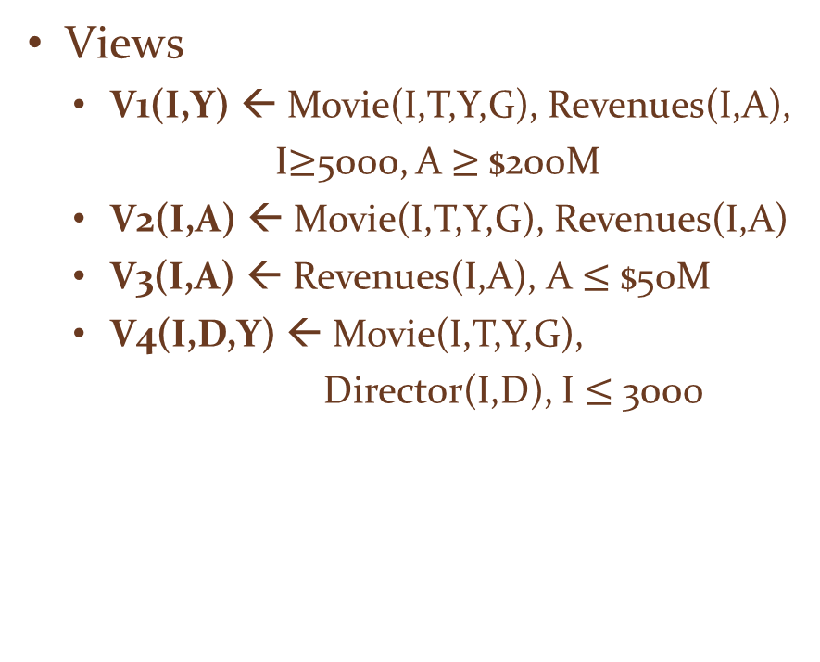
The Bucket Algorithm
Integrated Schema
Movie(ID, title, year, genre)
Director(ID, director)
Actor(ID, actor)
Revenues(ID, amount)
Query against integrated schema
Q(ID, Dir) ← Movie(ID,Title,Year,Genre), Revenues(ID,Amount), Director(ID,Dir), A>$100M
Views
V1(I,Y) ← Movie(I,T,Y,G), Revenues(I,A),
I$≥$5000, A $≥$$200M
V2(I,A) ← Movie(I,T,Y,G), Revenues(I,A)
V3(I,A) ← Revenues(I,A), A $≤$ $50M
V4(I,D,Y) ← Movie(I,T,Y,G),
Director(I,D), I $≤$ 3000

Slide 3
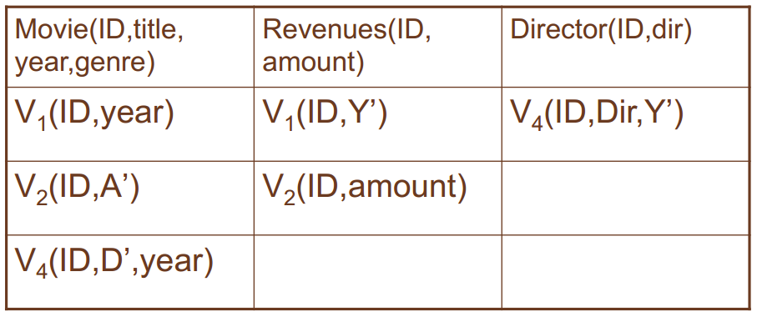
Bucket Formation and Maximally Contained Rewriting
Why not V3(I,A)?
Interpreted predicate
Rewriting 1: q’1 (ID,Dir)← V1(ID,year),V1(ID,Y’),V4(ID,Dir,Y’), A>$100M
Rewriting 2: : q’2 (ID,Dir)← V2(ID,A’), V1(ID,Y’),V4(ID,Dir,Y’), A>$100M
Rewriting 3: q’3 (ID,Dir)← V2(ID,A’), V2(ID, amount), V4(ID,Dir,Y’), A>$100M

Slide 4
The Bucket Algorithm: Summary
Cuts down the number of rewriting that need to be considered, especially if views apply many interpreted predicates
The search space can still be large because the algorithm does not consider the interactions between different subgoals
Interactions
join predicates in the query body
These predicates determine which other subgoals from the view should be used with the view
Addressed by the Minicon Algorithm

Slide 5
MinCon Algorithm Steps
Create MiniCon descriptions (MCDs):
Homomorphism on view heads
Each MCD covers a set of subgoals in the query with a set of subgoals in a view
Combination step:
Any set of MCDs that covers the query subgoals (without overlap) is a rewriting
No need for an additional containment check!

Slide 6
Applying the Minicon Algorithm
Minicon Description
Minimal set of subgoals that should be mapped to subgoals in V given that query subgoal g will be mapped to view subgoal g₁
Query:
Q(Title, Year, Dir) ← Movie(ID, Title, Year, Genre), Director(ID, Dir), Actor(ID,Dir)
Views
V5(D,A) ← Director(I,D), Actor(I,A)
V6(T,Y,D,A) ← Director(I,D), Actor(I,A), Movie(I,T,Y,G)
Try to apply V5
Two query subgoals map to the subgoals of v5. But
The variable I is needed to join the two subgoals of V5
I is not in the head variables of V5
Can’t use V5. Try v6
A→D, V6(T, Y, D, D), Title → T, Year → Y, Dir → D covering all subgoals of a query
MCD: ID → I, Dir → D
Covers subgoals {2, 3} of query

Slide 7
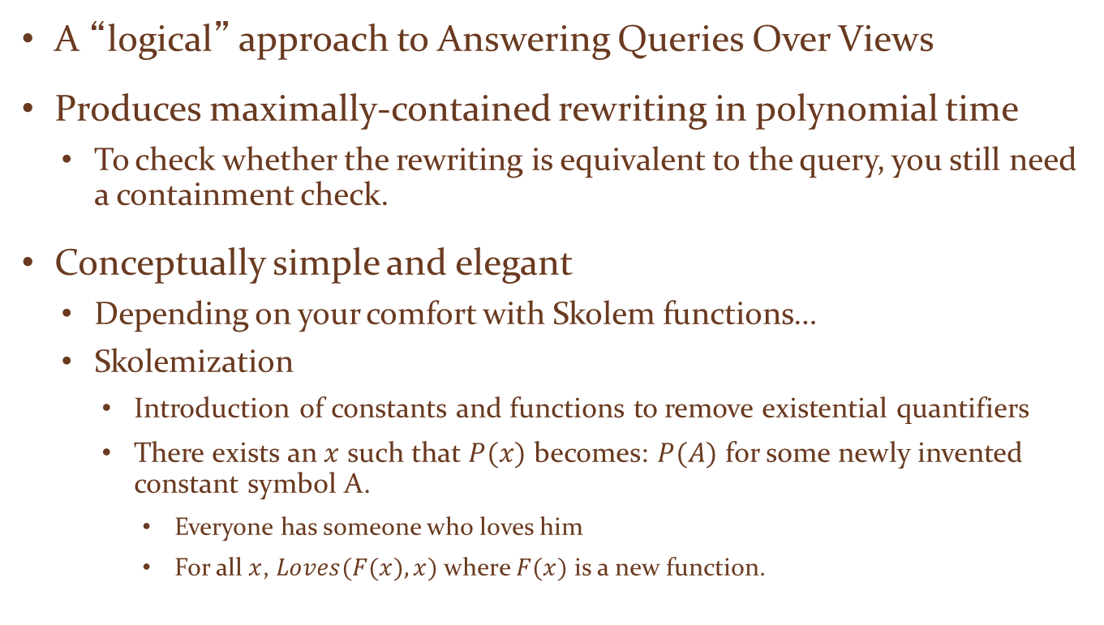
Inverse-Rules Algorithm
A “logical” approach to Answering Queries Over Views
Produces maximally-contained rewriting in polynomial time
To check whether the rewriting is equivalent to the query, you still need a containment check.
Conceptually simple and elegant
Depending on your comfort with Skolem functions…
Skolemization
Introduction of constants and functions to remove existential quantifiers
There exists an $x$ such that $P(x)$ becomes: $P(A)$ for some newly invented constant symbol A.
Everyone has someone who loves him
For all $x$, $Loves(F(x),x)$where $F(x)$ is a new function.

Slide 8
Inverse Rules by Example
Given the following view:
And the following tuple in V₇:
V₇(79,Manhattan,1979,Comedy)
Then we can infer the tuple:
Movie(79,Manhattan,1979,Comedy)
Hence, the following ‘rule’ is sound:
IN₁: Movie(I,T,Y,G) :- V₇(I,T,Y,G)

Slide 9
Using Skolem Functions in Inverse Rules
Now suppose we have the tuple
V₇(79,Manhattan,1979,Comedy)
Then we can infer that there exists some director. Hence, the following rules hold (note that they both use the same Skolem function):
IN₂: Director(I,f₁(I,T,Y,G)):- V₇(I,T,Y,G)
IN₃: Actor(I,f₁(I,T,Y,G)):- V₇(I,T,Y,G)

Slide 10
Inverse Rules in General Rewriting = Inverse Rules + Query
Given Q2, the rewriting would include:
IN₁, IN₂, IN₃, Q₂.
Given input: V₇(79,Manhattan,1979,Comedy)
Inverse rules produce:
Movie(79,Manhattan,1979,Comedy)
Director(79,f₁(79,Manhattan,1979,Comedy))
Actor(79,f₁(79,Manhattan,1979,Comedy))
Movie(Manhattan,1979,Comedy)
(the last tuple is produced by applying Q₂).

Slide 11
Integrity Constraints with LAV
Mediated schema:
Schedule(airline, flightNum, date, pilot, aircraft)
Functional dependencies:
Pilot → Airline and Aircraft → Airline
Data source:
S(date,pilot,aircraft) ⊆
schedule(a,fN,date,pilot,aircraft)
Query: (pilots in same airline as Mike)
q(p) :- schedule(a,fN,date, “Mike”,aircraft)
schedule(a,fN,date,p,aircraft)
Without functional dependencies, no answers!

Slide 12
But We Do Have Answers…
Date | Pilot | Aircraft
1/1 | Mike | 111
5/2 | Ann | 111
1/3 | Ann | 222
4/3 | John | 222
Mike and Ann work for the same airline
111 and 222 belong to the same airline
John and Ann work for the same airline, …

Slide 13
No Limit to Rewriting Size
Does this sound familiar?
Recursive plans to the rescue!

Slide 14
Recursive Plan
Start with inverse rules and get:
But we know that:

Slide 15
The e relation
Let’s define a relation e(X,Y) that stores all pairs that are actually equal.
e(x,x) – holds for every x.
The other rules for inferring e(X,Y) are derived from the functional dependencies.
Add: e(X,Y) :- e(X,Z), e(Z,Y)

Slide 16
The Rules
Aircraft → Airline: So…
Schedule(airline, flightNum, date, pilot, aircraft)
Pilot → Airline: So…

Slide 17
One More Step
Reformulate the query to use e(X,Y):

Slide 18
Integrity Constraints in GAV
Airline | flNum | Date | Pilot | Craft
United | 111 | 1/1 | Mike | 15
SAS | 222 | 1/3 | Ann | 17
flightNum | Origin | Dest
222 | Seattle | SFO
333 | SFO | CPH
q(fn) :- schedule(airline, fN, date, pilot, aircraft)
flight(fN, origin, destination)
111 should be in the answer, but won’t.
How do we get 111?

Slide 19
DSE 203
Day 5: CROSS-MODEL data integration

Slide 20
Model Transformation
Scenario
Source and mediator have different data models
Data transformation from source model to mediator model
Query transformation from mediator’s query language to the source’s query language
We will look at some examples

Slide 21
Case 1: Semi-structured and Relational
Many solutions
Convert relational data to EER representation → convert EER to SS schema → mediator queries SS schema
Create relational view of SS data → transform SS query to relational query against the view ← write source’s relational schema to the SS view
Create an SSQuery (XQuery, SQL++, …) to SQL converter → package the results into an SS document
Create SS view of relational data → rewrite SS queries to queries against the views → transform these queries into SQL → compose results into SS
…

Slide 22
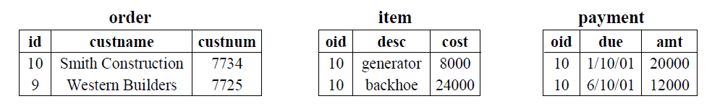
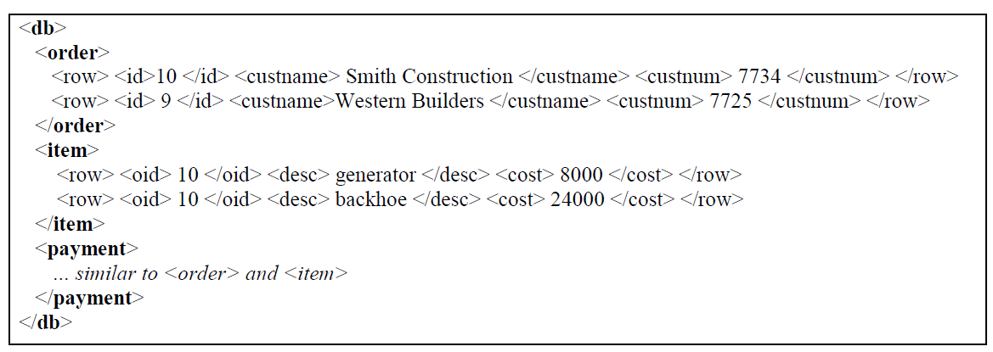
The XPERANTO Approach (IBM Almaden)
A simple purchase order database – relational and its default XML view

Slide 23
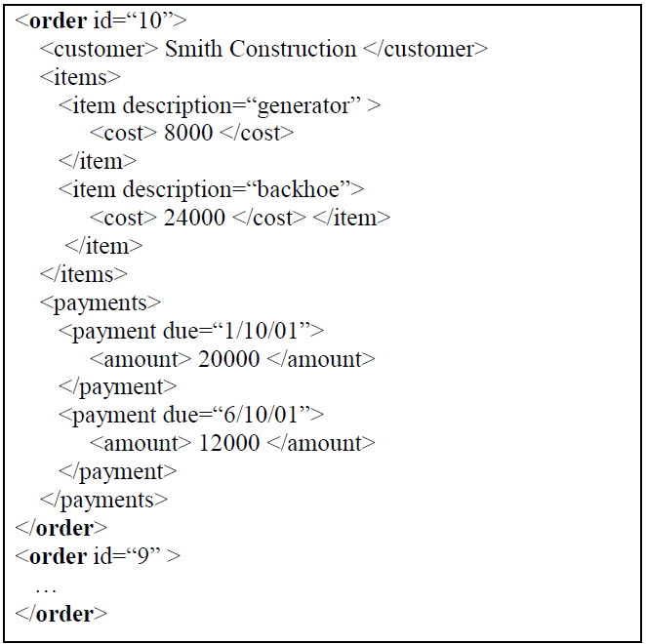
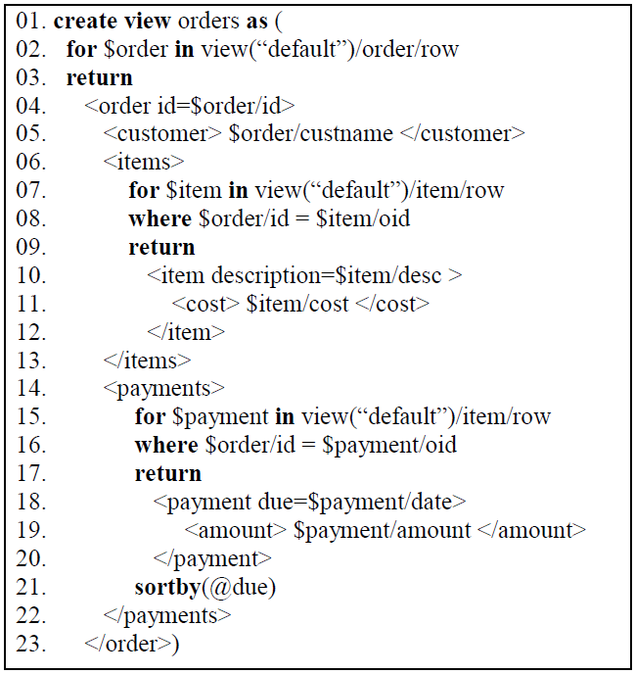
XML Views
The desired view (purchase order)
The view definition (in XQuery)

Slide 24
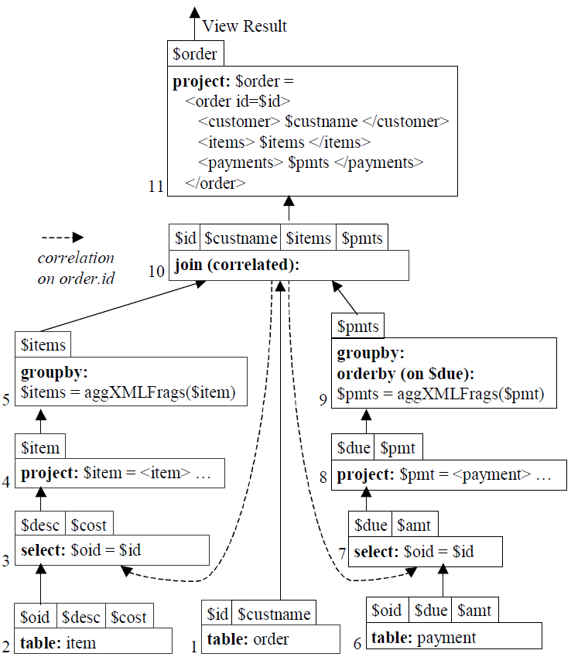
Query Graph for the view
A node is an operation on a data structure containing the result of the previous operation
The output of the operation is a tuple as marked on top of the node
An edge represents the flow of intermediate results from one operator to the next

Slide 25
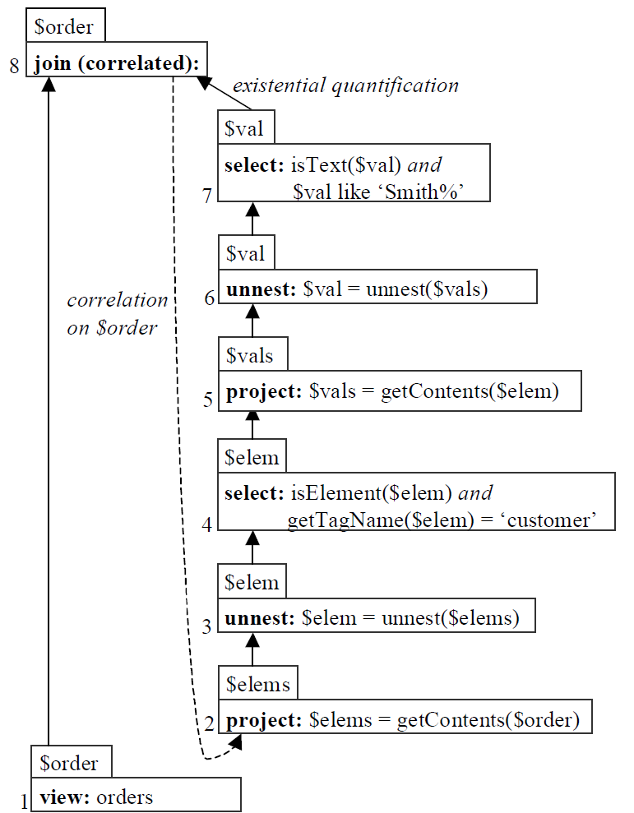
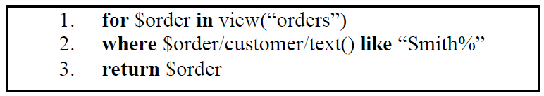
Querying the XML view
Correlated join
Join whose inputs are correlated queries
Correlated subqueries
Queries where variables of an outer query are shared by the inner subquery
Query decorrelation
Rewriting the query such that the inner query doesn’t get executed for every value of the correlating variable of outer query

Slide 26
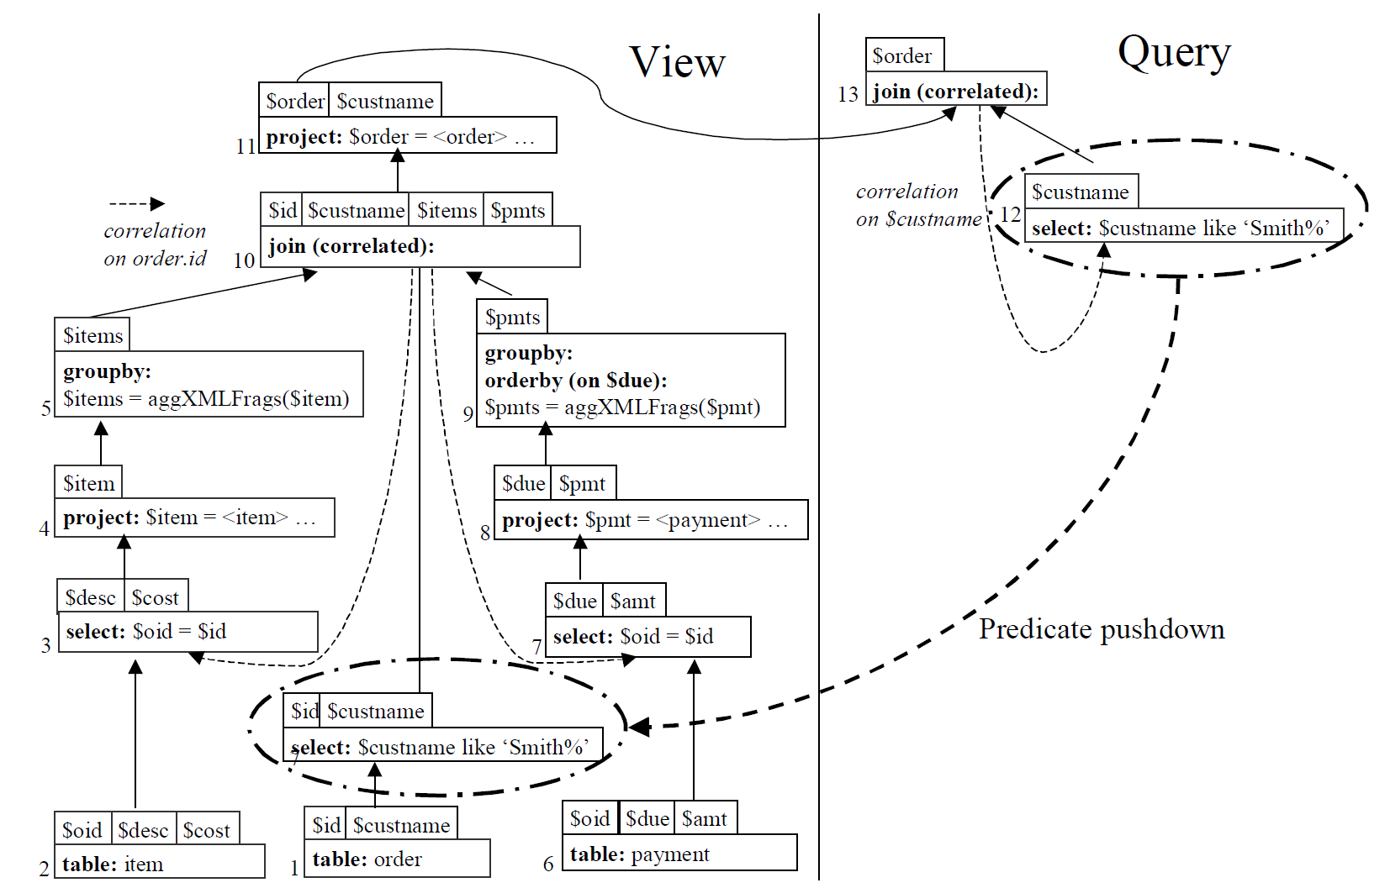
Composing the query with the view

Slide 27
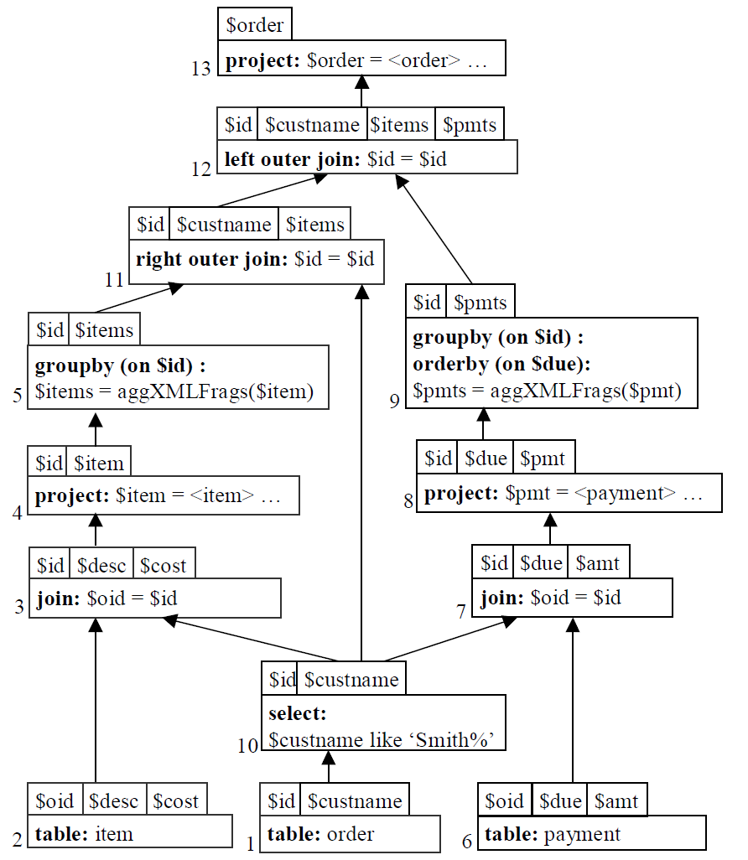
Translate to SQL
Translate to SQL

Slide 28
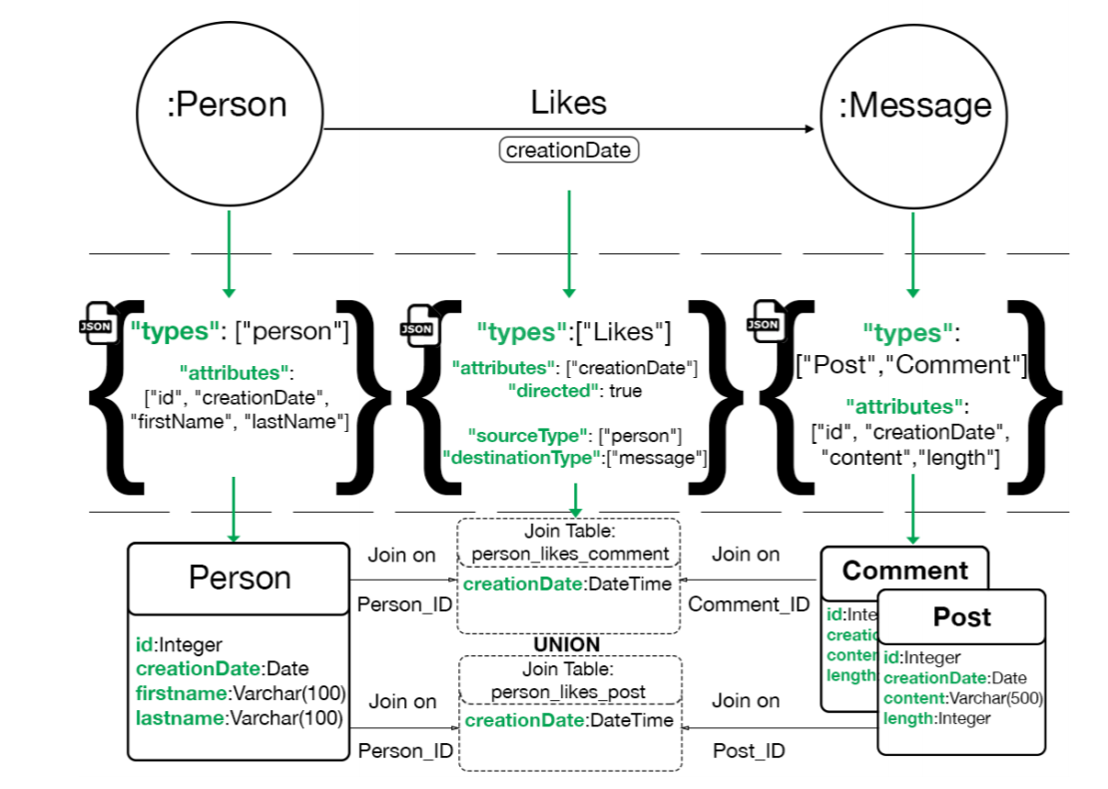
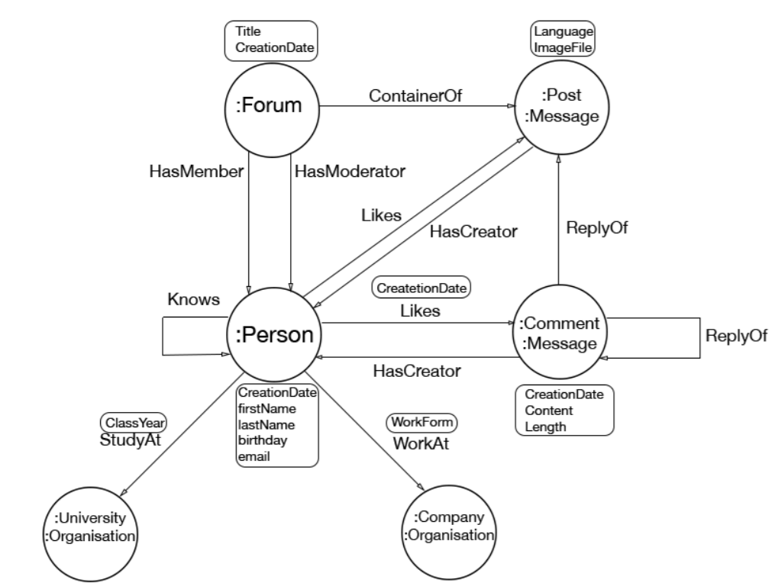
Property Graphs and Relational Data
GTop Mapping
An example Property Graph
Person ➔ database table
Message ➔ Comment, Post

Slide 29
Cypher to rOCQ Using GTop
Match (p : {firstName : “John”})
Match (p) − [ ∗ 1 . . 2 ]−> (m: Message)
Return p, m. content;
Expand VarLength
Paths
( p : Person) −−−> (m: Message)
( p : Person) −−−> ( ) −−> (m: Message)
Using GTop mappings Fill in the Relations and Expand MultiPaths
(p : Person) −[ : Likes]−>(m: Post)
(p : Person) −[ : Likes]−>(m: Comment )
(p : Person) −[ : Knows ] − >(:Person) −[ :Likes]−>(m: Post)
...
Construct Cypher style queries after all expansions are complete
Match (p : {firstName : “John”})
Match (p : Person) −[ : Likes]−>(m: Post)
Match (p : Person) −[ : Knows ] − >(:Person) −[ :Likes]−>(m: Post)
Return p, m. content;
...

Slide 30
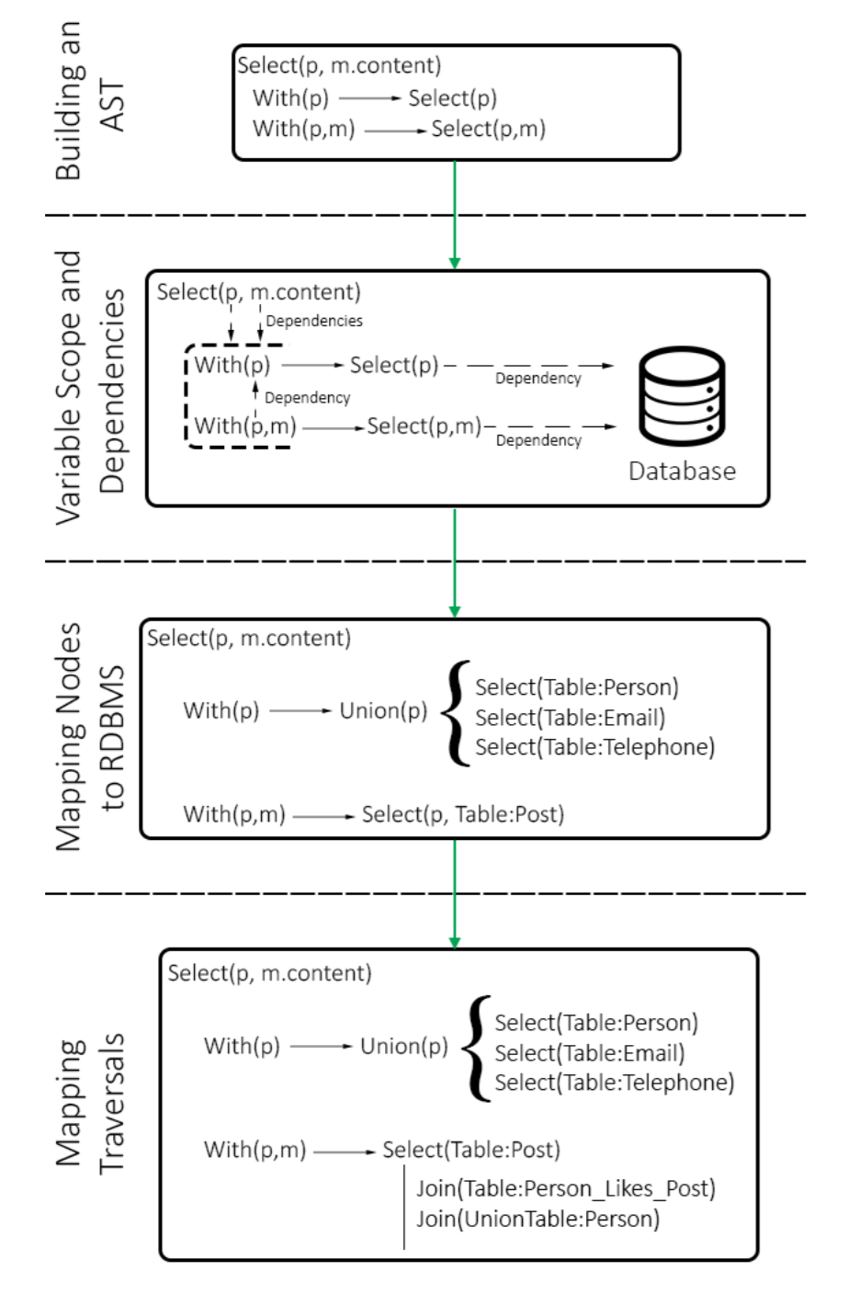
rOCQ to SQL
The return clause becomes the outer select
Every match clause is transformed into an WITH…SELECT clause
When a node label can be mapped to multiple tables, a UNION is introduced
All edges are translated through the JOIN Tables using UNIONs where needed

Slide 31
DSE 203
Day 5: MODERN TRENDS

Slide 32
The Big Stack
AI, Decision Support System:
Model Deployment: Experimentation, Validation, Tuning, Evolution
Cleaning/Pre-processing: Featurization, anomaly detection, data preparation
Infrastructure: HPC, Cloud systems, Databases, Custom processors, Big Data frameworks
Data Collection: Instrumentation, Logging, Sensors
Model Generation: Metrics, Validation, algorithm selection, domain application

Slide 33
A Taxonomy of Multi-Database Systems
Federated database system
A collection of homogeneous data stores and features a single standard query interface
Polyglot system
Hosts data using a collection of homogeneous data stores and exposes multiple query interfaces to the users.
Multistore system
System to manage data across heterogeneous data stores, while supporting a single query interface.
Polystore system
Enables query processing across heterogeneous data stores and supports multiple query interfaces.

Slide 34
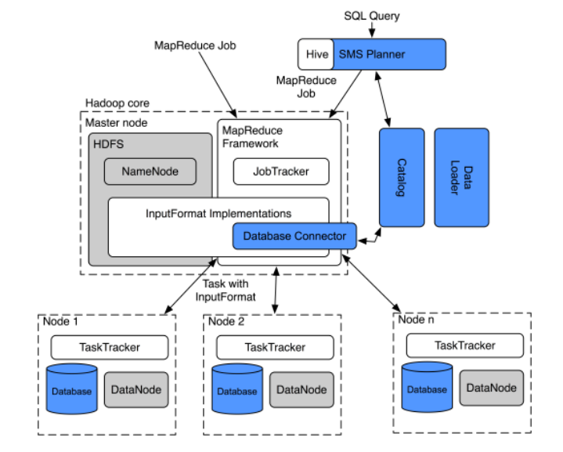
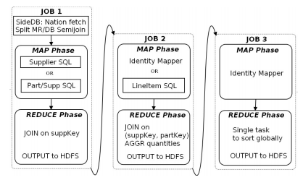
HadoopDB → Hadapt
SELECT S_NAME, S_ADDRESS FROM SUPPLIER, NATION WHERE S_SUPPKEY IN (SELECT PS_SUPPKEY FROM PARTSUPP WHERE PS_PARTKEY in (SELECT P_PARTKEY FROM PART WHERE P_NAME like 'forest%%') AND PS_AVAILQTY > (SELECT 0.5*sum(L_QUANTITY) FROM LINEITEM WHERE L_PARTKEY = PS_PARTKEY AND L_SUPPKEY = PS_SUPPKEY AND L_SHIPDATE >= '1994-01-01' AND L_SHIPDATE < dateadd(yy,1,'1994-01-01'))) AND S_NATIONKEY = N_NATIONKEY AND N_NAME = 'CANADA' ORDER BY S_NAME

Slide 35

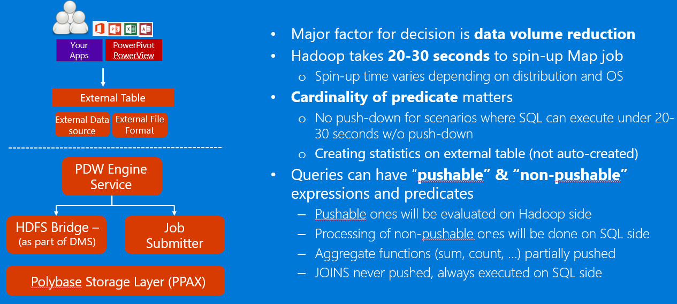
Polybase (Microsoft)

Slide 36
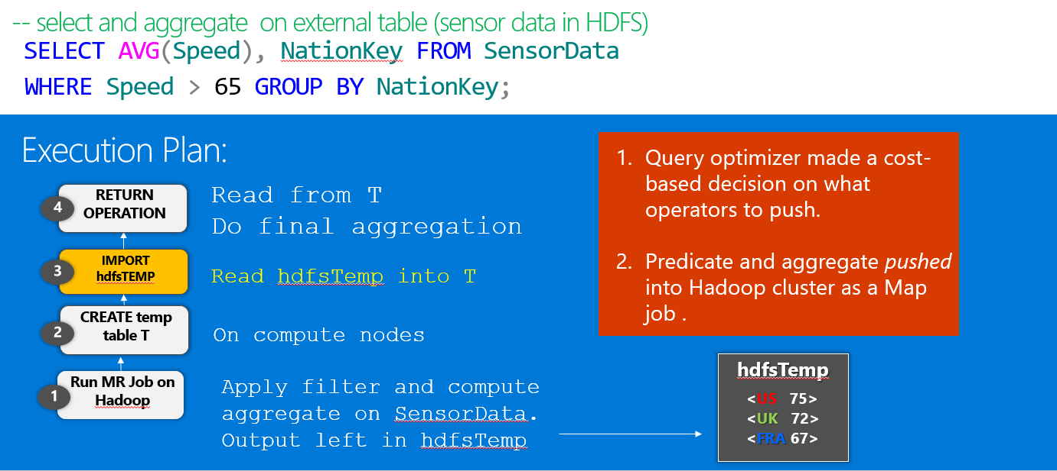
Polybase (Microsoft)

Slide 37
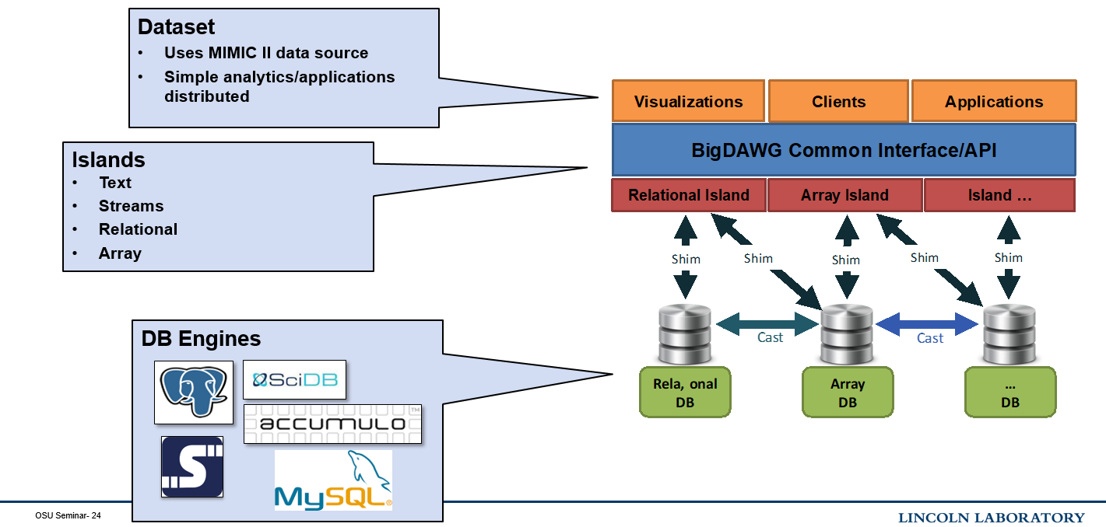
BIGDAWG (MIT+Collaborators)

Slide 38
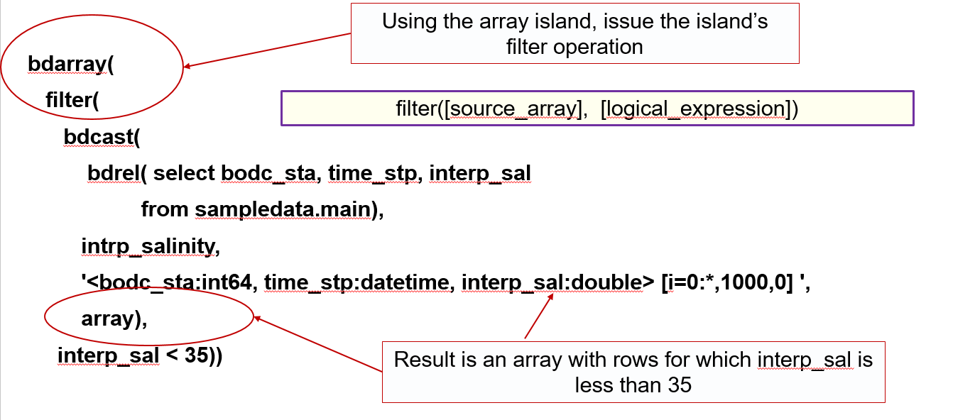
Queries in BIGDAWG

Slide 39
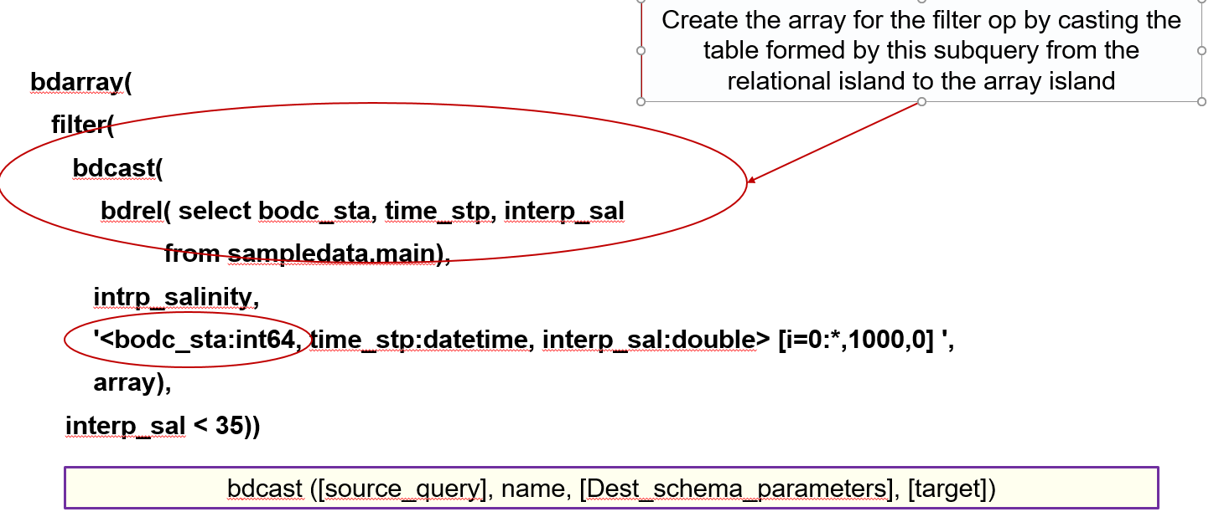
Queries in BIGDAWG

Slide 40
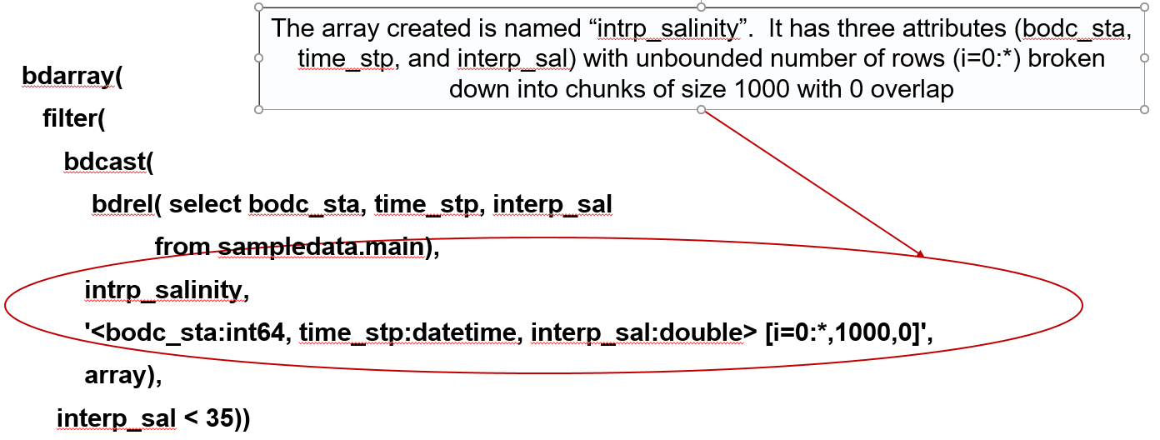
Queries in BIGDAWG

Slide 41
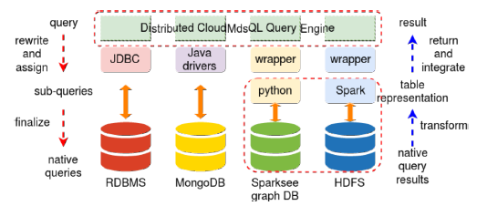
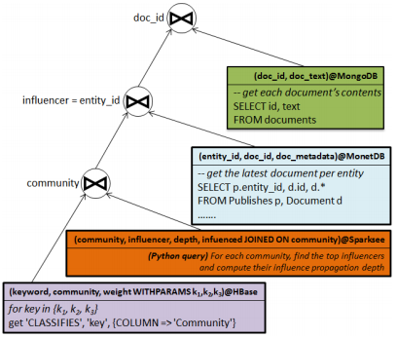
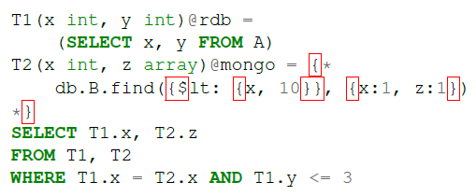
CloudMDSQL (INRIA)
Given a set of keywords k1, k2, k3, find the 10 biggest communities and, for each community, find the 20 most influencers. For each of these influencers, the system must return the number of influenced entities inside the community, the influencer’s id, name and account creation date and the last published document.

Slide 42
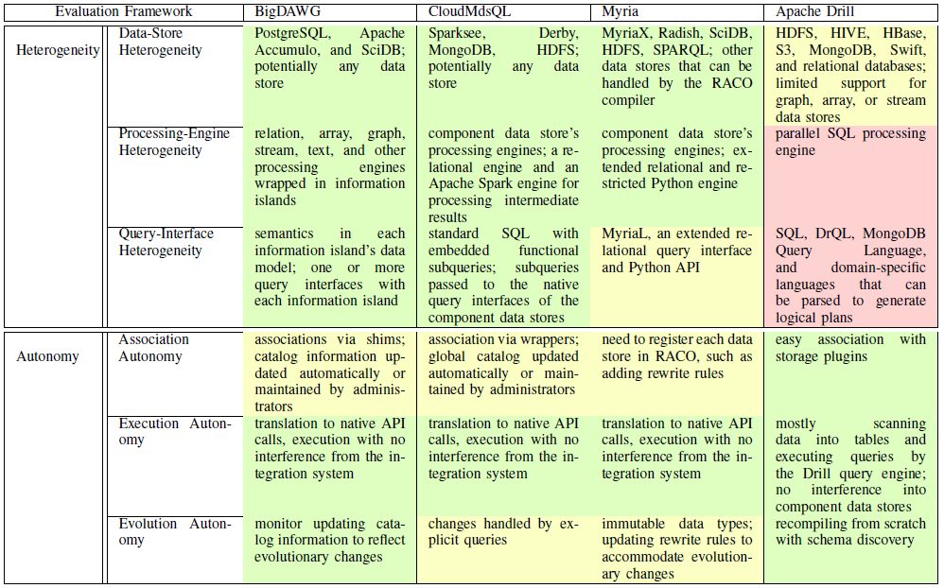

Slide 43
