Slide 1
DSE 203
Day 3: Schema Matching

Slide 2
The Problem
In a data integration system, we have the integrated (mediated) schema and a set of source schemas
You already have done the mapping for the first 10 sources, and now you get the next 50.
You Need Automation!!
How do we know which elements of the mediated (target) schema gets it data supply from which elements of the source schema?
Schema matching
Assume we have
The target schema
The source schemata
Some sample data
Can we use some matching technique that would offer potential correspondences between the elements of the two schemata?

Slide 3
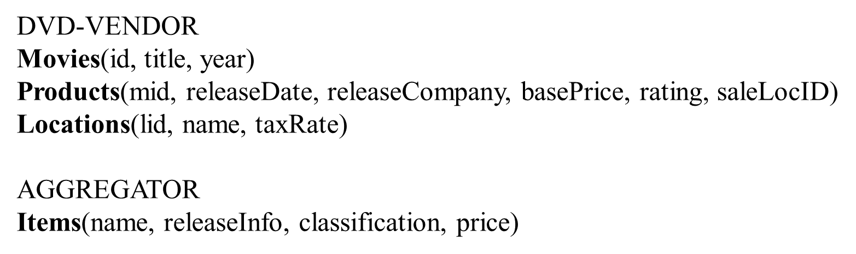
Example 1
Sources
Target

Slide 4
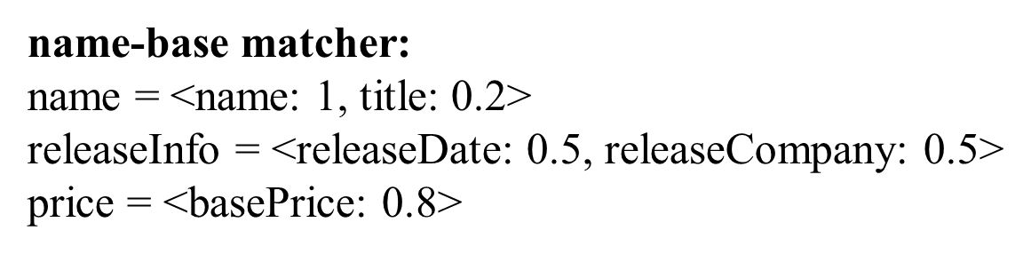
A First Approach – Name-based Matching
?
Based on a synonym dictionary
Based on a string similarity

Slide 5
Instance-Based Matchers
When schemas come with data instances, these can be extremely helpful in deciding matches
Many instance-based matchers have been proposed
Some of the most popular
recognizers
use dictionaries, regexes, or simple rules
overlap matchers
examine the overlap of values among attributes
classifiers
use learning techniques

Slide 6
Recognizers
Use dictionaries, regexes, or rules to recognize data values of certain kinds of attributes
Example attributes for which recognizers are well suited
country names, city names, US states
person names (can use dictionaries of last and first names)
color, rating (e.g., G, PG, PG-13, etc.), phone, fax, soc sec
genes, protein, zip codes

Slide 7
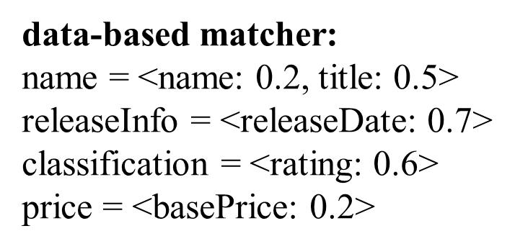
Measuring the Overlap of Values
Typically applies to attributes whose values are drawn from some finite domain
e.g., movie ratings, movie titles, book titles, country names
Jaccard measure is commonly used
Example:
Use Jaccard measure to build a data-based matcher between DVD-VENDOR and AGGREGATOR
AGGREGATOR.name refers to DVD titles, DVD-VENDOR.name refers to sale locations, DVD-VENDOR.title refers to DVD titles ➔ low score for (name, name), high score for (name, title)

Slide 8
Using Classifiers
Builds classifiers on one schema and uses them to classify the elements of the other schema
e.g., use Naïve Bayes, decision tree, rule learning, SVM
A common strategy
for each element s_{i} of schema S, want to train classifier C_{i} to recognizer instances of s_{i}
to do this, need positive and negative training examples
take all data instances of s_{i} (that are available) to be positive examples
take all data instances of other elements of S to be negative examples
train C_{i} on the positive and negative examples

Slide 9
Using Classifiers
A common strategy (cont.)
now we can use C_{i} to compute sim score between s_{i} and each element t_{j} of schema T
to do this, apply C_{i} to data instances of t_{j}
for each instance, C_{i} produces a number in [0,1] that is the confidence that the instance is indeed an instance of s_{i}
now need to aggregate the confidence scores of the instances (of t_{j}) to return a single confidence score (as the sim score between s_{i} and t_{j})
a simple way to do so is to compute the average score over all instances of t_{j}

Slide 10
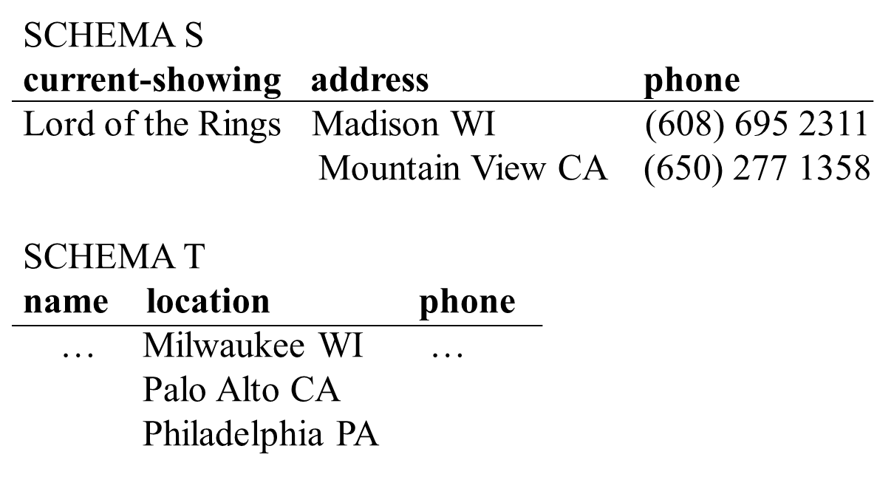
Using Classifiers: An Example
s_{i} is address, t_{j} is location
Sim scores are 0.9, 0.7, and 0.5, respectively for the three instances of T.location ➔ return average score of 0.7 as sim score between address and location

Slide 11
Using Classifiers
Designer decides which schema should play the role of schema S (on which to build classifiers)
typically chooses the mediated schema to be S, so that can reuse the classifiers to match the schemas of new data sources
May want to do it both ways
build classifiers on S and use them to classify instances of T
then build classifiers on T and use them to classify instances of S
e.g., when both S and T are taxonomies of concepts

Slide 12
The Overall Architecture for Schema Matchers
Match
selector
Constraint
enforcer
Test
Combiner
Matcher
Matcher
…
Searcher
Generate
…
candidate
pairs
Searcher

Slide 13
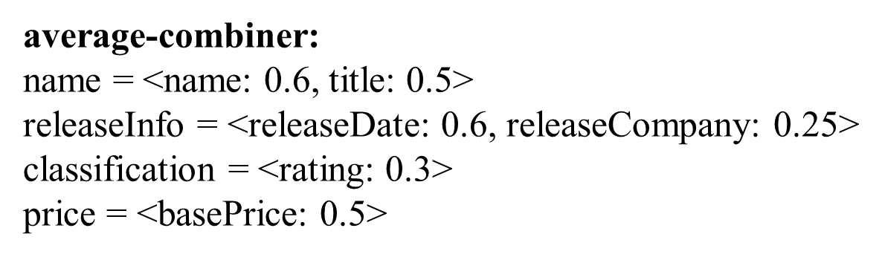
Combining Match Predictions with Average Combiner
0.8

Slide 14
Combining Match Predictions
When to use which combiner?
average combiner : when we do not have any reason to trust one matcher over the others
maximum combiner: when we trust a strong signal from matchers, i.e., if a matcher outputs a high value, we are relatively confident that the two elements match
minimum combiner: when we want to be more conservative
More complex types of combiners
use hand-crafted scripts
e.g., if s_{i} is address, return the score of the data-based matcher otherwise, return the average score of all matchers

Slide 15
Combining Match Predictions
More complex types of combiners (cont.)
weighted-sum combiners
give weights to each matcher, according to its importance
may learn the weights from training data
can combine the weights in many ways: linear regression, logistic regression, etc.
the combiner itself can be a learner, which learns how to combine the scores of the matchers
e.g., decision tree, logistic regression, etc.

Slide 16
Search for Complex Matches
Employ specialized searchers:
Text searcher: concatenations of columns
Numeric searcher: arithmetic expressions
Date searcher: combine month/year/date
Evaluate match candidates:
Compare with learned models
Statistics on data instances
Typical heuristics

Slide 17
Many-to-Many Matching
Mediated-schema
price num-baths address
homes.com
listed-price agent-id full-baths half-baths city zipcode
320K 53211 2 1 Seattle 98105
240K 11578 1 1 Miami 23591
Consider matches between combinations of columns
… unlimited search space!
Key challenge: control the search.

Slide 18
An Example: Text Searcher
Mediated-schema
price num-baths address
homes.com
listed-price agent-id full-baths half-baths city zipcode
320K 532a 2 1 Seattle 98105
240K 115c 1 1 Miami 23591
concat(agent-id,city)
concat(agent-id,zipcode)
concat(city,zipcode)
532a Seattle
115c Miami
532a 98105
115c 23591
Seattle 98105
Miami 23591
Best match candidates for address
(agent-id,0.7), (concat(agent-id,city),0.75), (concat(city,zipcode),0.9)

Slide 19
DSE 203
Day 3: Schema Mapping

Slide 20
The Problem
In a data integration system, we have the integrated (mediated) schema and a set of source schemas
How do we know which elements of the mediated (target) schema gets it data supply from which elements of the source schema?
Schema mapping
Can we write the views that will relate the target schema to the target schema?
Matching to Mapping
How do we use the results of the schema matching process to construct the schema mappings?

Slide 21
What is the Problem in Defining Mappings?
Source
Target
Address
id
Addr
Professor
id
name
salary
Personnel
Student
name
GPA
Yr
Sal
PayRate
Rank
HrRate
WorksOn
name
Proj
hrs
ProjRank
f1: PayRate(HrRate) * WorksOn(Hrs) = Personnel(Sal)

Slide 22
Two Possible Queries
select P.HrRate * W.hrs
from PayRate P, WorksOn W
where P.Rank = W.ProjRank
select P.HrRate * W.hrs
from PayRate P, WorksOn W, Student S
where W.Name=S.Name and
S.Yr = P.Rank
We could also consider the Cartesian product
but that seems intuitively wrong.

Slide 23
Horizontal Partitioning
Address
id
Addr
Professor
id
name
salary
Personnel
Student
name
GPA
Yr
Sal
PayRate
Rank
HrRate
WorksOn
name
Proj
hrs
ProjRank
f2: Professor(Sal) → Personnel(Sal)

Slide 24
What Kind of Union?
select P.HrRate * W.hrs
from PayRate P, WorksOn W
where P.Rank = W.ProjRank
UNION ALL
select Sal
from Professor
Could also do an outer-union … and even a join.

Slide 25
Two Sets of Decisions
What join paths to choose?
(we’ll call these ‘candidate sets’)
How to combine the results of the joins?
Underlying database-design principles:
Values in the source should appear in the target
They should only appear once
We should not lose information

Slide 26
Join Paths
Discover candidate join paths by:
following foreign keys
look at paths used in queries
paths discovered by mining data for joinable columns.
Select paths by:
Prefer foreign keys
Prefer ones that involve a constraint
Prefer smaller difference between inner and outer joins.
Result of this step: candidate sets.

Slide 27
Selecting Covers
Candidate cover: a minimal set of candidate sets that covers all the input correspondences
Select best cover:
Prefer with fewest candidate paths
Prefer one that covers more attributes of target
Express mapping as union of candidate sets in selected cover.

Slide 28
Semantics of Schema Mappings
Formally, schema mappings describe a relation: which instances of the mediated schema are consistent with the current instances of the data sources.
Mediated Schema (G)
I(G)
M
S₁
S₂
S_{n}
I(S₁)
I(S₂)
I(S_{n})
I(G) (I(S_{i})): the set of possible instances of the schema G (S_{i}).
M_{R}⊆ I(G) x I(S₁) x … I(S_{n})

Slide 29
Example
Movie: title, director, year, genre
Actors: title, name
Mediated Schema
Plays: movie, location, startTime
Reviews: title, rating, description
logic
Sources
S1
Movie(title, director, year, genre)
Actor(AID, firstName, lastName, nationality, yearofBirth)
ActorPlays(AID, MID)
MovieDetails(MID, director, genre, year)
S5
MovieGenres(title, genre)
S6
MovieDirectors(title, dir)
S7
MovieYears(title, year)
S2
Cinemas(place, movie, start)
S3
NYCCinemas(name, title, startTime)
S4
Reviews(title, date, grade, review)

Slide 30
DSE 203
Day 3: A DIGRESSION INTO DATALOG

Slide 31
Predicates and Atoms
Relations are represented by predicates
Tuples are represented by atoms
Purchase( “joe”, “bob”, “Nike Town”, “Nike Air”)
- arithmetic comparison atoms:
X < 100, X+Y+5 > Z/2
- negated atoms:
NOT Product(“Brooklyn Bridge”, $100, “Microsoft”)

Slide 32
Datalog Rules and Queries
A datalog rule has the following form:
head :- atom1, atom2, …., atom,…
← also used
Examples:
PerformingComp(name) :- Company(name,sp,c), sp > $50
AmericanProduct(prod) :-
Product(prod,pr,cat,mak), Company(mak, sp,“USA”)
All the variables in the head must appear in the body.
A single rule can express exactly select-from-where queries.

Slide 33
The Meaning of Datalog Rules
AmericanProduct(prod) :-
Product(prod,pr,cat,mak), Company(mak, sp,“USA”)
Consider every assignment from the variables in the body
to the constants in the database.
If each of the atoms in the body is in the database,
then
the tuple for the head is in the resulting.

Slide 34
More Examples
CREATE VIEW Seattle-view AS
SELECT buyer, seller, product, store
FROM Person, Purchase
WHERE Person.city = “Seattle” AND
Person.per-name = Purchase.buyer
SeattleView(buyer,seller,product,store) :-
Person(buyer, “Seattle”, phone),
Purchase(buyer, seller, product, store).

Slide 35
More Examples (negation, union)
SeattleView(buyer,seller,product,store) :-
Person(buyer, “Seattle”, phone),
Purchase(buyer, seller, product, store)
not Purchase(buyer, seller, product, “The Bon”)
Q5(buyer) :- Purchase(buyer, “Joe”, prod, store)
Q5(buyer) :- Purchase(buyer, seller, store, prod),
Product(prod, price, cat, maker)
Company(maker, sp, country),
sp > 50.

Slide 36
Rule Safety
Every variable that appears anywhere in the
query must appear also in a relational, non-negated
atom in the query.
Q(X,Y,Z) :- R1(X,Y) & X < Z not safe
Q(X,Y,Z) :- R1(X,Y) & NOT R2(X,Y,Z) not safe

Slide 37
Defining Views
SeattleView(buyer,seller,product,store) :-
Person(buyer, “Seattle”, phone),
Purchase(buyer, seller, product, store)
not Purchase(buyer, seller, product, “The Bon”)
Q6(buyer) :- SeattleView(buyer, “Joe”, prod, store)
Q6(buyer) :- SeattleView(buyer, seller, store, prod),
Product(prod, price, cat, maker)
Company(maker, sp, country),
sp > 50.

Slide 38
Extending to Datalog Sets
With this extension Datalog can have sets as first class objects
Set of elements: {1, 2, 3}
Set of tuples: {(1, a), (2, b), (3, c)}
Set defined with predicates: {(X, Y )| ∃Z. p(Z, Y ), r(X, Z, W)}
Two operations
memberOf(X,S)
Returns true if term X is a member of set S
Concatenation (|)
Adds a member to a set
sum({}, 0)
sum(X | S, A) :- sum(S, A1), A = A1 + X
Recursive definition

Slide 39
Using Datalog Sets for Aggregation
Data
p(x1, y1, 1)
p(x1, y2, 1)
p(x2, y3, 3)
Rule (query)
q(X, A) :- setof({Z}, {Y }, p(X, Y, Z), S), count(S, A)
Setof(free-variables, relation, set)
creates set for every binding of the non-free variable
S = {(Z, Y )| p(X, Y, Z)} for every binding of the variable X
For X = x1, the set S = {(1, y1), (1, y2)} and for X = x2, the set S = {(3, y3)}
Count – cardinality of the set
Result
q(x1, 2)
q(x2, 1)

Slide 40
A Slightly More Complex Case
Data – r(X, Y, Z, W, V)
r(x1, y1, z1, 3, v1) r(x1, y2, z2, 3, v1) r(x1, y3, z2, 3, v1) r(x2, y1, z2, 5, v1) r(x2, y1, z2, 5, v2)
Query
q(X, A) :- setof({W}, {Z}, ∃Y. r(X, Y, Z, W, V ), S), sum(S, A)
Steps
S = {(3, z1),(3, z2)} for the variable binding X = x1 and V = v1
S ={(5, z2)} for X = x2, V=v1
S ={(5, z2)} for X = x2, V=v2
Using aggregates
average(S, A) :- sum(S, A1), count(S, A2), A = A1/A2
A = 6
Take only one for X = x2

Slide 41
DSE 203
Day 3: And back to schema mapping

Slide 42
Example
Movie: title, director, year, genre
Actors: title, name
Mediated Schema
Plays: movie, location, startTime
Reviews: title, rating, description
logic
Sources
S1
Movie(title, director, year, genre)
Actor(AID, firstName, lastName, nationality, yearofBirth)
ActorPlays(AID, MID)
MovieDetails(MID, director, genre, year)
S5
MovieGenres(title, genre)
S6
MovieDirectors(title, dir)
S7
MovieYears(title, year)
S2
Cinemas(place, movie, start)
S3
NYCCinemas(name, title, startTime)
S4
Reviews(title, date, grade, review)

Slide 43
Relationship between Local Schema and Global Schema
Defining views to specify the schema mappings between the global and local schemata
Global as View (GAV)*
Local as View (LAV)
Global-Local as View (GLAV)
Tuple-generating dependencies (TGDs)

Slide 44
Query Reformulation
Problem
Rewrite a user query expressed in the mediated schema into a query expressed in the source schema
Given a query Q in terms of the mediator schema relations, and descriptions of information sources
Find a query Q’ that uses only the source relations, such that
Q’ ⊆ Q, and
Q’ provides all possible answers to Q given the sources

Slide 45
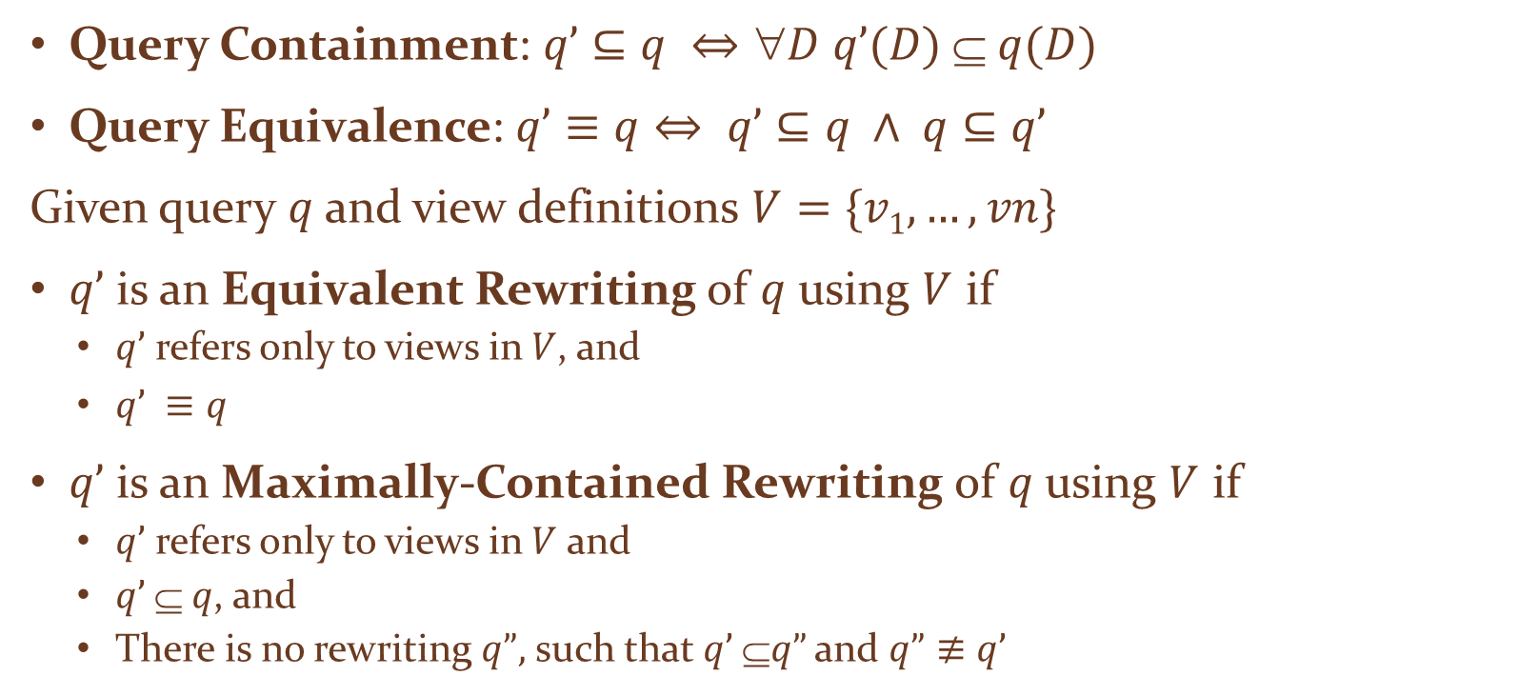
Query Rewriting Using Views
Query Containment: $q’⊆$ $q ⇔D q’(D)  q(D)$
Query Equivalence: $q’≡q⇔ q’⊆q ∧ q⊆q’$
Given query $q$ and view definitions $V=\{v1, …, vn\}$
$q’$ is an Equivalent Rewriting of $q$ using $V$ if
$q’$ refers only to views in $V$, and
$q’ ≡q$
$q’$ is an Maximally-Contained Rewriting of $q$ using $V$ if
$q’$ refers only to views in $V$ and
$q’  q$, and
There is no rewriting $q”,$ such that $q’ q”$and $q”≢q’$

Slide 46
Examples
Query Containment
Ans(movie, director) :- S1(movie, director, year, rating) contains the query
Ans(movie, director) :- S1(movie, director, year, rating), year = 2010
Query Equivalence
Ans(movie, director) :- S1(movie, director, year, rating), year = 2010
Ans(movie, director) :- S1(movie, director, year, rating), year > 2009, year < 2011
Equivalent Rewriting
We will see in the next step

Slide 47
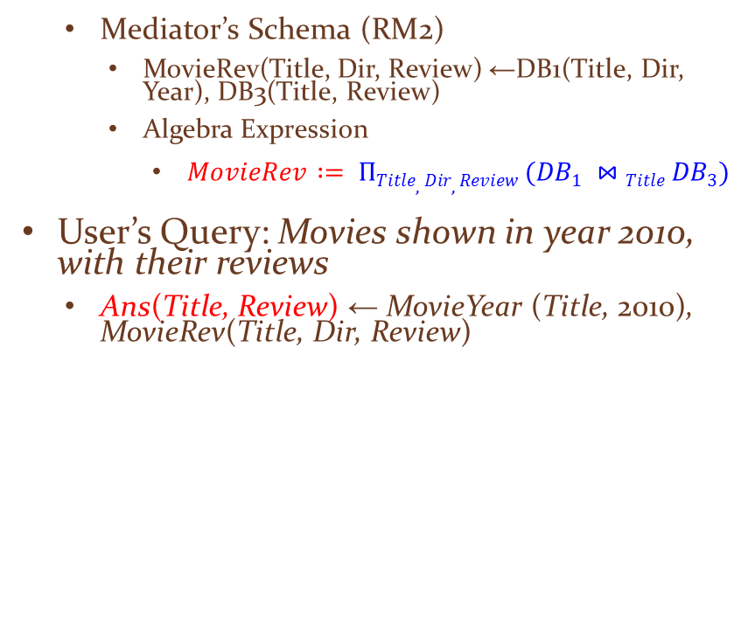
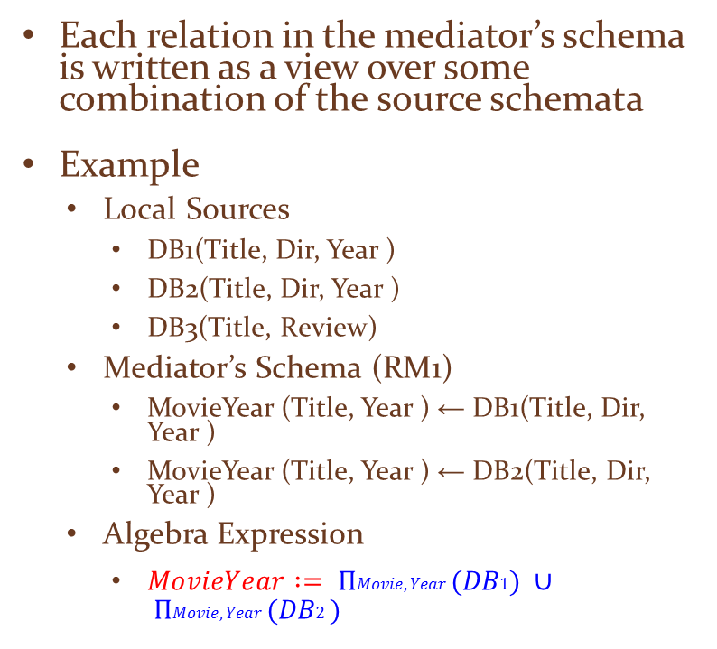
Global as View
Each relation in the mediator’s schema is written as a view over some combination of the source schemata
Example
Local Sources
DB1(Title, Dir, Year )
DB2(Title, Dir, Year )
DB3(Title, Review)
Mediator’s Schema (RM1)
MovieYear (Title, Year ) ← DB1(Title, Dir, Year )
MovieYear (Title, Year ) ← DB2(Title, Dir, Year )
Algebra Expression
$MovieYear := ΠMovie,Year (DB1) ∪ ΠMovie,Year (DB2 )$
Mediator’s Schema (RM2)
MovieRev(Title, Dir, Review) ←DB1(Title, Dir, Year), DB3(Title, Review)
Algebra Expression
$MovieRev := ΠTitle,Dir, Review (DB1 ⋈Title DB3)$
User’s Query: Movies shown in year 2010, with their reviews
Ans(Title, Review) ← MovieYear (Title, 2010), MovieRev(Title, Dir, Review)

Slide 48
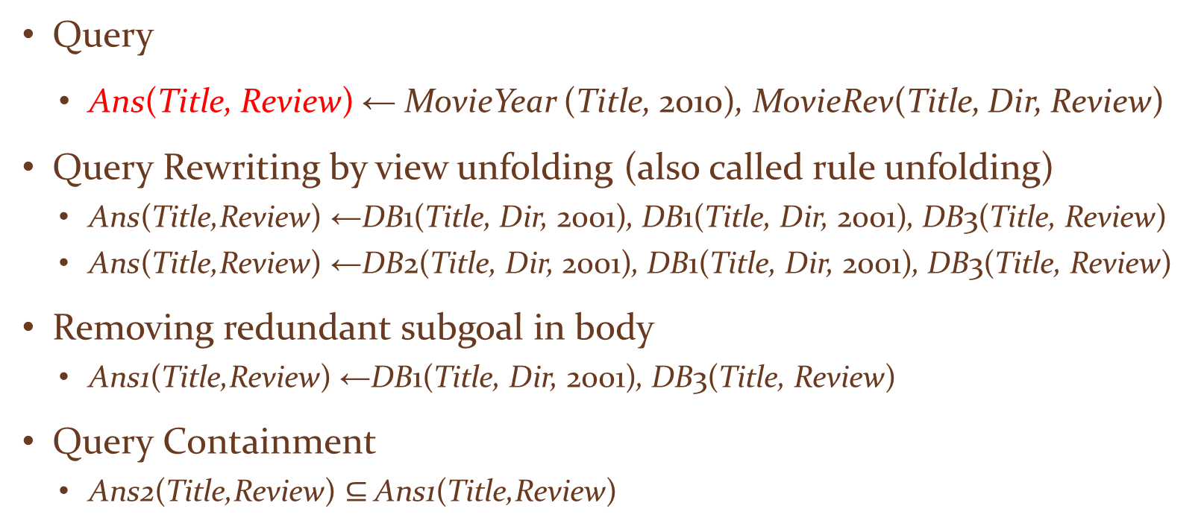
Query Answering in GAV
Query
Ans(Title, Review) ← MovieYear (Title, 2010), MovieRev(Title, Dir, Review)
Query Rewriting by view unfolding (also called rule unfolding)
Ans(Title,Review) ←DB1(Title, Dir, 2001), DB1(Title, Dir, 2001), DB3(Title, Review)
Ans(Title,Review) ←DB2(Title, Dir, 2001), DB1(Title, Dir, 2001), DB3(Title, Review)
Removing redundant subgoal in body
Ans1(Title,Review) ←DB1(Title, Dir, 2001), DB3(Title, Review)
Query Containment
Ans2(Title,Review) $⊆$Ans1(Title,Review)
What does this imply?

Slide 49
Alternate Reformulations
Q(title, location, startTime) :-
Movie(title, director, year, “comedy”),
Plays(title, location, st), st ≥ 8pm
Q’(title, location, startTime) :-
S1.Movie(MID, title),
S1.MovieDetail(MID, director, “comedy”, year)
S2.Cinemas(location,title, st), st ≥ 8pm

Slide 50
Another Reformulation
Q(title, location, startTime) :-
Movie(title, director, year, “comedy”),
Plays(title, location, st), st ≥ 8pm
Q’(title, location, startTime) :-
S1.Movie(MID, title),
S1.MovieDetail(MID, director, “comedy”, year)
S3.NYCCinemas(location,title, st), st ≥ 8pm

Slide 51
Local As View
The mediator’s schema is known
Every source maps its schema as a view over the mediator’s schema
The query is placed against the mediator’s schema and needs to be transformed by “inverting” the mapping to construct queries against the sources

Slide 52
LAV Example
Mediator’s Schema
Movie(Title, Year , Director , Genre)
AmerDir (Director)
Review(Title, Review)
S1: Has a relation V1(Title, Year , Director) containing comedies, filmed after 1960, with American directors and their years
In terms of the mediator
V1(Title, Year , Director ) ← Movie(Title, Year , Director , Genre), AmerDir (Director), Genre = comedy, Year ≥ 1960.
S2: Has a relation V2(Title, Review) containing movies filmed after 1990 with their reviews, but no directors
In terms of the mediator
V2(Title, Review) ← Movie(Title, Year , Director , Genre), Review(Title,Review), Year ≥ 1990.

Slide 53
Querying Mediators with LAV Mappings
Find Comedies with their reviews produced since 1950
Ans(Title,Review) ← Movie(Title, Year , Director , comedy), Review(Title,Review), Year ≥ 1950.
Not possible to obtain answers by a simple, obvious or direct computation of the RHS of the query
No simple rule unfolding for the relations in the body: no definitions for them as in GAV
V1(Title, Year , Director ) ← Movie(Title, Year, Director , Genre), AmerDir (Director), Genre = comedy, Year ≥ 1960.
V2(Title, Review) ← Movie(Title, Year , Director , Genre), Review(Title, Review), Year ≥ 1990.

Slide 54
A Good Rewriting (with Some Caveats)
Query
Ans(Title,Review) ← Movie(Title, Year , Director , comedy), Review(Title,Review), Year ≥ 1950.
Rewriting
Ans(Title,Review) ← (V1(Title, Year , Director), Year ≥ 1950), (V2(Title,Review))
Query is rewritten in terms of the views; and can be computed:
Extract values for Title from V1
Extract the tuples from V2
At the mediator level, compute the join via Title
Note: The results are only partial – why?

