Slide 1

DSE 203
Fall, 2017
Prof. Amarnath Gupta
TAs: Chetan Gandotra and Ashwin Ramesh

Slide 2
Session on one slide
1. Sampling
1.1 Random
1.2 Repeatable Random
1.3 Proportional Stratified
1.4 Balanced
2. TableSample
2.1 System and Bernoulli
2.2 System Rows and comparing query efficiency
3. Histogram
3.1 Histogram of Counts
3.2 Cumulative Histograms of Counts
3.3 Histograms for Numeric Values

Slide 3
1.1 Random Sample
Large data sets
Memory, speed constraints
Subset of data
Representative of the entire data
Ex: Generate a 10% random sample of the customers table.
SELECT *
FROM customers c
-- (1) For every row, a random number between 0 and 1 is generated. If this number is less than 0.1, it is selected. Otherwise, it is not.
WHERE random() < 0.1
-- (2) Approximately 10% and the number varies every time we run the same query.
Ex: Generate a random sample consisting of 1000 rows from the customers table.
SELECT c.*
FROM customers c
ORDER BY random()
-- Generate a sample with 1000 rows
LIMIT 1000

Slide 4
1.2 Repeatable Random Sample
Ex: Generate a 10% random sample of the customers table, such that it can be reproduced at a later point of time.
Seed variable - Pseudorandom function
SELECT setseed(0.5);
SELECT *
FROM customers
WHERE random() < 0.1
Without Repetition:
SELECT setseed(0.5);
-- Common Tablular Expression(CTE)
WITH shuffled_data AS (
-- Assign a sequential value, starting with 1 to each row
SELECT *, ROW_NUMBER() OVER (ORDER BY random()) AS rownum
FROM customers
)
SELECT *
FROM shuffled_data
WHERE rownum <= 100

Slide 5
1.3 Proportional Stratified Sample
The distribution of values in a column of the sample matches with the overall population.
Ex: Obtain a 1% sample of customers that maintains the same gender ratio as the original table.
Original Gender Ratio:
SELECT SUM(CASE WHEN cust.gender = 'F' THEN 1 ELSE 0 END) * 100 / COUNT(*) AS percent_f,
SUM(CASE WHEN cust.gender = 'M' THEN 1 ELSE 0 END) * 100 / COUNT(*) AS percent_m,
COUNT(*) AS total_count
FROM customers cust
Sample Gender Ratio:
WITH cust AS (
SELECT c.*, ROW_NUMBER() OVER (ORDER BY c.gender) AS rownum
FROM customers c
)
SELECT
SUM(CASE WHEN cust.gender = 'F' THEN 1 ELSE 0 END) * 100 / COUNT(*) AS percent_f,
SUM(CASE WHEN cust.gender = 'M' THEN 1 ELSE 0 END) * 100 / COUNT(*) AS percent_m,
COUNT(*) AS total_count
FROM cust
WHERE cust.rownum % 100 = 1

Slide 6
Exercise
Obtain a 10% sample of orders, along with the information of whether or not it availed free shipping. The distribution of orders in the sample that received and did not receive free shipping should match the original data.
-- Original free shipping distribution
WITH cte AS (
SELECT ord.*, camp.freeshppingflag
FROM orders ord
JOIN campaigns camp
ON ord.campaignid = camp.campaignid
)
SELECT
((SUM(CASE WHEN cte.freeshppingflag = 'Y' THEN 1 ELSE 0 END) * 100)::decimal(10,1) / COUNT(*))::decimal(10,2) AS freeshipping_received,
((SUM(CASE WHEN cte.freeshppingflag = 'N' THEN 1 ELSE 0 END) * 100)::decimal(10,1) / COUNT(*))::decimal(10,2) AS freeshipping_not_received,
COUNT(*) AS total_count
FROM cte
-- Free Shipping distribution in sample
WITH cte AS (
SELECT ord.*, camp.freeshppingflag, ROW_NUMBER() OVER (ORDER BY camp.freeshppingflag) AS rownum
FROM orders ord
JOIN campaigns camp
ON ord.campaignid = camp.campaignid
)
SELECT
((SUM(CASE WHEN cte.freeshppingflag = 'Y' THEN 1 ELSE 0 END) * 100)::decimal(10,2) / COUNT(*))::decimal(10,2) AS freeshipping_received,
((SUM(CASE WHEN cte.freeshppingflag = 'N' THEN 1 ELSE 0 END) * 100)::decimal(10,2) / COUNT(*))::decimal(10,2) AS freeshipping_not_received,
COUNT(*) AS total_count
FROM cte
WHERE cte.rownum % 10 = 1

Slide 7
1.4 Balanced Sample
Sample in which all groups of a column are represented equally.
Ex: Generate a random sample consisting of 1000 customers that has equal number of male and female customers i.e., with 1:1 gender ratio
WITH cust AS (
SELECT c.*,
-- Assign the same row number for all rows with the same value of isF
ROW_NUMBER() OVER (PARTITION BY isF) AS seqnum
FROM (SELECT c.*,
(CASE WHEN c.gender = 'F' THEN 1 ELSE 0 END) AS isF
FROM customers c
WHERE c.gender <> ''
) c
)
SELECT
SUM(CASE WHEN cust.isF = 1 THEN 1 ELSE 0 END) * 100 / COUNT(*) AS percent_f,
SUM(CASE WHEN cust.isF = 0 THEN 1 ELSE 0 END) * 100 / COUNT(*) AS percent_m,
COUNT(*) AS total_count
FROM cust
WHERE seqnum <= 500

Slide 8
Exercise
Obtain a sample of 100 orders along with the customer information, exactly half of which have received some discount.
-- Balanced sample - Discount
WITH cte AS (
SELECT t.*,
ROW_NUMBER() OVER (PARTITION BY discountReceived) AS seqnum
FROM (SELECT cust.*, camp.discount,
(CASE WHEN camp.discount > 0 THEN 1 ELSE 0 END) AS discountReceived
FROM customers cust
JOIN orders ord
ON cust.customerid = ord.customerid
JOIN campaigns camp
ON camp.campaignid = ord.campaignid
) t
)
SELECT *
FROM cte
WHERE seqnum <= 50

Slide 9
2.1 TableSample - System and Bernoulli
SELECT expr
FROM table
TABLESAMPLE sampling_method (argument) [REPEATABLE(seed)]
Two types of sampling methods:
(i) SYSTEM - which does block level sampling. It groups a set of tuples and randomly selects these groups.
(ii) BERNOULLI - which does tuple level sampling. Each row has equal probability of being selected.
Ex: Generate a 10% random sample of the customers table, such that it can be reproduced at a later point of time.
SELECT *
FROM customers
TABLESAMPLE SYSTEM(10) REPEATABLE(200);
SELECT *
FROM customers
TABLESAMPLE BERNOULLI(10) REPEATABLE(200);

Slide 10
2.2 System Rows and Comparing Efficiency
Ex: Generate a random sample consisting of 1000 rows from the customers table and compare the query execution times.
EXPLAIN ANALYSE
SELECT *
FROM customers
ORDER BY random()
LIMIT 1000
CREATE EXTENSION IF NOT EXISTS "tsm_system_rows";
EXPLAIN ANALYZE
SELECT *
FROM customers
TABLESAMPLE SYSTEM_ROWS(1000)

Slide 11
3 Histograms
Analyze distribution with the help of charts.
Ex: What is the distribution of orders by state and how is this related to the state’s population?
— (4) Display the state along with number of orders and population of that state.
SELECT State, SUM(numorders) as numorders, SUM(pop) as pop
FROM (
-- (1) For each state in orders table, we find the number of orders.
(SELECT o.State, COUNT(*) as numorders, 0 as pop
FROM Orders o
GROUP BY o.state
)
-- (3) UNION ALL combines all rows in two tables.
UNION ALL
-- (2) For each state in zipcensus table, we find the total population.
(SELECT zc.stab, 0 as numorders, SUM(totpop) as pop
FROM ZipCensus zc
GROUP BY zc.stab
)
) summary
GROUP BY State
-- (5) Arrange the rows in descending order of number of orders
ORDER BY numorders DESC

Slide 12
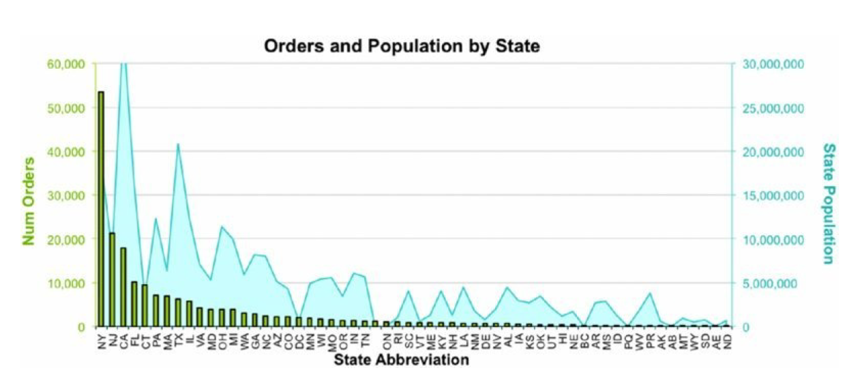
Observations
Marketing and sales efforts are focused on the northeast because New York and New Jersey have larger numbers of orders.
California, which has the largest population, is third in number of orders.

Slide 13
3.1 Histogram of Counts
Ex: What is the number of order lines where the product occurs once (overall), twice, and so on?
-- (2) Group by number of order lines and find the product count
SELECT numol, COUNT(*) as numprods, MIN(ProductId), MAX(ProductId)
FROM (
-- (1) Find the number of order lines where each product appears - group by ProductId
SELECT ProductId, COUNT(*) as numol
FROM OrderLines
GROUP BY ProductId
) op
GROUP BY numol
ORDER BY numol

Slide 14
Observations
Find the most common product/products from this table
The last row of the table has the most common product, whose ID is 12820 and appears in 18,648 order lines.
Find the least common product/products
The least common products are in the first row, there are 933 that occur only once.
How many different values of ProductId are there?
Sum all values in the number of products column - 4,040
How many order lines?
Sum of the product of the first two columns - 286,017
Hence, average number of order lines per product = 70.8
i.e, a given product occurs in 70.8 order lines, on average

Slide 15
3.2 Cumulative Histograms of Counts
Ex: What proportion of products account for half of all order lines?
WITH counts AS (
-- (2) Group by number of order lines and find the product count
SELECT numol, COUNT(*) as numprods,
-- (4) Find cumulative number of order lines.
SUM(COUNT(*) * numol) OVER (ORDER BY numol) AS cumulative_numol,
-- (3) Find cumulative number of products.
SUM(COUNT(*)) OVER (ORDER BY numol) AS cumulative_numprods
FROM (
-- (1) Find the number of order lines where each product appears
SELECT ProductId, COUNT(*) as numol
FROM OrderLines
GROUP BY ProductId
) op
GROUP BY numol
ORDER BY numol
)
SELECT numol, numprods, cumulative_numol, cumulative_numprods,
-- (5) Convert the cumulative sums to percentage
(cumulative_numol/286017 * 100)::decimal(5,1) AS percentage_cumulative_numol,
(cumulative_numprods/4040 * 100)::decimal(5,1) AS percentage_cumulative_numprods
FROM counts

Slide 16
Observations
Products with six or fewer order lines account for 65.0% of all products. However, they appear in only 2.2% of order lines.
Cumulative percentage of orderlines is 50% in row 332 (out of 385), which shows that 98.7% of all products account for half the order lines, so 1.3% accounts for the other half.

Slide 17
3.3 Histograms (Frequencies) for Numeric Values
Ex: How many different values does totalprice take on?
TotalPrice has over 4,000 values
Solution: Group them into ranges
SELECT SIGN(numdigits) * POWER(10, numdigits - 1) as lowerbound,
POWER(10, numdigits) as upperbound,
COUNT(*) as numorders,
MIN(TotalPrice) as min_totalprice,
MAX(TotalPrice) as maxtotalprice
FROM (SELECT (CASE WHEN TotalPrice::decimal(10,2) >= 1 THEN FLOOR(1 + LOG(TotalPrice::decimal(10,2)) / LOG(10))
WHEN -1 < TotalPrice::decimal(10,2) AND TotalPrice::decimal(10,2) < 1 THEN 0
ELSE - FLOOR(1 + LOG(-TotalPrice::decimal(10,2)) / LOG(10)) END
) as numdigits, TotalPrice
FROM Orders o
) a
GROUP BY numdigits
ORDER BY numdigits

Slide 18
Equal-sized groups
Int width_bucket(numeric op, numeric b1, numeric b2, int count)
Ex: Divide the product data into 10 equal price buckets and draw a histogram depicting the number of products that fall into each of these price buckets. For simplicity, consider products with price less than $1000.
WITH p_1000 AS (
-- (1) Filter out the products with price > $1000
SELECT p.*
FROM products p
WHERE fullprice::decimal(10,1) <= 1000
),
p_minmax AS (
-- (2) Find the min and max price of the current distribution
SELECT MIN(fullprice::DECIMAL(10,1)) AS min_price,
MAX(fullprice::DECIMAL(10,1)) AS max_price
FROM p_1000
)
-- (3) The data in the range min_price to max_price is divided into 10 + 1 buckets. Find the bucket to which the price of each product belongs to. And group them by buckets.
SELECT WIDTH_BUCKET(fullprice::DECIMAL(10,1), min_price, max_price, 10) AS bucket,
MIN(fullprice::DECIMAL(10,1)) as min_price, MAX(fullprice::DECIMAL(10,1)) as max_price,
COUNT(*) AS freq
FROM p_1000, p_minmax
GROUP BY bucket
ORDER BY bucket

Slide 19

Covered
Different methods of sampling a table
Using TableSample construct to sample a table
Different types of histograms

