Slide 1
DSE 203: Data Integration
Fall 2017

Slide 2
Preliminaries
Instructor:
Amarnath Gupta
Office: SDSC E-312
Email: a1gupta@ucsd.edu
TA
Chetan Gandotra (cgandotr@ucsd.edu)
Ashwin Ramesh (a5ramesh@eng.ucsd.edu)
Web sites:
Piazza: https://piazza.com/class/ucsd/fall2017/dse203/

Slide 3
The Class Setting
We will solve a practical problem in this class to show data integration in action
In-class work
Learning Objectives for each class
Lectures to cover basic integration techniques
Hands-on tasks to get used to these techniques
Class Project
Done in groups
Divided into 4 Milestones – 10% of your grades on each
10-15-minute presentation by each group in every class
All work in Github
Mid-term – 15% of your grade on Nov. 3
Final Presentation on Dec. 8– 45% of your grades on successful completion and presentation

Slide 4
Learning Objectives for Today
Be able to understand and use several data models
Comprehend and formulate different kinds of data integration tasks
Develop a “data-management-centric” view to Predictive Analytics
Get started on the mechanics of data exploration needed for integration
Analytics-oriented queries in databases

Slide 5
The Problem We Solve

Slide 6
Analytics-R’-Us
Customer analytics is a process by which data from customer behavior is used to help make key business decisions via market segmentation and predictive analytics. This information is used by businesses for direct marketing, site selection, and customer relationship management.
Our “Company”
A consulting company in
Data Science and Analytics
We have expertise in software development related to
Statistical analysis
Machine learning
Data management

Slide 7
Our “Client”
A bookstore wants to start an analytics department
Goals:
Understand customer demands and concerns
Understand and predict demand patterns
Understand and predict what to stock and inventory size
It currently has an operational relational database
It needs to ensure
It is collecting all data to provide it the analytical results it seeks
It is using the right infrastructure for using all data
It is running the right analytical models

Slide 8
Our “Job”
Develop a proof-of-concept system
Use a small set of data given by the customer
Order pattern
Supplement with all additional data needed
Customer reviews on items
Customer reviews on store
Product classification
Customer social network information?
Scalable design
Show a few sample analytical tasks that can be performed

Slide 9
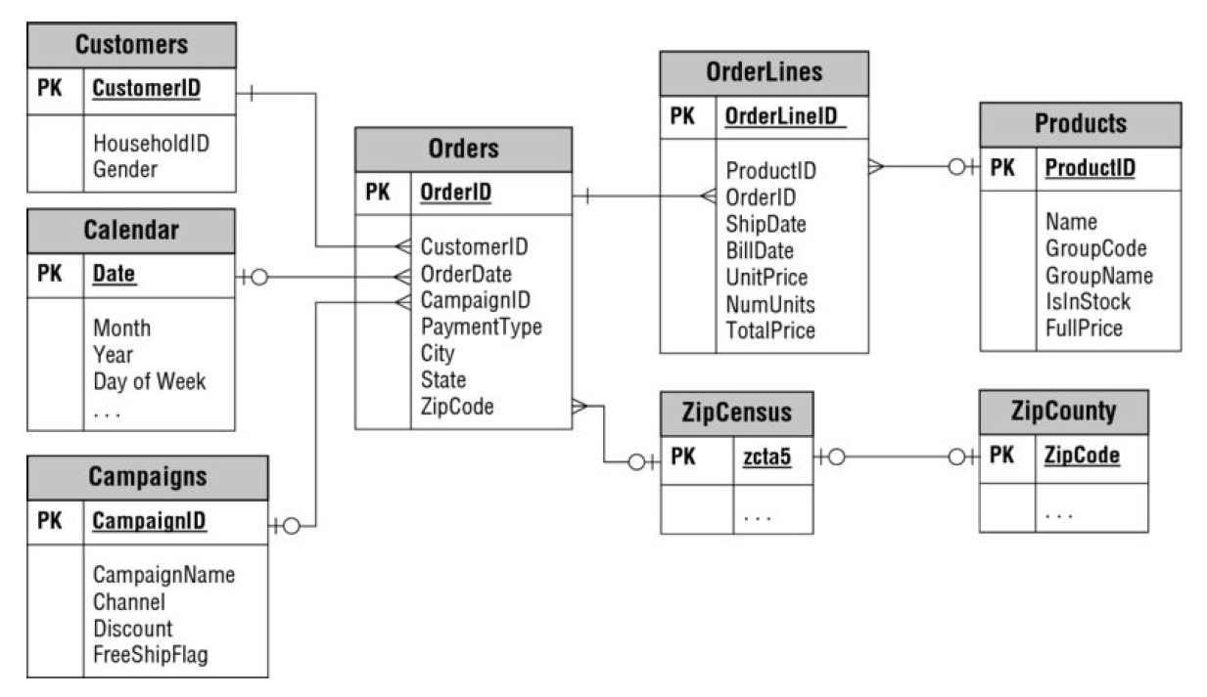
Customer’s Current Data is Relational

Slide 10
Some Topics Covered in Previous Courses
DSE 201: Database Management
Relational Data Model
Database Design
SQL
Query Processing
Performance tuning (indexing, materialized views)
Column Stores
Parallel Databases (includes the Map-Reduce programming paradigm)
Datalog
DSE 210: Probability and Statistics
Probability Spaces
Discrete and Continuous Distributions
Basic Statistical Procedures
Regression
Classification
Statistical Testing
Sampling
Hypothesis Testing
Probabilistic Models
Bayesian Nets
Topic Models

Slide 11
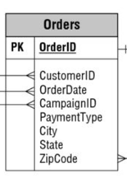
Statistics With SQL - I
Based on a sample size of 1000 orders, find the frequency distribution of cities placing orders
How do you get a random sample from a table?
How do you get the frequency distribution of the data values in a column?

Slide 12
Some Topics Covered in Previous Courses
DSE 230: Data Analysis Using Spark
Data Science
Distributed Computation with Map-Reduce
Analysis Based on Squared Error
PCA
Regression
Clustering and Intrinsic Dimension
K-Means
Graph Laplacian
Classification
Logistic Regression, Boosting
DSE 220: Machine Learning
Supervised and Unsupervised Learning
Decision Trees
Generative Models
Regression, Classifiers
Discriminative Models
Logistic Regression
SVM and Kernels
Clustering and Projections
Embeddings, manifold and dictionary learning
Random forests and decision trees
Bagging and Boosting
Deep Learning

Slide 13
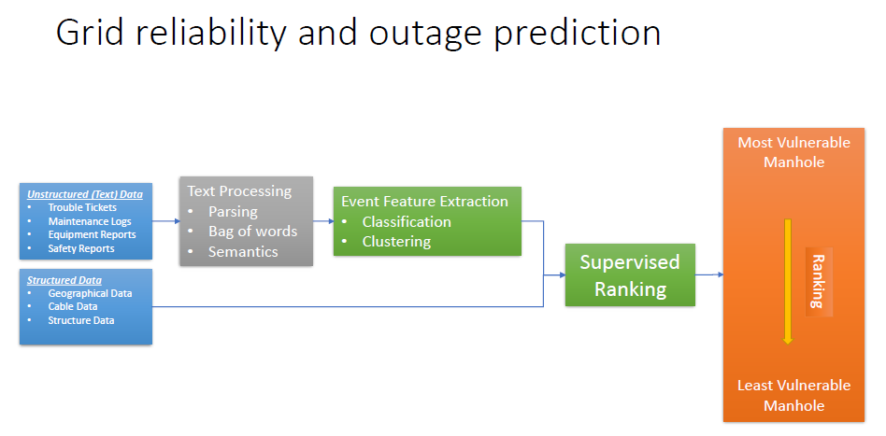
Slide from DSE 220

Slide 14
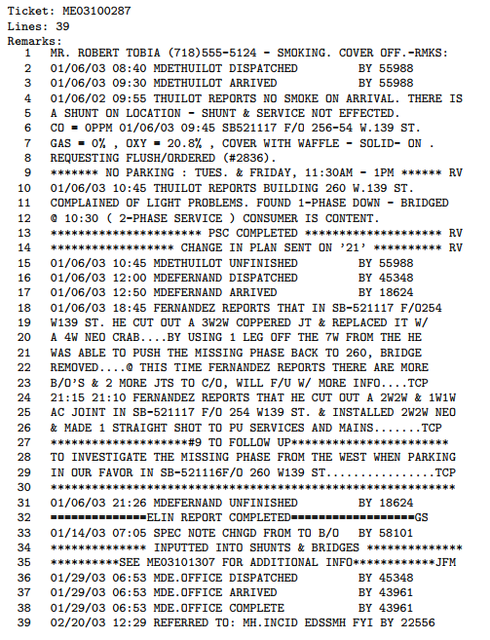
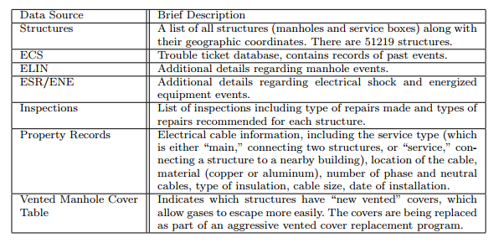
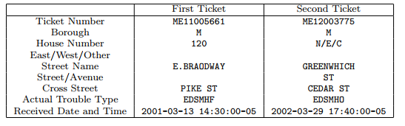
Machine Learning Often Needs Multiple Data Sources

Slide 15
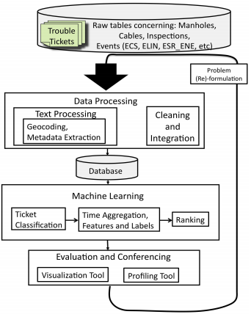
The Power Grid Analysis Example
What happens if this data is more heterogeneous?
What happens if this is very large?
What does “integration” mean here?
What is the structure of this database?
Can we do (part of) the feature extraction here?

Slide 16
Statistics With SQL - II
Suppose you create a view that keeps the daily count of orders per zipcode:
Create View OrderCount as
Select row_number() over () as OCID, ZipCode as orderZip, OrderDate, count(OrderID) as oCount
From Orders
Group by OrderDate, ZipCode
Create a linear regression model which, given a zip code and a date will predict the number of orders for that date

Slide 17
DSE 203
Day 1: Data Models

Slide 18
Data Models
A specification that precisely defines
The structure of the data
The fundamental operations on the data
The logical language to specify queries on the data

Slide 19
Relational Data Model
Fields or attributes
Atomic or complex
Domain of an attribute
Tuple or record of attributes
Relation = Set of tuples
The special value called NULL
Set and bag (multiset) semantics
Relational Algebra Operators
Selection
(generalized) Projection
Cross product
Joins (inner join, outer join, semioin, …)
Union
Difference
Rename
Other operations
Group By
Aggregates

Slide 20
What is a Semi-structured Data Model?
A data model, based on trees (sometimes graphs), for representing both regular and irregular data
Self-describing data:
The content comes with its own description
Contrast with the relational model, where schema and content are represented separately
Flexible typing:
Data may be typed (i.e., “such nodes are integer values” or “this subtree complies with this description”)
Often no typing, or a very flexible one
Serialized form:
The graph representation is associated to a serialized form
Convenient for exchanges in an heterogeneous environment.

Slide 21
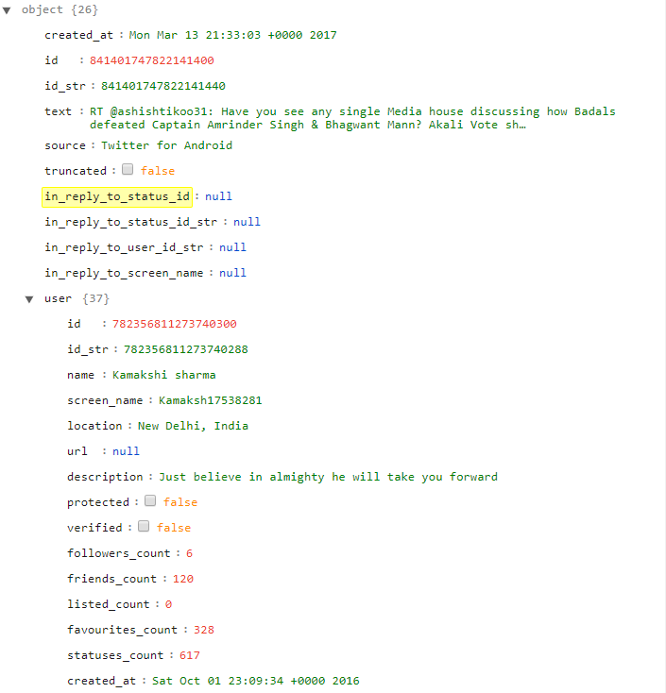
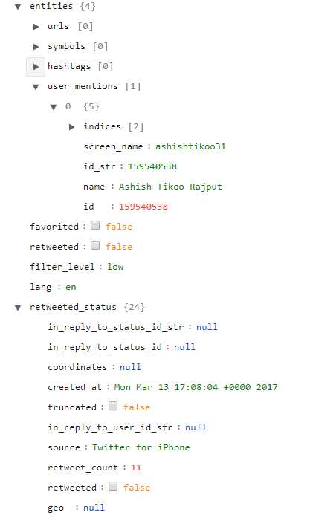
Semi-structured Data

Slide 22
Serial and Tree Forms of Semi-structured Data
"entities": {
"urls": [],
"symbols": [],
"hashtags": [],
"user_mentions": [
{
"indices": [3, 17],
"screen_name": "ashishtikoo31",
"id_str": "159540538",
"name": "Ashish Tikoo Rajput",
"id": 159540538
}
]
},
entities
list
urls
symbols
hashtags
user_mentions
list
user_mentions[0]
tuple
indices
screen_name
id_str
name
id
3
17
“159540538”
159540538
Atomic value
"ashishtikoo31"
"Ashish Tikoo Rajput"

Slide 23
XML as Semi-structured Data
<book>
<title>
“The Art of Programming”
</title>
<author>
<book>
“D. Knuth”
<title>
<author>
<year>
</author>
<year>
“The Art of
Programming”
“D. Knuth”
“1969”
“1969”
</year>
</book>

Slide 24
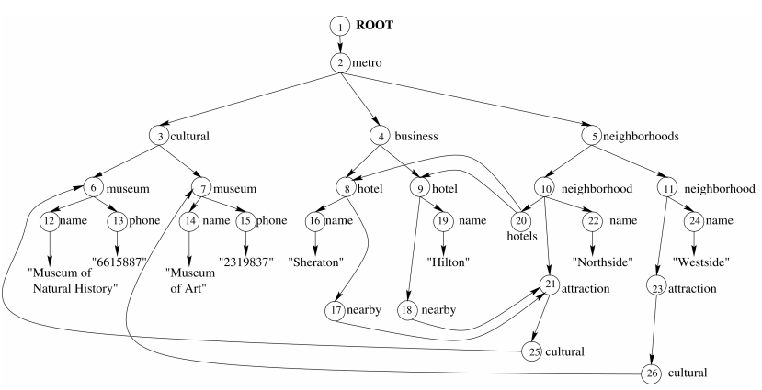
XML Data with ID and IDREF Creates a Graph
hotelID=“h5” xsd:type=“ID”
hotelID=“h9”
hotelIDREFS=“h5”, “h9” xsd:type = “IDREFS”

Slide 25
Storing and Querying Semi-structured Data
Schemaless Models
MongoDB’s document model
Schematized Models
XML DTDs
XML Schema
JSON Schema
AsterixDB Model*

Slide 26
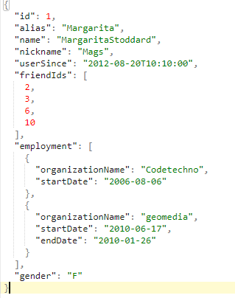
JSON in AsterixDB
Regular JSON
AsterixDB JSON
{"id":1,
"alias":"Margarita",
"name":"MargaritaStoddard",
"nickname":"Mags",
"userSince":datetime("2012-08-20T10:10:00"),
"friendIds": {{2,3,6,10}},
"employment":[
{"organizationName":"Codetechno",
"startDate":date("2006-08-06")
},
{"organizationName":"geomedia",
"startDate":date("2010-06-17"),
"endDate":date("2010-01-26")
}
],
"gender":"F"}
string
Scalar list
date

Slide 27
Schema Declaration in AsterixDB – Types
create type EmploymentType as closed {
organizationName: string,
startDate: date,
endDate: date?
};
create type GleambookUserType as open {
id: int,
alias: string,
name: string,
userSince: datetime,
friendIds: {{ int }},
employment: [EmploymentType]
};
create type GleambookMessageType as {
messageId: int,
authorId: int,
inResponseTo: int?,
senderLocation: point?,
message: string
};

Slide 28
Schema Declaration in AsterixDB – Datasets
use dataverse TinySocial;
create dataset GleambookUsers(GleambookUserType)
primary key id;
create dataset GleambookMessages(GleambookMessageType)
primary key messageId;
create feed UserFeed
using localfs (
("type-name"=“GleamBookUserType"),
("path"="HOSTNAME://LOCAL_FILE_PATH"),
("format"="adm")
)

Slide 29
Querying AsterixDB
Two languages
AQL: influenced by XQuery Language
SQL++: SQL for JSON*
Cannot express queries with unbounded paths

Slide 30
SQL ++ Query Examples (AsterixDB version)
Return the subtree under the Root Node of a Dataset tree
SELECT VALUE user
FROM GleambookUsers user;
If you omit the alias to the data set, you will get k null records of the data set has k elements
Return the subtree under a specific node of the tree
SELECT VALUE user
FROM GleambookUsers user
WHERE user.id = 6;

Slide 31
SQL ++ Query Examples (AsterixDB version)
Return subtree under a node satisfying different predicates
Predicates on typed data
SELECT VALUE chirp
FROM ChirpMessages chirp
WHERE chirp.user.friendsCount < 200 and
get_date_from_datetime( chirp.sendTime) > date('2011-01-01') ;
Predicates on list-valued elements
SELECT VALUE user
FROM GleambookUsers user
WHERE array_count(user.friendIds) = 1 ;

Slide 32
SQL ++ Query Examples (AsterixDB version)
{
"id": 2,
"alias": "Isbel",
"name": "IsbelDull",
"userSince": "2011-01-
22T10:10:00.000Z",
"friendIds": [ 1, 4 ],
"employment": [
{ "organizationName":
"Hexviafind",
"startDate": "2010-04-27"
}
],
"nickname": "Izzy"
}
A second look at querying lists
Find GleambookUsers who work for an organization called Hexviafind
SELECT VALUE user
FROM GleambookUsers user
WHERE user.employment.organizationName = “Hexviafind” ;
ASX1002: Type mismatch: function field-access-by-name expects its 1st input parameter to be type object, but the actual input type is array [TypeMismatchException]
SELECT VALUE user
FROM GleambookUsers user
UNNEST user.employment e
WHERE e.organizationName = “Hexviafind” ;

Slide 33
SQL ++ Query Examples (AsterixDB version)
Nested queries – theta join
SELECT cm1.messageText AS message,
(SELECT VALUE cm2.messageText
FROM ChirpMessages cm2
WHERE `spatial-distance`(cm1.senderLocation, cm2.senderLocation) <= 1
AND cm2.chirpId < cm1.chirpId) AS nearbyMessages
FROM ChirpMessages cm1;
Queries with quantification
SELECT VALUE gbu
FROM GleambookUsers gbu
WHERE (SOME e IN gbu.employment SATISFIES e.endDate IS UNKNOWN);
EVERY e IN gbu.employment SATISFIES e.endDate IS NOT UNKNOWN

Slide 34
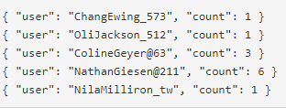
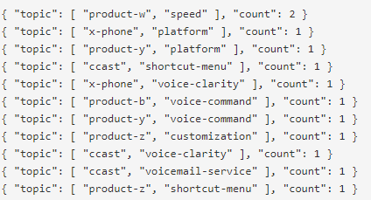
SQL ++ Query Examples (AsterixDB version)
Group By and Aggregation
SELECT uid AS user, COUNT(cm) AS count
FROM ChirpMessages cm
GROUP BY cm.user.screenName AS uid;
SELECT topics AS user, COUNT(cm) AS count
FROM ChirpMessages cm
GROUP BY cm.referredTopics AS topics;

Slide 35
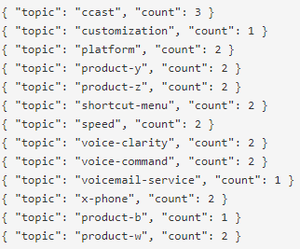
SQL ++ Query Examples (AsterixDB version)
Group By, Unnest and Aggregation
SELECT topics AS topic, COUNT(cm) AS count
FROM ChirpMessages cm
UNNEST cm.referredTopics t
GROUP BY t AS topics;
UNNEST has SQL’s inner join semantics — that is, if a message has no referred topics, no tuple corresponding to that message will be emitted in the result
SELECT u.id AS userId, h.hobbyName AS hobby
FROM GleambookUsers u
LEFT OUTER UNNEST u.hobbies h
WHERE u.id = 1;
{ "userId": 1 }

Slide 36
SQL ++ Query Examples (AsterixDB version)
{ "uid": 1, "$1": [ { "m": { "messageId": 8, "authorId": 1, "inResponseTo": 11, "senderLocation": [40.33, 80.87], "message": " like ccast the 3G is awesome:)" } }, { "m": { "messageId": 10, "authorId": 1, "inResponseTo": 12, "senderLocation": [42.5, 70.01], "message": " can't stand product-w the touch-screen is terrible" } }, { "m": { "messageId": 11, "authorId": 1, "inResponseTo": 1, "senderLocation": [38.97, 77.49], "message": " can't stand acast its plan is terrible" } }, { "m": { "messageId": 2, "authorId": 1, "inResponseTo": 4, "senderLocation": [41.66, 80.87], "message": " dislike x-phone its touch-screen is horrible" } }, { "m": { "messageId": 4, "authorId": 1, "inResponseTo": 2, "senderLocation": [37.73, 97.04], "message": " can't stand acast the network is horrible:(" } } ] }
{ "uid": 2, "$1": [ { "m": { "messageId": 6, "authorId": 2, "inResponseTo": 1, "senderLocation": [31.5, 75.56], "message": " like product-z its platform is mind-blowing" } }, { "m": { "messageId": 3, "authorId": 2, "inResponseTo": 4, "senderLocation": [48.09, 81.01], "message": " like product-y the plan is amazing" } } ] }
{ "uid": 3, "$1": [ { "m": { "messageId": 9, "authorId": 3, "inResponseTo": 12, "senderLocation": [34.45, 96.48], "message": " love ccast its wireless is good" } }, { "m": { "messageId": 1, "authorId": 3, "inResponseTo": 2, "senderLocation": [47.16, 77.75], "message": " love product-b its shortcut-menu is awesome:)" } } ] }
Grouping without aggregation
SELECT *
FROM GleambookMessages m
GROUP BY m.authorId AS uid
ORDER BY uid;

Slide 37
SQL ++ Query Examples (AsterixDB version)
{ "uid": 1, “msgs": [ { "m": { "messageId": 8, "authorId": 1, "inResponseTo": 11, "senderLocation": [40.33, 80.87], "message": " like ccast the 3G is awesome:)" } }, { "m": { "messageId": 10, "authorId": 1, "inResponseTo": 12, "senderLocation": [42.5, 70.01], "message": " can't stand product-w the touch-screen is terrible" } }, { "m": { "messageId": 11, "authorId": 1, "inResponseTo": 1, "senderLocation": [38.97, 77.49], "message": " can't stand acast its plan is terrible" } }, { "m": { "messageId": 2, "authorId": 1, "inResponseTo": 4, "senderLocation": [41.66, 80.87], "message": " dislike x-phone its touch-screen is horrible" } }, { "m": { "messageId": 4, "authorId": 1, "inResponseTo": 2, "senderLocation": [37.73, 97.04], "message": " can't stand acast the network is horrible:(" } } ] }
{ "uid": 2, “msgs": [ { "m": { "messageId": 6, "authorId": 2, "inResponseTo": 1, "senderLocation": [31.5, 75.56], "message": " like product-z its platform is mind-blowing" } }, { "m": { "messageId": 3, "authorId": 2, "inResponseTo": 4, "senderLocation": [48.09, 81.01], "message": " like product-y the plan is amazing" } } ] }
{ "uid": 3, “msgs": [ { "m": { "messageId": 9, "authorId": 3, "inResponseTo": 12, "senderLocation": [34.45, 96.48], "message": " love ccast its wireless is good" } }, { "m": { "messageId": 1, "authorId": 3, "inResponseTo": 2, "senderLocation": [47.16, 77.75], "message": " love product-b its shortcut-menu is awesome:)" } } ] }
Grouping without aggregation
SELECT *
FROM GleambookMessages m
GROUP BY m.authorId AS uid
GROUP AS msgs
ORDER BY uid;

Slide 38
SQL ++ Query Examples (AsterixDB version)
{ "uid": 1, “msgs": [ { "msg": { "messageId": 8, "authorId": 1, "inResponseTo": 11, "senderLocation": [40.33, 80.87], "message": " like ccast the 3G is awesome:)" } }, { "msg": { "messageId": 10, "authorId": 1, "inResponseTo": 12, "senderLocation": [42.5, 70.01], "message": " can't stand product-w the touch-screen is terrible" } }, { "msg": { "messageId": 11, "authorId": 1, "inResponseTo": 1, "senderLocation": [38.97, 77.49], "message": " can't stand acast its plan is terrible" } }, { "msg": { "messageId": 2, "authorId": 1, "inResponseTo": 4, "senderLocation": [41.66, 80.87], "message": " dislike x-phone its touch-screen is horrible" } }, { "msg": { "messageId": 4, "authorId": 1, "inResponseTo": 2, "senderLocation": [37.73, 97.04], "message": " can't stand acast the network is horrible:(" } } ] }
{ "uid": 2, “msgs": [ { "msg": { "messageId": 6, "authorId": 2, "inResponseTo": 1, "senderLocation": [31.5, 75.56], "message": " like product-z its platform is mind-blowing" } }, { "msg": { "messageId": 3, "authorId": 2, "inResponseTo": 4, "senderLocation": [48.09, 81.01], "message": " like product-y the plan is amazing" } } ] }
{ "uid": 3, “msgs": [ { "msg": { "messageId": 9, "authorId": 3, "inResponseTo": 12, "senderLocation": [34.45, 96.48], "message": " love ccast its wireless is good" } }, { "msg": { "messageId": 1, "authorId": 3, "inResponseTo": 2, "senderLocation": [47.16, 77.75], "message": " love product-b its shortcut-menu is awesome:)" } } ] }
Grouping without aggregation
SELECT *
FROM GleambookMessages m
GROUP BY m.authorId AS uid
GROUP AS msgs(m as msg)
ORDER BY uid;

Slide 39
Practice Work
Install AsterixDB from https://asterixdb.apache.org/download.html
Populate the database with examples from https://ci.apache.org/projects/asterixdb/index.html
Run all queries shown in class
Run other examples from the documentation to gain familiarity

Slide 40
Vector Space Model for Text Data
Term-document count matrices
Consider the number of occurrences of a term in a document:
Each document is a count vector in ℕ^{v}: represented as a column

Slide 41
Bag of words model
Vector representation doesn’t consider the ordering of words in a document
John is quicker than Mary and Mary is quicker than John have the same vectors
This is called the bag of words model.
In a sense, this is a step back: The positional index was able to distinguish these two documents.
For now: bag of words model

Slide 42
Term frequency tf
The term frequency tf_{t,d} of term t in document d is defined as the number of times that t occurs in d.
We want to use tf when computing query-document match scores. But how?
Raw term frequency is not what we want:
A document with 10 occurrences of the term is more relevant than a document with 1 occurrence of the term.
But not 10 times more relevant.
Relevance does not increase proportionally with term frequency.
NB: frequency = count in IR

Slide 43
Log-frequency weighting
Sec. 6.2
The log frequency weight of term t in d is
0 → 0, 1 → 1, 2 → 1.3, 10 → 2, 1000 → 4, etc.
Score for a document-query pair: sum over terms t in both q and d:
score
The score is 0 if none of the query terms is present in the document.

Slide 44
Document frequency
Sec. 6.2.1
Rare terms are more informative than frequent terms
Recall stop words
Consider a term in the query that is rare in the collection (e.g., arachnocentric)
A document containing this term is very likely to be relevant to the query arachnocentric
→ We want a high weight for rare terms like arachnocentric.

Slide 45
Document frequency, continued
Sec. 6.2.1
Frequent terms are less informative than rare terms
Consider a query term that is frequent in the collection (e.g., high, increase, line)
A document containing such a term is more likely to be relevant than a document that doesn’t
But it’s not a sure indicator of relevance.
→ For frequent terms, we want high positive weights for words like high, increase, and line
But lower weights than for rare terms.
We will use document frequency (df) to capture this.

Slide 46
idf weight
Sec. 6.2.1
df_{t} is the document frequency of t: the number of documents that contain t
df_{t} is an inverse measure of the informativeness of t
df_{t} ≤ N
We define the idf (inverse document frequency) of t by
We use log (N/df_{t}) instead of N/df_{t} to “dampen” the effect of idf.
Will turn out the base of the log is immaterial.

Slide 47
idf example, suppose N = 1 million
Sec. 6.2.1
term | df_{t} | idf_{t}
calpurnia | 1
animal | 100
sunday | 1,000
fly | 10,000
under | 100,000
the | 1,000,000
There is one idf value for each term t in a collection.
Notes:
6 4 3 2 1 0

Slide 48
Effect of idf on ranking
Does idf have an effect on ranking for one-term queries, like
iPhone
idf has no effect on ranking one term queries
idf affects the ranking of documents for queries with at least two terms
For the query capricious person, idf weighting makes occurrences of capricious count for much more in the final document ranking than occurrences of person.

Slide 49
Collection vs. Document frequency
The collection frequency of t is the number of occurrences of t in the collection, counting multiple occurrences.
Example:
Which word is a better search term (and should get a higher weight)?
Word | Collection frequency | Document frequency
insurance | 10440 | 3997
try | 10422 | 8760
Notes:
Why do you get these numbers?
Suggests df is better.

Slide 50
High-idf query terms only
For a query such as catcher in the rye
Only accumulate scores from catcher and rye
Intuition: in and the contribute little to the scores and so don’t alter rank-ordering much
Benefit:
Postings of low-idf terms have many docs → these (many) docs get eliminated from set A of contenders

Slide 51
tf-idf weighting
The tf-idf weight of a term is the product of its tf weight and its idf weight.
Best known weighting scheme in information retrieval
Note: the “-” in tf-idf is a hyphen, not a minus sign!
Alternative names: tf.idf, tf x idf
Increases with the number of occurrences within a document
Increases with the rarity of the term in the collection

Slide 52
Score for a document given a query
There are many variants
How “tf” is computed (with/without logs)
Whether the terms in the query are also weighted
…

Slide 53
Length normalization
A vector can be (length-) normalized by dividing each of its components by its length – for this we use the L₂ norm:
Dividing a vector by its L₂ norm makes it a unit (length) vector (on surface of unit hypersphere)
Effect on the two documents d and d′ (d appended to itself) from earlier slide: they have identical vectors after length-normalization.
Long and short documents now have comparable weights

Slide 54
cosine(query,document)
Dot product
Unit vectors
q_{i} is the tf-idf weight of term i in the query
d_{i} is the tf-idf weight of term i in the document
cos(q,d) is the cosine similarity of q and d … or,
equivalently, the cosine of the angle between q and d.
Notes:
See Law of Cosines (Cosine Rule) wikipedia page

Slide 55
Cosine for length-normalized vectors
For length-normalized vectors, cosine similarity is simply the dot product (or scalar product):
for q, d length-normalized.

Slide 56
Cosine similarity amongst 3 documents
Sec. 6.3
How similar are
the novels
SaS: Sense and
Sensibility
PaP: Pride and
Prejudice, and
WH: Wuthering
Heights?
term | SaS | PaP | WH
affection | 115 | 58 | 20
jealous | 10 | 7 | 11
gossip | 2 | 0 | 6
wuthering | 0 | 0 | 38
Term frequencies (counts)
Note: To simplify this example, we don’t do idf weighting.

Slide 57
3 documents example contd.
Sec. 6.3
Log frequency weighting
After length normalization
term | SaS | PaP | WH
affection | 3.06 | 2.76 | 2.30
jealous | 2.00 | 1.85 | 2.04
gossip | 1.30 | 0 | 1.78
wuthering | 0 | 0 | 2.58
term | SaS | PaP | WH
affection | 0.789 | 0.832 | 0.524
jealous | 0.515 | 0.555 | 0.465
gossip | 0.335 | 0 | 0.405
wuthering | 0 | 0 | 0.588
cos(SaS,PaP) ≈
0.789 × 0.832 + 0.515 × 0.555 + 0.335 × 0.0 + 0.0 × 0.0
≈ 0.94
cos(SaS,WH) ≈ 0.79
cos(PaP,WH) ≈ 0.69
Why do we have cos(SaS,PaP) > cos(SaS,WH)?

Slide 58
Weighting may differ in queries vs documents
Sec. 6.4
Many search engines allow for different weightings for queries vs. documents
SMART Notation: denotes the combination in use in an engine, with the notation ddd.qqq, using the acronyms from the previous table
A very standard weighting scheme is: lnc.ltc
Document: logarithmic tf (l as first character), no idf and cosine normalization
Query: logarithmic tf (l in leftmost column), idf (t in second column), no normalization …
A bad idea?
Notes:
Leaving off idf weighting on documents is good for both efficiency and system effectiveness reasons.

Slide 59
Docs containing many query terms
Any doc with at least one query term is a candidate for the top K output list
For multi-term queries, only compute scores for docs containing several of the query terms
Say, at least 3 out of 4
Imposes a “soft conjunction” on queries seen on web search engines (early Google)

Slide 60
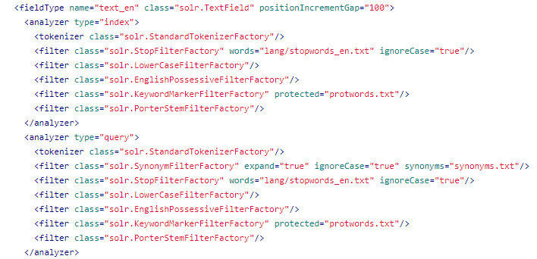
Apache Solr – A Full Text Search System
Schema declaration

Slide 61
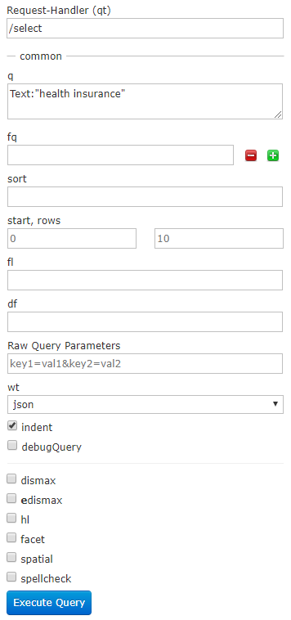
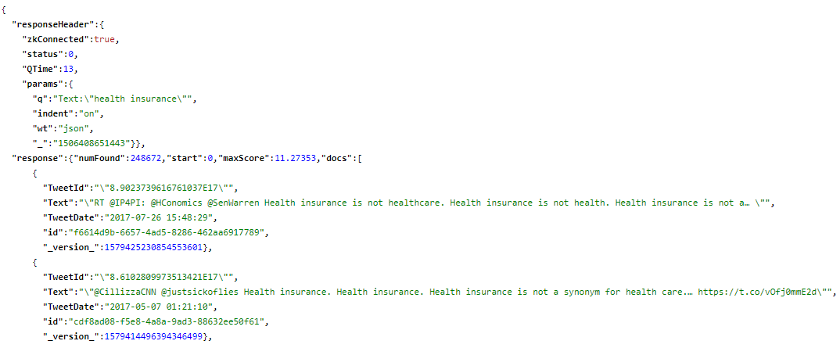
Querying Solr
https://awesome-ucla.sdsc.edu:8983/solr/uclaaca/select?indent=on&q=*:*&rows=0&wt=json
https://awesome-ucla.sdsc.edu:8983/solr/uclaaca/select?indent=on&q=Text:%22health%20insurance%22&rows=1000&wt=json

Slide 62
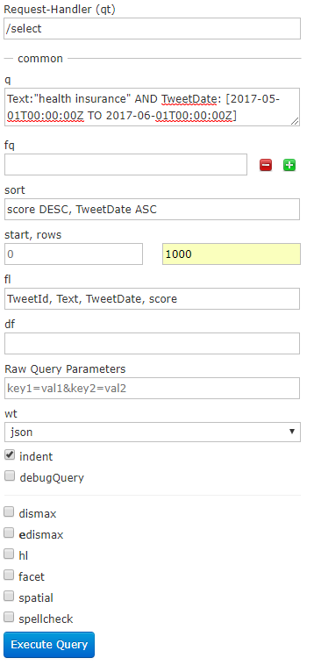
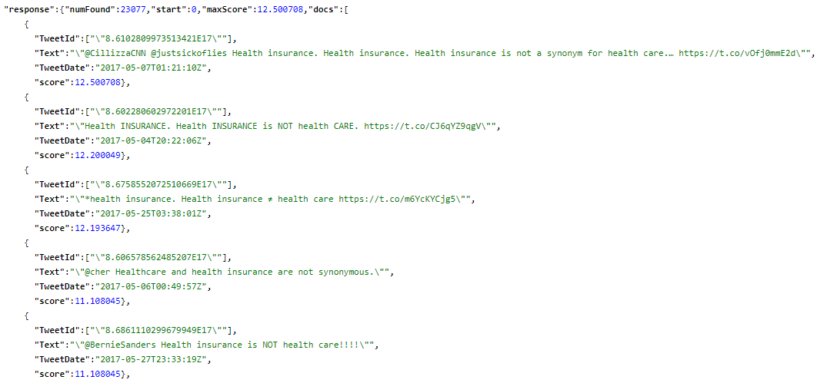
https://awesome-ucla.sdsc.edu:8983/solr/uclaaca/select?fl=TweetId,%20Text,%20TweetDate,%20score&indent=on&q=Text:%22health%20insurance%22%20AND%20TweetDate:%20[2017-05-01T00:00:00Z%20TO%202017-06-01T00:00:00Z]&rows=1000&sort=score%20DESC,%20TweetDate%20ASC&wt=json

Slide 63
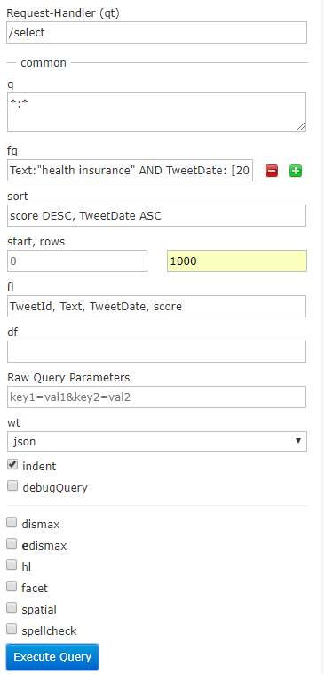
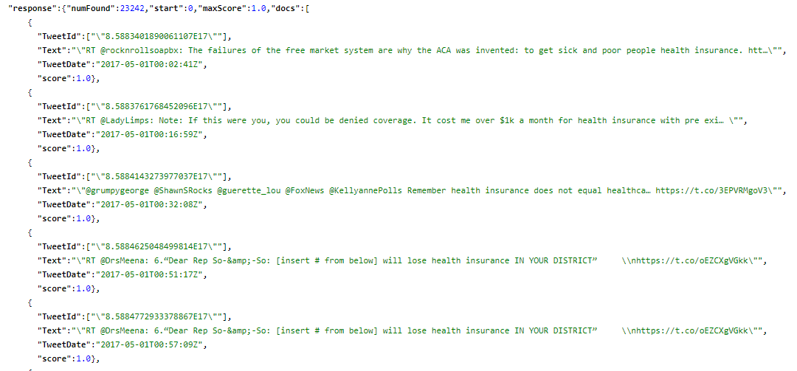
https://awesome-ucla.sdsc.edu:8983/solr/uclaaca/select?fl=TweetId,%20Text,%20TweetDate,%20score&fq=Text:%22health%20insurance%22%20AND%20TweetDate:%20[2017-05-01T00:00:00Z%20TO%202017-06-01T00:00:00Z]&indent=on&q=*:*&rows=1000&sort=score%20DESC,%20TweetDate%20ASC&wt=json

Slide 64
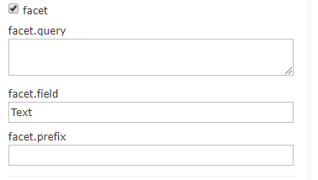
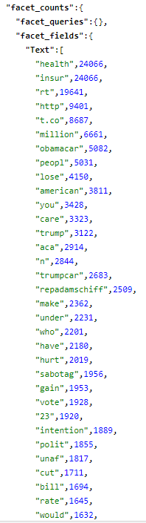

Slide 65
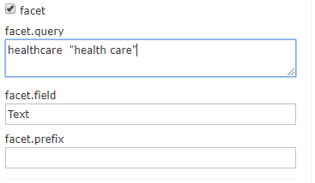

Slide 66
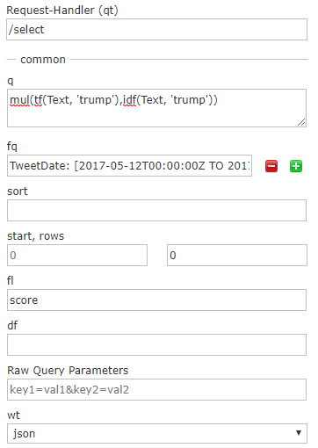
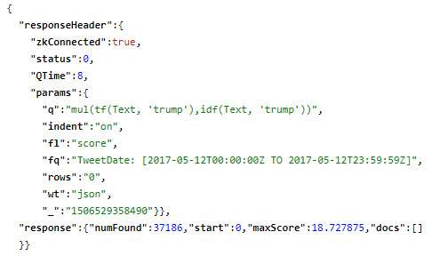
https://awesome-ucla.sdsc.edu:8983/solr/uclaaca/select?fl=score&fq=TweetDate:%20[2017-05-12T00:00:00Z%20TO%202017-05-12T23:59:59Z]&indent=on&q=mul(tf(Text,%20%27trump%27),idf(Text,%20%27trump%27))&rows=0&wt=json

Slide 67
Practical work
Try the queries
Read http://www.openjems.com/solr-lucene-score-tutorial/ to understand how a score is computed by Solr
There are many more query operations and useful functions in Solr. Look at the examples provided in
The Solr documentation
Examples from Lucidworks
Get text data from the project examples into Solr and run queries on them

Slide 68
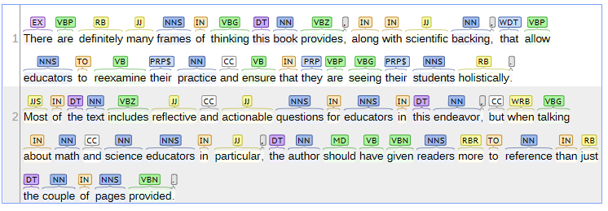
Data From a Computational Process – NLP
There are definitely many frames of thinking this book provides, along with scientific backing, that allow educators to reexamine their practice and ensure that they are seeing their students holistically. Most of the text includes reflective and actionable questions for educators in this endeavor, but when talking about math and science educators in particular, the author should have given readers more to reference than just the couple of pages provided.
POS Tagging

Slide 69
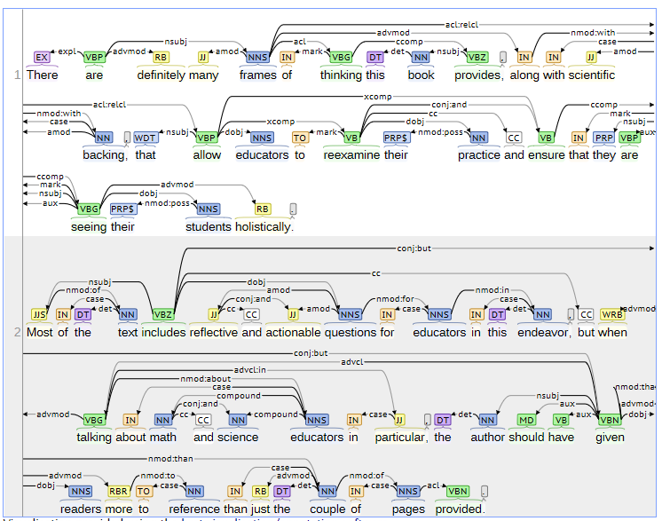
Data From NLP
There are definitely many frames of thinking this book provides, along with scientific backing, that allow educators to reexamine their practice and ensure that they are seeing their students holistically. Most of the text includes reflective and actionable questions for educators in this endeavor, but when talking about math and science educators in particular, the author should have given readers more to reference than just the couple of pages provided.

Slide 70
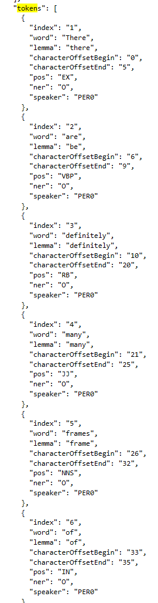
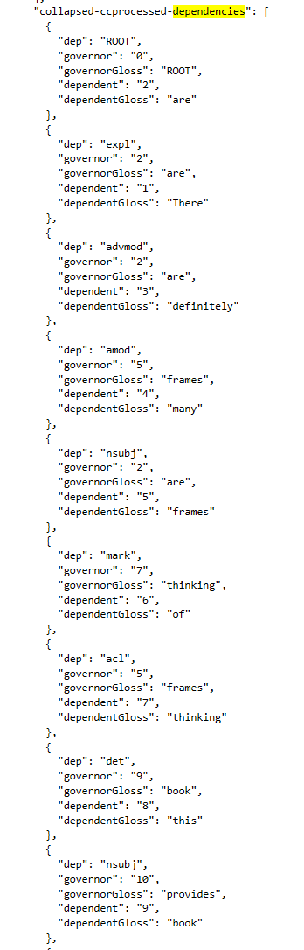
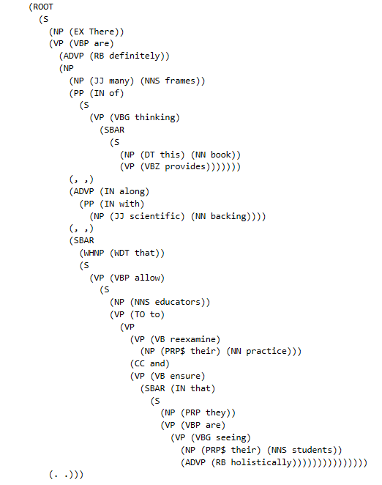

Slide 71
DSE 203
Day 1: MODELS AND TASKS OF DATA INTEGRATION

Slide 72
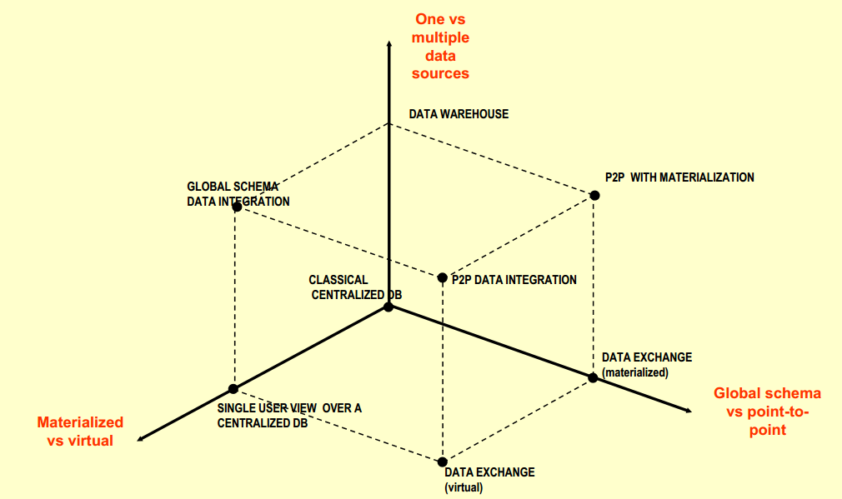
Data Integration Architecture – Design Axes

Slide 73
Materialized vs. Virtual
Materialized Data Integration
Multiple sources
Data transformed to conform to a unified schema
The unified view of data is stored
Example: a data warehouse
Virtual Data Integration
The unified view is virtual
Data resides only at sources
Global schema, source schema, mapping between them
User queries are reformulated
What are the advantages and disadvantages of each?

Slide 74
Centralized vs. Distributed
Centralized
The data may reside in the same location (materialized) or different locations (virtual)
The integrated schema is defined centrally
Queries and results are communicated through a central control
Query planning and execution are performed through the central control
Distributed
Multiple networked computers connected in some topology
Each machine has its own local schema and a summary of its neighbors’ schemata
Queries can be submitted to any machine
Queries are executed by performing local evaluation and passing partial results
What are the advantages and disadvantages of each?

Slide 75
Data Exchange – not exactly integration
2 parties – source and target
Goal
Materializing an instance that adheres to a target schema, given an instance of a source schema and a specification of the relationships between the source schema and the target schema
Relationships expressed as constraints between the source and the target and further constrainst on the target schema
Main focus – actually materializing a target instance that reflects the source data as accurately as possible
Challenge
The relationship between the source and the target is undesrspecified

Slide 76
Source Description
Catalog of sources and their capabilities
Schema if available
Export schema, views, …
Data description
Data types
Complex structures
Constraints that apply
Access methods
Can be modeled as schemas
Invocation specification
Calling restrictions, update rates
Auxiliary Information
Rough estimate of data size
Location, availability parameters, communication delays, reliability

Slide 77
Matching
What needs to match?
Elements of the target schema with elements of source schemata
How to construct a “value” in the target element as a function of corresponding values in the source elements
Schema matching
Defining the exact correspondence between elements of the source schemata and the value of a target schema element
Schema mapping
Rules for construction of the target tuples
Data Matching
Value matching
“Record” matching

Slide 78
Data Preparation
For any given source can the data be used “as is” for integration?
Does it need reformatting?
Does it need restructuring?
Does it need discarding “noise data”?
Do we need all the data that is provided by the source?
Do we need to transform/wrap/translate the data from its current state to an integration-ready state?
Are the transformation rules completely known?
Is human validation needed for the data or the data transformation?

Slide 79
Data Transformation
Stems from the semantic incongruity problem
Structural types vs. semantic types
Integer (with non-negative constraint) vs. age
Transformations
Functions that convert structures (and values) but maintain semantic type
Unit conversions
Numerical manipulations
Implementation through UDFs (User Defined Functions) in an SQL setting

Slide 80
Model Manipulation
The data sources to be integrated can come from different data models
Often different data models are transformed into a common model
Are there a set of operations for model transformation?
Are there ways to perform these model transformations automatically?

Slide 81
Query Planning and Evaluation
The user asks a query to the integrated schema
Which sources should be used for this query?
The source selection problem
How does the query get reformulated to smaller, component queries that would be evaluated by each source?
The query reformulation problem
Where does the query execute?
Different answers depending on the integration architecture
What happens when data sources are to be accessed over the Internet?

Slide 82
Query Reformulation
The problem
Given
A query against a target schema
Source descriptions
Mapping information
Rewrite new queries against the sources
We will sometimes use a logical language to describe queries

Slide 83
Data Aggregation
Special case of data integration – vertical integration
The schema of each source is identical
Virtual bookstore integrating other stores for regular books, textbooks and antique books
The sources may have overlapping content
What happens when there are too many sources?

Slide 84
Data Fusion
Information sources like the internet often have small fragments of information about an entity
These information fragments are heterogeneous, almost never complete and sometimes inaccurate
This gives rise to potential conflicts when all data are assimilated into the integration system
Data Fusion
Combining multiple records representing the same real-world object into a single, consistent, and clean representation

Slide 85
DSE 203
Day 1: PREDICTIVE ANALYTICS through “Data management” glasses

Slide 86
The Process of Analytics – Things to Decide
What happens if this data is more heterogeneous?
What happens if this is very large?
What does “integration” mean here?
What is the structure of this database?
Can we do (part of) the feature extraction here?

Slide 87
A Generic Template for Predictive Analytics
Demand prediction
Given a commodity product or product category, the history of its past consumption, and other characteristic and exogenous factors
Prepare the data, eliminating unwanted input
Determine features
Identify different consumption patterns (e.g., by season, by customer profile, …)
Select appropriate feature subsets for every consumption pattern
Select the right modeling framework
Perform training and learning
Predict
Demand for next time period
Consumption for next time period
Apply the template to Books

Slide 88
Designing an Analysis Plan
Which books or book categories should be used for demand analysis?
Let’s say we choose the category (how?)
Books/Education & Teaching/Higher & Continuing Education/
Should we include all books under this category?
Should we select a subset by price, sales, number of reviews, average rating?
Should we consider all sales?
Should we consider gift seasons?
Should we consider all reviews?
Eliminate really short reviews?
Only consider reviews with some specific expressions in them?
Eliminate reviews that are from reviewers who give high (or low) recommendation to too many books?
Eliminate low reviews where the only negative factor is price and not content?

Slide 89
Designing an Analysis Plan
How should we choose the training labels?
Label demand-level into a categorical variable based on sales of the next
Day? Week? Month?
Should variables like price also be binned into buckets?
Do we perform the learning task on samples of data?
What’s the sampling scheme?
Should we aggregate data (e.g., take min, max and avg of weekly sales)?
Should we introduce lumped variables (e.g., books that are often sold together form a group)?

Slide 90
From Analysis Plans to Database Operations
Find books
whose category name contains the string “Education” and
must be at least two levels below “Books” (why?) AND
the price of the book is between $20 and $60 (why?) AND
the book must have an average sale of 20 copies/month AND
the book has received at least 10 reviews (why?)
each of which must have at least three sentences (why?)
Let’s say we choose the category Books/Education & Teaching/Higher & Continuing Education/
Should we include all books under this category?
Should we select a subset by price, sales, number of reviews, average rating?
What would be a conforming schema for this part of the data preparation task?
What would be the corresponding query against this schema?

Slide 91
Data Exploration with Queries
Simple Random Sampling
A simple random sample is a subset of a statistical population in which each member of the subset has an equal probability of being chosen
Repeatable or non-repeatable?
With or without replacement?
SELECT * FROM OrderTable
WHERE price > 20
ORDER BY random()
LIMIT 1000;
SELECT * from OrderTable
WHERE random() <= 0.01
ORDER BY random()
LIMIT 1000;

Slide 92
Data Exploration with Queries
Stratified Sampling
Partition the population into groups (strata)
Obtain a simple random sample from each group (stratum)
Collect data on each sampling unit that was randomly sampled from each group (stratum)
Stratified sampling works best when a heterogeneous population is split into fairly homogeneous groups.

Slide 93
Data Exploration with Queries
Histograms
What is the distribution of orders by state and how is this related to the state’s population?
SELECT State, SUM(numorders) as numorders, SUM(pop) as pop
FROM ((SELECT o.State, COUNT(*) as numorders, 0 as pop
FROM Orders o
GROUP BY o.state
) UNION ALL
(SELECT zc.stab, 0 as numorders, SUM(totpop) as pop
FROM ZipCensus zc
GROUP BY zc.stab
)
) summary
GROUP BY State
ORDER BY numorders DESC

