Slide 1
Probabilistic Models of time series data
Dirichlet Processes
- Krishna Devkota

Slide 2
Motivation
Your friends are always complaining about food in the mensa
So, you decide to start a restaurant nearby
But, there is a problem ...
- you have no clue about the food preferences of the students (some can’t do without beer and pizza, some prefer vegan tofu, some want sushi maybe)
So, you start with a survey of people around you
Goal:
- Find the food preferences of the students and cluster them into appropriate groups

Slide 3
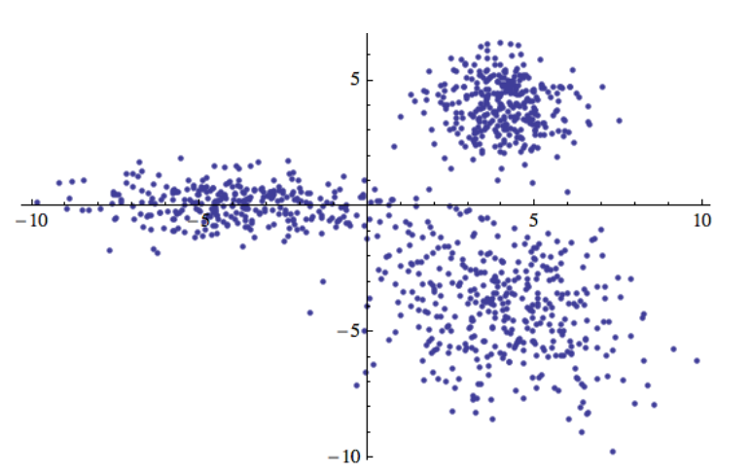
Clustering problem:
- Given observations: x₁, x₂,….x_{n}
Objective:
- subdivide them into subsets, i.e. clusters
- some sort of similarity sought for observations within each cluster
Fig: 1000 points divided into 3 clusters

Slide 4
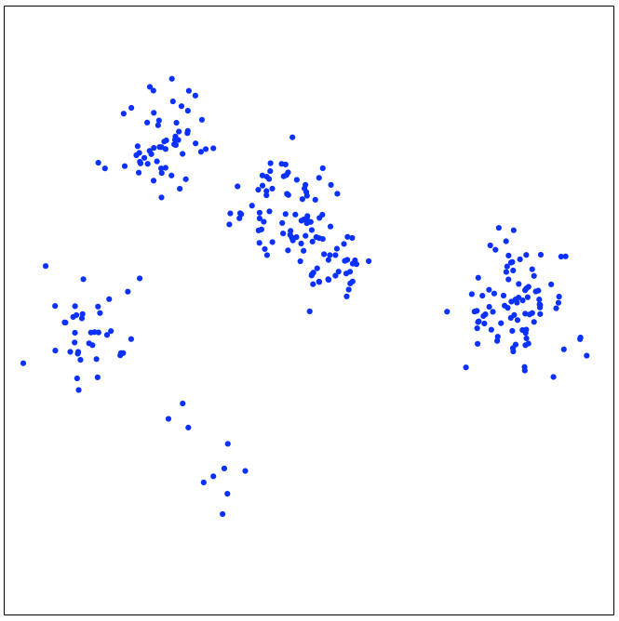
Clustering in terms of mixture models:
First, some basics!
Modeling assumption:
- Data is partitioned into groups / clusters
- Each observation x_{i} belongs to a single cluster k
Express cluster assignment as random variable L_{i}
- so, L_{i} = k means X_{i} belongs to cluster k
- As cluster assignments unknown, L_{i} remains latent (unobserved)
Stating it differently,
what is unknown is the partition of data-space {1,…..,N}
N = number of observed data-points

Slide 5


- Distribution characterizing a single cluster k,
given as:
- Probability that newly generated observation belongs to cluster k (basically the weights):
As c_{k} are probabilities of mutually exclusive events, they sum up to 1.

Slide 6
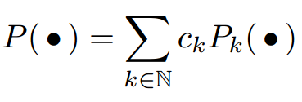
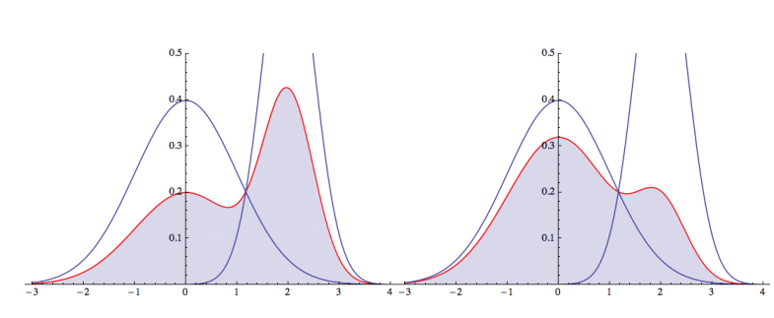
So, now the distribution of X is of the form:
- A model of this form is called a mixture distribution.
Figure: mixture of two Gaussian, left: c1 = 0.5, c2 = 0.5, right: c1 = 0.8, c2 = 0.2
- If the number of clusters is finite, meaning if there are finite number of K with non-zero probabilities c_{k}, we call the mixture a finite mixture

Slide 7
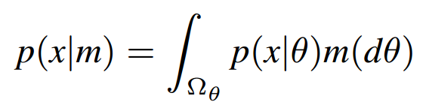
Mixture models:
Where, p (x|θ) is the component distribution
m(dθ) is called the mixing measure
To see what this means,
Think of p(x| θ) as a Gaussian distribution with parameter θ,
The second part m(dθ) is a distribution over θ .
m(dθ) is a distribution of finitely many delta spikes.
(p(x|θ) defines what kind of mixture model it is, i.e. if p (x|θ) is a Gaussian then a Gaussian mixture model)

Slide 8
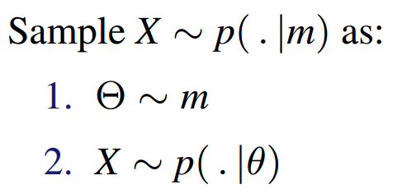
Mixture models can be looked upon as a two stage sampling:
For a given mixture model:
- first sample θ from the mixing measure ‘m’
- plug-in the theta as a parameter of the distribution p(x|θ)
- then sample the random variable x from the resulting distribution p(x|θ)
Parameter space for a mixture model:
- Set of all discrete probabilities on the parameter space Ω_{Φ} defined by p(x|φ)
- Φ = location of atoms

Slide 9
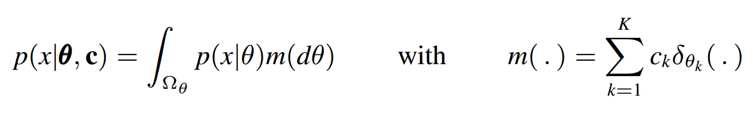
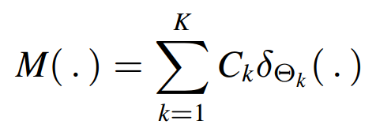
Finite mixture model
- where, mixing measure m(.) is simply sum over finite number of delta spikes at k different locations
- c_{k} ‘s are the convex coefficients to weigh the Dirac deltas
(convex coefficients simply mean that c values are non-negative and sum to 1)
Note: The mixture model is parameterized by the mixing distribution/ mixing measure!
Bayesian mixture model
A Bayesian mixture model is simply a mixture model with a random mixing measure.
Randomizing our parameters c and θ will give us a random mixing measure:

Slide 10
We basically want to put a prior for the mixing distribution!
How to choose the priors?
Idea from the very start: Use a conjugate prior!
What is a conjugate prior?
- Posterior belongs to the same class of distribution as the prior!
Conjugate priors generally occur only in the exponential families in the parametric case!
This accounts for the θ’s but we still have the c’s.
What we observe is that, when we sample from the mixture-model the c’s (index of the clusters) are multinomial distributed.
The parameter of this distribution is the vector of coefficients [c1,c2,….ck]
The conjugate prior of a multinomial is a Dirichlet!
So, we’ll use a Dirichlet distribution on our weight vector [c1,c2,….ck]

Slide 11
Let’s quickly look back at our restaurant problem:
We could use one of the standard algorithms based on FMM:
- k-means clustering
- Gaussian mixture models
- But remember, we surveyed very limited group of students!
- In reality, there are infinite (well, very large) number of foodies out there!
- How do you account for new food choices of other students (hidden clusters) which may arise later on?
To use a Finite mixture model, we (need to) start by assuming a certain (finite) number of clusters
But, what we really want is to allow newer clusters as our data (students) grow!
So, we have to do it in a non-parametric way!

Slide 12
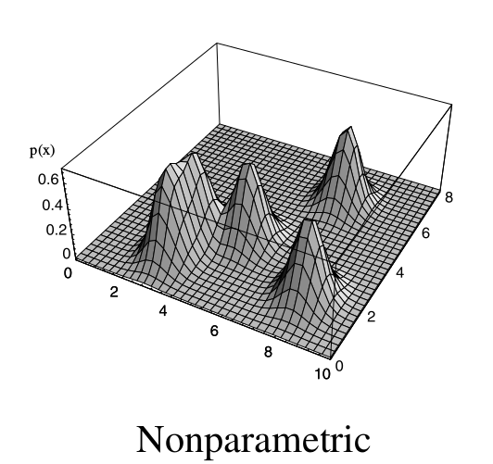
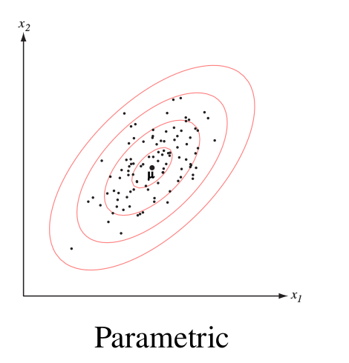
Very quick look at parametric vs. non-parametric model
Parametric:
Number of parameters fixed w.r.t sample size
Non-parametric:
- number of parameters grow with sample size
- infinite dimensional parameter space
(parameter space: space of models that can explain our data)
Quick example of density estimation:

Slide 13
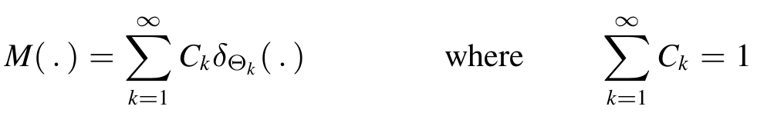
Dirichlet process mixture: Infinite limit of finite mixture models:
In the Bayesian mixture model, the mixing measure was:
If K → ∞, in our previous model, we get a non parametric model :
When nonparametric, we need to generate M(.) at random. Think about how we could do that?
Also, note the restriction: infinite sum over c’s must be 1.
Simple distribution that does this: Dirichlet process!

Slide 14
What is simple?
- as much independence as possible
- if c’s and θ’s highly dependent, very difficult to do inference on that model
Dirichlet Process:
A Dirichlet process is a distribution on random probability measures of the form:
Take some base distribution Go and sample atoms thetas iid from it (infinite seq of thetas)
What about the weights?
- they can’t be independent, because sum up to one
- so if 1st weight 0.5, second can’t be greater than 1.
Next best thing we can do?
- sample independent proportions and use them to generate weights.
This brings us to: stick breaking construction!

Slide 15
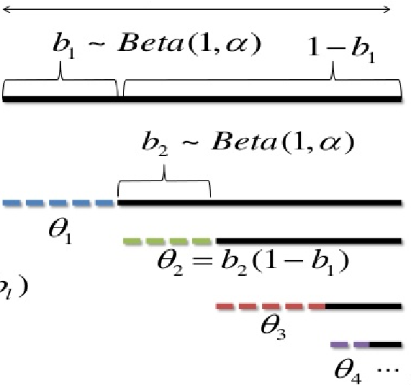
Constructive definition of DP(𝛼,G₀) [stick-breaking analogy]
STEPS:
- Start with a stick of length one
- Generate a random variable: β1∼Beta(1,α)
- By the definition of the Beta distribution, this will be a real number between 0 and 1, with expected value 1/(1+α)
- Break off the stick at b1
- w1 = 1-b1 is then the length of the stick on the left
- Now, generate β2∼Beta(1,α)
- Break off the part of stick b2.
- Again, w2 is the length of the stick to the left, i.e., w2=(1−b1)b2
- Repeat the process.

Slide 16
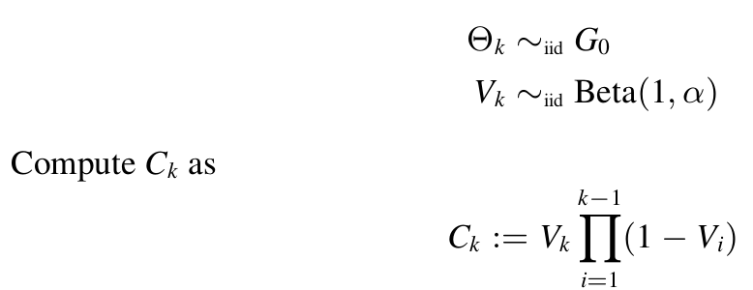
Mathematically, the process can be described as:
Things to note:
- weights v_{k} can’t be independent, as we have a constraint : Beta (1, 𝛼)
- so, the closest we can do to being independent is:
- sample independent proportions (v_{k}), and use them to generate weights, (as shown in previous page)

Slide 17
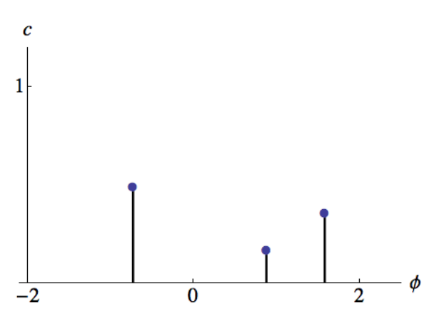
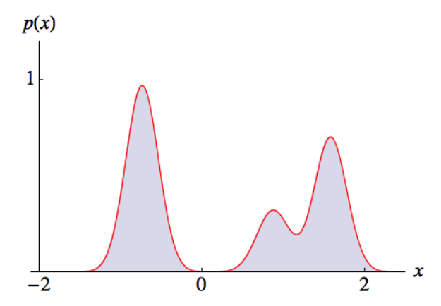
Dirichlet process in our clustering problem:
Intuitive understanding of the above expression:
Let’s say the centers of our clusters come from a base distribution (Go) that is a Gaussian:
- each line here is a weighted atom
- each draw here will be our cluster
- these are the center of our clusters
- For each atoms in the left figure, new Gaussian is created around the point that we drew
If our data comes from cluster 1, lands in first area with high probability, and so on!

Slide 18
So far we,
- described a generative model that allows us to calculate probability of assigning any particular set of groups to our data points
But, how do we actually learn a good set of group assignments!

Slide 19
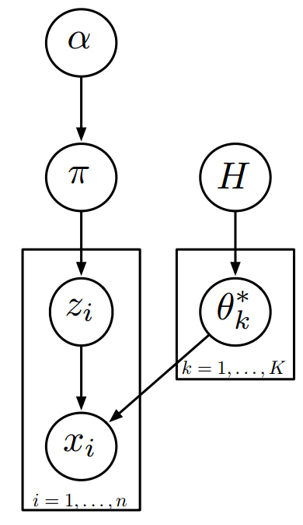
Inference in the DP mixture (Gibbs sampling):
Approach: MCMC sampling (particularly Gibbs)
Three unknowns:
π (parameter), z_{i} (latent variable), θ_{k}* (parameter)
Observation:
x_{i} (data)
Objective: learn about π, z_{i}, θ_{k}* in an iterative fashion

Slide 20
Inference (Gibbs sampling):
Steps:
STEP 1:
- Start with some estimate of parameters θ_{k}* and π
- Compute the “conditional distribution” of z_{i} given the parameters and data
- Draw a sample from that conditional distribution
(hope: to achieve high probability values of z_{i} that are more likely given the param and data)
STEP 2:
- After sampling the latent variables (z_{i}), conditioned on these latent variables and our data, compute the conditional distribution of the parameters
STEP 3:
- Sample from the newly computed distribution of the parameters, and the update the value of latent variables.
- This completes one cycle of MCMC update.
Repeat the above steps till convergence!
Will converge to true posterior distribution!

Slide 21
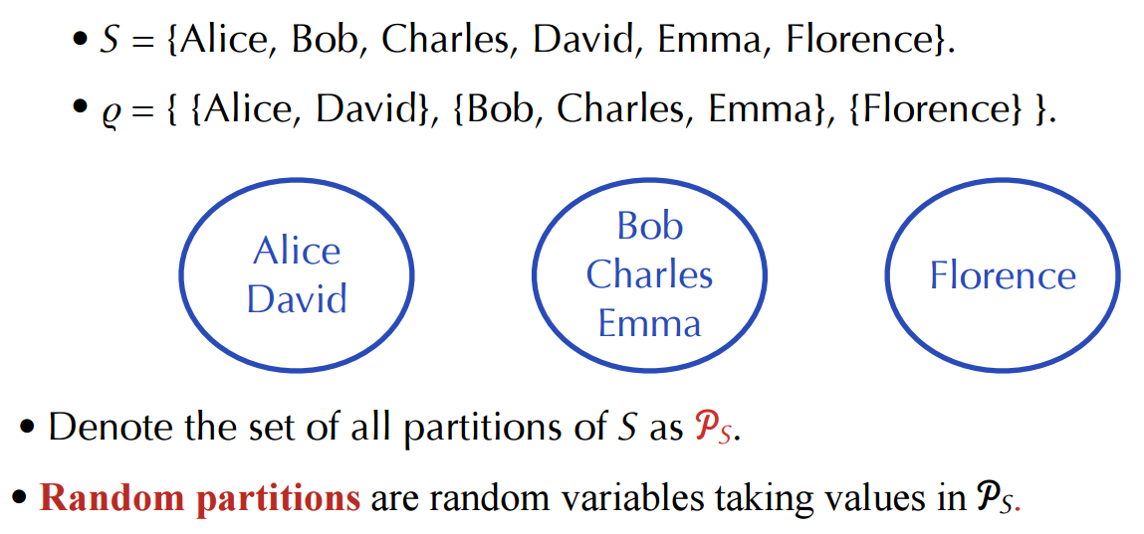
Chinese Restaurant Process:
The distribution of random partition induced by the Dirichlet process can be clearly explained through the Chinese Restaurant Process.
Quick Definition of Partition:
A partition of a set S is defined as a disjoint family of non-empty subsets of S whose union is S.

Slide 22
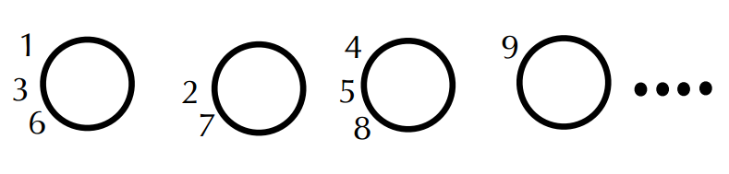
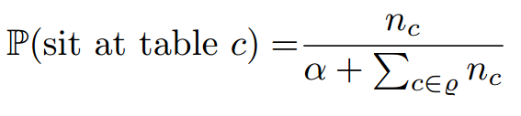
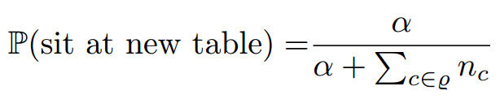
Chinese Restaurant Process
Each customer comes into a restaurant and sits at a table
Customers correspond to elements of : S
Tables correspond to clusters in :
Rich get richer : large clusters more likely to attract new customers

Slide 23
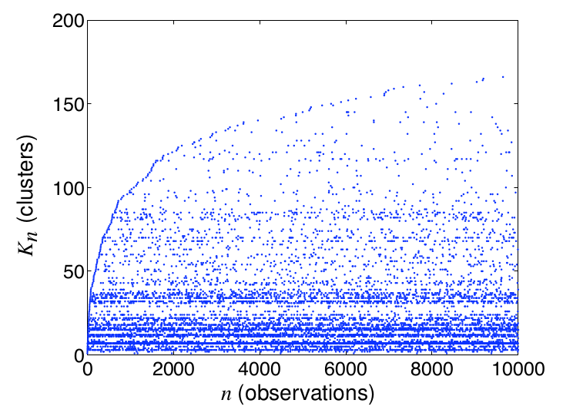

Number of clusters of a DP:
If Kn is number of clusters in sample of size n, then:

Slide 24
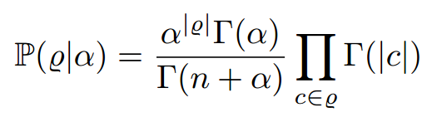
Chinese Restaurant Process
Exchangeable Partition Probability function:
Multiplying conditional probabilities together, the overall probability of
This is known as Exchangeable Partition Probability function.
We see that the order of the customers entering the restaurant does not affect the probability of
As we see above, ex-changeability is one of the important properties of Dirichlet process!!

Slide 25
What we have seen so far:
Non-parametric Bayesian clustering:
- Infinite number of clusters Kn <= n, where n = observations
- If partition exchangeable, it can be modeled using a random discrete distribution
Inference:
- since partitions (cluster assignments) not directly observed, latent variable algorithm used
- Gibbs sampling
Assumptions:
- prior assumption of number of clusters Kn
- distribution of cluster sizes

Slide 26
Dirichlet process applied to time-series data
TODO: will finish today! (including examples)

