Slide 1
Dirichlet Processes

Slide 2
Motivation
Your friends are always complaining about food in the mensa
So, you decide to start a restaurant nearby
But...
- you have no clue what food items to start with
- or what group of students prefer what kind of food (some can’t do without beer and pizza, some prefer vegan tofu, some want sushi maybe)
So, you start with a survey of people around you
Goal:
-Discover different types of groups (clusters) from the data you have gathered

Slide 3
Clustering in terms of mixture models
So what can he do?
One approach:
Standard algorithms for clustering
- k-means
- Gaussian Mixture models (GMM)
What we just saw above are known as Mixture models!

Slide 4
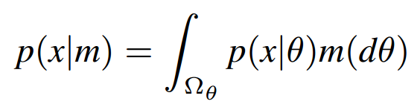
A very quick look into mixture models
Mixture models:
Where, p (x|θ) is the component distribution
m(dθ) is called the mixing measure
p (x|θ) defines what kind of mixture model it is, i.e. if p (x|θ) is a Gaussian then a Gaussian mixture model.

Slide 5
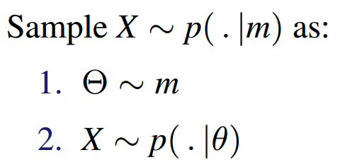
Easier if looked as a two stage sampling
- first sample θ’s from the mixing measure ‘m’
- then sample the random variable x from the distribution θ

Slide 6
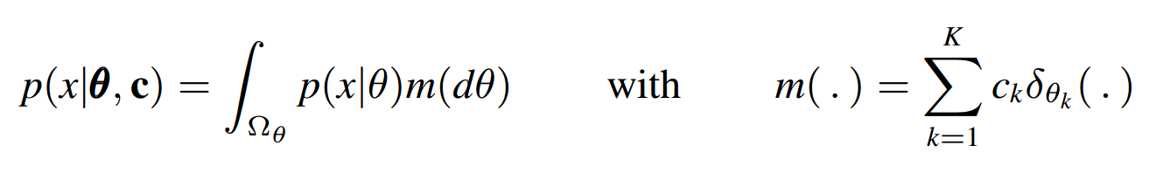
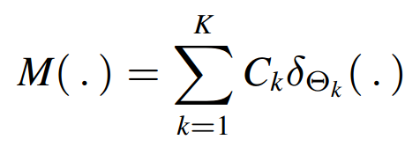
Finite mixture model
- where, mixing measure m(.) is simply sum over finite number of delta spikes at k different locations
- c_{k} ‘s are the convex coefficients to weigh the Dirac deltas
(convex coefficients simply mean that c values are non-negative and sum to 1)
Bayesian mixture model
Randomizing our parameters c and θ will give us a random mixing measure:
One fundamental idea behind Bayesian mixture model is to use conjugate prior for each parameter.
Conjugate prior:
A Bayesian model is conjugate if the posterior is an element of the same class of distributions as the prior.

Slide 7
Limitations of a Finite Mixture Models
Getting back to our restaurant problem:
- Some people including your friends and their group surveyed
- But your data is limited, and there are infinite (well, very large) number of foodie types
- How do you account for new food choices (hidden clusters) which may arise later on?
Problems with Finite mixture models:
- Need to start by assuming a certain (finite) number of clusters
So, what we really want is to allow the number of clusters as our data grows!
Luckily, as we have seen in some of our previous presentations, we have non-parametric Bayesian models to our rescue!

Slide 8
Bayesian nonparametrics
Advantages of Bayesian nonparametrics:
- forming clusters on the go
- helps reduce over-fitting or under-fitting which may be caused due to inappropriate selection of no. of clusters
- large function spaces to work with
- flexible way to build complex models

