Slide 1
Shortest Path Trees and Reach in Road Networks
Louis Abraham & Sayuli Drouard

Slide 2
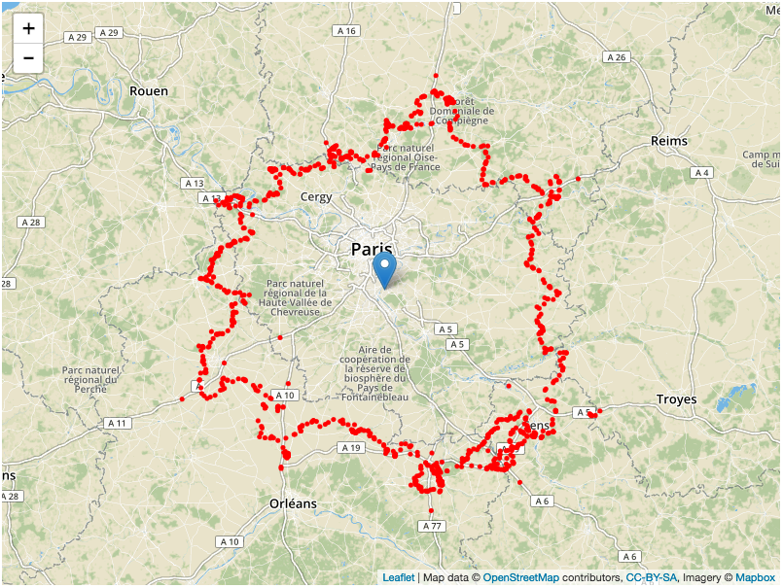
Our subject: shortest paths
Given a starting point, where do t hours on a shortest path bring you ?
What if your destination is at least t’ hours away ?
Study of the notion of reach (option B)

Slide 3
Method for Part I
Given a starting point, where do t hours on a shortest path bring you ?
What if your destination is at least t’ hours away ?
Dijkstra implemented with binary
Compute shortest paths using Dijkstra, then select vertices further away than t’, and backtrack to a t distance

Slide 4
Optimization
Dijkstra stop
Dijkstra memoization
Distance sorting
Online Dijkstra

Slide 5
Part II (Option B)
The notion of reach
Notes:
For a vertex v in a directed graph, reach(v) is the largest non-negative real r such that there exists a pair of points s and t, such that:
Some fastest path from s to t passes through v
The travel time from s to v as well as from v to t following that path is at least r

Slide 6
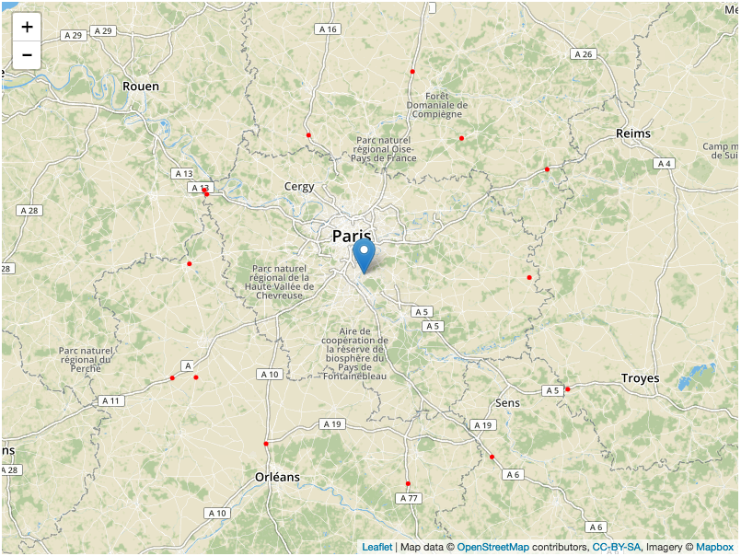

Part II (Option B)
T_{out} = set of points from problem (1.3)
S_{in} : same definition as T_{out} with the converse graph

Slide 7
Part II (Option B)
If reach(v) < 1 hour :
NO shortest path joins S_{in} and T_{out} through v

Slide 8
Part II (Option B)
If reach(v) ≥ 2 hours :
There MUST be a shortest path joining S_{in} and T_{out} through v

Slide 9
Part II (Option B)
T_{out}
S_{in}

Slide 10
The algorithm: estimating reach(v)

Slide 11
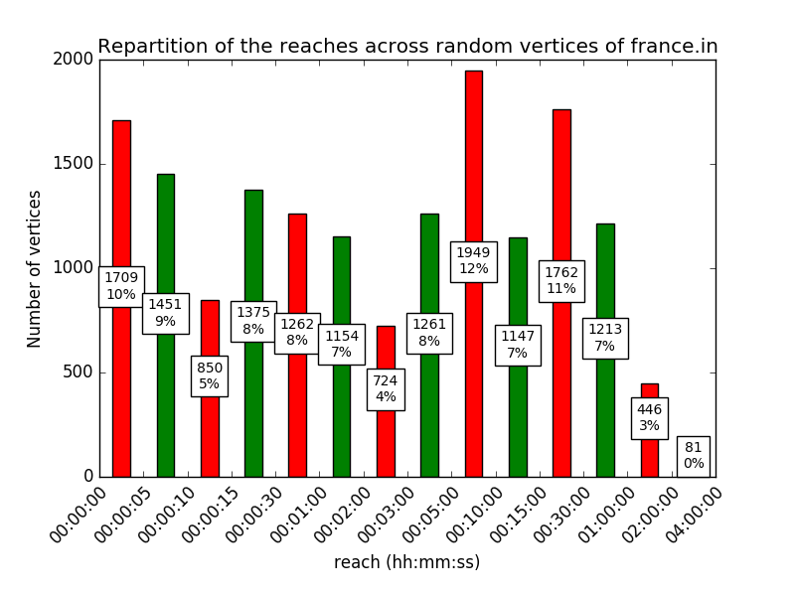
Reach in France

Slide 12
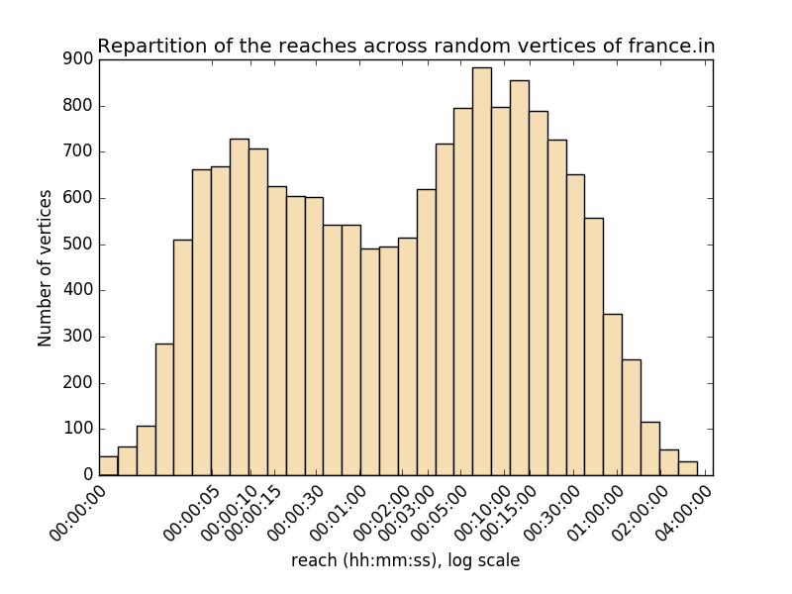
Reach in France

Slide 13
Thank you.

