Slide 1
Data Science in the Humanities
Week 4: The geometry of meaning
Feb 7, 2017

Slide 2
Finding distinctive words: what exactly does it prove? Other applicatations we can think of?

Slide 3
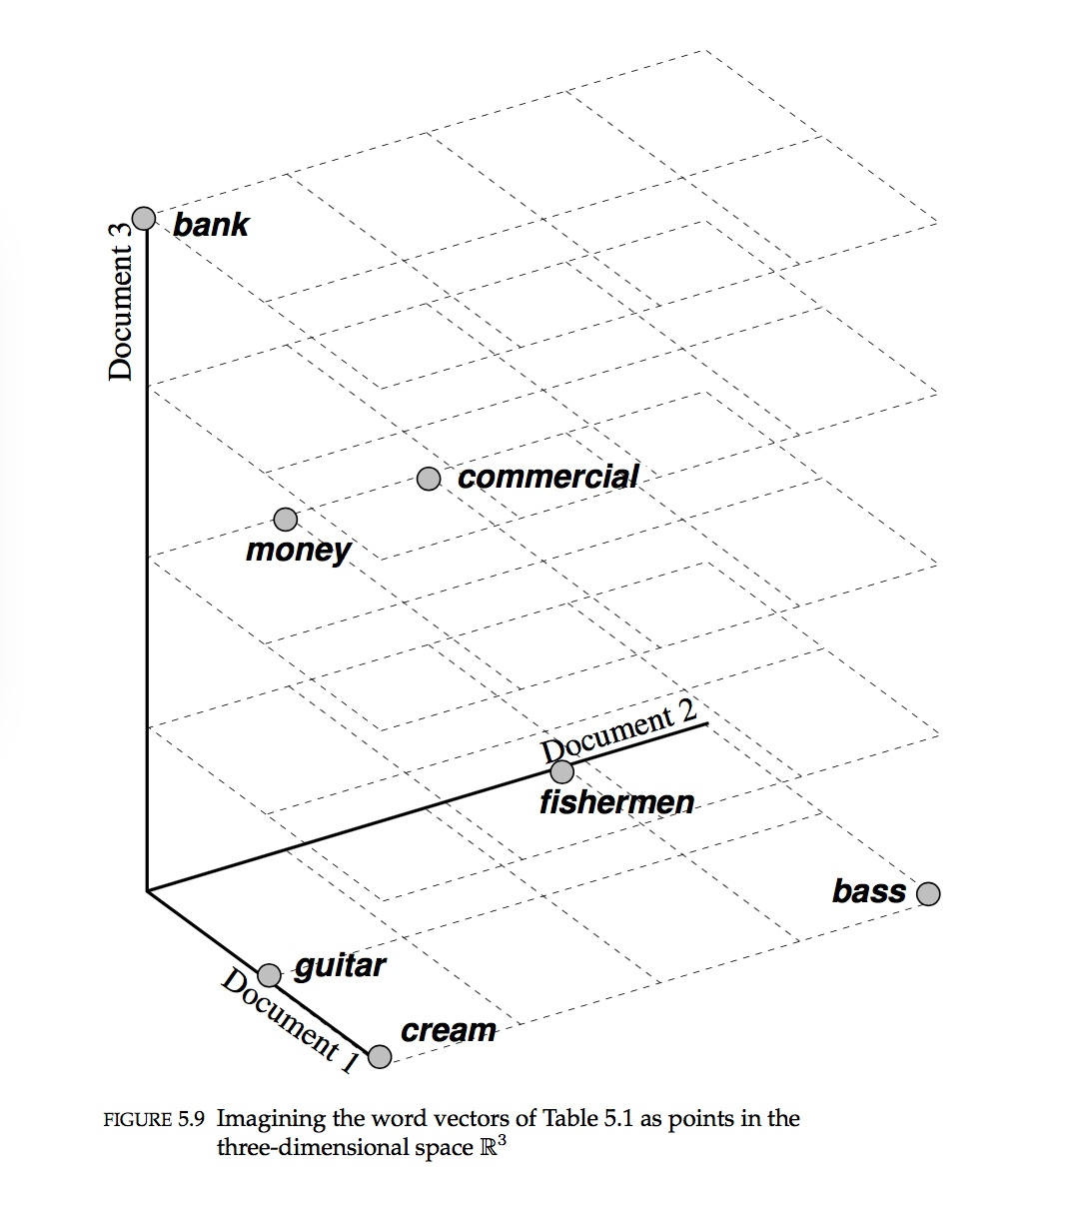
Words in document-space

Slide 4
Cosine similarity)

Slide 5
Cosine similarity)

Slide 6
Latent Semantic Analysis: let’s squash the document space (aka, dimension-reduction)

Slide 7
Finding a good l-d representation of a 2-d space
Gif borrowed from amoeba on statsexchange: http://stats.stackexchange.com/questions/2691/making-sense-of-principal-component-analysis-eigenvectors-eigenvalues/140579#140579

Slide 8
Sum of squares (not actually how SVD does it, but it’s still worth knowing.)

