Slide 1
Data Science in the Humanities
Week 6: Applying Machine Learning
Feb 21, 2017

Slide 2
Inferential stats, but not ML: ordinary least squares linear regression

Slide 3
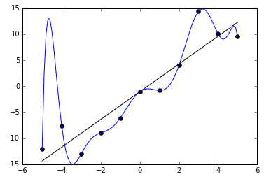
Problem: as the model gets more sophisticated, it overfits the data

Slide 4
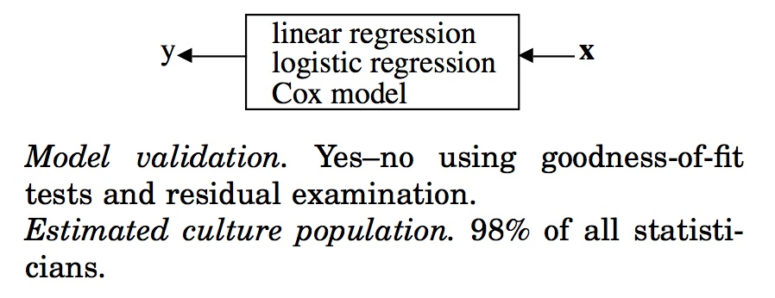
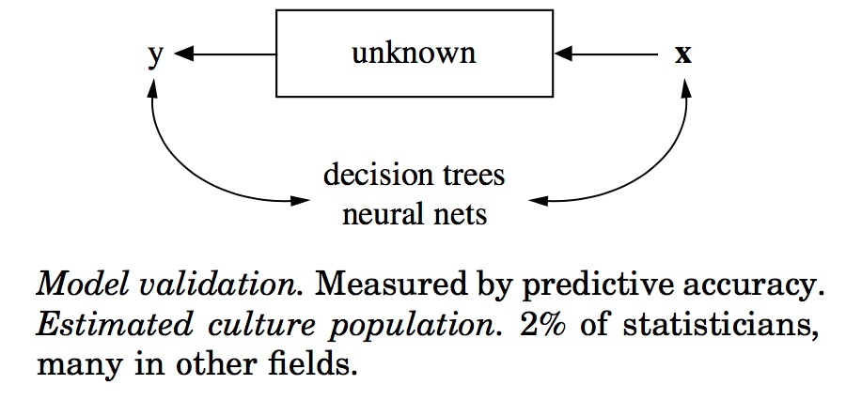
So why isn’t this just statistics?
Leo Breiman’s “data modeling culture”
Leo Breiman’s “algorithmic modeling culture”

Slide 5
Deliberate fuzziness
Lots of variables
The logic of machine
learning
Predict,
rather than explain
Test
out-of-sample

Slide 6
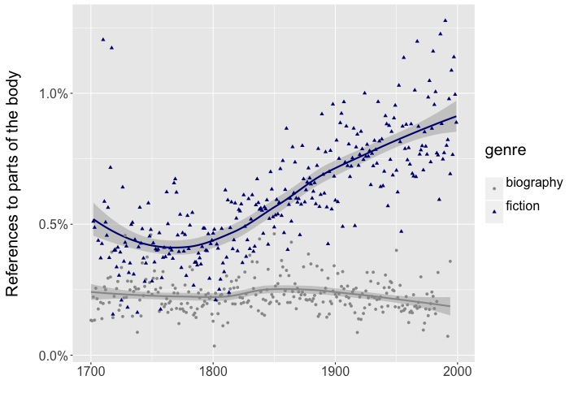
References to the body
The unknown we’re inquiring about
fiction
Genre, treated as a known distinction
biography

Slide 7
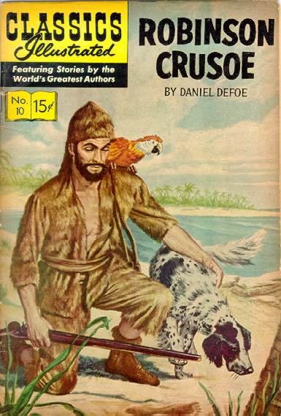




The relation of fiction to biography isn’t really known

Slide 8
1850s
novels
Computer learns to distinguish them
Then is tested on unlabeled 1850s texts.
1850s
biographies

Slide 9
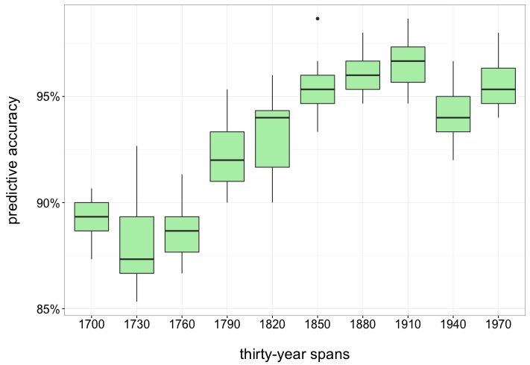
How accurately can a predictive model distinguish fiction from biography?
Range of accuracies for 15 maxent models, each using the 3200 most common words in 75 vols fiction and 75 vols biography from each period.

Slide 10
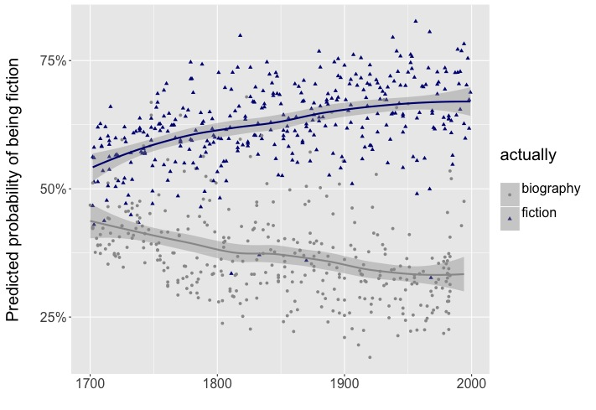
Predicted probabilities for individual volumes

Slide 11
Features that (broadly) organize the y axis

Slide 12
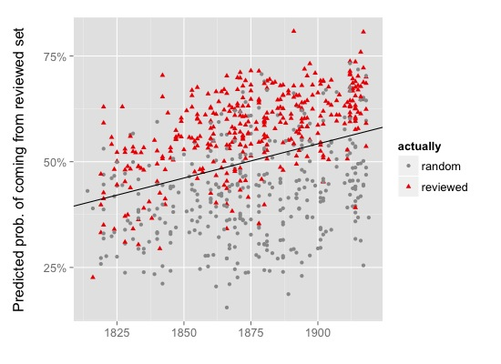
79%
77%

Slide 13
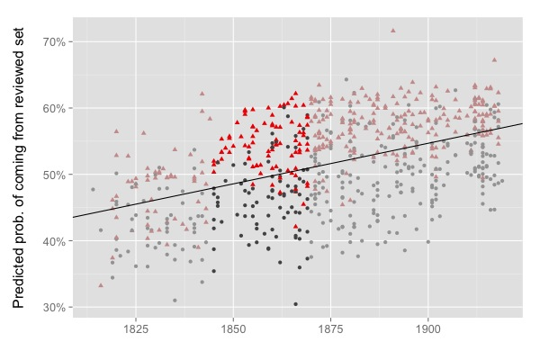

Slide 14
supervised model: learns from labeled examples
unsupervised model:
finds new patterns in the data

Slide 15
supervised model: learns from labeled examples
just the amount of novelty we want

Slide 16
Tasks
Regression — produce a continuous variable
Classification — produce a categorical variable
But most classification algorithms can also be “calibrated” to produce a continuous probability-of-belonging-to class X.
Clustering (unsupervised).

Slide 17
Classification algorithms
Naïve Bayes
Decision trees
Random forests
k-Nearest Neighbors
Logistic regression (a classifier, despite the name)
Support Vector Machines
Neural nets

Slide 18
Linear decision boundaries
Naïve Bayes
Decision trees
Random forests
k-Nearest Neighbors
Logistic regression (a classifier, despite the name)
Support Vector Machines
Neural nets

Slide 19
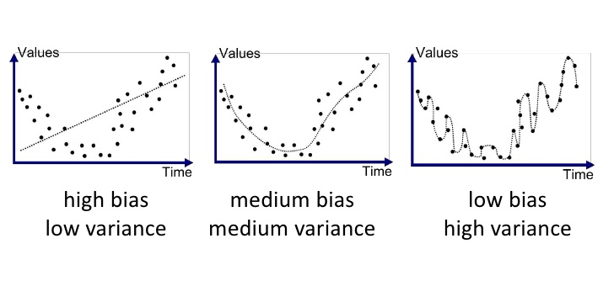
Bias-variance tradeoffs
Picture: Johannes Vermoral, 2009.

Slide 20
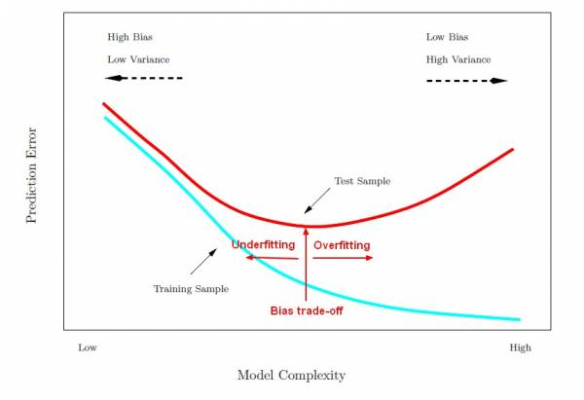
Bias-variance tradeoffs

Slide 21
How to evaluate a model?
Picture: Kevin Markham, 2014.

Slide 22
accuracy = (TP + TN) / total
Here it’s good, ~91%. But notice, we could get almost 64% just by always guessing “yes.”

Slide 23
precision = TP / (TP + TN)
100 / 110 = 0.91

Slide 24
recall = TP / (TP + FN)
100 / 105 = 0.952

Slide 25
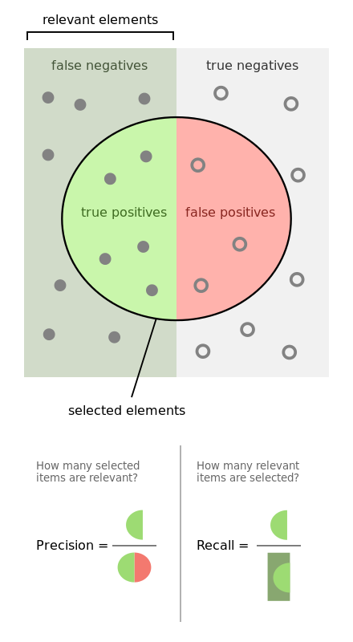
“Precision and recall,”
Wikipedia.

Slide 26
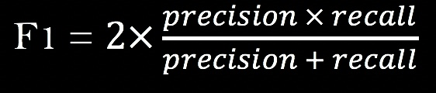
F-measure

Slide 27
Area under the ROC curve
True positive rate:
true positives / all positives
False positive rate:
false positives / all negatives
A good tutorial: http://www.dataschool.io/roc-curves-and-auc-explained/

