Slide 2
Data Science in the Humanities
Introduction
January 17, 2017

Slide 3
What is data science?

Slide 4
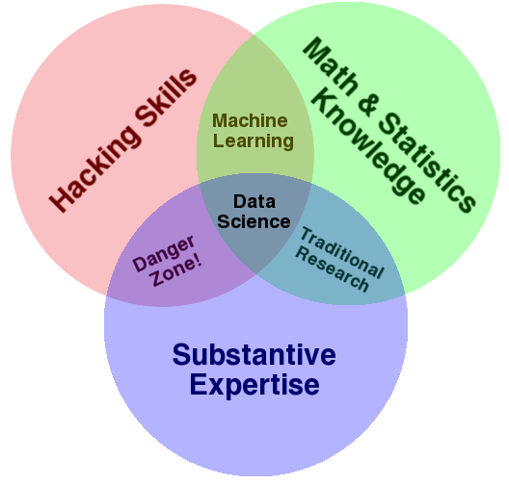
Drew Conway’s Venn diagram

Slide 5
David Donoho, “50 years of data science” (2015)
John Tukey (1962) moves statistics in the direction of science (exploring/interpreting phenomena) rather than pure math.
The rise of machine learning over the past 25 years or so has produced a “predictive culture” that is perhaps even more empirical.

Slide 6
What are the humanities?
Often care about the subtleties of cultural expression (art, music, literature), and also,
Interested in understanding the historical particularity of human life rather than deducing universal laws of human behavior.

Slide 7
What can data science achieve in the humanities?

Slide 8
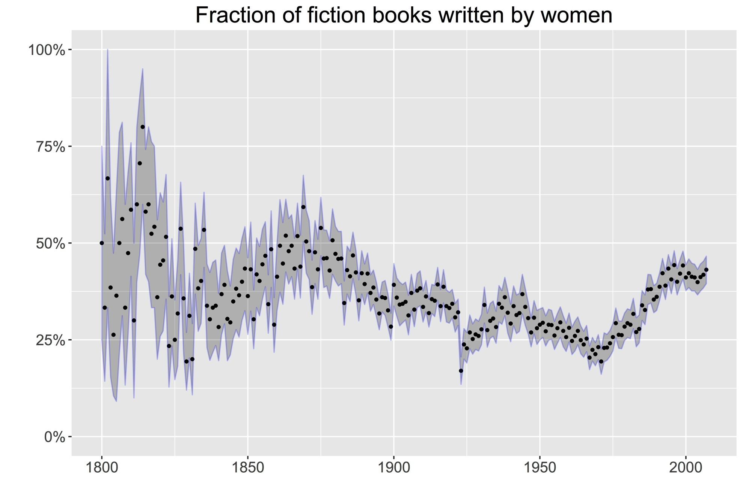
Low-hanging fruit

Slide 9
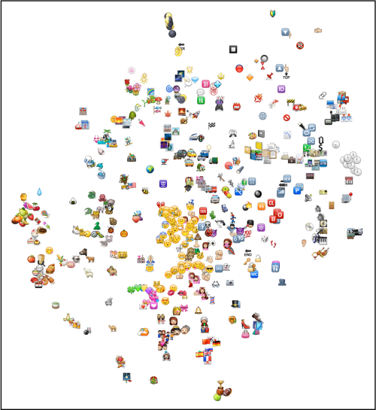
More sophisticated analysis

Slide 10
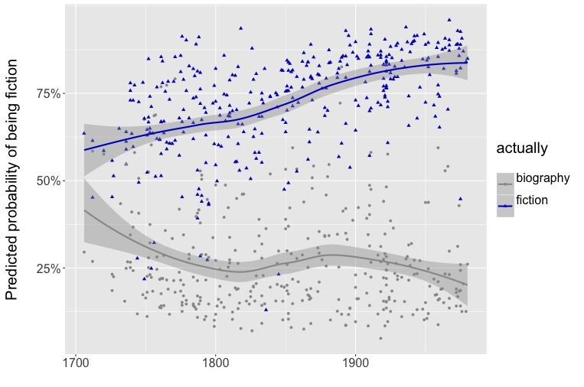
Scholars want evidence that can support arguments.

Slide 11
The unstructured evidence humanists grapple with is a lot like the evidence you’ll find in business and journalism.

Slide 12
How can the humanities contribute to our analysis of data?
Daniel Rosenberg, “Data Before the Fact”
Lisa Gitelman, “ ‘Raw Data’ is an Oxymoron”

