Slide 1
Data Science in the Humanities
Week 5: Statistical learning; naïve Bayes
Feb 14, 2017

Slide 2
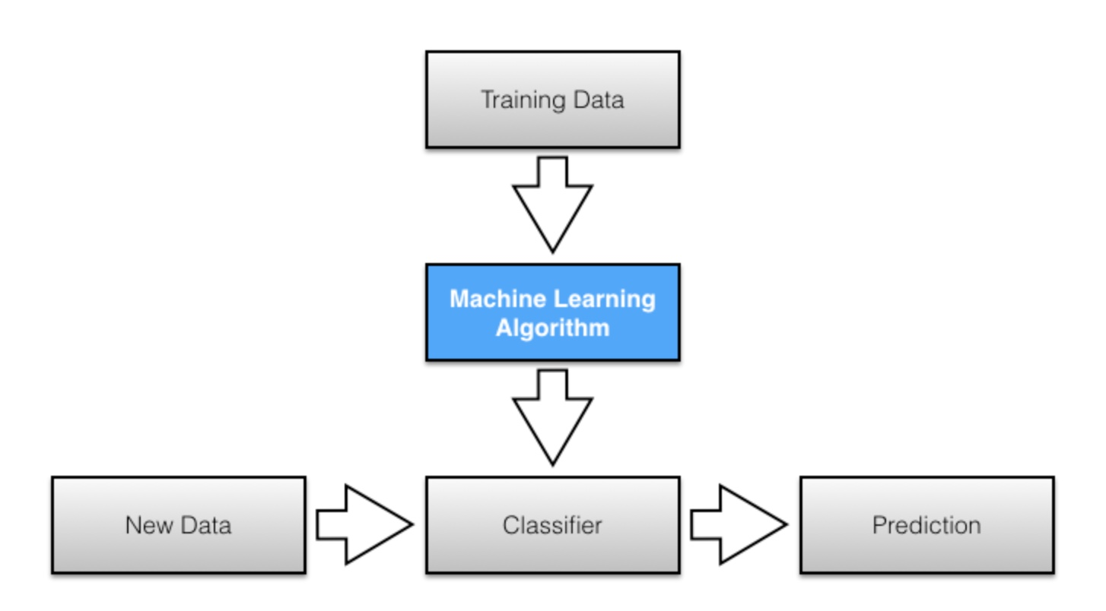
A pragmatic approach to supervised machine learning (image credit: Sebastian Raschka)

Slide 3
A more principled approach: “statistical learning”
There is some process that relates
a vector, X {x₁, x₂, x₃, …}
To an output, Y, or y, or g.
Our job is to infer
A vector of parameters 𝛳 {β₁, β₂, β₃, …}
That describes the relation between X and y / g.
Then we can use that vector on new data to predict ŷ, or g-hat.

Slide 4
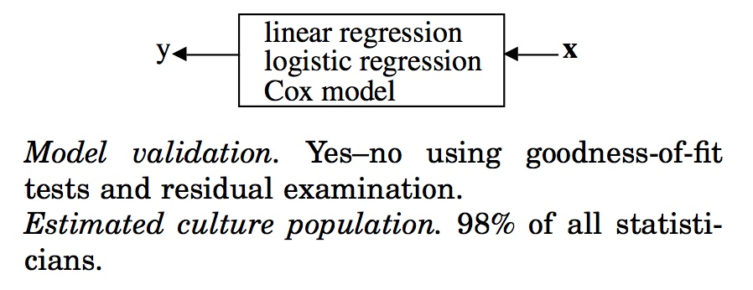
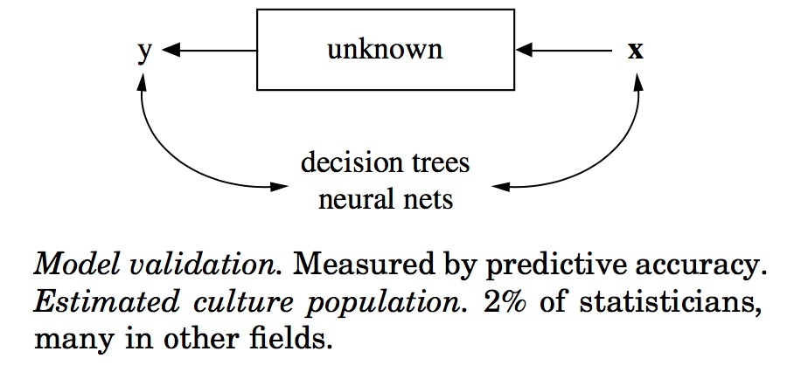
So why isn’t this just statistics?
Leo Breiman’s “data modeling culture”
Leo Breiman’s “algorithmic modeling culture”

Slide 5
Generative versus discriminative models
Naïve Bayes is a generative algorithm.
Why “naïve”?

Slide 6
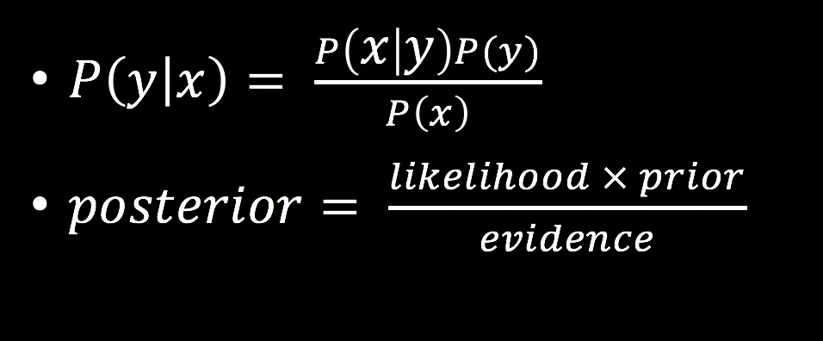
Bayes’ rule
https://www.youtube.com/watch?v=rUoJvogN7qQ

Slide 7
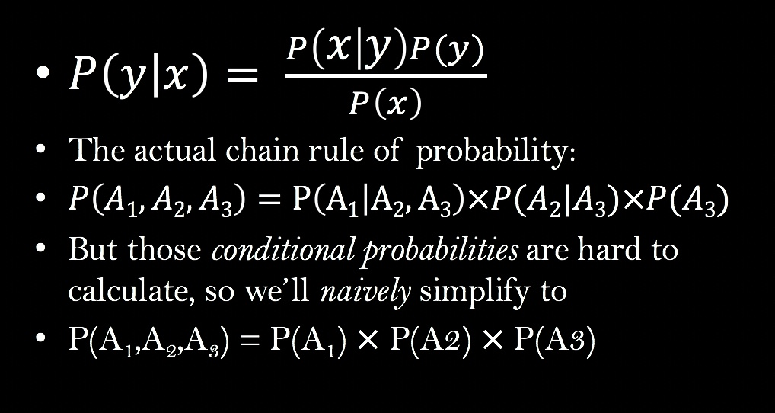
How to make that into a classifier, using multiple features?

Slide 8
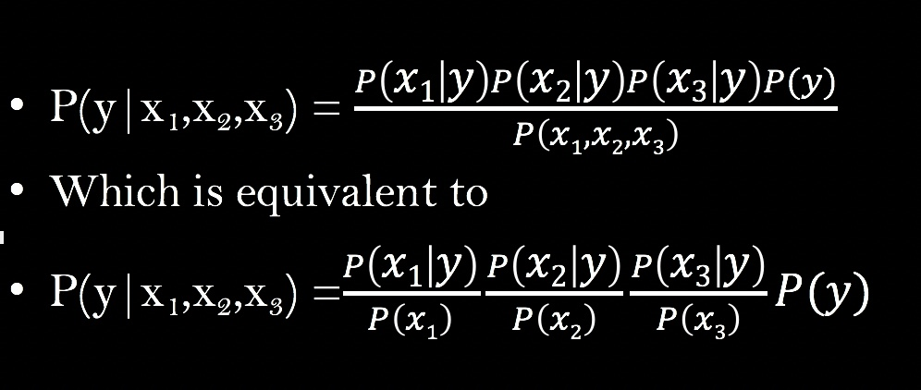
Combining Bayes’ rule with our simplified chain rule gives us

