Slide 1
Lyrics +
Predictive Analytics
Brendan Herger
Chandrashekar Konda
Layla Martin

Slide 2
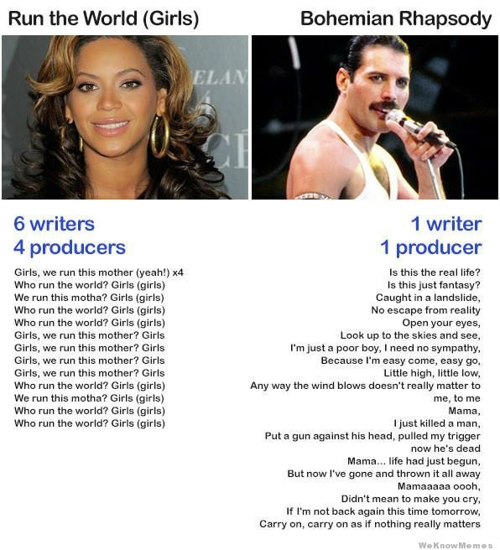

Slide 4
Can we identify genre from lyrics?

Slide 5
Data Acquisition
Feature Engineering
Statistical Modeling

Slide 6
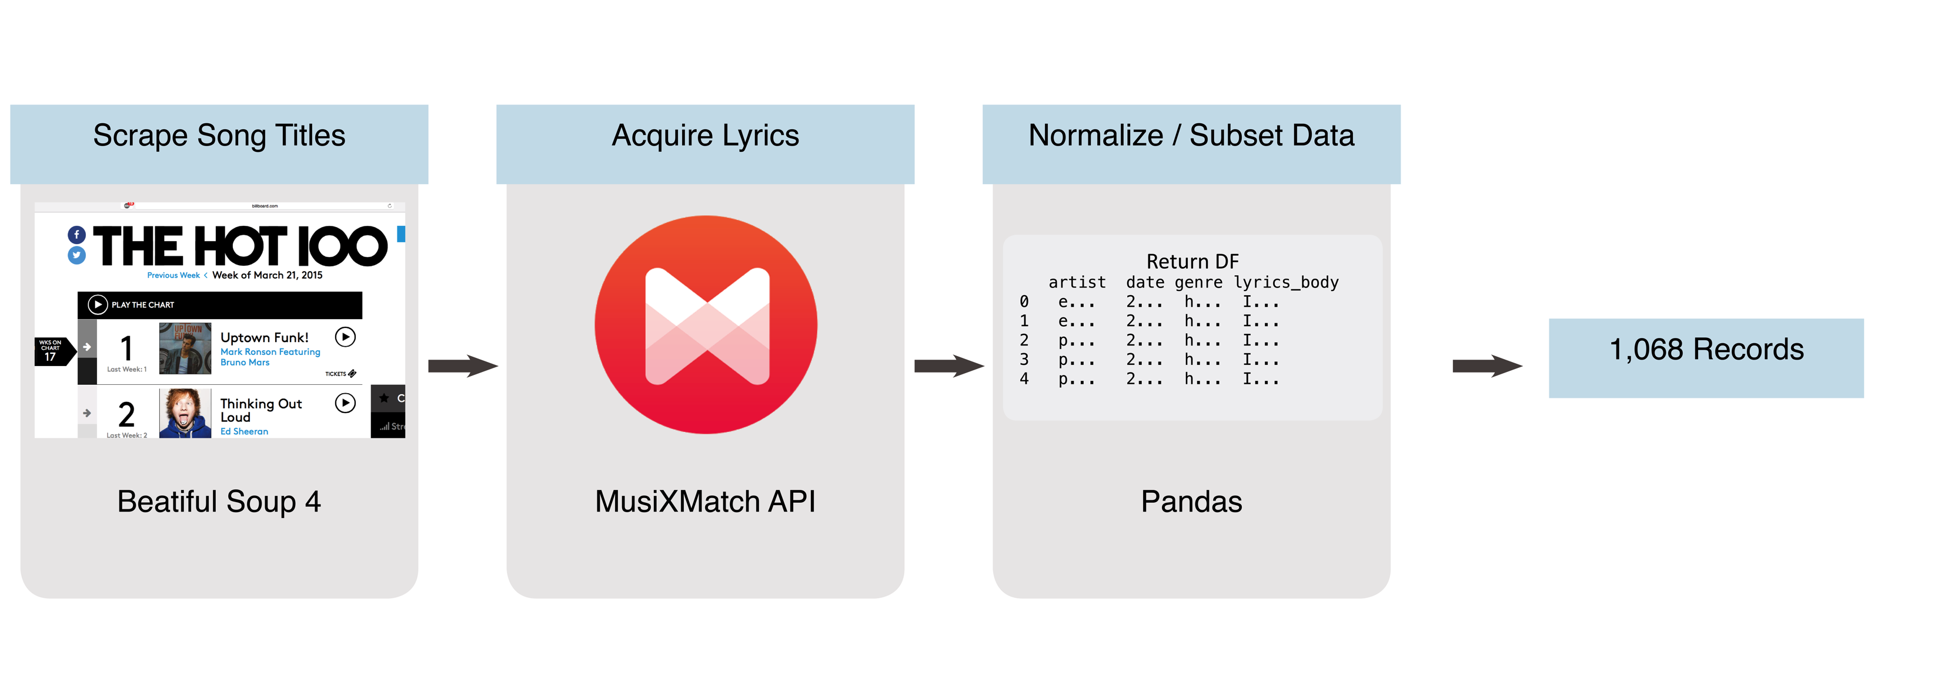
Data Acquisition

Slide 7
Feature Extraction
Curse word density
Verb density
Stop word density
Words per line
Number of words
Unique word density
Noun density

Slide 8
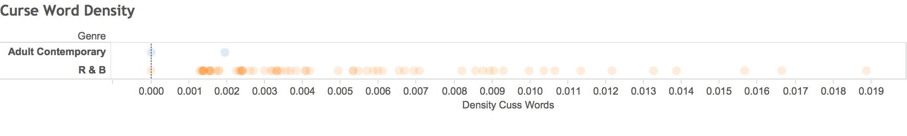

Slide 9
Models
Algorithm
Logistic Regression
Support Vector Classifier
Random Forest
AdaBoost
KNN
Stochastic Gradient Boost

Slide 10
Accuracies
Algorithm | Accuracy
Logistic Regression | 70.4%
Support Vector Classifier | 74.1%
Random Forest | 75.9%
AdaBoost | 75.9%
KNN | 79.6%
Stochastic Gradient Boost | 81.5%

Slide 11
Accuracies
Algorithm | Accuracy
Logistic Regression | 70.4%
Support Vector Classifier | 74.1%
Random Forest | 75.9%
AdaBoost | 75.9%
KNN | 79.6%
Stochastic Gradient Boost | 81.5%
Naive Bayes | 81.2%

Slide 12
Future Work
Generalize past 2 genre
Model probability of commercial success
Author identification

Slide 13
Thanks!
GitHub: goo.gl/YVtW2u
Brendan Herger | | 13herger@gmail.com
Chandrashekar Konda | | chandrak1907@gmail.com
Layla Martin | | layla.d.martin@gmail.com

