Slide 1
CS 584 MACHINE LEARNING
Generative vs Discriminative Learning
-Deric Roshan Pinto
-Saurab Katkar

Slide 2
Objective
We compare the generative and discriminative classifiers by applying Logistic Regression and Naïve Bayes algorithm on different datasets and gathering inferences based on their performance with respect to time, precision, accuracy, error rate and various other factors on the data.
The goal of this project is to apply these algorithms on the several datasets, differentiating in size, features and the number of classes to identify the avenues of comparison with respect to performance as well as the empirical and theoretical advantages of each approach.

Slide 3
Generative Classifiers
Generative classifiers, such as Normal­based Discriminant Analysis and the Naive Bayes
classifier, model the joint distribution P(x, y) of the measured features x and the class labels y
factorized in the form P(x|y)P(y), and learn the model parameters through maximization of the
likelihood given by P(x|y)P(y).
Fig1: Formula for the Naïve Bayes Classifier
In other words, a generative classifier tries to learn the model that generates the data behind the
scenes by estimating the assumptions and distributions of the model. It then uses this to predict
unseen data, because it assumes the model that was learned captures the real model.

Slide 4
Discriminative Classifiers
Discriminative classifiers, such as logistic regression, model the conditional distribution P(y|x) of
the class labels given the features, and learn the model parameters through maximizing the
conditional likelihood based on P(y|x).
Fig2: Formula for the Logistic Classifier
A discriminative classifier tries to model by just depending on the observed data. It makes fewer
assumptions on the distributions but depends heavily on the quality of the data (For e.g. Is it
representative? Is there a lot of data?).

Slide 5
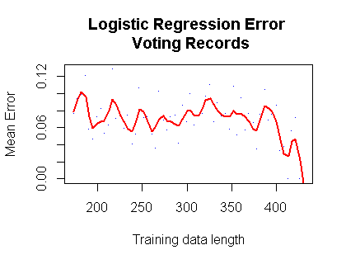
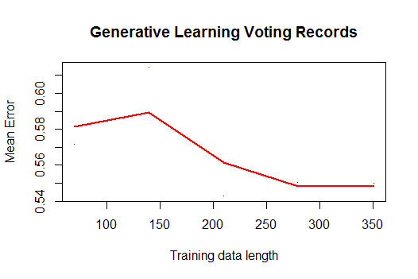
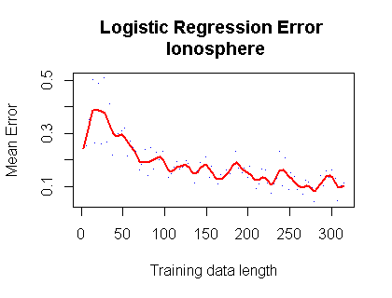
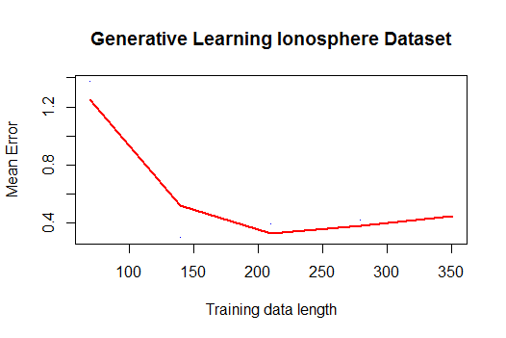
VOTING
IONOSPHERE
PRAMOTER

Slide 6
