Slide 1
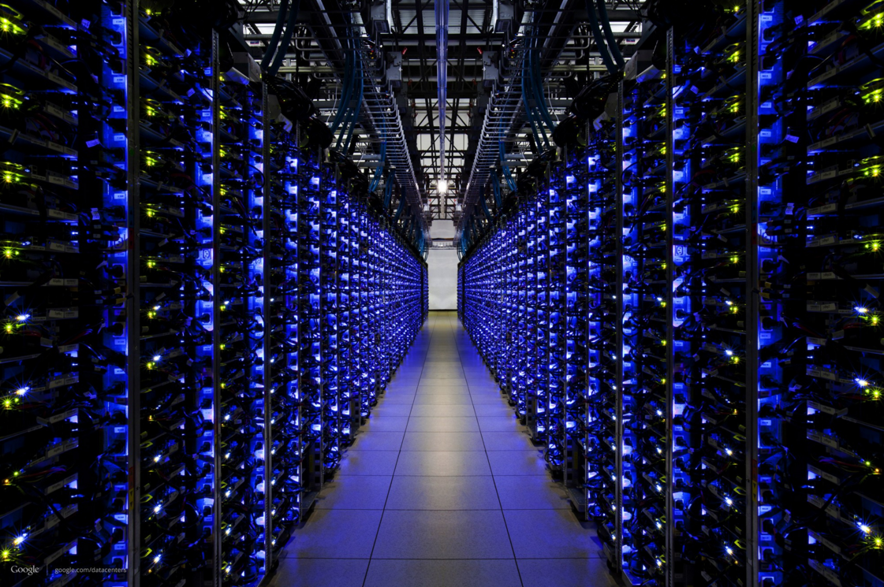
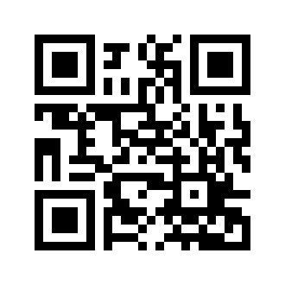
Machine Learning Workshop @ UTSC
Want to pick up machine learning / data science skills?
Want to apply these skills to unsolved problems in astronomy/exoplanet science?
First Meeting: March 9th
Room 160 Arts & Administration Bldg., UTSC
Must register here:
http://goo.gl/forms/lxHFlLNHPL

