Slide 1
Spell Checking & Correction
Devendra Singh Chaplot (100050033)
Nishanth Dikkala (100050052)
Vipul Singh (100050057)

Slide 2
Kernighan Technique
Misspelled word x = x1, x2, x3… xm
Correct word w = w1, w2, w3,…, wn
P(x|w) = probability of the edit
(deletion/insertion/substitution/transposition)

Slide 3
Computing error probability: confusion “matrix”
del[x,y]: count(xy typed as x)
ins[x,y]: count(x typed as xy)
sub[x,y]: count(y typed as x)
trans[x,y]: count(xy typed as yx)
Insertion and deletion conditioned on previous character

Slide 4
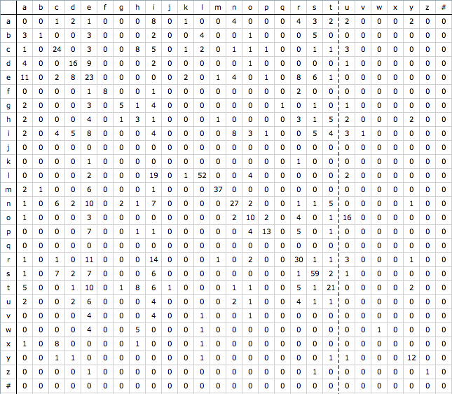
Insertion Matrix

Slide 5
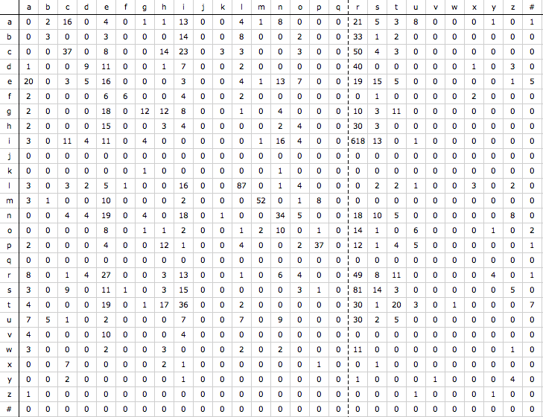
Deletion Matrix

Slide 6
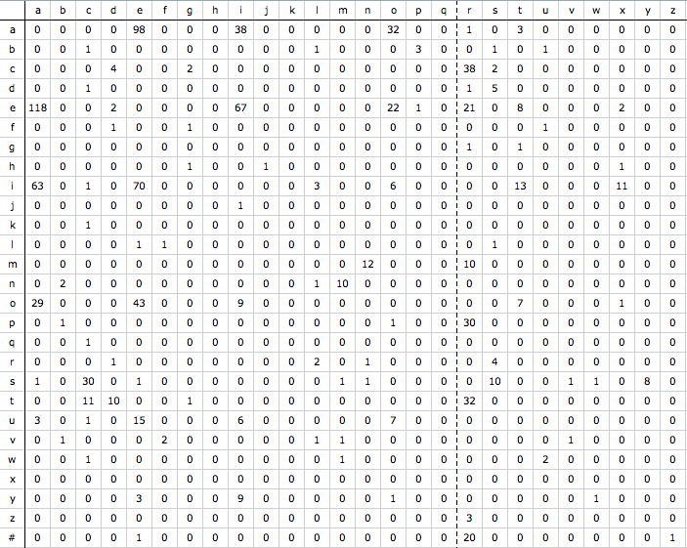
Transposition Matrix

Slide 7
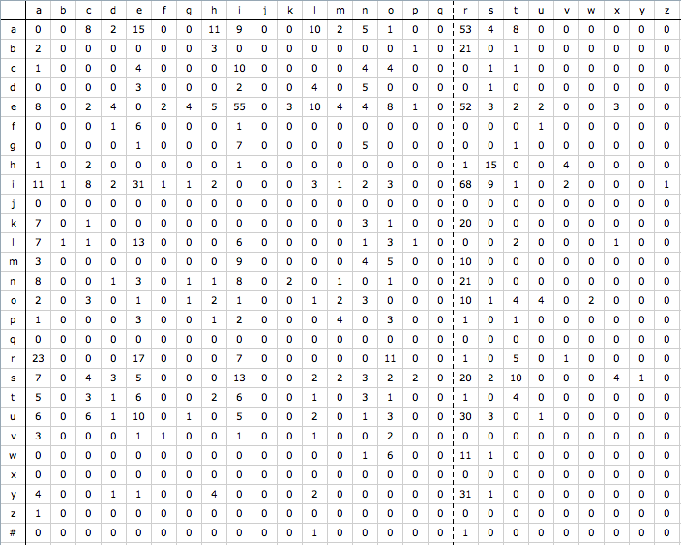
Substitution Matrix

Slide 8
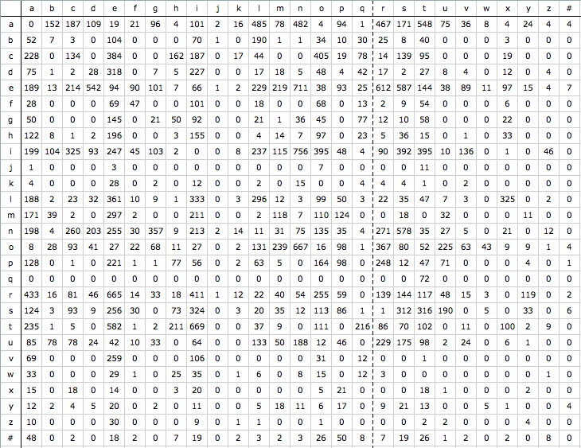
Pair Wise Frequency Matrix

Slide 9
Calculating P(x|w)

Slide 10
Algorithm
Given an incorrectly spelled word, look for correct words at edit distance <= 2
Choose one with best score according to Kernighan's formulae

Slide 11
Results
Gives 100% accurate results, except for bad cases in corpus like
ninties->1990s
Removed such cases first.

Slide 12
5-fold cross validation
Divide corpus into 5 folds
Use one for training, rest for testing
Accuracy from around 100 when entire corpus was used to 86-87 %
Values observed are:
87.01%, 85%, 86.06%, 86.30%, 87.84%

Slide 13
Drop in accuracy
Example error in 5th fold
tghe->the
But insertion error for (t,g) does not exist anywhere in first 4 folds
So, in absence of training instance, model fails to give correct output.

Slide 14
References
AT&T Bell Labs. Kernighan, Mark D., Kenneth W. Church, and William A. Gale. 1990. A spelling correction program based on a noisy channel.
Data Source: Parallel list of incorrect and correct words
http://en.wikipedia.org/wiki/Wikipedia:Lists_of_common_misspellings/For_machines

