Slide 1
Efficiency Simulation for Bus Traffic in Taipei City
2012.06.21
Tsung-Hsien, WEN
Po-Chun, HSU

Slide 2
Outline
Objective
Collecting Data
Agents
Buses
Clients
Simulation
Conclusion

Slide 3
Objective

Slide 4
Collecting Data

Slide 5
Collecting Data
For more real case simulation, we need:
Simplified Taipei City Graph (nodes, edges)
Distance between each two nodes.
The current traffic information
Real Taipei bus routes in operation (include departure intervals)
Traffic information
They are all available but…
They are hard to get automatically.

Slide 6
Parser
The most powerful parser in the world.
Workers’ Wisdom sometimes is easier than A.I.
Hand-coded data are collecting from several sources:
Google Map
Taipei public transportation office
Statistics:
75 nodes, 134 edges, 125 bus routes

Slide 7
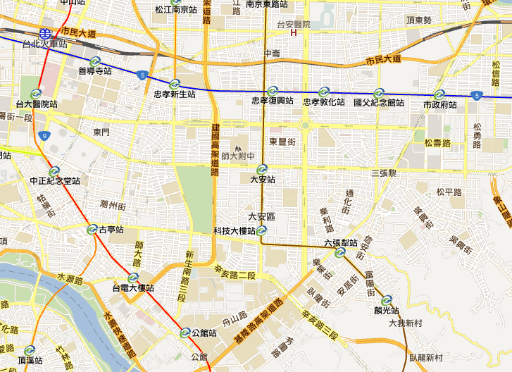
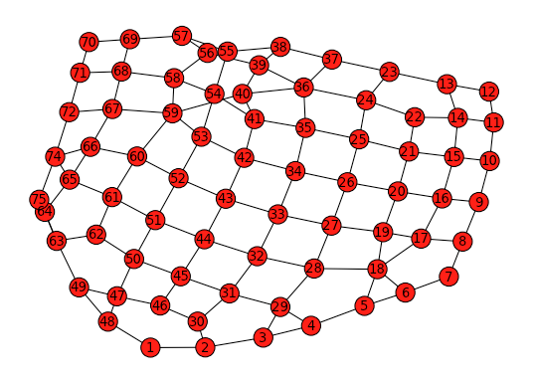
Map

Slide 8
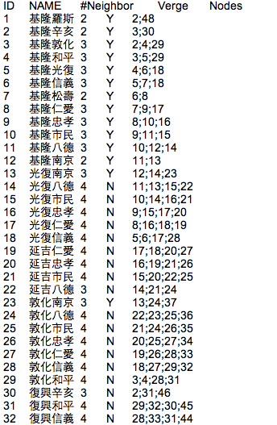
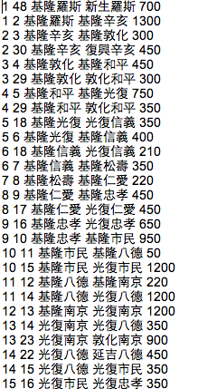
Nodes & Edges

Slide 9
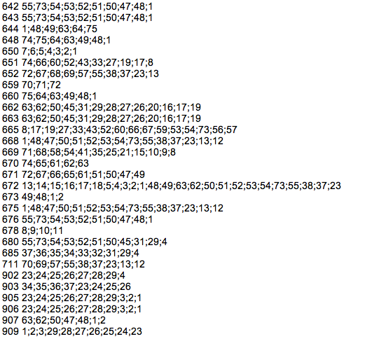
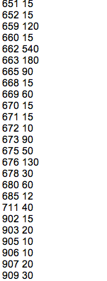
Bus routes & Interval

Slide 10
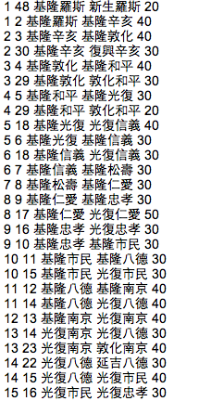
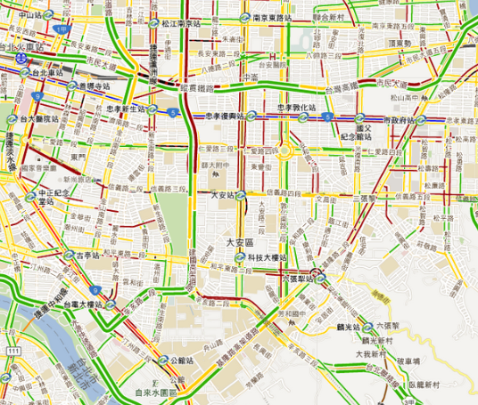
Traffic

Slide 11
Agents
Buses
Clients

Slide 12
Bus Behavior
A bus manager to handle bus schedules.
After a bus is departed, it will follow the scheduled route with a speed equal to the current road speed.
Bus will park into a node if a scheduled stop is reached, then call if any client wants to get on or off the bus.
Bus will be destroyed after a round trip is finished.

Slide 13
Simulation

Slide 14
Environment Setup
Simulate every minute (iteration)
10000 minutes (iteration) for each simulation. Total ~ 6.9 hours
Run on three scenarios.
Gaussian distribution for generating clients:
Off-peak: mean 1.2, var: 0.5
Evening & Morning: mean 3.6, var: 0.5

Slide 15
Bus Policy
Three policies are compared:
Original Settings: Bus routes in operation now.
Total 124 routes
Chessboard: The main policy we want to compare.
Total only 20 routes
1 bus departure/10 min
All-pairs: Every route has only two stops.
Total 134 routes = # of edges
1 bus departure/10 min

Slide 16
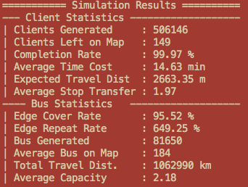
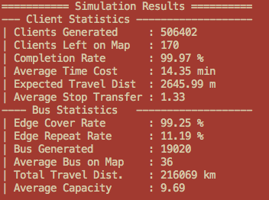
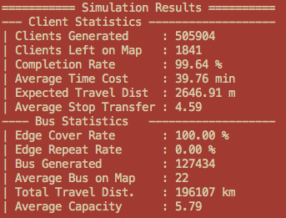
Result - Offpeak
Original
Chess
Allpair

Slide 17
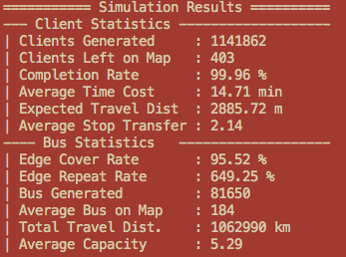
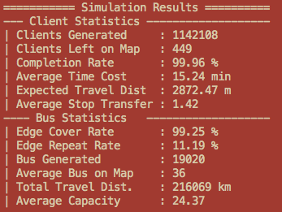
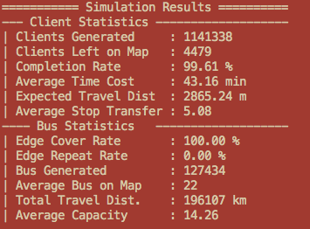
Result - Morning
Original
Chess
Allpair

Slide 18
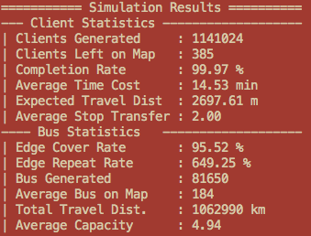
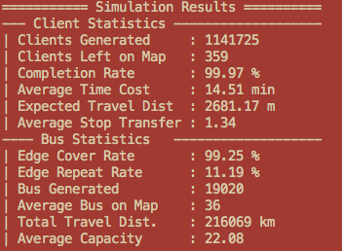
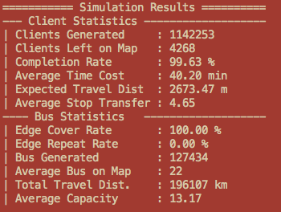
Result - Evening
Original
Chess
Allpair

Slide 19
Conclusion

Slide 20
Thank you

