Slide 1

Efficiency Simulation for Bus Traffic in Taipei City
2012.06.21
Tsung-Hsien, WEN
Po-Chun, HSU
Heng, WANG

Slide 2
Outline
Motivation & Objectives
Collecting Data
Agents
Buses
Clients
Simulation
Conclusion & Future Work

Slide 3
Motivation & Objectives
Bus Routes in Taipei City
About Bus Route Policies

Slide 4
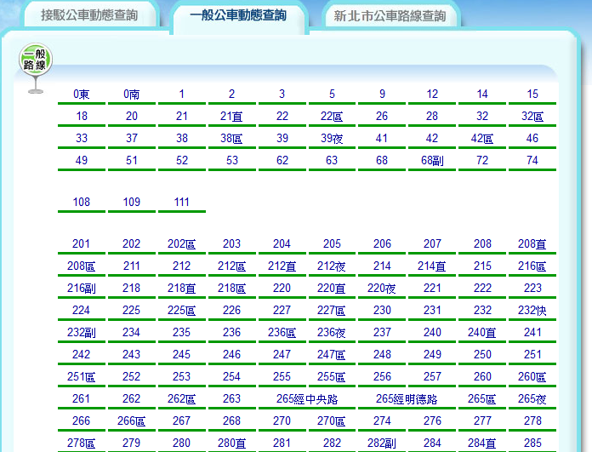
Bus Routes in Taipei City
There are many routes

Slide 5
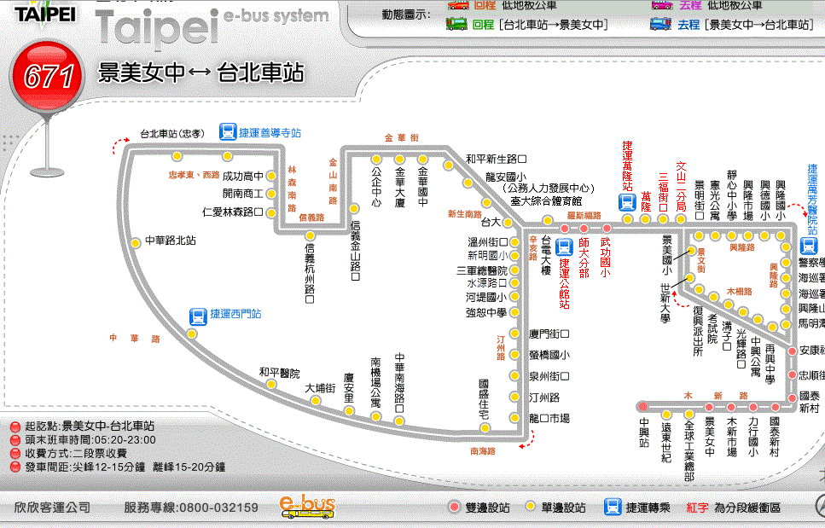
Bus Routes in Taipei City
Some routes are like this

Slide 6
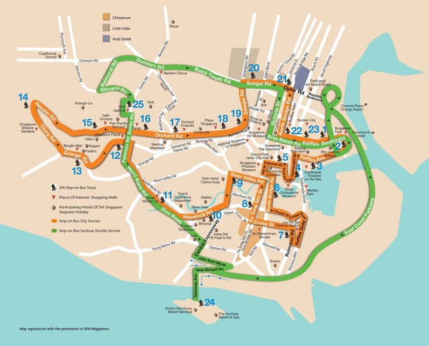
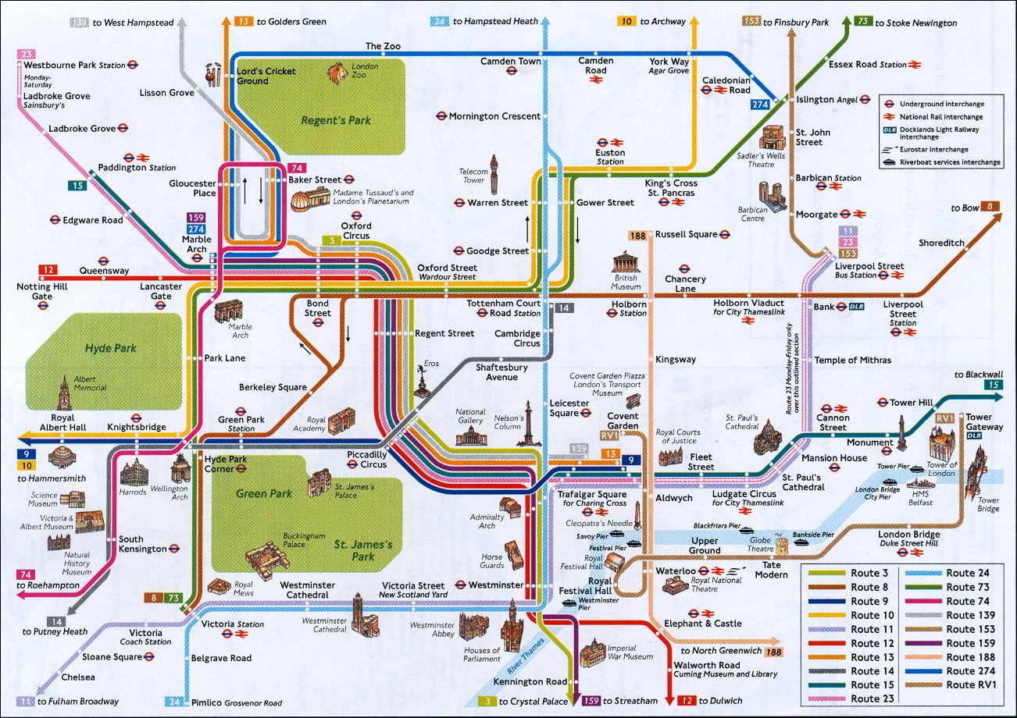
Bus Routes in Taipei City
How about other types of bus route networks?

Slide 7
About Bus Route Policies
Could a chessboard-like bus route network work better in Taipei?
信義幹線的闢駛，要追溯到民國78年間，當時的台北市政府要推動所謂「棋盤式幹線公車路網」，推出了忠孝幹線、信義幹線、松江新生幹線、復興敦化幹線… 後來又推出了如重慶幹線、仁愛幹線、和平幹線……等二期的幹線公車。不過這些路線到現在能夠存活下來的並不多，大多都已經停駛，要不就是班次很少，「信義幹線」算是當時推行的棋盤幹線公車中的佼佼者。 by Akito.S (http://akitosun.pixnet.net/blog/)

Slide 8
About Bus Route Policies
【2006/03/15 聯合報】 台北市交通局長林志盈擬發展捷運化的棋盤式公車路網，延燒到北縣與基市民眾。許多老公車族急到跳腳，擔心未來到北市上班或就醫，「光轉車就暈了」。 一名公車族說，原本進城只要「一班到位」，現在恐怕要轉個3、4班，甚至更多。 … 林志盈強調，這項整併作業涉及各家業者利益，這是主要困難所在，未來不排除先於設有公車專用道路段試辦實施，必要時採訂自治法規強制規範，預定明年度編列預算並送市議會審查後正式推動。

Slide 9
About Bus Route Policies
北市／鼓勵搭大眾運具 議員促闢設棋盤式公車路網 2010年4月17日 …
他指出，目前公民營公車業者約14家，營運路線逾兩百條，民眾總是抱怨路線過於彎繞、班次有些密有些疏、路線太長，而導致尖峰時間行駛緩慢等問題，因而不願搭乘。他表示，整併公車路線、闢設棋盤式之公車路網有其急迫性，提高公車速率、方便轉乘，民眾自然會減少私人運具使用，並且在此同時先實施幹線公車、轉乘免費。 …
部份縣市都有不少幹線免費公車，或是在重大節日可以免費搭乘，例如台北縣、桃園縣、台中市、台南市及高雄市。林晉章指出，台中市甚至從５月起，台北市民持悠遊卡也可免費搭乘。他強調各縣市為鼓勵民眾搭乘大眾交通工具，也都積極朝向全市公車免費的目標邁進，因此台北沒有理由腳步緩慢。

Slide 10
Objectives
Simulation of behavior of bus and clients in different conditions
Comparisons between current bus routes and a chessboard-like bus route network
Observing what influences the efficiency of the bus route network

Slide 11
Collecting Data
Map
Bus Routes
Traffic Conditions

Slide 12
Collecting Data
For more real case simulation, we need:
Simplified Taipei City Graph (nodes, edges)
Distance between each two nodes
Current traffic information
Real Taipei bus routes in operation (include departure intervals)
They are all available but…
They are hard to get automatically.

Slide 13
Parser
The most powerful parser in the world.
Workers' Wisdom sometimes is easier than A.I.
Hand-coded data are collecting from several sources:
Google Map
Taipei public transportation office
Statistics:
75 nodes, 134 edges, 125 bus routes

Slide 14
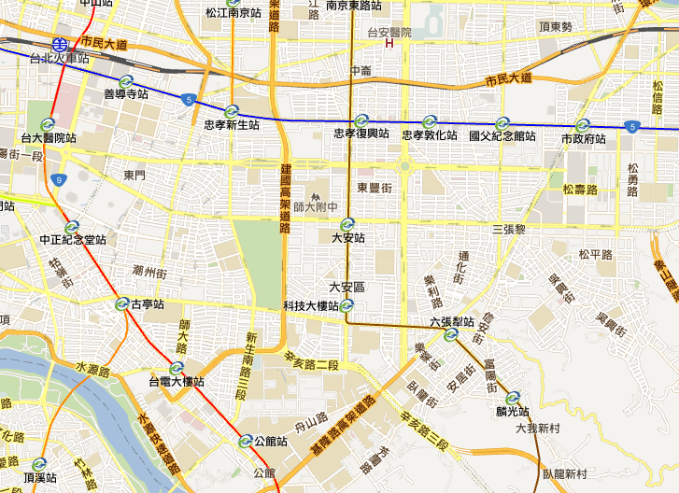
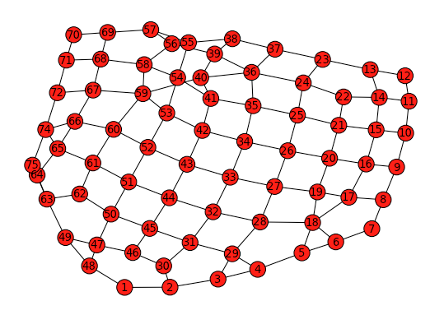
Map

Slide 15
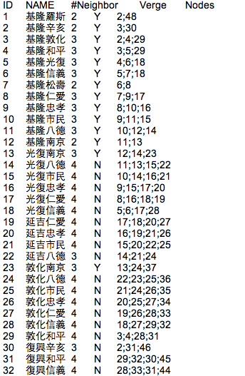
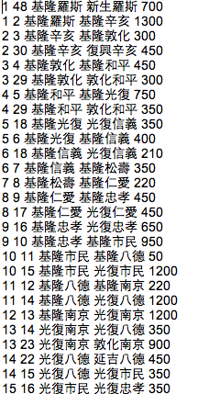
Nodes & Edges

Slide 16
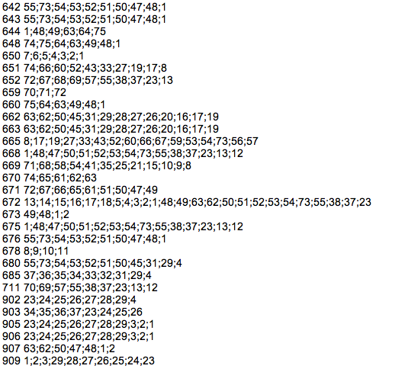
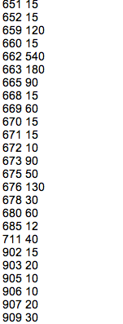
Bus routes & Interval

Slide 17
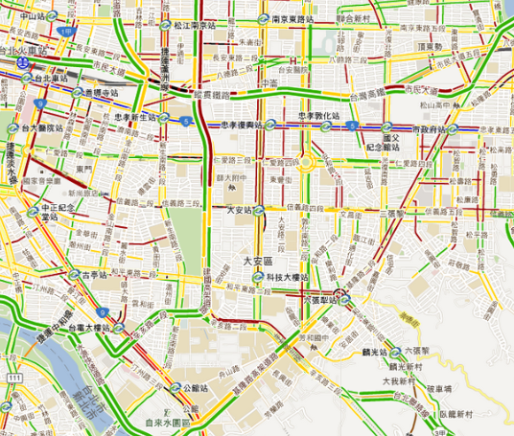
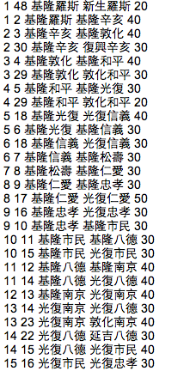
Traffic

Slide 18
Agents
Buses
Clients

Slide 19
Bus Behavior
A bus manager to handle bus schedules.
After a bus is departed, it will follow the scheduled route with a speed equal to the current road speed.
Bus will park into a node if a scheduled stop is reached, then call if any client wants to get on or off the bus.
Bus will be destroyed after a round trip is finished.

Slide 20
Client Behavior
Clients are generated on nodes with destinations.
Three scenarios are considered:
Morning rush hour (people come inward)
Evening rush hour (people go outward)
Off peak
How to take a bus:
Greedy algorithm to reduce the computation cost
If a bus can take Client A to a node which is "closer" to A's destination than A's current location is, A will get on the bus.
The "distance" metric is based on the bus routes.
May not be intuitive…

Slide 21
Simulation

Slide 22
Environment Setup
Simulate every minute (iteration)
10000 minutes (iteration) for each simulation. Total ~ 6.9 hours
Run on three designated scenarios.
Gaussian distribution for generating clients:
Off-peak: mean 1.2, var 0.5
Evening & Morning: mean 3.6, var 0.5

Slide 23
Bus Policy
Three policies are compared:
Original Settings: Bus routes in operation now.
Total 124 routes
Chessboard: The main policy we want to compare.
Total only 20 routes
1 bus departure/10 min
All-pairs: Every route has only two stops.
Total 134 routes = # of edges
1 bus departure/10 min

Slide 24
Result – Off-peak
 |  | Original | Chessboard | All-pair
Client Statistics | Client Generated | 506,146 | 506,402 | 505,904
 | Client Left on Map | 149 | 170 | 1841
 | Completion Rate | 99.97% | 99.97% | 99.64%
 | Average Time Cost | 14.63 min | 14.35 min | 39.76 min
 | Expected Travel Dist. | 2663.35 m | 2645.99 m | 2646.91 m
 | Avg. Stop Transfer | 1.97 | 1.33 | 4.59
Bus Statistic | Edge Cover Rate | 99.52% | 99.25% | 100.00%
 | Edge Repeat Rate | 649.25% | 11.19% | 0.00%
 | Bus Generated | 81,650 | 19020 | 127,434
 | Avg. Bus on Map | 184 | 36 | 22
 | Total Travel Dist. | 1,062,990 km | 216,069 km | 196,107 km
 | Average Capacity | 2.18 | 9.69 | 5.79

Slide 25
Result – Morning
 |  | Original | Chessboard | All-pair
Client Statistics | Client Generated | 1,141,862 | 1,142,108 | 1,141,338
 | Client Left on Map | 403 | 449 | 4479
 | Completion Rate | 99.96% | 99.96% | 99.61%
 | Average Time Cost | 14.71 min | 15.24 min | 43.16 min
 | Expected Travel Dist. | 2885.72 m | 2872.47 m | 2865.24 m
 | Avg. Stop Transfer | 2.14 | 1.42 | 5.08
Bus Statistic | Edge Cover Rate | 99.52% | 99.25% | 100.00%
 | Edge Repeat Rate | 649.25% | 11.19% | 0.00%
 | Bus Generated | 81,650 | 19020 | 127,434
 | Avg. Bus on Map | 184 | 36 | 22
 | Total Travel Dist. | 1,062,990 km | 216,069 km | 196,107 km
 | Average Capacity | 5.29 | 24.37 | 14.26

Slide 26
Result – Evening
 |  | Original | Chessboard | All-pair
Client Statistics | Client Generated | 1,141,024 | 1,141,725 | 1,142,253
 | Client Left on Map | 385 | 359 | 4268
 | Completion Rate | 99.97% | 99.97% | 99.63%
 | Average Time Cost | 14.53 min | 14.51 min | 40.20 min
 | Expected Travel Dist. | 2697.61 m | 2681.17 m | 2673.47 m
 | Avg. Stop Transfer | 2.00 | 1.34 | 4.65
Bus Statistic | Edge Cover Rate | 99.52% | 99.25% | 100.00%
 | Edge Repeat Rate | 649.25% | 11.19% | 0.00%
 | Bus Generated | 81,650 | 19020 | 127,434
 | Avg. Bus on Map | 184 | 36 | 22
 | Total Travel Dist. | 1,062,990 km | 216,069 km | 196,107 km
 | Average Capacity | 4.94 | 22.08 | 13.17

Slide 27
Conclusion & Future Work

Slide 28
Conclusion
The simulation is an initial attempt to model the bus activities in Taipei city based on some real world data collected from Internet.
However, the data are still limited so real world behavior of clients is hard to model.
With some proper assumptions, the experiment results suggested that the chessboard policy is far more efficient in terms of the resource utilization compared to the policy in operation.
However, it is not a engineering problem but a political/social one, which is 10 times harder than a pure engineering one.

Slide 29
Future work
More real world data should be collected to avoid incorrect assumptions. More data can also provide us a sophisticated modeling of the world.
There is much room for improvement in modeling client behavior.
We wait at a bus stop for a bus which takes us to our destination directly.
We do not like transfers.
An optimization algorithm can be applied if more real data are available.
Optimize on bus routes
Optimize on bus intervals

Slide 30
Thank you

