Slide 1
Machine Technical Analysis
Time series learning with computer vision
Alex lee

Slide 2
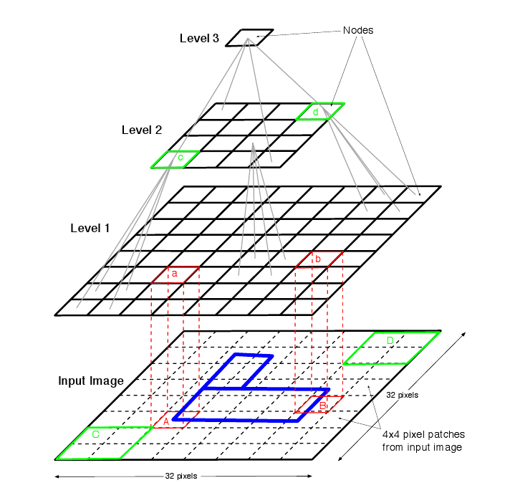
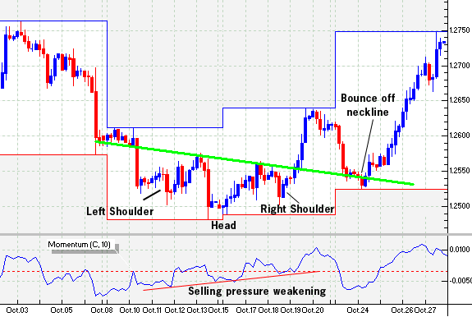
The Question
Can visual features be used for predictive modeling of security prices?
“Technical analysis” attempts to do so, with humans as the “algorithm”… but is basically bunk
Machine learning may be able to improve upon fallible human traits and perceptual biases
= baloney
= better (?)

Slide 3
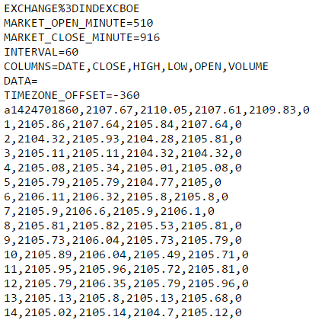
The Data
Time series data were obtained from a Google Finance API that allows pulls of price data for a given ticker at the one-minute tick level (up to 20 days historical)
Data are provided for open, high, low, and close (OHLC) prices for each interval
Data are clean, but inconveniently timestamped (in Unix epoch format)…
…fortunately, Python and pandas allow for relatively easy cleanup and indexing of time data
Time indexing is important, to keep our models honest by barring them from peering into the future

Slide 4
The Modeling Approach
Obtain appropriate time series data (minute level)
Slice into windows
Window length is somewhat arbitrary, but impacts predictions, so can be tuned depending on specific use case (macro vs. HFT, e.g.)
Graph data for each window and save as images
Use computer vision (CV) to extract features:
Directly from images using linear feature extraction
Indirectly, by converting the graph to pixel intensity data, then unrolling the pixel data matrix into a vector 1000s of new features for each observation, “generated” from the underlying price data
Train models on extracted features

Slide 5
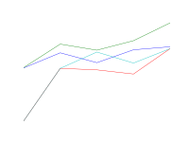
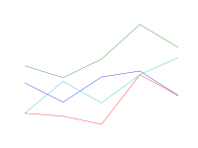
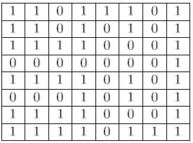
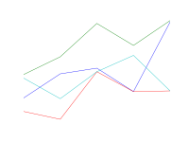
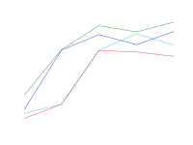
Modeling Approach, continued
From this:
To this:

Slide 6

Challenges
Wrangling the graphical data while not running out of RAM
Having patience while trying to train models on massive datasets (~ 6,000 x 30,000 matrix of raw pixel data)
Not being able to use regular TTS / Cross-Validation due to time series data
Not knowing much of anything about CV prior to embarking on this project
Time constraints on learning and applying new modeling techniques

Slide 7
Results
Modeling was carried out on basic OHLC price data + 5 created features as a baseline
Models varied in performance over these data; high end performance was impressive
CV-based extracted features also performed fairly well (for one target case only)
Raw pixel data did not perform well with standard modeling; ANN may be better
Model | Target | Base | Score | Delta
AdaBoost | 1 min | .49 | .60 | .11
Random Forest | 1 min | .49 | .72 | .23
Random Forest | 5 min | .50 | .64 | .14
Support Vector Machine | 1 min | .49 | .81 | .32
Support Vector Machine | 5 min | .50 | .71 | .21
Logistic Regression | 1 min | .49 | .84 | .35
Logistic Regression | 5 min | .50 | .72 | .22
CV Features SVM | 5 min, up | .50 | .78 | .28
CV Features LR | 5 min, up | .50 | .77 | .27

Slide 8
Next Steps
Future avenues of exploration:
Different types of tuning at both the pre-processing step and model training steps
Alternative models to try on graphical data, particularly Artificial Neural Networks
Additional CV-based features, e.g. custom Haar cascades
Additional time-series features, e.g. weighted trailing feature stats baked into current observation
Further discretization of targets
Further “productionizing” of analytic processes as Python is very nice for this sort of thing:
Web scraping a set of tickers
Functions for more loops
Grid searching optimal time slice and lookahead combinations

Slide 9
Questions?

