Slide 1
BLUETOOTH & Wi-Fi TRACKING (Dr. Kaan Ozbay,Dr.Kontokosta )
Graduate Research Assistant :
Priya Khokher

Slide 2
Tracking :
Crowd Routing
Analytics based on paths
Gauging Traffic
Used in Malls, Roads, Buildings

Slide 3
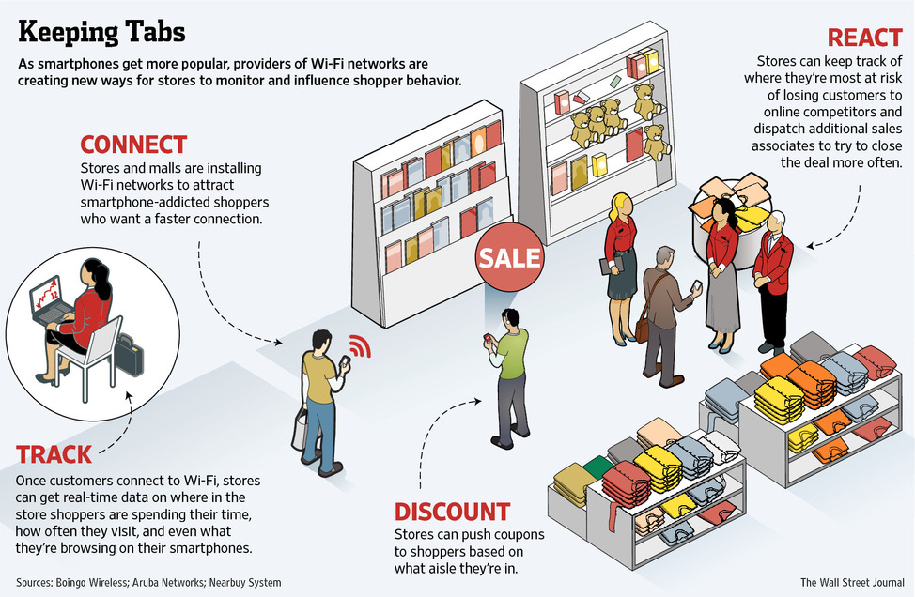
http://omnichannel.me/wp-content/uploads/2013/05/wifiinstore.jpg

Slide 4
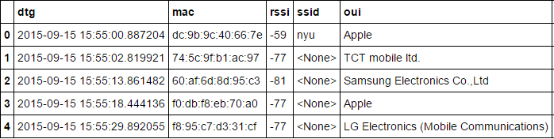
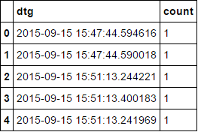
How does the data look like?
MAC ID DATA
PIR DATA

Slide 5
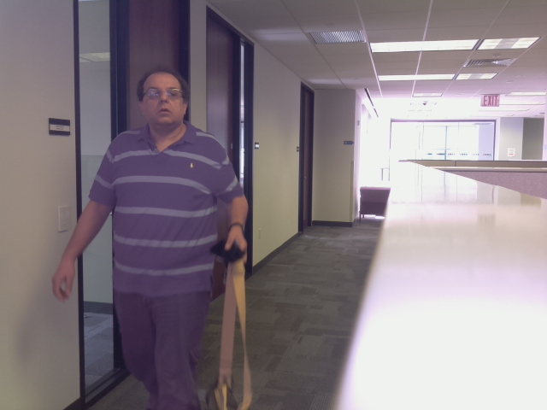

Image Processing Section
Process the number of people in the captured images .
Two types of images:
(a.) Face can get detected (TYPE 1) (b.) Side arms gets captured (TYPE 2)

Slide 6
Two Approaches
1. Thresholding and Background Subtraction for Type 1 and 2 images
It is the simplest method of image segmentation, to create binary images from grayscale images .
Face Detection

Slide 7
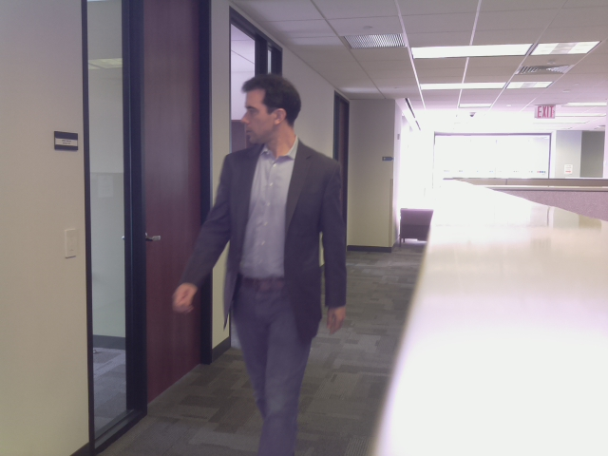
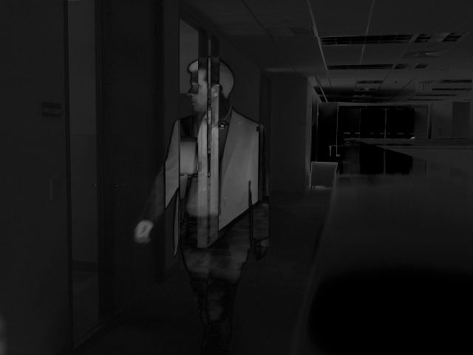
Initial approach: Thresholding
a. Original Image b. Thresholded Image

Slide 8
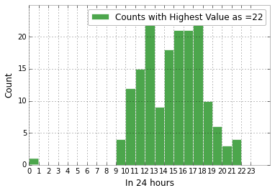
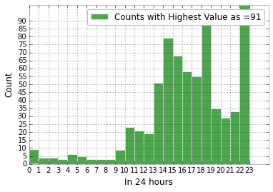
Data Statistics: WHAT DOES THE DATA TELL US ?
Preliminary count using PIR
a. Data 1 (17th Sept-Thursday) b. Data 2 (2nd Oct-Friday)

Slide 9
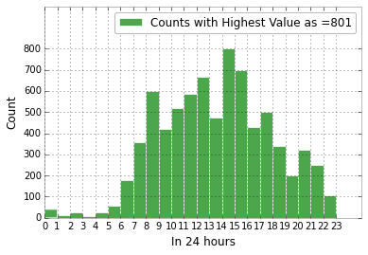
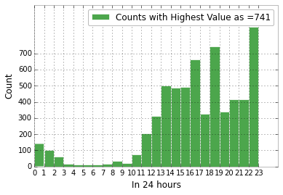
Data Statistics
Preliminary count using MAC Addresses
a. Data 1 (17th Sept-Thursday) b. Data 2 (2nd Oct-Friday)

Slide 10
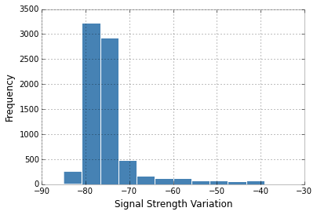
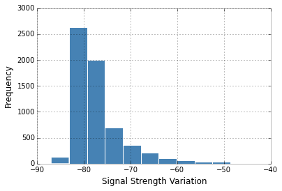
Data Statistics
Signal Strength Distribution
a. Data 1 (17th Sept-Thursday) b. Data 2 (2nd Oct-Friday)

Slide 11
Data Cleaning
Removing data between 12PM-6AM
Slicing by Hour
Slicing by 5 minutes
Removing consecutive MAC -ID occurrences

Slide 12
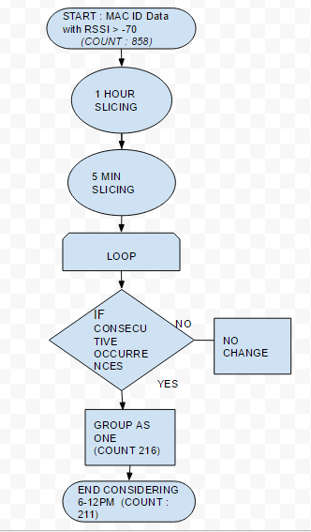
ALGORITHM FLOWCHART

Slide 13
Data Statistics
Preliminary count using MAC Addresses
a. Data 1 (17th Sept-Thursday) b. Data 2 (2nd Oct-Friday)

Slide 14
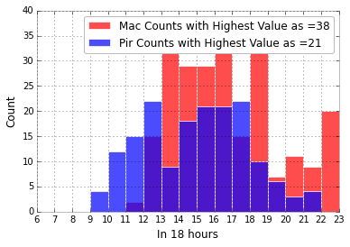
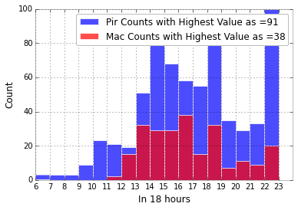
Data Statistics
Preliminary count using MAC Addresses
a. Data 1 (17th Sept-Thursday) b. Date 2 (2nd Oct, Friday)

Slide 15
Whitelist Automatic Update
Supervised Learning
Building MAC ID training set for initial 15 minutes and testing on the next 15 minutes
Cumulative process with new data as test and previous dataset as training
Applying Prior Grouping Algorithm

Slide 16
Bluetooth Sniffing
To get Bluetooth MAC Addresses giving ground truth data
Using Raspberry Pi and SSHing it to another system
Data collection

Slide 17
Documentation
Started A GitHub Account (GRA Wifi and Bluetooth Tracking)
Only Python Notebooks and analysis using Python[No images or data collected of any form has been put up]
Description of work done in the past , Logging ideas for steps to be used ahead
Started Documenting my work
For future use by any person trying to understand the project

