Slide 1
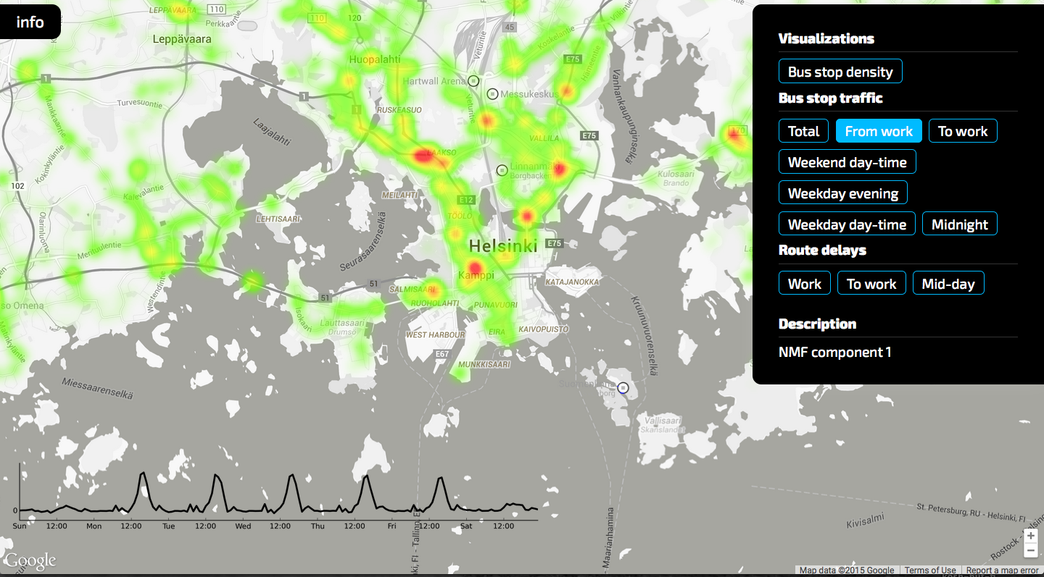
ViBE: Visual Bus Data Exploration Tool
Team: data & pizza => insight
Members: Arno Solin, Eric Malmi, Jaakko Luttinen

Slide 2
What’s ViBE and who uses it?
Target users
(Mainly) HSL - Functionality of the bus network
(Also) Passenger - Current congestion
Data: HSL ajoaika_gps (>1 year, all busses, 40 GB)
Technologies: SQLite, Python, Google Maps, JavaScript
Code on GitHub: https://github.com/asolin/aalto-data-science-hackathon

Slide 3
Case Analyses
Case 1: Stop times
Case 2: Delays
Case 3: PCA and Non-negative Matrix Factorization

Slide 4
“What’s the probability that I’ve missed the bus already?”

Slide 5
