Slide 1
Information Extraction
USC VSoE CSCI 544: Applied Natural Language Processing
Nanyun Violet Peng -- 彭楠赟
October 25, 2017
Many slides adapted from Dan Jurafsky: Stanford-NLP

Slide 2
Outline
Intro to Information Extraction
Inference
Named Entity Recognition
Learning
Entity Relation Extraction

Slide 3
Deep Neural Networks for Sequence Tagging

Slide 4
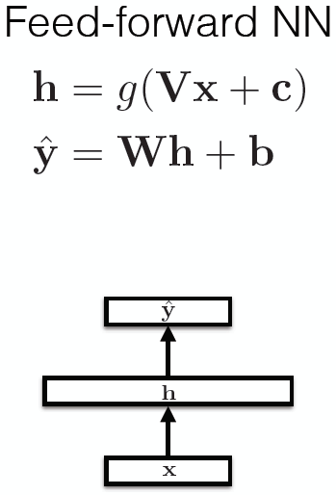
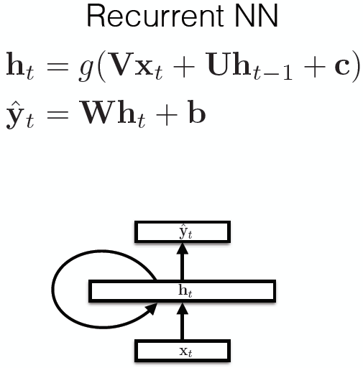
Recurrent Neural Networks

Slide 5
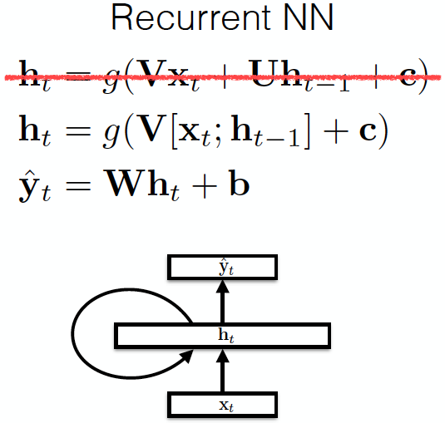
Recurrent Neural Networks

Slide 6
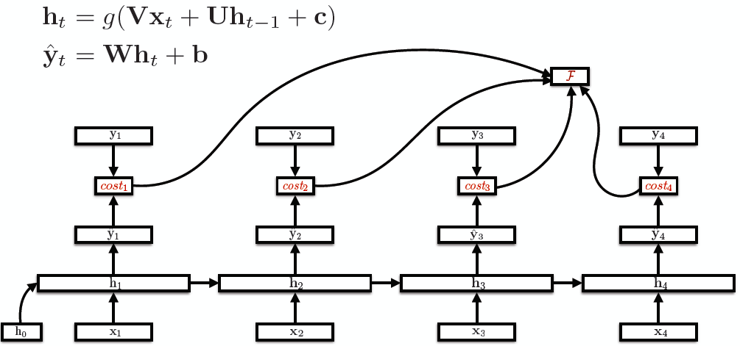
Unroll RNNs
U
V

Slide 7
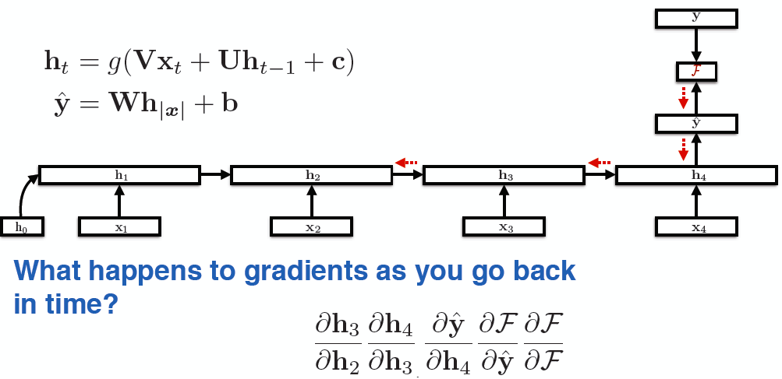
RNN training
Back-propagation over time

Slide 8
RNNs characteristics
Model hidden states dependencies
Errors “back propagation over time”
Feature learning methods
Vanishing gradient problem: cannot model long-distant dependencies of the hidden states.

Slide 9
Vanishing Gradients
For the traditional activation functions, each gradient term has the value in range (-1, 1).
Multiplying n of these small numbers to compute gradients
The longer the sequence is, the more severe the problems are.

Slide 10
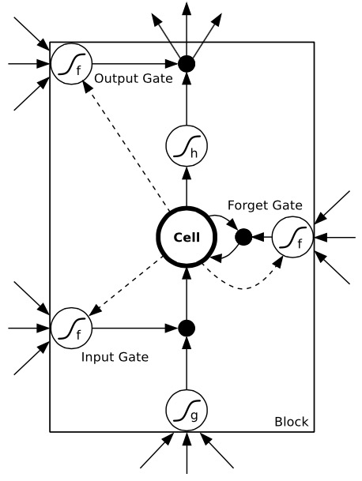
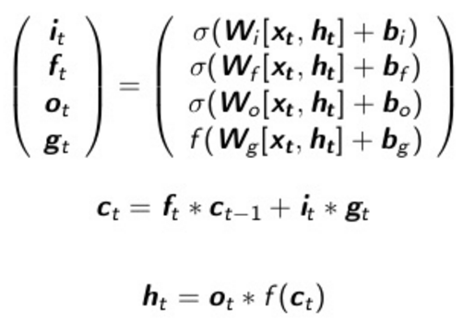
Long-Short Term Memory Networks (LSTMs)
Use gates to control the information to
be added from the input, forgot from the
previous memories, and outputted.
σ and f are sigmoid and tanh function
respectively, to map the value to [-1, 1]

Slide 11
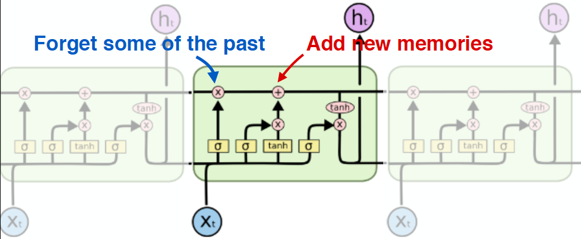
Another Visualization
Capable of modeling long-distant dependencies between states.
Figure credit: Christopher Olah

Slide 12
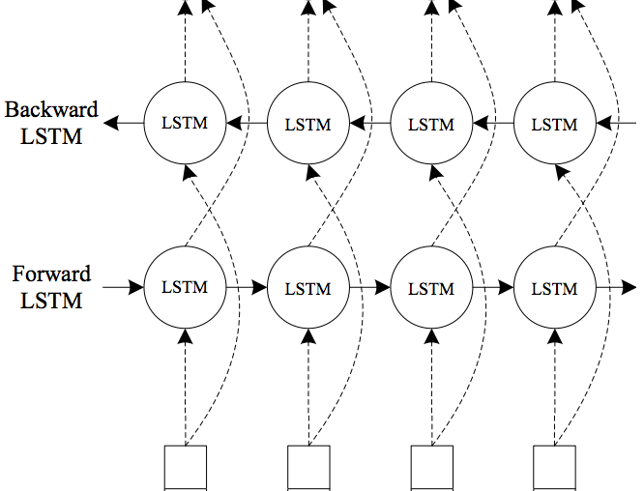
Bidirectional LSTMs

Slide 13
LSTMs for Sequential Tagging
y_{t}
Sophisticated model of input + local predictions.

Slide 14
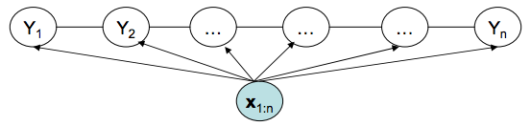
Recall CRFs for Sequential Tagging
Arbitrary features on the input side
Markov assumption on the output side

Slide 15
LSTMs for Sequential Tagging
Completely ignored the interdependencies of the outputs
Will this work? Yes.
Liang et. al. (2008), Structure Compilation: Trading Structure for Features
Is this the best model? Not necessarily.

Slide 16
Recall CRFs for Sequential Tagging
Arbitrary features on the input side
Markov assumption on the output side

Slide 17
Combining CRFs with LSTMs
Automatic feature learning with RNNs
Will this work? Yes.
Liang et. al. (2008), Structure Compilation: Trading Structure for Features
Is this the best model? Not necessarily.

Slide 18
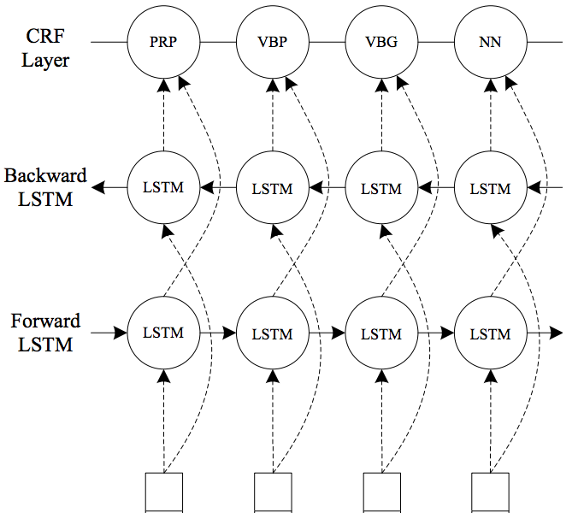
Combining CRFs with LSTMs

Slide 19
Combining Two Benefits
Directly model output dependencies by CRFs.
Powerful automatic feature learning using biLSTMs.
Jointly training all the parameters to “share the modeling responsibilities”

Slide 20
Outline
Intro to Information Extraction
Named Entity Recognition
Entity Relation Extraction

Slide 21
Extracting relations from text
Company report: “International Business Machines Corporation (IBM or the company) was incorporated in the State of New York on June 16, 1911, as the Computing-Tabulating-Recording Co. (C-T-R)…”
Extracted Complex Relation:
Company-Founding
Company IBM
Location New York
Date June 16, 1911
Original-Name Computing-Tabulating-Recording Co.
But we will focus on the simpler task of extracting relation triples
Founding-year(IBM,1911)
Founding-location(IBM,New York)

Slide 22
Automated Content Extraction (ACE)
17 relations from 2008 “Relation Extraction Task”

Slide 23
Automated Content Extraction (ACE)
Physical-Located PER-GPE
He was in Tennessee
Part-Whole-Subsidiary ORG-ORG
XYZ, the parent company of ABC
Person-Social-Family PER-PER
John’s wife Yoko
Org-AFF-Founder PER-ORG
Steve Jobs, co-founder of Apple…

Slide 24
UMLS: Unified Medical Language System
134 entity types, 54 relations
Injury disrupts Physiological Function
Bodily Location location-of Biologic Function
Anatomical Structure part-of Organism
Pharmacologic Substance causes Pathological Function
Pharmacologic Substance treats Pathologic Function

Slide 25
Extracting UMLS relations from a sentence
Doppler echocardiography can be used to diagnose left anterior descending artery stenosis in patients with type 2 diabetes
⬇
Echocardiography, Doppler DIAGNOSES Acquired stenosis

Slide 26
Relation databases that draw from Wikipedia
Resource Description Framework (RDF) triples
subject predicate object
Golden Gate Park location San Francisco
dbpedia:Golden_Gate_Park dbpedia-owl:location dbpedia:San_Francisco
DBPedia: 1 billion RDF triples, 385 from English Wikipedia
Frequent Freebase relations:
people/person/nationality, location/location/contains
people/person/profession, people/person/place-of-birth
biology/organism_higher_classification film/film/genre

Slide 27
Ontological relations
Examples from the WordNet Thesaurus
IS-A (hypernym): subsumption between classes
Giraffe IS-A ruminant IS-A ungulate IS-A mammal IS-A vertebrate IS-A animal…
Instance-of: relation between individual and class
San Francisco instance-of city

Slide 28
How to build relation extractors
Hand-written patterns
Supervised machine learning
Semi-supervised and unsupervised
Bootstrapping (using seeds)
Distant supervision
Unsupervised learning from the web

Slide 29
Rules for extracting IS-A relation
Early intuition from Hearst (1992)
“Agar is a substance prepared from a mixture of red algae, such as Gelidium, for laboratory or industrial use”
What does Gelidium mean?
How do you know?`

Slide 30
Rules for extracting IS-A relation
Early intuition from Hearst (1992)
“Agar is a substance prepared from a mixture of red algae, such as Gelidium, for laboratory or industrial use”
What does Gelidium mean?
How do you know?`

Slide 31
Hearst’s Patterns for extracting IS-A relations
(Hearst, 1992): Automatic Acquisition of Hyponyms
“Y such as X ((, X)* (, and|or) X)”
“such Y as X”
“X or other Y”
“X and other Y”
“Y including X”
“Y, especially X”

Slide 32
Hearst’s Patterns for extracting IS-A relations
Hearst pattern | Example occurrences
X and other Y | ...temples, treasuries, and other important civic buildings.
X or other Y | Bruises, wounds, broken bones or other injuries...
Y such as X | The bow lute, such as the Bambara ndang...
Such Y as X | ...such authors as Herrick, Goldsmith, and Shakespeare.
Y including X | ...common-law countries, including Canada and England...
Y , especially X | European countries, especially France, England, and Spain...

Slide 33
Extracting Richer Relations Using Rules
Intuition: relations often hold between specific entities
located-in (ORGANIZATION, LOCATION)
founded (PERSON, ORGANIZATION)
cures (DRUG, DISEASE)
Start with Named Entity tags to help extract relation!

Slide 34


Named Entities aren’t quite enough. Which relations hold between 2 entities?
Cure?
Prevent?
Drug
Cause?
Disease
Notes:
Drug and disease pictures from Wikimedia Commons
http://commons.wikimedia.org/wiki/File:Gnome-face-sick.svg

Slide 35
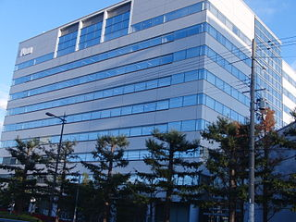

What relations hold between 2 entities?
Founder?
Investor?
Member?
PERSON
ORGANIZATION
Employee?
President?
Notes:
pictures from Wikimedia Commons
http://upload.wikimedia.org/wikipedia/commons/thumb/9/9a/Sanyo_Electric_Corporation.JPG/320px-Sanyo_Electric_Corporation.JPG

Slide 36
Extracting Richer Relations Using Rules and Named Entities
Who holds what office in what organization?
PERSON, POSITION of ORG
George Marshall, Secretary of State of the United States
PERSON(named|appointed|chose|etc.) PERSON Prep? POSITION
Truman appointed Marshall Secretary of State
PERSON [be]? (named|appointed|etc.) Prep? ORG POSITION
George Marshall was named US Secretary of State

Slide 37
Hand-built patterns for relations
Plus:
Human patterns tend to be high-precision
Can be tailored to specific domains
Minus
Human patterns are often low-recall
A lot of work to think of all possible patterns!
Don’t want to have to do this for every relation!
We’d like better accuracy

Slide 38
Relation Extraction
Supervised relation extraction

Slide 39
Supervised machine learning for relations
Choose a set of relations we’d like to extract
Choose a set of relevant named entities
Find and label data
Choose a representative corpus
Label the named entities in the corpus
Hand-label the relations between these entities
Break into training, development, and test
Train a classifier on the training set

Slide 40
How to do classification in supervised relation extraction
Find all pairs of named entities (usually in same sentence)
Decide if 2 entities are related
If yes, classify the relation
Why the extra step?
Faster classification training by eliminating most pairs
Can use distinct feature-sets appropriate for each task.

Slide 41

Relation Extraction
Classify the relation between two entities in a sentence
American Airlines, a unit of AMR, immediately matched the move, spokesman Tim Wagner said.
EMPLOYMENT
FAMILY
NIL
CITIZEN
…
INVENTOR
SUBSIDIARY
FOUNDER

Slide 42
Word Features for Relation Extraction
American Airlines, a unit of AMR, immediately matched the move, spokesman Tim Wagner said
Mention 1
Mention 2
Headwords of M1 and M2, and combination
Airlines Wagner Airlines-Wagner
Bag of words and bigrams in M1 and M2
{American, Airlines, Tim, Wagner, American Airlines, Tim Wagner}
Words or bigrams in particular positions left and right of M1/M2
M2: -1 spokesman
M2: +1 said
Bag of words or bigrams between the two entities
{a, AMR, of, immediately, matched, move, spokesman, the, unit}

Slide 43
Named Entity Type and Mention Level Features for Relation Extraction
American Airlines, a unit of AMR, immediately matched the move, spokesman Tim Wagner said
Mention 1
Mention 2
Named-entity types
M1: ORG
M2: PERSON
Concatenation of the two named-entity types
ORG-PERSON
Entity Level of M1 and M2 (NAME, NOMINAL, PRONOUN)
M1: NAME [it or he would be PRONOUN]
M2: NAME [the company would be NOMINAL]

Slide 44
Parse Features for Relation Extraction
American Airlines, a unit of AMR, immediately matched the move, spokesman Tim Wagner said
Mention 1
Mention 2
Base syntactic chunk sequence from one to the other
NP NP PP VP NP NP
Constituent path through the tree from one to the other
NP ⬆ NP ⬆ S ⬆ S ⬇ NP
Dependency path
Airlines matched Wagner said

Slide 45
Gazetteer and trigger word features for relation extraction
Trigger list for family: kinship terms
parent, wife, husband, grandparent, etc. [from WordNet]
Gazetteer:
Lists of useful geo or geopolitical words
Country name list
Other sub-entities

Slide 46
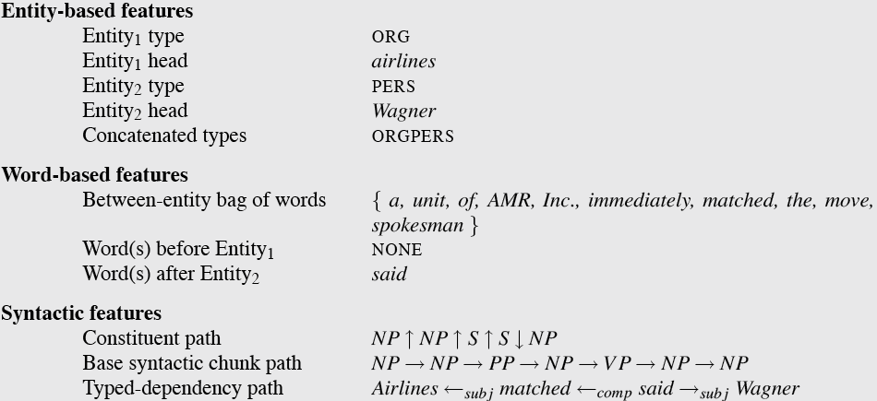
American Airlines, a unit of AMR, immediately matched the move, spokesman Tim Wagner said.

Slide 47
Classifiers for supervised methods
Now you can use any classifier you like
MaxEnt
Naïve Bayes
SVM
Convolutional Neural Networks
...
Train it on the training set, tune on the dev set, test on the test set

Slide 48
Evaluation of Supervised Relation Extraction
Compute P/R/F₁ for each relation

Slide 49
Summary: Supervised Relation Extraction
+ Can get high accuracies with enough hand-labeled training data, if test similar enough to training
- Labeling a large training set is expensive
- Supervised models are brittle, don’t generalize well to different genres

Slide 50
Relation Extraction
Semi-supervised and unsupervised relation extraction

Slide 51
Seed-based or bootstrapping approaches to relation extraction
No training set? Maybe you have:
A few seed tuples or
A few high-precision patterns
Can you use those seeds to do something useful?
Bootstrapping: use the seeds to directly learn to populate a relation

Slide 52
Relation Bootstrapping (Hearst 1992)
Gather a set of seed pairs that have relation R
Iterate:
Find sentences with these pairs
Look at the context between or around the pair and generalize the context to create patterns
Use the patterns for grep for more pairs

Slide 53
Bootstrapping
<Mark Twain, Elmira> Seed tuple
Grep (google) for the environments of the seed tuple
“Mark Twain is buried in Elmira, NY.”
X is buried in Y
“The grave of Mark Twain is in Elmira”
The grave of X is in Y
“Elmira is Mark Twain’s final resting place”
Y is X’s final resting place.
Use those patterns to grep for new tuples
Iterate

Slide 54
Dipre: Extract <author,book> pairs
Brin, Sergei. 1998. Extracting Patterns and Relations from the World Wide Web.
Start with 5 seeds:
Find Instances:
The Comedy of Errors, by William Shakespeare, was
The Comedy of Errors, by William Shakespeare, is
The Comedy of Errors, one of William Shakespeare's earliest attempts
The Comedy of Errors, one of William Shakespeare's most
Extract patterns (group by middle, take longest common prefix/suffix)
?x , by ?y ,
?x , one of ?y ‘s
Now iterate, finding new seeds that match the pattern
Author | Book
Isaac Asimov | The Robots of Dawn
David Brin | Startide Rising
James Gleick | Chaos: Making a New Science
Charles Dickens | Great Expectations
William Shakespeare | The Comedy of Errors

Slide 55
Snowball
E. Agichtein and L. Gravano 2000. Snowball: Extracting Relations
from Large Plain-Text Collections. ICDL
Similar iterative algorithm
Group instances w/similar prefix, middle, suffix, extract patterns
But require that X and Y be named entities
And compute a confidence for each pattern
Organization | Location of Headquarters
Microsoft | Redmond
Exxon | Irving
IBM | Armonk
.69
ORGANIZATION
{’s, in, headquarters}
LOCATION
.75
LOCATION
{based}
ORGANIZATION

Slide 56
Distant Supervision
Snow, Jurafsky, Ng. 2005. Learning syntactic patterns for automatic hypernym discovery. NIPS05
Fei Wu and Daniel S. Weld. 2007. Autonomously Semantifying Wikipeida. CIKM07
Mintz, Bills, Snow, Jurafsky. 2009. Distant supervision for relation extraction without labeled data. ACL09
Combine bootstrapping with supervised learning
Instead of 5 seeds,
Use a large database to get huge # of seed examples
Create lots of features from all these examples
Combine in a supervised classifier

Slide 57
Distant supervision paradigm
Like supervised classification:
Uses a classifier with lots of features
Supervised by detailed hand-created knowledge
Doesn’t require iteratively expanding patterns
Like unsupervised classification:
Uses very large amounts of unlabeled data
Not sensitive to genre issues in training corpus

Slide 58
Distantly supervised learning of relation extraction patterns
1
For each relation
For each tuple in big database
Find sentences in large corpus with both entities
Extract frequent features (parse, words, etc)
Train supervised classifier using thousands of patterns
Born-In
<Edwin Hubble, Marshfield>
<Albert Einstein, Ulm>
2
3
Hubble was born in Marshfield
Einstein, born (1879), Ulm
Hubble’s birthplace in Marshfield
4
PER was born in LOC
PER, born (XXXX), LOC
PER’s birthplace in LOC
5
P(born-in | f₁,f₂,f₃,…,f₇₀₀₀₀)

Slide 59
Unsupervised relation extraction
M. Banko, M. Cararella, S. Soderland, M. Broadhead, and O. Etzioni. 2007. Open information extraction from the web. IJCAI
Open Information Extraction:
extract relations from the web with no training data, no list of relations
Use parsed data to train a “trustworthy tuple” classifier
Single-pass extract all relations between NPs, keep if trustworthy
Assessor ranks relations based on text redundancy
(FCI, specializes in, software development)
(Tesla, invented, coil transformer)

Slide 60
Evaluation of Semi-supervised and Unsupervised Relation Extraction
Since it extracts totally new relations from the web
There is no gold set of correct instances of relations!
Can’t compute precision (don’t know which ones are correct)
Can’t compute recall (don’t know which ones were missed)
Instead, we can approximate precision (only)
Draw a random sample of relations from output, check precision manually
Can also compute precision at different levels of recall.
Precision for top 1000 new relations, top 10,000 new relations, top 100,000
In each case taking a random sample of that set
But no way to evaluate recall

