Slide 1


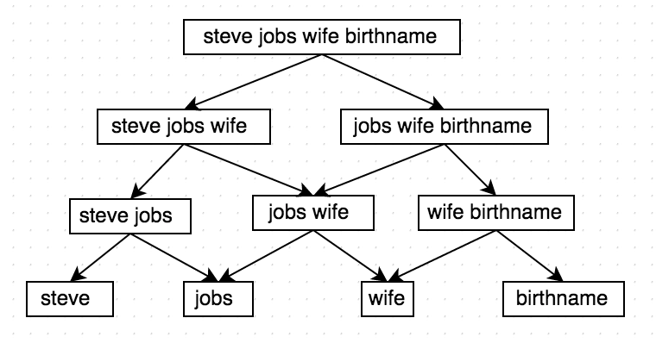
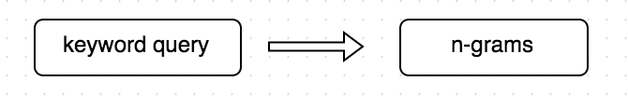
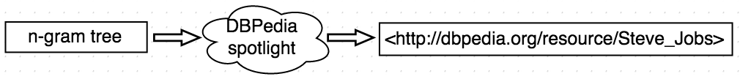
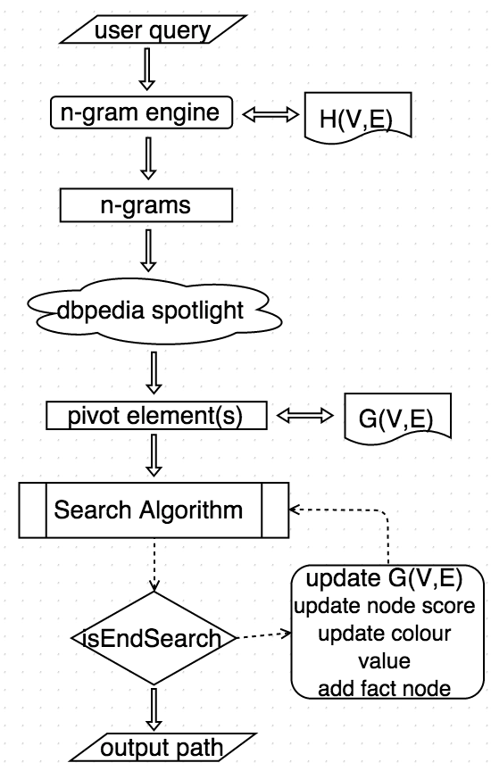
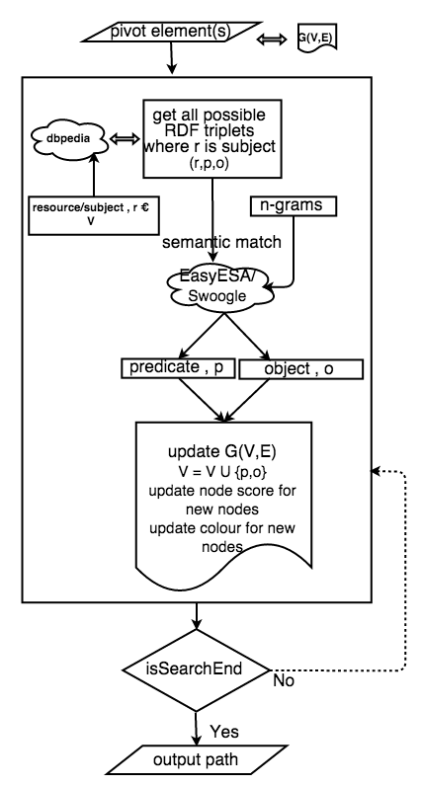
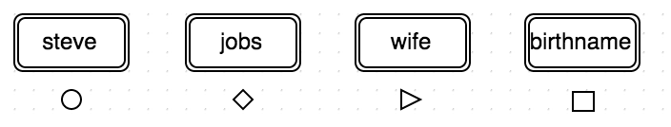
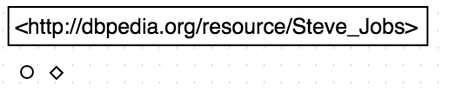
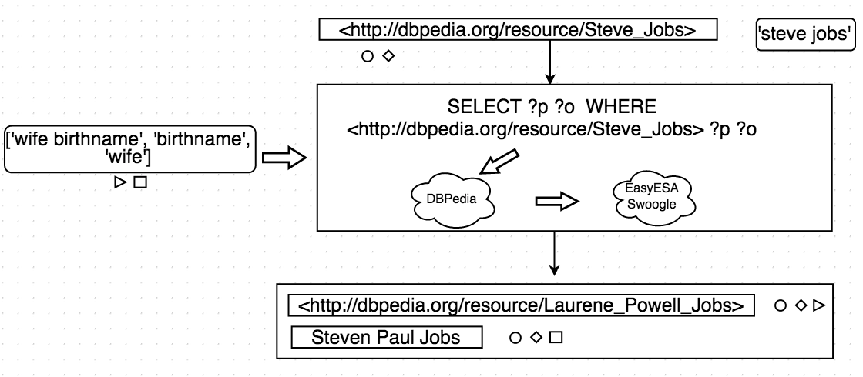
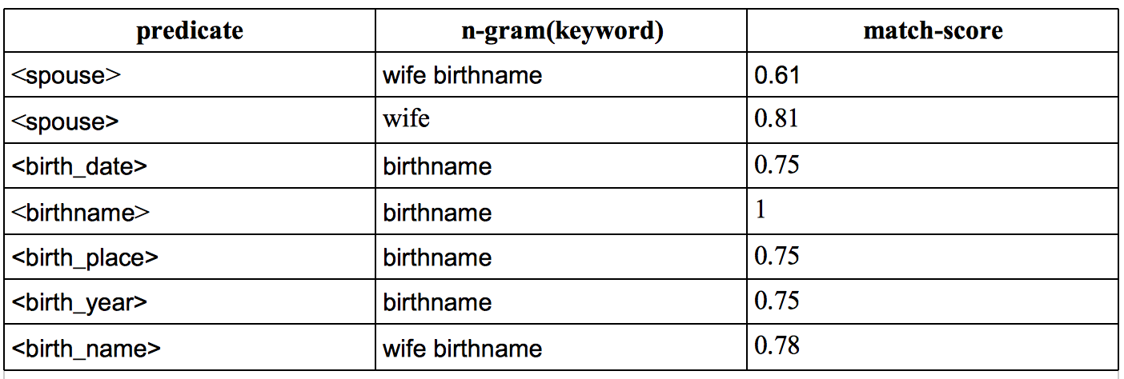
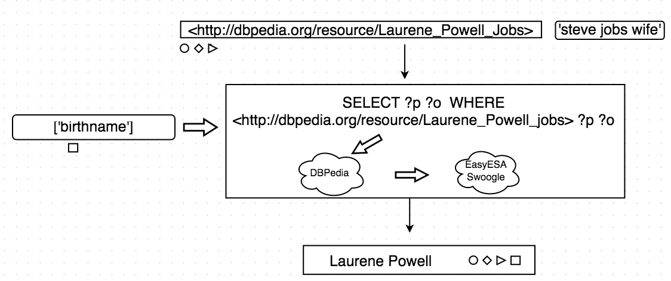
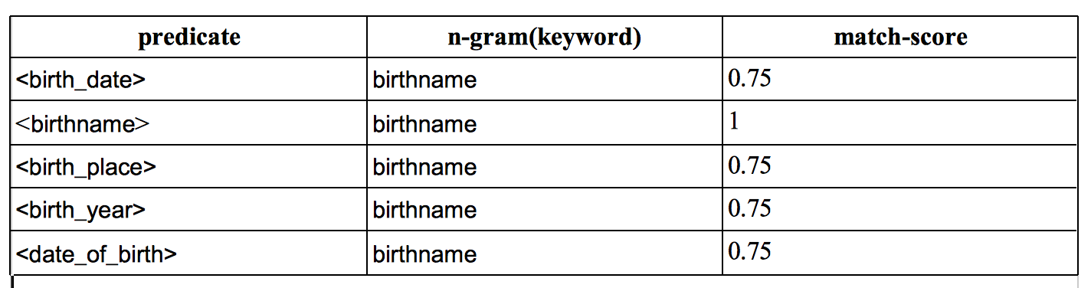
Graph Keyword Search
Pedro Szekely
University of Southern California
pszekely@isi.edu
Shreenidhi Bhat
University of Southern California
shreenib@usc.edu
Research Goals
Example
A keyword-based query interface for semantic stores
Semantic store: DBPedia
Semantic similarity: EasyESA and Swoogle
Future work: use context to disambiguate the meaning of keywords
Query : Steve Jobs wife birth-name
1. n-gram tree generation
2. Pivot Entity Recognition
Technical Approach
System components
Search algorithm
3. Color assignment
4.Search
Iteration 1
Results
Following are the top results for a set of queries that we ran on the system
Query 1 : Steve Jobs wife birth-name
Iteration 2
<Laurene_Powell_Jobs> <birthName> Laurene Powell
<Laurene_Powell_Jobs> <birthDate> 1963-11-06+02:00
<Steve_Jobs> <birthName> Steven Paul Jobs
Query 2 : Lisbon ruling party
<Lisbon> <leaderParty> <Socialist_Party_(Portugal)>
<Lisbon> <mayorParty> <Socialist_Party_(Portugal)>
<Lisbon> <leader> Helena Roseta
<Lisbon,_Ohio> <leaderName> Michael B. Lewis
Query 3 : Turkmenistan languages
<Turkmenistan> <languagesType> languages
<Turkmenistan> <languagesType> Inter-ethnic
<Turkmenistan> <officialLanguages> <Turkmen_language>
<Turkmenistan> <language> <Russian_language>

