Slide 1
Data Science Course Overview

Slide 2
0. Meet Your Instructors I. Instructor Philosophy II. Content Philosophy III. How to Succeed IV. Typical Class V. Logistics VI. Questions?
agenda

Slide 3
Cari Levay Current Senior Technical Recruiter at LinkedIn Former STUDENT, GA Data Science
MEET YOUR INSTRUCTORS

Slide 4
Peter Gao Current Data Science at LinkedIn Former STUDENT, GA Data Science
MEET YOUR INSTRUCTORS

Slide 5
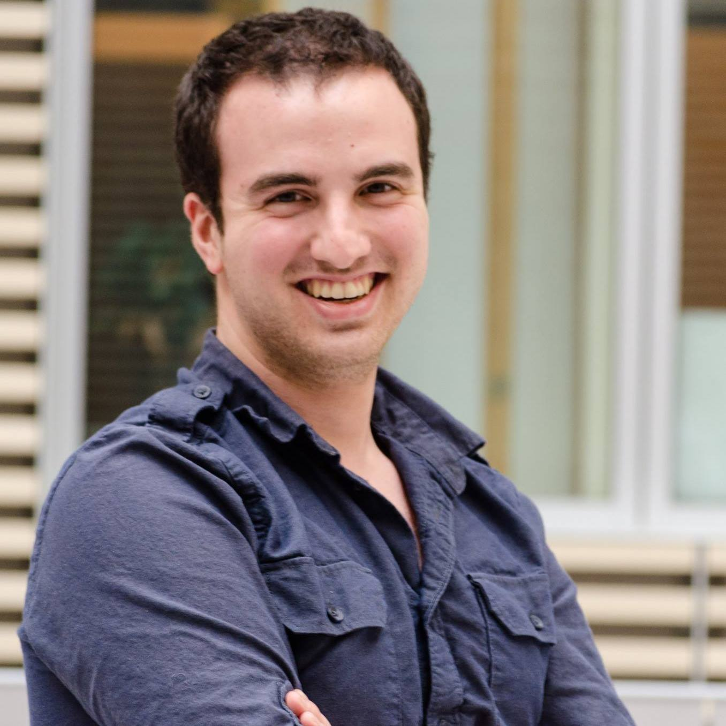
SINAN OZDEMIR Current FOUNDER of Legion Analytics Former PROFESSOR, Johns Hopkins University
MEET YOUR INSTRUCTORS

Slide 6
Instructor Philosophy
Embrace diversity
Seek an optimal pace
Communicate early and often
Success is not a grade
Notes:
Embrace diversity – We have a lot of different backgrounds in terms of interests, knowledge, skills – embrace that and learn from one another
Seek an optimal pace – We will do our best to find a pace that works well for everyone – if it’s too slow for you, we will help you go deeper and give you bigger challenges – if it’s too fast for you, we will provide you with extra help and resources
Communicate early and often – We want to know how you are doing with the course, what confuses you, what learning style works for you and what doesn’t – keep us updated so we can help you to be successful – we are going to be checking in with you (one-on-one) throughout the course and getting your feedback
Success is not a grade – Success in this course is not about grades (we don’t give out grades) or about how you do compared to your classmates, it’s about achieving your goal and helping you to get where you want to be

Slide 7
Content Philosophy
Application-based approach
Understand key principles
Balance depth with breadth
Course project
Notes:
Application-based approach – We will be teaching you a combination of theory and practical implementation and having you practice things as much as possible – our goal is that you can effectively use these tools to do data science – data science means implementation, not just ideas
Understand key principles – We want you to understand the principles behind the methods and algorithms – “black box” data science will only get you so far – understanding what you’re doing and why will get you much further
Balance depth with breadth – We want you to know enough depth that you understand what you are doing, but not so much that we exclude crucial topics – we will try to accommodate your interests if you want to learn something we’re not planning on teaching
Course project – We are going to focus on the project from the start because that is where a lot of learning will occur

Slide 8
How to Succeed
Effort not prior knowledge
Ask questions
Communicate what you’ve learned
Help your classmates
Be patient with yourself
Notes:
Effort not prior knowledge – It’s not about what you know now, it’s about what you put into the course
Ask questions – Default to asking questions – helps with your understanding and helps us to know how you are doing
Communicate what you’ve learned – Blog about class, share it with others – will definitely deepen your knowledge
Help your classmates – We are all teachers and we are all learners – don’t be shy
Be patient with yourself – It’s okay if you don’t understand some of the course material – there is a lot of material and the complexity can be quite high – focus on learning as much as you can – we want to equip you with enough knowledge that you can learn independently both during and after this course

Slide 9
Typical Class
Lecture
Code walk-throughs
Code exercises
Discussion of homework and readings

Slide 10
Logistics
Bathrooms
Parking
Dress code
Start and end on time
Missing class
Slack instead of email
Office hours
GitHub for course content and homework

Slide 11
Questions?
COURSE OVERVIEW

