Slide 1
Safety-critical control in mixed criticality embedded systems
Emil Hjelm

Slide 2
Project overview
Five master thesis students
Lane detection
Data aggregation
Control theory
Communication in mixed criticality systems
Safety-critical control in mixed criticality systems
Demonstrator
Two RC-cars simulating “platooning”

Slide 3
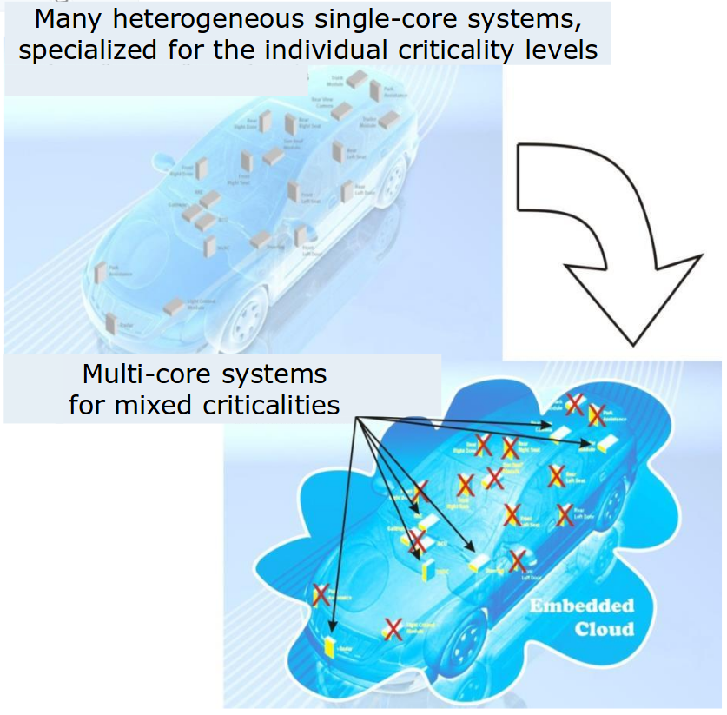
Background
Today, modern cars have around 100 ECUs, this means:
Inefficient resource usage
Clear separation between functions
Moving towards MCS would mean:
Efficient resource usage
Less power consumed
Less weight
Less volume
Lower production cost
Difficult to separate functions of different criticality
Fewer but more complex systems
Illustration of combining applications to reduce ECUs [1]
[1] https://www.artemis-emc2.eu/project_overview/ll1_automotive_applications/

Slide 4
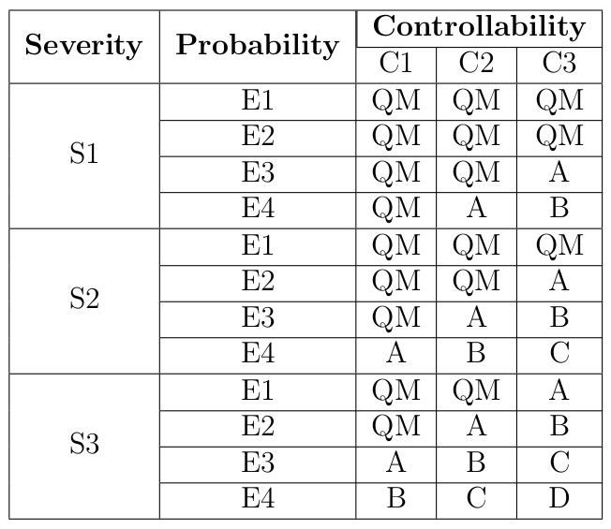
ISO 26262
Five different Automotive Safety Integrity Levels, ASIL [3]
[3] Road vehicles – functional safety – part 9: Automotive safety integrity level (asil)-oriented and safety-oriented analyses. Standard, International Organization for Standardization, Geneva, CH, November 2011.

Slide 5
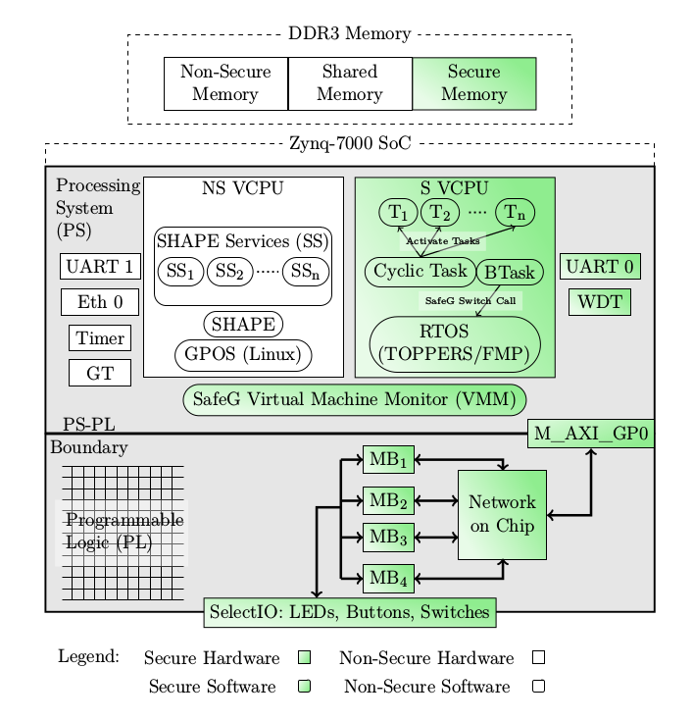
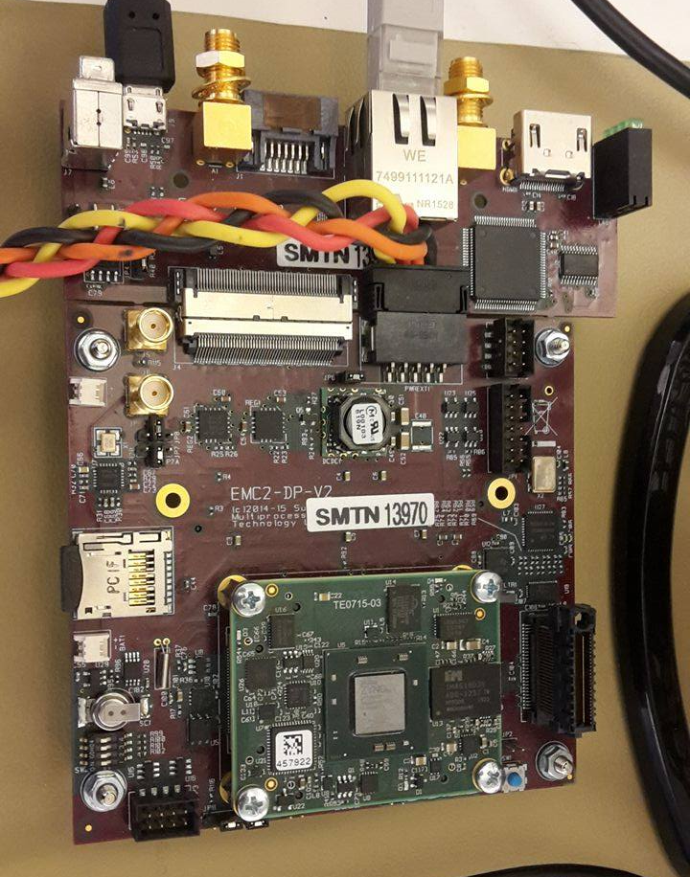
EMC²DP – EMC² Development Platform
System overview [4]
[4] Youssef Zaki. An embedded multi-core platform for mixed-criticality systems: Study and analysis of virtualization techniques. Master’s thesis, KTH, School of Information and Communication Technology (ICT), 2016.

Slide 6
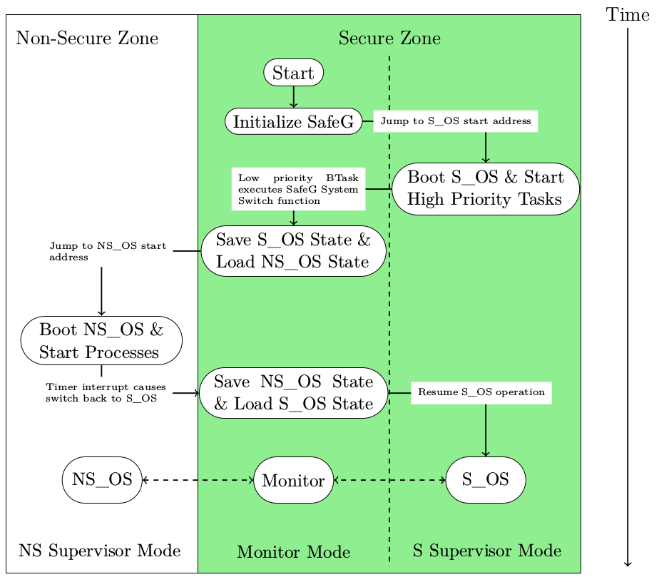
Processor switching state
Processor boot sequence [4]
[4] Youssef Zaki. An embedded multi-core platform for mixed-criticality systems: Study and analysis of virtualization techniques. Master’s thesis, KTH, School of Information and Communication Technology (ICT), 2016.

Slide 7
Research question
Underlying research question:
How, in a disciplined way, to reconcile the conflicting requirements of partitioning for safety assurance and sharing for efficient resource usage? [5]
Specific research questions:
How well can a safety-critical control system perform when implemented on a mixed criticality system using virtualization?
Is virtualization an efficient approach when trying to reconcile the conflicting requirements of partitioning for safety assurance and sharing for efficient resource usage when implementing a safety-critical control system?
[5] Alan Burns and Robert I. Davis. Mixed criticality systems - a review. July 2016

Slide 8
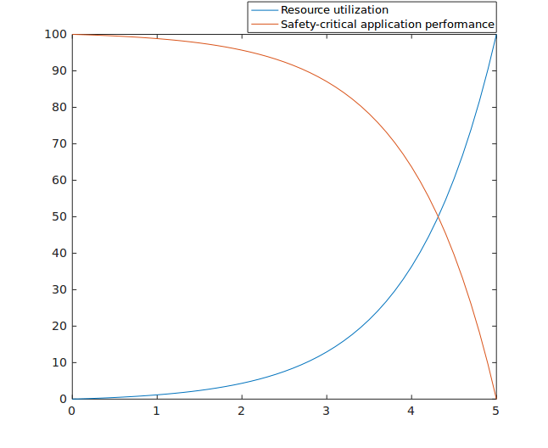
Conflict between efficiency and performance

Slide 9
Problem statement
Implement distance keeping control algorithm as a safety critical application. Compare between not using a second OS and for both cases:
Evaluate performance of control algorithm
Rise time
Overshoot
Settling time
Evaluate performance of processor
Missed deadlines
CPU utilization

Slide 10
Problem extended
Mode-switch takes 2 μs
Theoretical maximum frequency for any control algorithm f_{max}< 250 kHz
Processor boot sequence [4]
[4] Youssef Zaki. An embedded multi-core platform for mixed-criticality systems: Study and analysis of virtualization techniques. Master’s thesis, KTH, School of Information and Communication Technology (ICT), 2016.

Slide 11
Research design
Quantitative
Confirmatory investigation using quantitative data/operations with a deductive approach.

Slide 12
Questions

