Slide 1





Safety-critical control in mixed criticality embedded systems
Emil Hjelm

Slide 2
Presentation outline
Background
Research question and problem statement
What has been done in the field?
Demonstrator system overview
Results
Conclusion

Slide 3
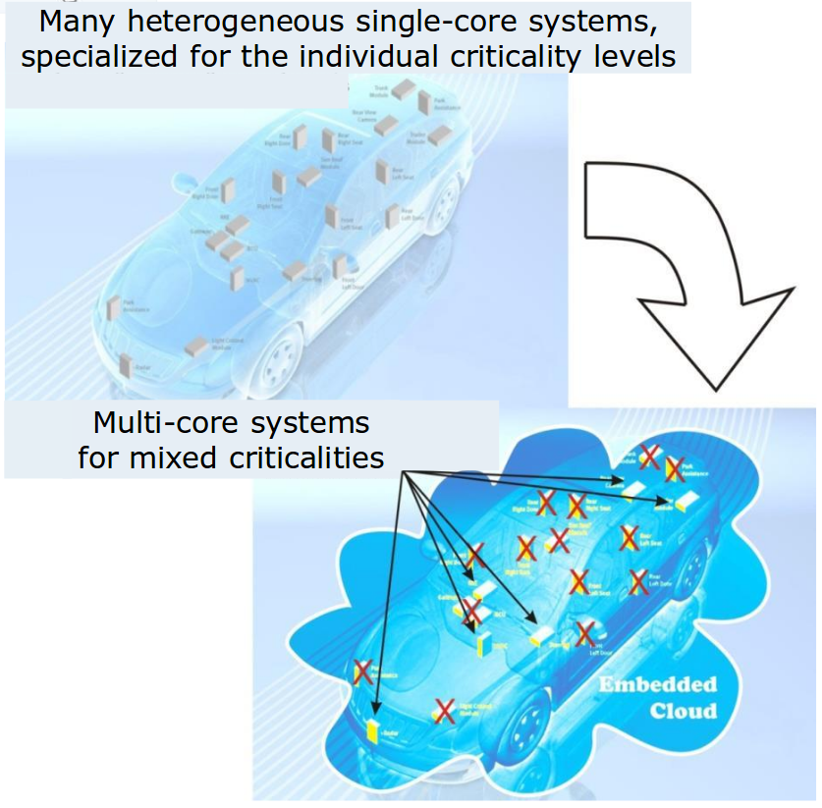
Background
Today, modern cars have around 100 ECUs, this means:
Inefficient resource usage
Clear separation between functions
Moving towards MCS would mean:
Efficient resource usage
  Less power consumed
  Less weight
  Less volume
  Lower production cost
Difficult to separate functions of different criticality
Fewer but more complex systems
Illustration of combining applications to reduce ECUs [1]
[1] https://www.artemis-emc2.eu/project_overview/ll1_automotive_applications/

Slide 4
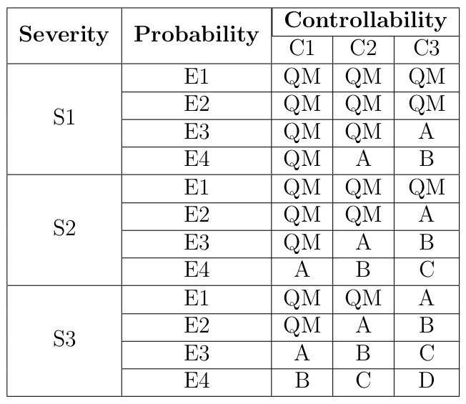
ISO 26262
Four different Automotive Safety Integrity Levels, ASILs
[3] Road vehicles – functional safety – part 9: Automotive safety integrity level (asil)-oriented and safety-oriented analyses. Standard, International Organization for Standardization, Geneva, CH, November 2011.

Slide 5
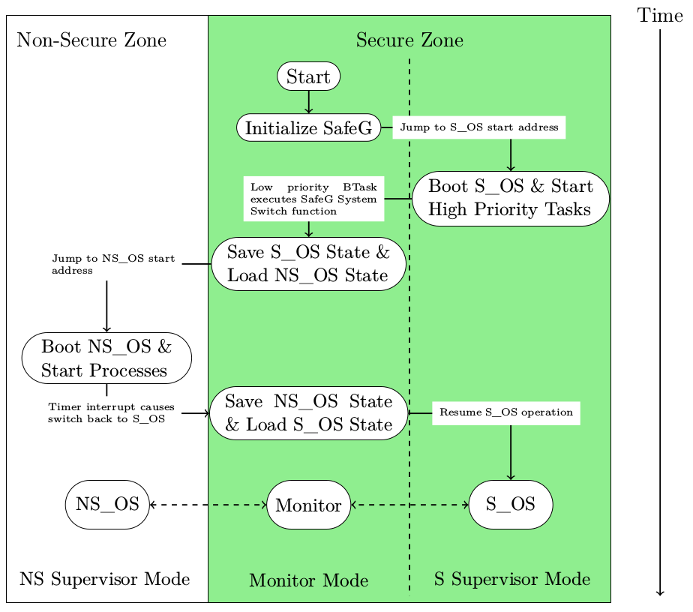
Alten MCS - Processor switching state
Processor boot sequence [4]
[4] Youssef Zaki. An embedded multi-core platform for mixed-criticality systems: Study and analysis of virtualization techniques. Master’s thesis, KTH, School of Information and Communication Technology (ICT), 2016.

Slide 6
Alten MCS - Processor switching state
Mode-switch takes ~2 μs
Theoretical maximum frequency for any control algorithm f_{max}< 250 kHz
Processor boot sequence [4]
[4] Youssef Zaki. An embedded multi-core platform for mixed-criticality systems: Study and analysis of virtualization techniques. Master’s thesis, KTH, School of Information and Communication Technology (ICT), 2016.

Slide 7
Research question
Is virtualization an efficient approach when trying to reconcile the conflicting requirements of partitioning for safety assurance and sharing for efficient resource usage when implementing a safety-critical control system?
[5] Alan Burns and Robert I. Davis. Mixed criticality systems - a review. July 2016

Slide 8
Problem statement
Implement distance keeping control algorithm as a safety critical application on a mixed criticality system. Evaluate performance of processor
Missed deadlines?
Robustness of hypervisor
CPU utilization

Slide 9
Schedulers
Steve Vestal showed that neither RM nor DM was optimal when criticality levels are introduced [6]
Sanjoy Baruah and Steve Vestal showed that EDF does not dominate FP in mixed criticality systems [7]
[6] Steve Vestal. Preemptive scheduling of multi-criticality systems with varying degrees of execution time assurance, 2007.
[7] Sanjoy Baruah and Steve Vestal. Schedulability analysis of sporadic tasks with multiple criticality specifications, 2008.

Slide 10
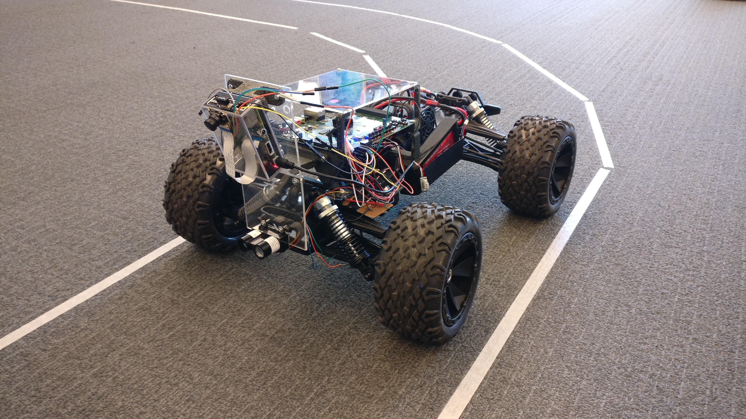
System overview

Slide 11
System overview
GPOS, non-critical
(Linux)
RTOS, safety-critical
(FMP)
Main
Initialize functions
Longitudinal control
PID controllers for CC, ACC and CACC
Lateral control
Control steering
Data Aggregation
Filter sensor data
Determine unsafe conditions
Communication
Send and receive messages from vehicles and infrastructure
Switch OS
FPGA
PWM
UART
Decoders
Driver
Microblaze
Throttle
Raspberry Pi
Encoders
Lidar
WiFi
Motor
Camera
Wheels
Object

Slide 12
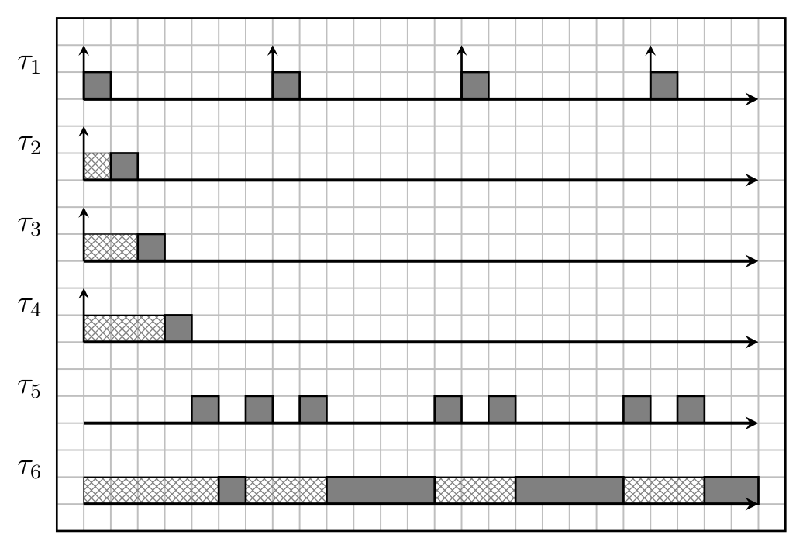
Processor scheduling
Data aggregation
Communication
Lateral control
Longitudinal control
OS switch
GPOS
Time not to scale

Slide 13
OS switch execution times
WCET:
153 clock cycles
3.06 us
Median execution time:
86 clock cycles
1.72
1 kHz switching frequency:
  RTOS CPU utilization 0.005%
  Hypervisor overhead 0.6%
  Increased total CPU utilization to potentially 99.4%

Slide 14
WCET
Median execution time
100% CPU utilization by RTOS and monitor at 40kHz
(Meaning 0% time for GPOS)
34% CPU utilization by GPOS at 40kHz if RTOS and monitor runs for median execution time

Slide 15
Conclusion
Is virtualization an efficient approach when trying to reconcile the conflicting requirements of partitioning for safety assurance and sharing for efficient resource usage when implementing a safety-critical control system?
Yes!
[5] Alan Burns and Robert I. Davis. Mixed criticality systems - a review. July 2016

Slide 16
Questions
?

