Slide 1
Safety-critical control in mixed criticality embedded systems
Emil Hjelm

Slide 2
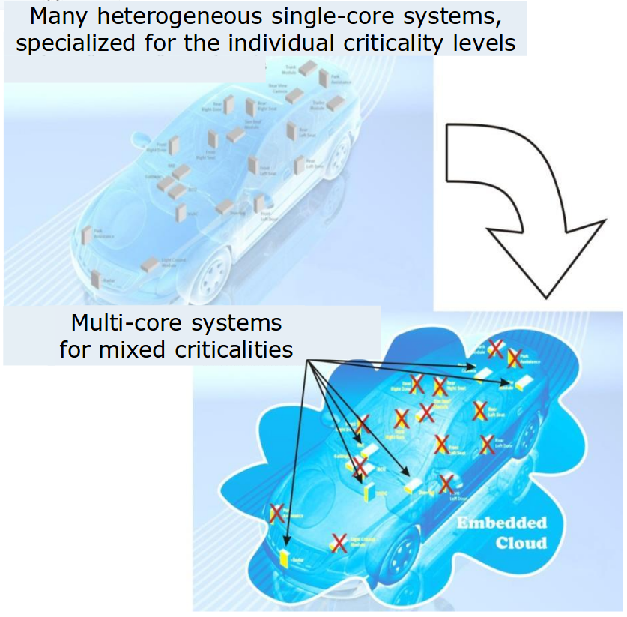
Background
Today, modern cars have around 100 ECUs, this means:
Inefficient resource usage
Clear separation between functions
Moving towards MCS would mean:
Efficient resource usage
Less power consumed
Less weight
Less volume
Lower production cost
Difficult to separate functions of different criticality
Fewer but more complex systems
Illustration of combining applications to reduce ECUs [1]
[1] https://www.artemis-emc2.eu/project_overview/ll1_automotive_applications/

Slide 3
EMC² project goals [2]
Reduce the cost of the system design by 15%
Reduce the effort and time required for re-validation and re-certification of systems after making changes by 15%
Manage a complexity increase of 25% with 10% effort reduction
Achieve cross-sectorial reusability of Embedded Systems devices and architecture platforms that will be developed using the ARTEMIS JU results.
[2] Werner Weber. A Platform Project on Embedded Microcontrollers in Applications of Mobility, Industry and the Internet of Things, Mars 2015.

Slide 4
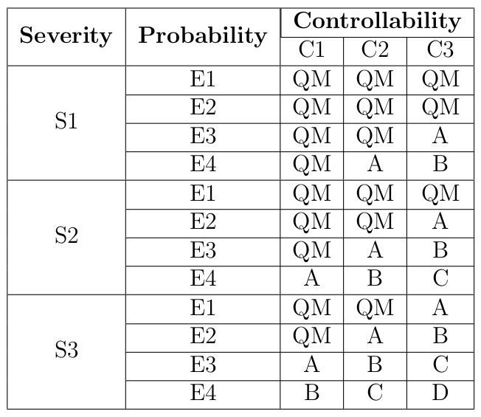
ISO 26262
Five different Automotive Safety Integrity Levels, ASIL [3]
[3] Road vehicles – functional safety – part 9: Automotive safety integrity level (asil)-oriented and safety-oriented analyses. Standard, International Organization for Standardization, Geneva, CH, November 2011.

Slide 5
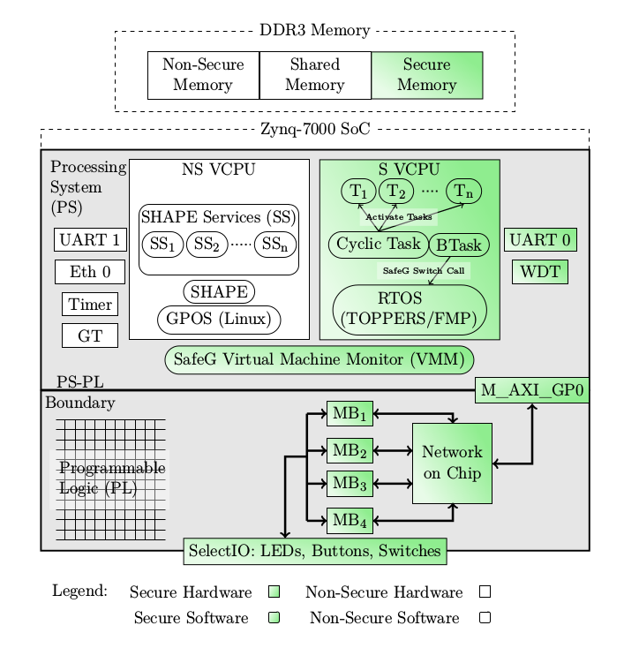
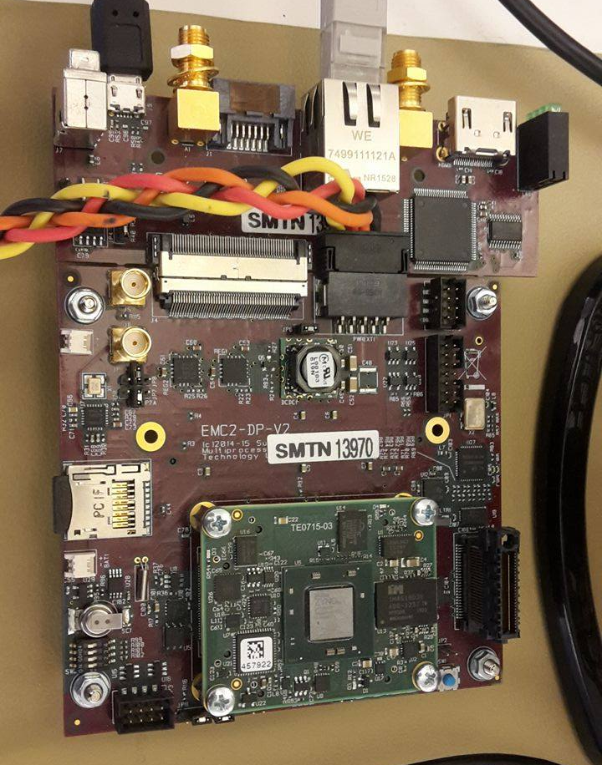
EMC²DP – EMC² Development Platform
System overview [4]
[4] Youssef Zaki. An embedded multi-core platform for mixed-criticality systems: Study and analysis of virtualization techniques. Master’s thesis, KTH, School of Information and Communication Technology (ICT), 2016.

Slide 6
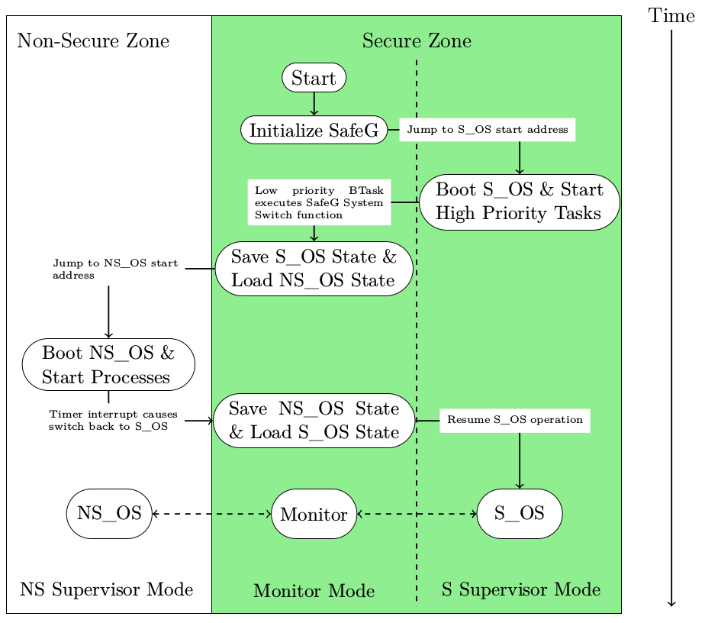
Processor switching state
Processor boot sequence [4]
[4] Youssef Zaki. An embedded multi-core platform for mixed-criticality systems: Study and analysis of virtualization techniques. Master’s thesis, KTH, School of Information and Communication Technology (ICT), 2016.

Slide 7
Research question
Underlying research question:
How, in a disciplined way, to reconcile the conflicting requirements of partitioning for safety assurance and sharing for efficient resource usage? [5]
Specific research questions:
How well can a safety-critical control system perform when implemented on a mixed criticality system using virtualization?
Is virtualization an efficient approach when trying to reconcile the conflicting requirements of partitioning for safety assurance and sharing for efficient resource usage when implementing a safety-critical control system?
[5] Alan Burns and Robert I. Davis. Mixed criticality systems - a review. July 2016

Slide 8
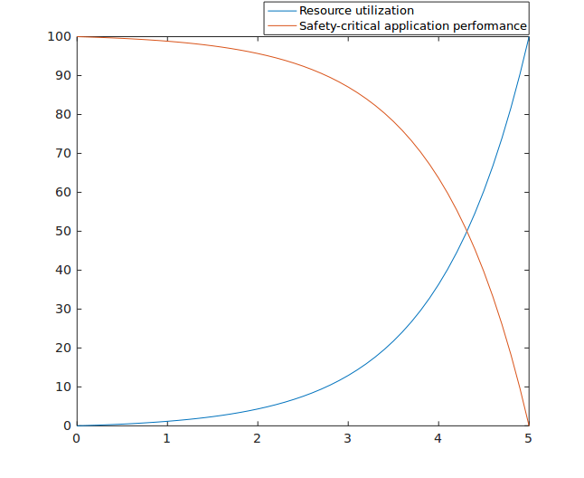
Conflict between efficiency and partitioning

Slide 9
Schedulers
Steve Vestal showed that neither RM nor DM was optimal [6]
Sanjoy Baruah and Steve Vestal showed that EDF does not dominate FP [7]
[6] Steve Vestal. Preemptive scheduling of multi-criticality systems with varying degrees of execution time assurance, 2007.
[7] Sanjoy Baruah and Steve Vestal. Schedulability analysis of sporadic tasks with multiple criticality specifications, 2008.

Slide 10
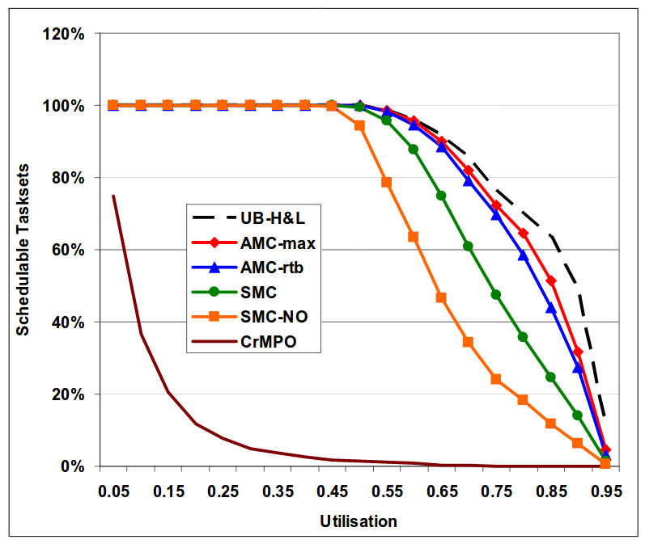
Schedulers
20 tasks of varying rate and WCET
Adaptive Mixed Criticality showed highest schedulability
Amount of schedulable tasks as a function of CPU utilization [8]
[8] S. K. Baruah, A. Burns, and R. I. Davis. Response-time analysis for mixed criticality systems. In 2011 IEEE 32nd Real-Time Systems Symposium, pages 34–43, Nov 2011.

Slide 11
Problem statement
Implement distance keeping control algorithm as a safety critical application. Compare between not using a second OS and for both cases:
Evaluate performance of control algorithm
Rise time
Overshoot
Settling time
Evaluate performance of processor
Missed deadlines
CPU utilization

Slide 12
Problem extended
Mode-switch takes 2 μs
Theoretical maximum frequency for any control algorithm f_{max}< 250 kHz
Processor boot sequence [4]
[4] Youssef Zaki. An embedded multi-core platform for mixed-criticality systems: Study and analysis of virtualization techniques. Master’s thesis, KTH, School of Information and Communication Technology (ICT), 2016.

Slide 13
Deliverables so far
Project proposal
Poster
Time plan
State of the art study on mixed criticality systems
This presentation

Slide 14
Questions

