Slide 1
Safety-critical control in mixed criticality embedded systems
Emil Hjelm
Company: Alten

Slide 2
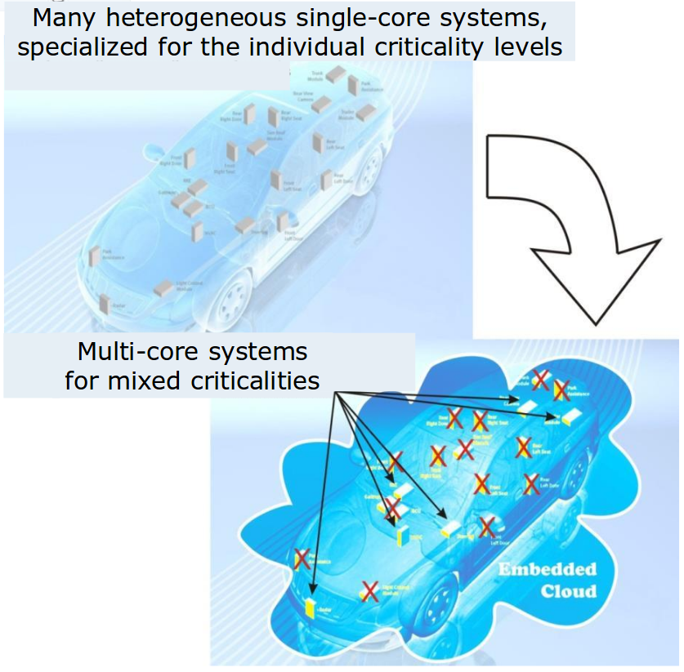
Background
Today, modern cars have around 100 ECUs, this means:
Inefficient resource usage
Clear separation between functions
Moving towards MCS would mean:
Efficient resource usage
  Less power consumed
  Less weight
  Less volume
  Lower production cost
Difficult to separate functions of different criticality

Slide 3
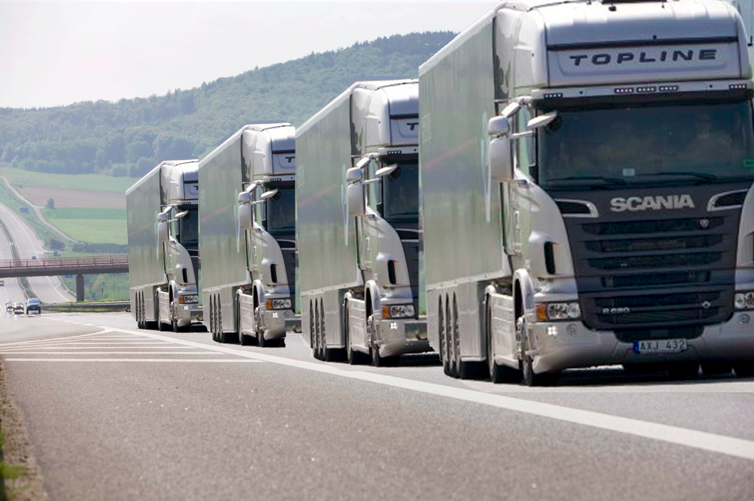
Project basics
Use case: Platooning
  One vehicle following another at a specified distance. Both autonomous.
Five master students
  Lane detection
  Cooperative adaptive cruise control
  Data aggregation
  Safety-critical communication
  Safety-critical control

Slide 4
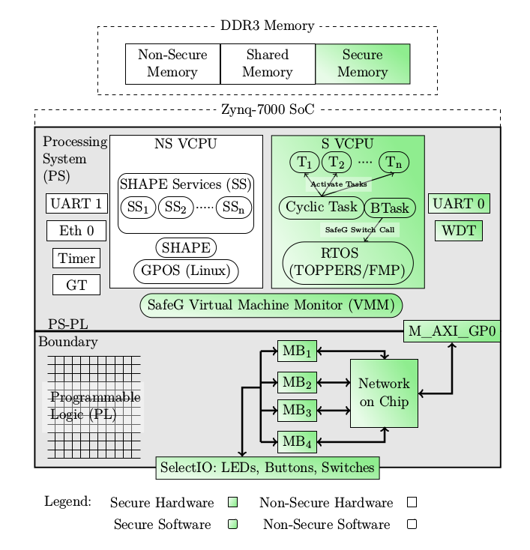
EMC2DP
EMC² Development Platform

Slide 5
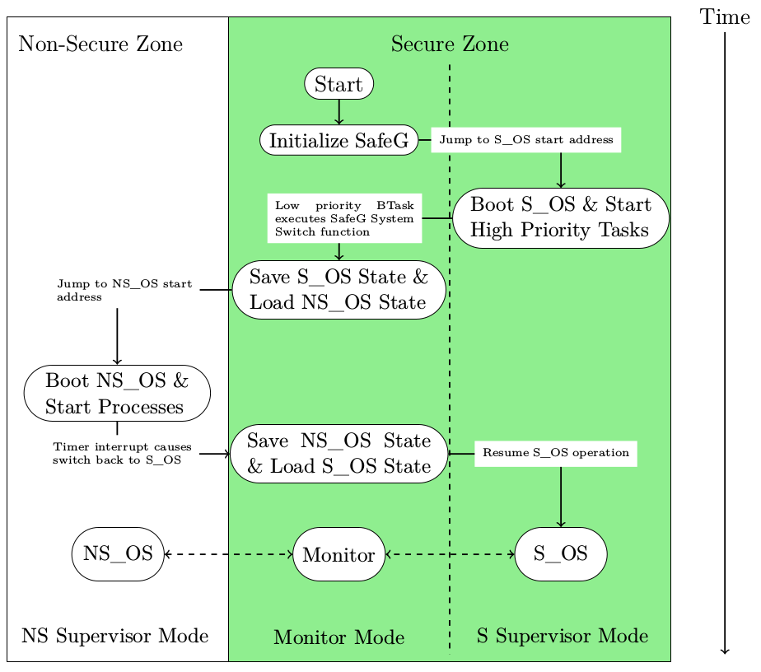
Processor switching state

Slide 6
Problem statement
Implement distance keeping control algorithm as a safety critical application. Compare between not using a second OS and for both cases:
  Evaluate performance of control algorithm
    Rise time
    Overshoot
    Settling time
  Evaluate performance of processor
    Missed deadlines
    CPU usage

Slide 7
Research question
Underlying research question:
How, in a disciplined way, to reconcile the conflicting requirements of partitioning for safety assurance and sharing for efficient resource usage?
Specific research questions:
How well can a safety-critical control system perform when implemented on a mixed criticality system using virtualization?
Is virtualization an efficient approach when trying to reconcile the conflicting requirements of partitioning for safety assurance and sharing for efficient resource usage when implementing a safety-critical control system?

Slide 8
Research design
Quantitative

Slide 9
