Slide 1


Safety-critical control in mixed criticality embedded systems
Emil Hjelm

Slide 2
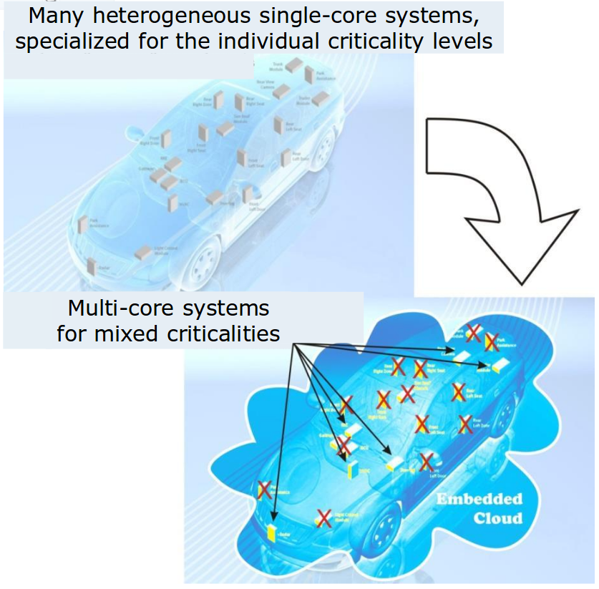
Background
Today, modern cars have around 100 ECUs, this means:
Inefficient resource usage
Clear separation between functions
Moving towards MCS would mean:
Efficient resource usage
  Less power consumed
  Less weight
  Less volume
  Lower production cost
Difficult to separate functions of different criticality
Fewer but more complex systems
Illustration of combining applications to reduce ECUs [1]
[1] https://www.artemis-emc2.eu/project_overview/ll1_automotive_applications/

Slide 3
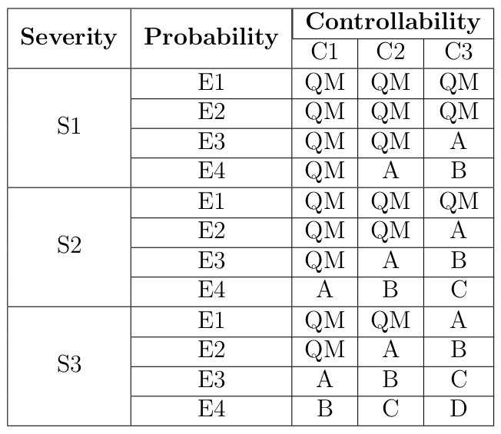
ISO 26262
Five different Automotive Safety Integrity Levels, ASIL [3]
[3] Road vehicles – functional safety – part 9: Automotive safety integrity level (asil)-oriented and safety-oriented analyses. Standard, International Organization for Standardization, Geneva, CH, November 2011.

Slide 4
Project overview
Platooning, two RC vehicles capable of following each other and keeping inside road markers.
Five master thesis students:
  Lane detection
  Control theory
  Safety-critical communication
  Data aggregation
  Safety-critical control
Implement distance keeping algorithm for platooning on a RC car.
  Ultrasound sensor
  Lidar
  Encoders

Slide 5
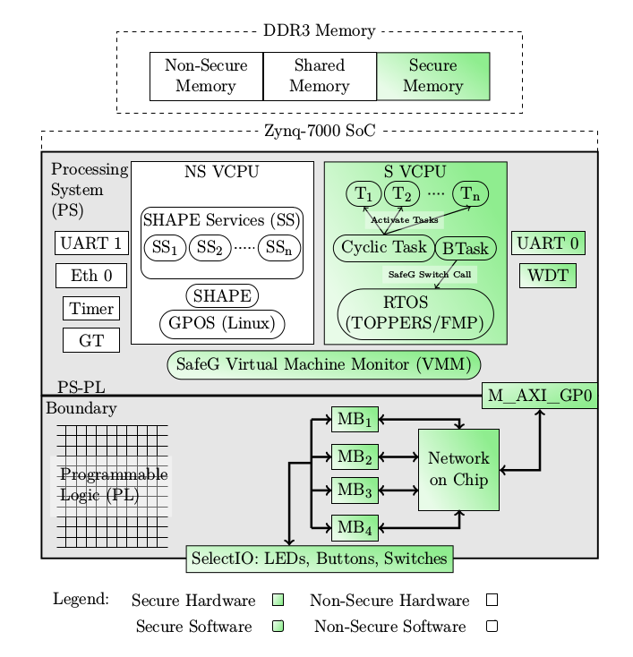
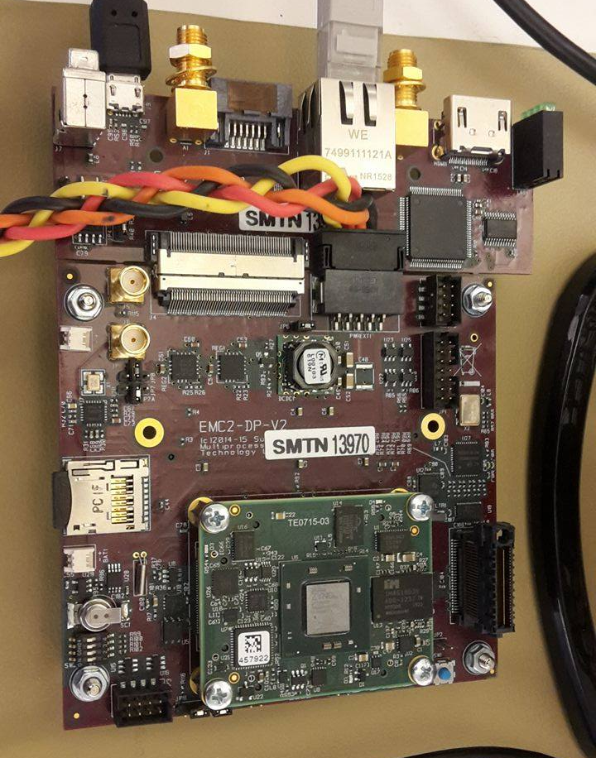
EMC²DP – EMC² Development Platform
System overview [4]
[4] Youssef Zaki. An embedded multi-core platform for mixed-criticality systems: Study and analysis of virtualization techniques. Master’s thesis, KTH, School of Information and Communication Technology (ICT), 2016.

Slide 6
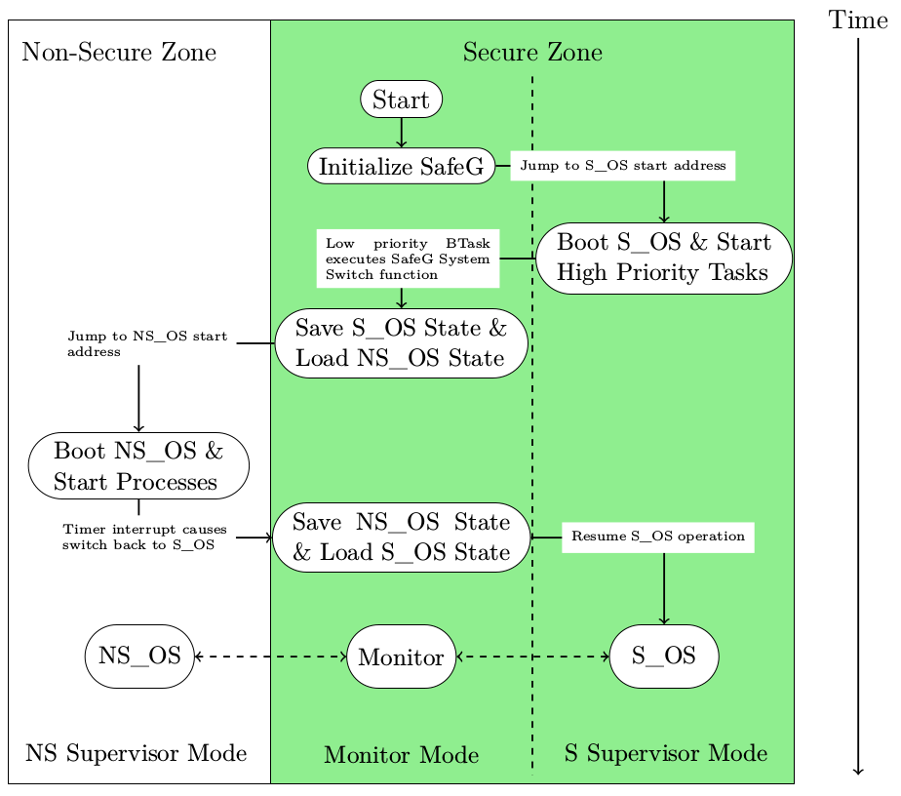
Processor switching state
Processor boot sequence [4]
[4] Youssef Zaki. An embedded multi-core platform for mixed-criticality systems: Study and analysis of virtualization techniques. Master’s thesis, KTH, School of Information and Communication Technology (ICT), 2016.

Slide 7
Research question
Underlying research question:
How, in a disciplined way, to reconcile the conflicting requirements of partitioning for safety assurance and sharing for efficient resource usage? [5]
Specific research questions:
How well can a safety-critical control system perform when implemented on a mixed criticality system using virtualization?
Is virtualization an efficient approach when trying to reconcile the conflicting requirements of partitioning for safety assurance and sharing for efficient resource usage when implementing a safety-critical control system?
[5] Alan Burns and Robert I. Davis. Mixed criticality systems - a review. July 2016

Slide 8
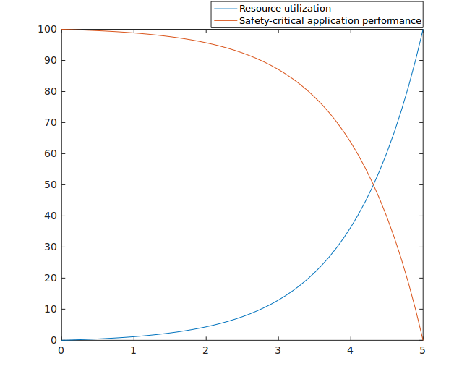
Conflict between efficiency and partitioning

Slide 9
Schedulers
Steve Vestal showed that neither RM nor DM was optimal when criticality levels are introduced [6]
Sanjoy Baruah and Steve Vestal showed that EDF does not dominate FP in mixed criticality systems [7]
[6] Steve Vestal. Preemptive scheduling of multi-criticality systems with varying degrees of execution time assurance, 2007.
[7] Sanjoy Baruah and Steve Vestal. Schedulability analysis of sporadic tasks with multiple criticality specifications, 2008.

Slide 10
MCS Schedulers
CrMPO
AMC
SMC
[8] S. K. Baruah, A. Burns, and R. I. Davis. Response-time analysis for mixed criticality systems. In 2011 IEEE 32nd Real-Time Systems Symposium, pages 34–43, Nov 2011.

Slide 11
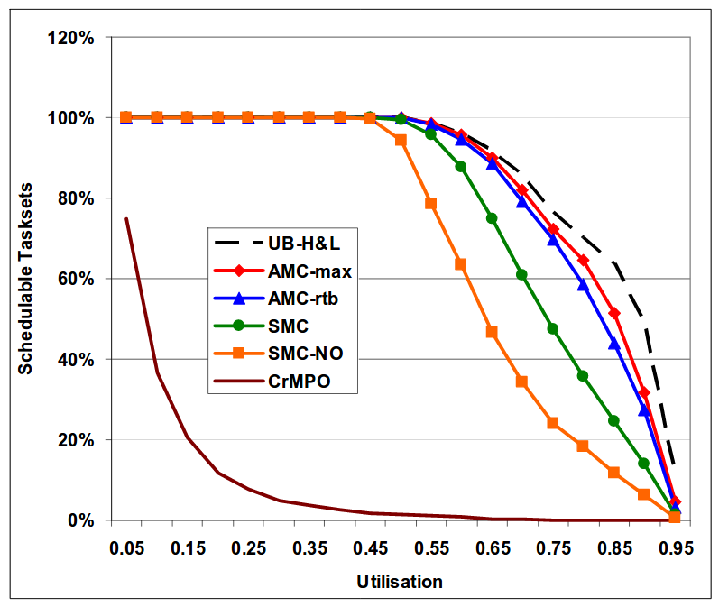
Schedulers
20 tasks of varying rate and WCET
Adaptive Mixed Criticality showed highest schedulability
Amount of schedulable tasks as a function of CPU utilization [8]
[8] S. K. Baruah, A. Burns, and R. I. Davis. Response-time analysis for mixed criticality systems. In 2011 IEEE 32nd Real-Time Systems Symposium, pages 34–43, Nov 2011.

Slide 12
Problem statement
Implement distance keeping control algorithm as a safety critical application. Compare between not using a second OS and for both cases:
  Evaluate performance of control algorithm
    Rise time
    Overshoot
    Settling time
  Evaluate performance of processor
    Missed deadlines
    CPU utilization

Slide 13
Problem extended
Mode-switch takes 2 μs
Theoretical maximum frequency for any control algorithm f_{max}< 250 kHz
Processor boot sequence [4]
[4] Youssef Zaki. An embedded multi-core platform for mixed-criticality systems: Study and analysis of virtualization techniques. Master’s thesis, KTH, School of Information and Communication Technology (ICT), 2016.

Slide 14
Research design
Quantitative
Confirmatory investigation using quantitative data/operations with a deductive approach

Slide 15
Questions

