Slide 1
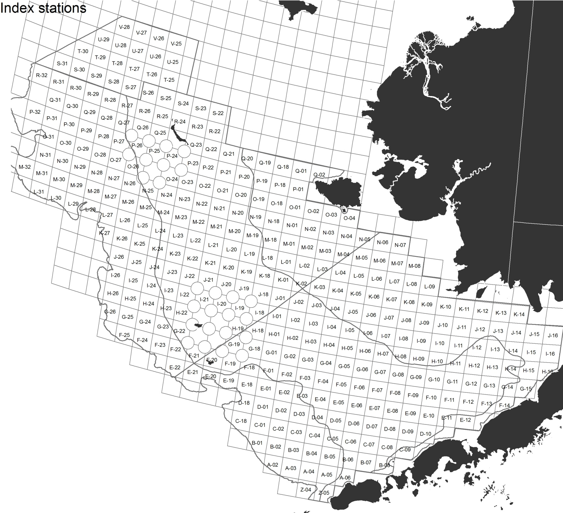
4 – N
snow
C. opilio
C. opilio Males: ≤ 94.0 mm
C. opilio Females: ≤ 50.0 mm
2016 BCS
Index Sites
C. opilio
C. bairdi
5 – NE
snow
PO
24/23
1 – NW
Tanner
6 – Prib
snow
C. bairdi
(WEST of 166º)
C. bairdi Males: ≤ 102.0 mm
C. bairdi Females: ≤ 79.0 mm
JI
22/21
JI
21/20
IH
22/21
IH
21/20
166°
GF
20/19
2 – Prib
Tanner
3 – BB
Tanner
C. bairdi
(EAST of 166^{o)}
C. bairdi Males: ≤112.0 mm
C. bairdi Females: ≤ 84.0 mm

