Slide 1
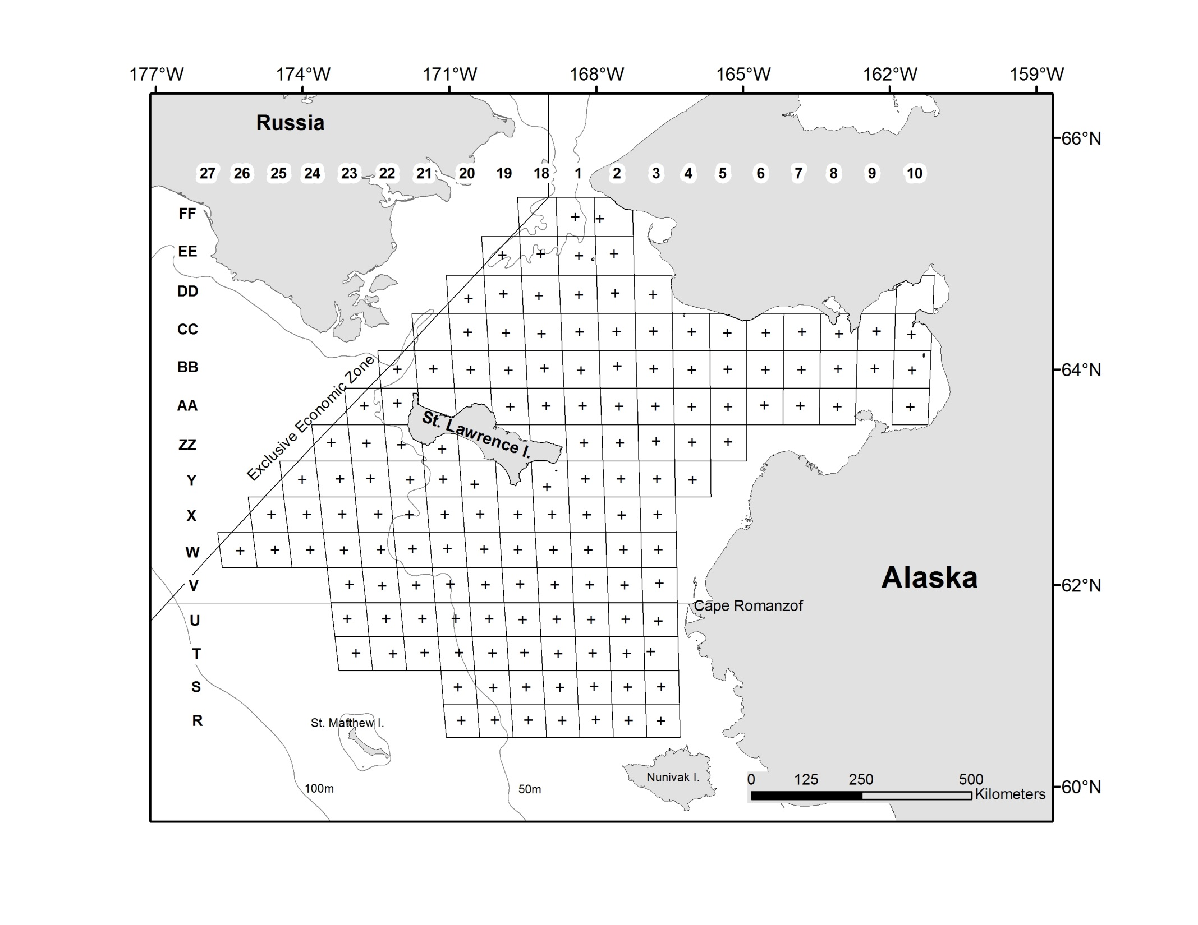
NBS 2017 Bitter crab stations for snow crab

Slide 2
NBS 2017 Bitter crab stations for snow crab

