Slide 1
Dsc 530 term project
ASSIGNMENT 10.4 Alfred Murray

Slide 2
Baseball Dataset
A random of sample of major league baseball players is used for the data.
Reference: The Baseball Encyclopedia, 9th Edition. Macmillan

Slide 3
The 6 Variables included in this dataset part 1
Batting AVERAGE
Runs scored
doubles
THE 1ST COLUMN OF DATA REPRESENTS THE PLAYERS BATTING AVERAGE
The 2nd column of data representing the number of runs scored per times at bat
The 3rd column of data representing the number of doubles by a player per times at bat

Slide 4
The 6 variables part 2
triples
Home runs
Strike outs
The 4th column of data representing the number of triples by a player per times at bat
The 5th column of data representing the number of home runs by a player per times at bat
The 6th column of data representing the number of strike outs by a player per times at bat

Slide 5
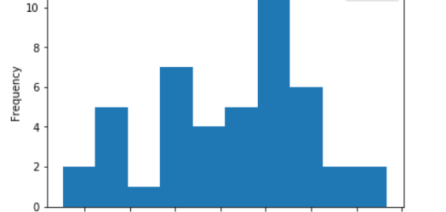
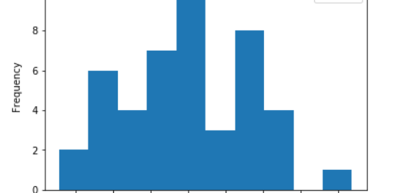
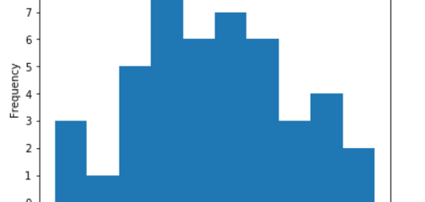
Histograms of the 6 variables
Batting average
Runs scored/times at bat
Doubles/times at bat

Slide 6
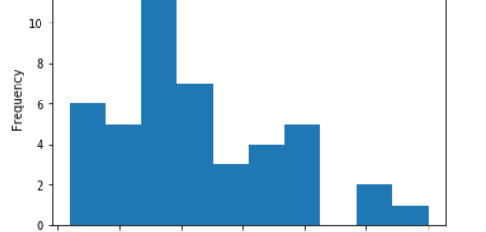
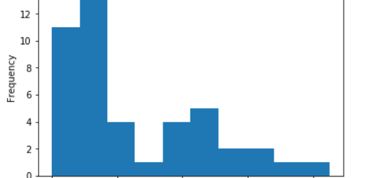
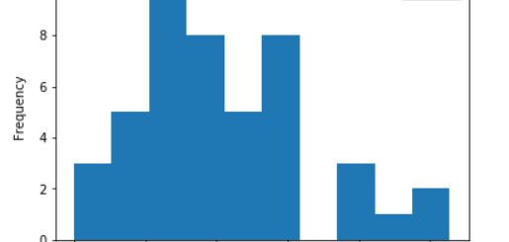
Histograms of the 6 variables
Triples/times at bat
Home runs/times at bat
Strike outs/times at bat

