Slide 2
Data Input
Data Training ➔ 4 x 108 = 432 buah
Data Testing ➔ 3 x 108 = 324 buah
Label/Class

Slide 3
Data Input
Data Training ➔ 4 x 108 = 432 buah
Data Testing ➔ 3 x 108 = 324 buah
Label/Class ➔ 108
D. Training | Label
D.Training ke 1 | 1
D.Training ke 2 | 1
D.Training ke 3 | 1
D.Training ke 4 | 1
D.Training ke 5 | 2
D.Training ke 6 | 2
D.Training ke 7 | 2
D.Training ke 8 | 2
dst...
D. Testing | Label
D.Testing ke 1 | 1
D.Testing ke 2 | 1
D.Testing ke 3 | 1
D.Testing ke 4 | 2
D.Testing ke 5 | 2
D.Testing ke 6 | 2
dst...

Slide 4
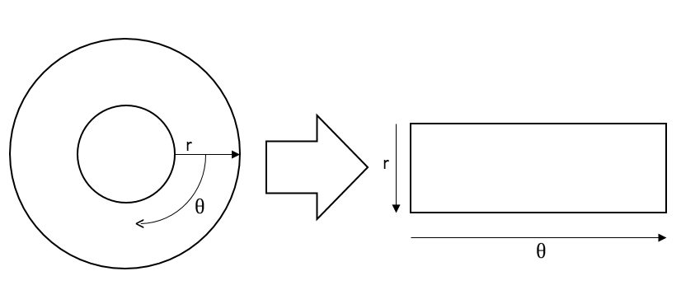
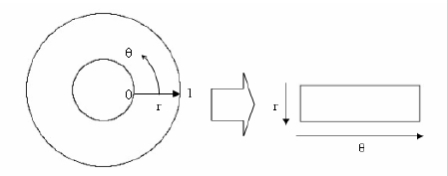
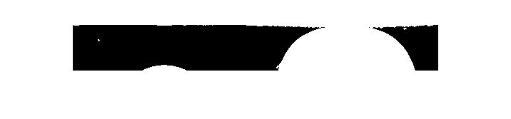
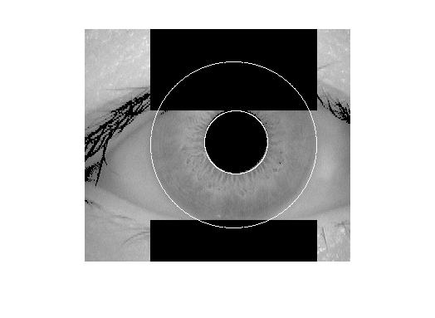
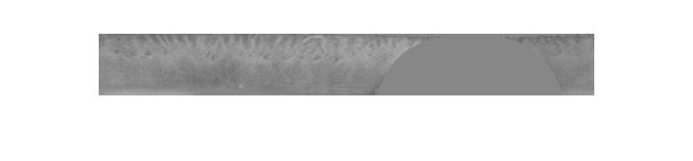
Normalisasi Iris Region
noise
citra
64
512

Slide 5
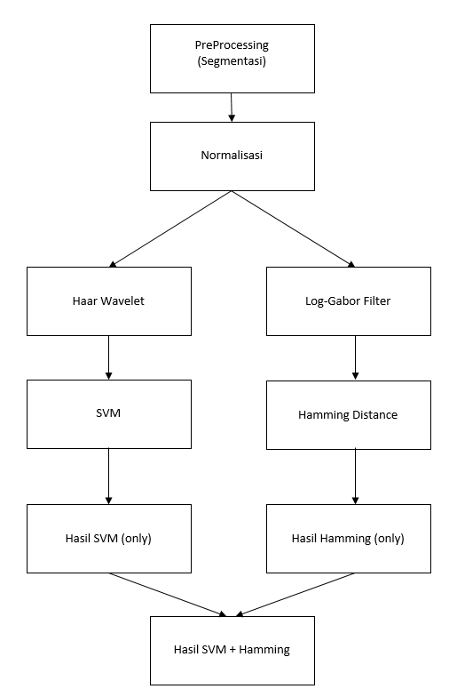

Slide 6
Wavelet
Uji Coba menggunakan classifier SVM dalam meng-klasifikasi iris mata
Menggunakan Nilai Hasil Haar Wavelet decomposition Lvl 3 bidang Approx ( 8 x 64 = 512) features
256
128
64
32
16
8
LL3
Wavelet decom lvl 1
Wavelet decom lvl 2
Wavelet decom lvl 3

Slide 7
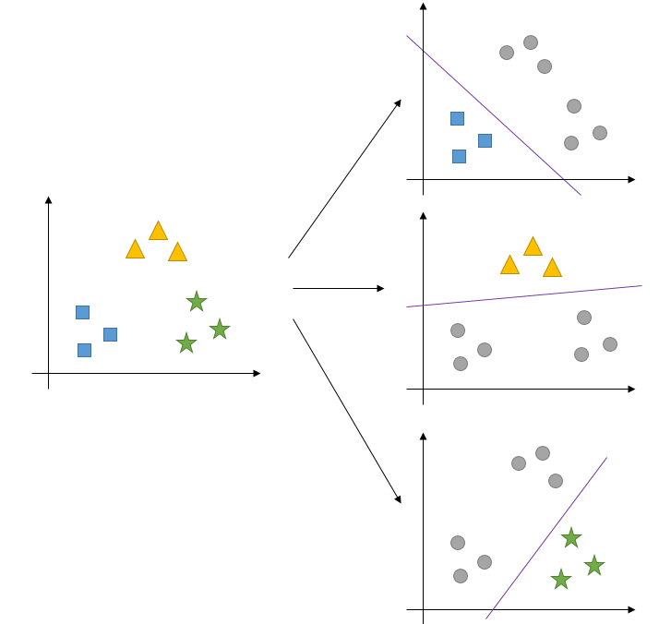
SVM (train)
Membuat SVM model sejumlah banyaknya class (one-against-all)
Satu model untuk satu class
Kernel function yg diguakan : RBF , C = 1
Data Training(class 1)
model(1)
model(2)
...
....
model(n)
Data Training(class 1)
Data Training(class 2)
Data Training(class 2)

Slide 8
SVM (predict)
Melakukan tahap verifikasi/identifikasi dengan mengetes setiap data testing terhadap semua n model.
Output yang didapat adalah probability estimates dari setiap model, dengan menggunakan “Platt’s probabilistic outputs for Support Vector Machines”.
model(1)
model(2)
...
....
model(n)
Mendapatkan probability estimates data testing dengan menggunakan masing-masing model
Data Testing
Prob(1) | Prob(2) | .... | .... | Prob(n-1) | Prob(n)

Slide 9
SVM (identification)
Dari vector probability estimates yang didapat, diambil nilai terbesar dari masing-masing rows.
Nilai tersebut mengidentifikasikan data testing yang diuji ke kelas sesuai dengan index column.
1
2
...
...
n-1
n
DataTest ke-1
Prob(1) | Prob(2) | .... | .... | Prob(n-1) | Prob(n)
DataTest ke-2
Prob(1) | Prob(2) | .... | .... | Prob(n-1) | Prob(n)
DataTest ke-3
Prob(1) | Prob(2) | .... | .... | Prob(n-1) | Prob(n)
DataTest ke-4
Prob(1) | Prob(2) | .... | .... | Prob(n-1) | Prob(n)

Slide 10
Normalisasi Iris Region
noise
citra
64
512

Slide 11
Log Gabor Filters
Hasil dari Proses Normalisasi dikonvulsi dgn 1D Log-Gabor Filters
normalisasi ; noise ; Std deviasi = .5 ; wavelength = 18
(1,1) | (1,2) | (1,..) | (1,n-1) | (1,n)
(2,1)
(3,1)
(...,1)
(...,1)
(m-1,1)
(m,1) |  |  |  | (m,n)

Slide 12
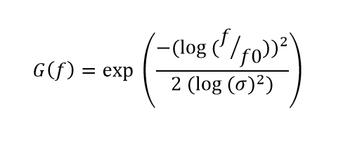
(1,1) | (1,2) | (1,..) | (1,n-1) | (1,n)
(2,1)
(3,1)
(...,1)
(...,1)
(m-1,1)
(m,1) |  |  |  | (m,n)
f = [0, .... , .... , .... , .... 0.5]; (values 0 – 0.5 , sejumlah ½ column dari vector normalisasi )
Matrix Values contain normalised radius from centre
fo = 1 / wavelength (centre frequency)
σ = std. deviasi (bandwith of the filter)
vector LogGabor = (1 x n column Normalisasi)

Slide 13
Setiap Row pada vector array “Normalisasi” dilakukan FFT
Kemudian dilakukan IFFT pada hasil dot product antara row Normalisasi FFT dengan filter Gabor
result( i,: ) = IFFT ( imagefft .* filterGabor )

Slide 14
Gabor Convolve
(1,1) | (1,2) | (1,..) | (1,n-1) | (1,n)
(2,1)
(3,1)
(...,1)
(...,1)
(m-1,1)
(m,1) |  |  |  | (m,n)
Ubah FFT
(1,1) | (1,2) | (1,..) | (1,n-1) | (1,n)
.*
(1,1) | (1,2) | (1,..) | (1,n-1) | (1,n)
Gabor Filter
Result IFFT
(1,1) | (1,2) | (1,..) | (1,n-1) | (1,n)

Slide 15
Gabor Convolve
(1,1) | (1,2) | (1,..) | (1,n-1) | (1,n)
(2,1)
(3,1)
(...,1)
(...,1)
(m-1,1)
(m,1) |  |  |  | (m,n)
Ubah FFT
(1,1) | (1,2) | (1,..) | (1,n-1) | (1,n)
.*
(1,1) | (1,2) | (1,..) | (1,n-1) | (1,n)
Gabor Filter
Result IFFT
(1,1) | (1,2) | (1,..) | (1,n-1) | (1,n)

Slide 16
Gabor Convolve
(1,1) | (1,2) | (1,..) | (1,n-1) | (1,n)
(2,1)
(3,1)
(...,1)
(...,1)
(m-1,1)
(m,1) |  |  |  | (m,n)
Ubah FFT
(1,1) | (1,2) | (1,..) | (1,n-1) | (1,n)
.*
(1,1) | (1,2) | (1,..) | (1,n-1) | (1,n)
Gabor Filter
Result IFFT
(1,1) | (1,2) | (1,..) | (1,n-1) | (1,n)

Slide 17
Kuantisasi Hasil Gabor
- 0.001 | - 0.02 | -0.2 | 0.24 | 0.03
- 0.001 | 1.02 | -0.2 | 0.004 | 0.23
0.102 | - 0.02 | -0.2 | 1.55 | -.03
- 0.001 | 0.02
0.101 | - 1.05
- 0.032 | - 0.04
0.021 | 0.03
0 | 0 | 0 | 0 | 0
0 | 1 | 0 | 0 | 0
0 | 0 | 0 | 1 | 0
0 | 0
0 | 0
0 | 0
0 | 0

Slide 18
Kuantisasi Noise Mask
- 0.001 | - 0.02 | -0.2 | 0.24 | 0.03
- 0.001 | 1.02 | -0.2 | 0.004 | 0.23
0.102 | - 0.02 | -0.2 | 1.55 | -.03
- 0.001 | 0.02
0.101 | - 1.05
- 0.032 | - 0.04
0.021 | 0.03
0 | 0 | 0 | 0 | 0
0 | 1 | 0 | 0 | 0
0 | 0 | 0 | 1 | 0
0 | 0
0 | 0
0 | 0
0 | 0

Slide 19
Hamming Distance
Norm Citra 1
Norm Citra 2
Norm Gabungan
XOR
AND
Mat. Hasil Akhir
Noise Citra 1
Noise Citra 2
Noise Gabungan
~ (negasi)
OR

Slide 20
Hamming Distance
Citra Normalisasi 1
Noise Mask 1
0 | 0 | 0 | 0 | 0
0 | 1 | 0 | 0 | 0
0 | 0 | 0 | 1 | 0
0 | 0
0 | 0
0 | 0
0 | 0
0 | 0 | 1 | 0 | 0
0 | 1 | 0 | 0 | 1
0 | 1 | 0 | 1 | 0
1 | 0
0 | 0
0 | 1
1 | 0

Slide 21
Hamming Distance
Citra Normalisasi 2
Noise Mask 2
0 | 0 | 0 | 0 | 0
0 | 1 | 0 | 0 | 0
0 | 0 | 0 | 1 | 0
0 | 0
0 | 0
0 | 0
0 | 0
0 | 0 | 1 | 0 | 0
0 | 1 | 0 | 0 | 1
0 | 1 | 0 | 1 | 0
1 | 0
0 | 0
0 | 1
1 | 0

Slide 22
Hamming Distance
Citra Normalisasi 1
Citra Normalisasi 2
0 | 0 | 0 | 0 | 0
0 | 1 | 0 | 0 | 0
0 | 0 | 0 | 1 | 0
0 | 0
0 | 0
0 | 0
0 | 0
0 | 0 | 1 | 0 | 0
0 | 1 | 0 | 0 | 1
0 | 1 | 0 | 1 | 0
1 | 0
0 | 0
0 | 1
1 | 0
XOR

Slide 23
Hamming Distance
Noise Mask 1
Noise Mask 2
0 | 0 | 0 | 0 | 0
0 | 1 | 0 | 0 | 0
0 | 0 | 0 | 1 | 0
0 | 0
0 | 0
0 | 0
0 | 0
0 | 0 | 1 | 0 | 0
0 | 1 | 0 | 0 | 1
0 | 1 | 0 | 1 | 0
1 | 0
0 | 0
0 | 1
1 | 0
OR

Slide 24
Hamming Distance
Normalisasi Gab
~ Mask Gab
0 | 0 | 0 | 0 | 0
0 | 1 | 0 | 0 | 0
0 | 0 | 0 | 1 | 0
0 | 0
0 | 0
0 | 0
0 | 0
1 | 1 | 0 | 1 | 1
1 | 0 | 1 | 1 | 0
1 | 0 | 1 | 0 | 1
0 | 1
1 | 1
1 | 0
0 | 1
AND

Slide 25
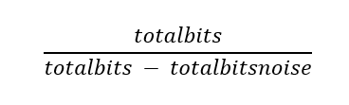
Dari hasil terakhir, dihitung jumlah element yang bernilai 1(True).
Kemudian dibagi dengan dimensi matrix tsb tanpa memperdulikan noise mask.
true
hd =

Slide 26
Data Input
Data Training ➔ 4 x 108 = 432 buah
Data Testing ➔ 3 x 108 = 324 buah
Label/Class ➔ 108
D. Training | Label
D.Training ke 1 | 1
D.Training ke 2 | 1
D.Training ke 3 | 1
D.Training ke 4 | 1
D.Training ke 5 | 2
D.Training ke 6 | 2
D.Training ke 7 | 2
D.Training ke 8 | 2
dst...
D. Testing | Label
D.Testing ke 1 | 1
D.Testing ke 2 | 1
D.Testing ke 3 | 1
D.Testing ke 4 | 2
D.Testing ke 5 | 2
D.Testing ke 6 | 2
dst...

Slide 27
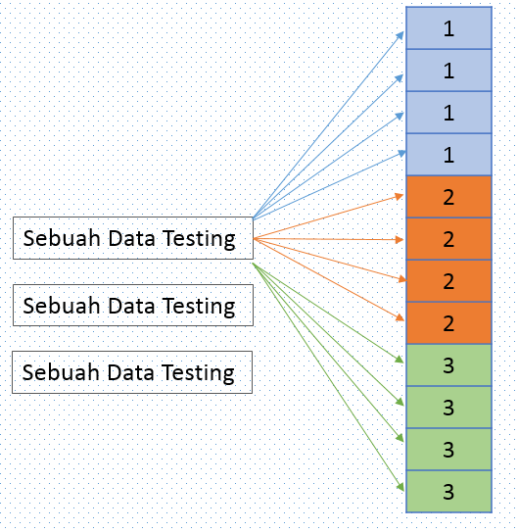

Hamming Distance
Hasil Dari Klasifikasi SVM yang masih False , akan di klasifikasi kan kembali menggunakan metode Hamming Distance
Tiap Data Training akan dihitung logical matrix (template&noise)
Testing yang salah akan diMatching kembali dengan setiap Data Training
Kemudian didapatkan mean dari tiap kelas
i = 1, 2, 3, ...n. Untuk setiap kelas i

Slide 28
Hamming Distance
Hasil Dari Klasifikasi SVM yang masih False , akan di klasifikasi kan kembali menggunakan metode Hamming Distance
Tiap Data Training akan dihitung logical matrix (template&noise)
Testing yang salah akan diMatching kembali dengan setiap Data Training
Kemudian didapatkan mean dari tiap kelas
i = 1, 2, 3, ...n. Untuk setiap kelas i

Slide 29
Contoh Hasil Hamming
Kelas
1
2
.
.
54
.
.
107
108
1
. 2621 | . 4860 | . 5093 | . 4973 | . 5055 | ... | ... | . 4945 | . 3452
. 2789 | . 4971 | . 5239 | . 5020 | . 5131 | ... | ... | . 5131 | . 4865
. 4823 | . 3441 | . 5420 | . 4211 | . 2931 | . 3132 | ... | ... | ...
. 2425 | . 4422 | . 323 | . 3231 | . 5123 | ... | ... | ... | ...
. 4555 | . 5350 | . 4255 | ... | ... | ... | ... | . 5522 | . 2770
. 4255 | . 5252 | . 3832 | ... | ... | ... | ... | . 4424 | . 3021
2
.
.
Data Testing
.
162
.
200
.
323
324

Slide 30
Hasil TEs
Combined ➔DataTesting yang tidak cocok(false) pada Hasil proses klasifikasi SVM, dilakukan pemrosesan kembali dengan menggunakan klasifikasi Hamming Distance
Classification Method | Accuracy | Citra Benar
SVM (only) | 94.444 % | 306/324
Hamming (only) | 94.414 % | 305/324
Combined (SVM + Hamming) | 98.456 % | 319/324

Slide 31
Pengukuran Kinerja Pencocokan Iris Mata

Slide 32
Uji Coba Lainnya
Uji Coba Kernel Function
RBF
Polymonial (2,3,4)
C (penalty error)
Feature Extract
Coefficients dari Approximation 3
std. deviasi & energy
?

Slide 33
False Match
SVM False (Testing Ke) | Citra Ke | Hamm False (Testing Ke) | Citra Ke
21 | 007_1_3 | 4 | 002_1_1
33 | 011_1_3 | 71 | 024_1_2
123 | 041_1_3 | 74 | 025_1_2
126 | 042_1_3 | 90 | 030_1_3
127 | 043_1_1 | 123 | 041_1_3
136 | 046_1_1 | 133 | 045_1_1
217 | 073_1_1 | 148 | 050_1_1
235 | 079_1_1 | 172 | 058_1_1
236 | 079_1_2 | 173 | 058_1_2
257 | 086_1_2 | 199 | 067_1_1
273 | 091_1_3 | 217 | 073_1_1
280 | 094_1_1 | 236 | 079_1_2
281 | 094_1_2 | 273 | 091_1_3
283 | 095_1_1 | 301 | 101_1_1
310 | 104_1_1 | 302 | 101_1_2
311 | 104_1_2 | 306 | 102_1_3
312 | 104_1_3 | 314 | 105_1_2
315 | 105_1_3 | 315 | 105_1_3
 |  | 316 | 106_1_1

Slide 34
Contoh Hasil SVM Prob
Kelas
1
2
107
108
1
0,995051 | 4,30E-05 | .... | .... | .... | 0,003792 | .... | ... | .... | 0,010466 | 9,00E-05
0,996602 | 1,91E-05 | .... | .... | .... | 0,006269 | .... | ... | .... | 0,020725 | 5,59E-05
0,995887 | 5,99E-05 | .... | .... | .... | 0,00297 | .... | ... | .... | 0,001298 | 0,000267
3,15E-07 | 0,962039 | ... | ... | ... | 4,11E-05 | ... | ... | ... | 3,05E-05 | 0,00418
5,52E-07 | 0,89398 | ... | ... | ... | 4,55E-05 | ... | ... | ... | 0,000162 | 0,00458
... | ... | ... | ... | ... | 8,64E-05 | ... | ... | ... | ... | ...
... | ... | ... | ... | ... | ... | ... | ... | ... | ... | ...
3,32E-10 | 0,002069 | ... | ... | ... | ... | ... | ... | ... | 2,36E-06 | 0,963111
6,99E-11 | 0,011788 | ... | ... | ... | ... | ... | ... | ... | 2,56E-06 | 0,966156
2
3
Data Testing
4
5
323
324

Slide 35
Lanj.
Data Testing
1
2
3
4
5
323
324
1
0,99505 | 0,9966 | 0,99589 | 3,15E-07 | 5,52E-07 | ... | ... | 3,32E-10 | 6,99E-11
4,30E-05 | 1,91E-05 | 5,99E-05 | 0,96204 | 0,89398 | ... | ... | 0,00207 | 0,01179
.... | .... | .... | ... | ... | ... | ... | ... | ...
.... | .... | .... | ... | ... | ... | ... | ... | ...
.... | .... | .... | ... | ... | ... | ... | ... | ...
0,00379 | 0,00627 | 0,00297 | 4,11E-05 | 4,55E-05 | 8,64E-05 | ... | ... | ...
.... | .... | .... | ... | ... | ... | ... | ... | ...
... | ... | ... | ... | ... | ... | ... | ... | ...
.... | .... | .... | ... | ... | ... | ... | ... | ...
0,01047 | 0,02073 | 0,0013 | 3,05E-05 | 0,00016 | ... | ... | 2,36E-06 | 2,56E-06
9,00E-05 | 5,59E-05 | 0,00027 | 0,00418 | 0,00458 | ... | ... | 0,96311 | 0,96616
2
3
4
Kelas
5
107
108

Slide 36
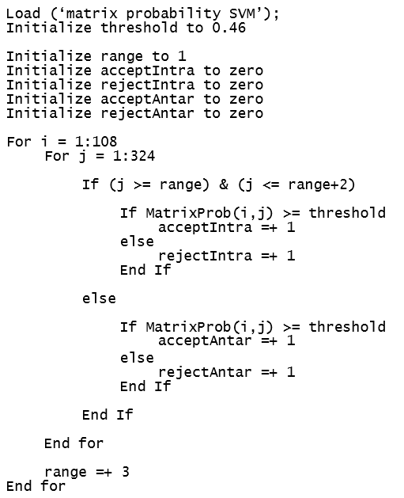
FAR & FRR
Men-set Threshold, range, dll
Melakukan looping sebanyak dimensi matrix
Melakukan pengecekan apakah prob tsb ada di Intra Kelas atau Antar Kelas

Slide 38
SVM
Model SVM dapat diklasifikasikan menjadi empat kelompok yang berbeda:
Classification SVM Type 1 (also known as C-SVM classification)
Classification SVM Type 2 (also known as nu-SVM classification)
Regression SVM Type 1 (also known as epsilon-SVM regression)
Regression SVM Type 2 (also known as nu-SVM regression)

Slide 39
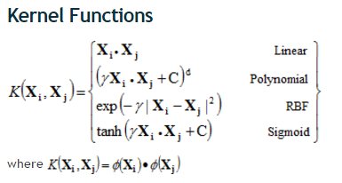
Kernel
Ga ngerti...

Slide 40
Classification SVM Type 1 (also known as C-SVM classification)
Kernel | Accuracy | True Positive
Linear | 90,12 % | (292 / 324)
Polymonial 2 | 86,41 % | (280 / 324)
Polymonial 3 | 85,49 % | (277 / 324)
Polynomial 4 | 84,87 % | (275 / 324)
RBF | 82,09 % | (266 / 324)
sigmoid | 0,92 % | (3 / 324)

Slide 41
Classification SVM Type 2 (also known as nu-SVM classification)
Kernel | Accuracy | True Positive
Linear | 88,58 % | (287 / 324)
Polymonial 2 | 84,87 % | (275 / 324)
Polymonial 3 | 82,71 % | (268 / 324)
Polynomial 4 | 81,17 % | (263 / 324)
RBF | 88,58 % | (287 / 324)
sigmoid | 0,92 % | (3 / 324)

Slide 42
1
1
1
1
2
2
2
2
3
3
3
3
Sebuah Data Testing
Sebuah Data Testing
Sebuah Data Testing

