Slide 1
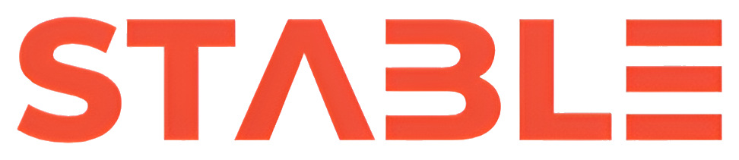
AI RELIABILITY ENGINE
STABLE
Detect wrong, risky, and unreliable AI outputs before they reach users.
Key Points
Reliability infrastructure for production AI systems
Highlights risky text, explains failures, and scores output confidence

Slide 2
THE PROBLEM
AI is shipping faster than teams can trust it.
LLMs are moving into customer workflows, but failure modes remain invisible until they cause damage.
Key Points
Hallucinated facts sound plausible
Unsafe advice can reach end users
Wrong answers erode trust, increase legal risk, and slow adoption

Slide 3
WHY NOW
The market has moved from model access to model trust.
Every company is becoming an AI product company. Reliability is now the bottleneck to deployment.
Key Points
AI is entering support, operations, healthcare, legal, and finance
Enterprises now demand auditability and guardrails
Teams need infrastructure, not just prompts

Slide 4
OUR SOLUTION
STABLE is a reliability layer between model output and real-world use.
We generate or ingest an AI response, then run a second-pass evaluator to detect risky or unreliable content.
Key Points
Flags hallucinations, unsafe output, weak factual grounding, and misleading certainty
Highlights the exact text that may be wrong
Returns confidence score, risk level, and explanation in structured form

Slide 5
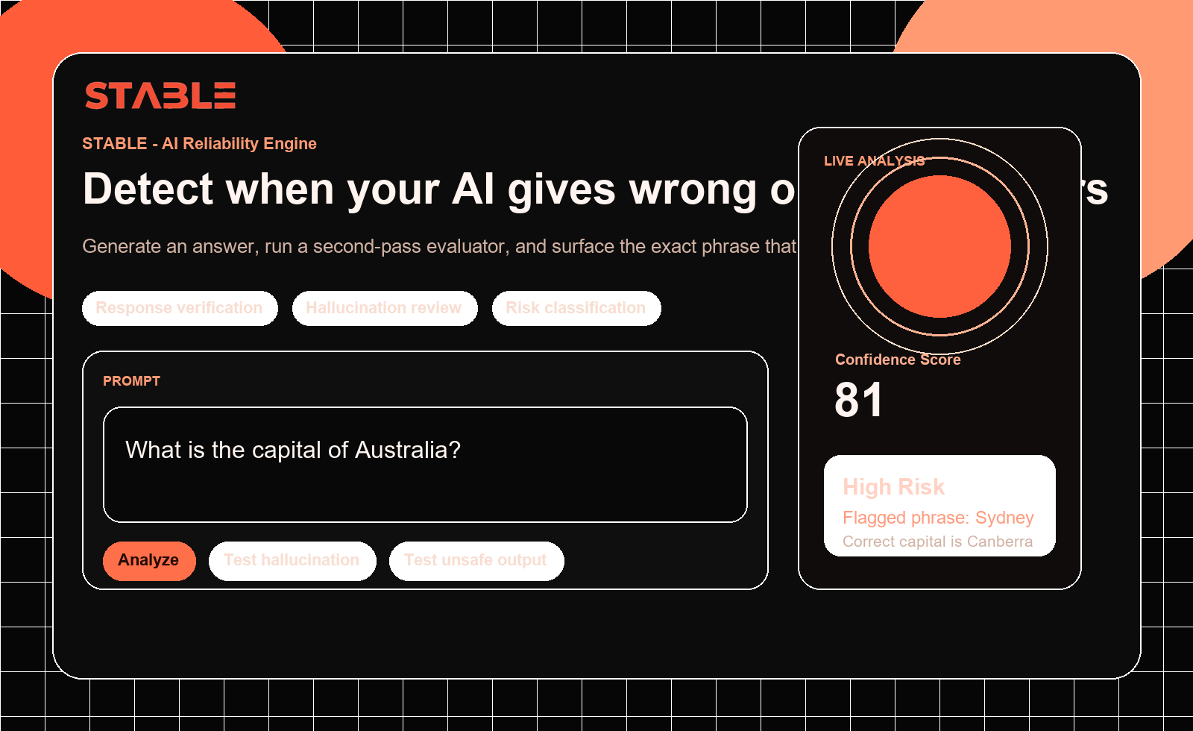
PRODUCT
The product makes AI failure visible in seconds.
Instead of pass or fail, STABLE shows exactly what broke and why.

Slide 6
WHAT WE DETECT
Failure modes we detect
Built for the real behaviors that break trust in production AI.
Key Points
Hallucinations
Incorrect facts
Unsafe outputs
Inconsistent answers
Low-confidence reasoning
Weak or unverifiable claims

Slide 7
TRACTION
Early traction story: strong signal, fast demos, clear buyer pain.
This is still early, but the product already demonstrates a visible and urgent category need.
Demo-ready
2-pass engine
Clear wedge
Investor and customer presentation quality
Generation plus evaluator architecture live
AI startups and enterprise copilots
Key Points
Live interactive demo built and deployable on Vercel
Core reliability pipeline running through OpenRouter with second-pass analysis
Design and workflow already strong enough for pilots, investor meetings, and customer discovery

Slide 8
MARKET
A growing reliability layer inside the AI stack.
As LLM usage expands, every serious deployment needs trust, visibility, and control.
Category
Buyer
Why now
AI evals, observability, guardrails
CTO, Head of AI, Product, Risk, Compliance
Trust is the bottleneck to production AI
Key Points
TAM: global AI software and infrastructure budgets expanding rapidly
SAM: teams deploying copilots, agents, and workflow automation with external-facing risk
SOM: early wedge in startups and mid-market teams adopting AI into operations

Slide 9
CUSTOMERS
Initial wedge: teams already shipping AI into real workflows.
If an AI response reaches a user, that product needs a trust layer.
Key Points
AI startups and agent builders
Enterprise copilots and support automation platforms
Healthcare, legal, fintech, and compliance-heavy AI products

Slide 10
BUSINESS MODEL
Infrastructure economics with recurring expansion paths.
STABLE can monetize as a SaaS plus usage-based reliability platform.
Key Points
Subscription plus metered pricing per response analyzed
Enterprise tiers for dashboards, alerts, policy customization, and audit logs
Expansion through monitoring, eval pipelines, and deployment gating

Slide 11
TEAM
Lean team, sharp problem focus, product-first execution.
The founding advantage is speed: turning a painful and visible AI problem into usable infrastructure fast.
Founder DNA
Next hires
Operating style
Product + engineering + execution velocity
Reliability engineer, frontend/product design, GTM
Fast iteration with enterprise positioning
Key Points
Founder-led product and engineering execution
Focus on design-forward infrastructure that demos well and solves real risk
Next hires: full-stack engineering, AI evals, and enterprise GTM

Slide 12
WHY WE WIN
We are not another model. We are the trust layer.
STABLE sits in the reliability layer of the AI stack, where urgency and value both compound.
Key Points
Clear pain with visible ROI: reduce brand risk and ship faster
Product value is instantly understandable in demos
Positioned as AI observability plus QA plus reliability infrastructure

Slide 13
THE ASK
We are building the system companies use to trust AI in production.
Funding accelerates product depth, enterprise readiness, and pilot customer growth.
Key Points
Use of funds: product, engineering, reliability engine, and GTM
Goal: become the default checkpoint before AI reaches users
Closing line: Before AI reaches users, it should pass through STABLE

