Slide 1

When Do Images Prove a Defect?
Evidence-bounded 3D defect estimation for aero-engine blades
Afeefa Azam · Khalifa University
Notes:
This talk asks when a CAD model and a few calibrated photographs are sufficient to conclude that an aero-engine blade is physically damaged, and what a method should do when they are not.

Slide 2
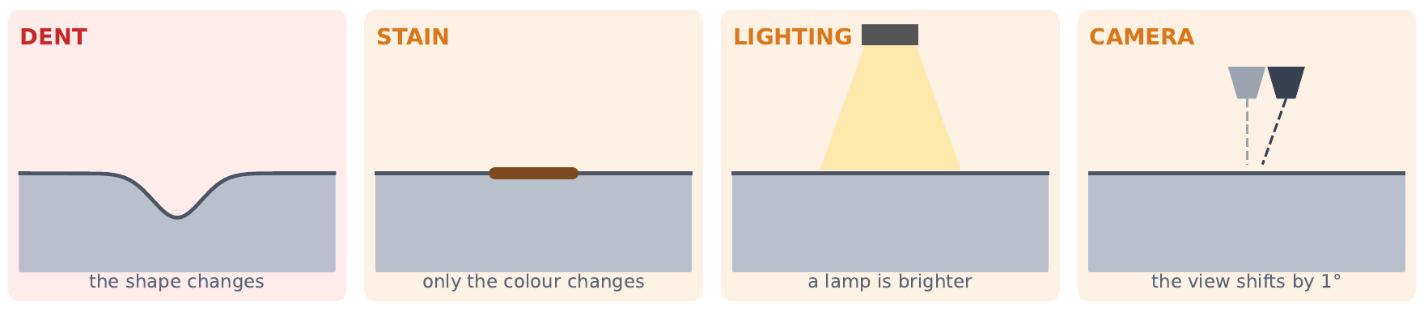
A dark region in an image has several physically different causes
▪ Signal scale. A 0.1 mm dent changes a few hundred pixels by a few grey levels; a 1° pose error or a 10% lighting change alters thousands.
▪ Consequence. A detector that flags any unexplained change confuses appearance with geometry; one that must always answer reports damage the images do not support.
▪ Requirement. Separate geometric change from pose, illumination and reflectance, and abstain when they cannot be separated.
MOTIVATION
2
Notes:
Only the first cause is physical damage. The signal of interest is much smaller than the nuisance. This motivates a decision that can abstain.

Slide 3
We pose defect estimation as a calibrated test that can abstain
 | Definition
Input | Healthy CAD mesh + K = 2–7 calibrated views
H0 (nuisance) | Per-view pose, light gains, smooth brightness field, local albedo patch
H1 (damage) | H0 + a continuous parametric surface displacement
Evidence | gain = L(H0) − L(H1), robust image loss
Decision | Report if gain > τ, else abstain
Calibration | τ = split-conformal quantile on healthy + stained blades (α = 5%)
▪ Constraints. Calibrated rig, fixed light positions, appearance change only through the brightness field and a local patch. Without such constraints, nuisance can explain any change.
▪ Output. A per-vertex displacement (location, depth) when supported; otherwise “not supported by these views”.
▪ Guarantee. False-change rate controlled on negatives exchangeable with the calibration set.
PROBLEM FORMULATION
3
Notes:
Formally a nested hypothesis comparison. The threshold is calibrated, not assumed. The constraints are what make geometry separable from appearance.

Slide 4
Prior work either localises anomalies in 2D or reconstructs a twin; none abstains
Line of work | Representative | Output | 3D change (mm) | Abstains
Pose/illumination-agnostic AD | PAD (NeurIPS 23), SplatPose (24), PIAD (CVPR 25) | 2D anomaly map | ✗ | ✗
Reference/CAD-based AD | Looking 3D (CVPR 24) | Class, box, mask | ✗ | ✗
CAD-prior reconstruction | CAD-NeRF (24), CADSplat (26) | Digital twin | ✗ | ✗
Blade defect datasets | BladeSynth (Sci. Data 25) | 2D detection | ✗ | ✗
3D AD benchmarks | MVTec 3D-AD, Real3D-AD, SiM3D | Anomaly score | ✗ | ✗
This work | Render-and-test with calibration | 3D displacement or abstain | ✓ | ✓
▪ Building blocks: differentiable rasterisation (nvdiffrast), score and likelihood-ratio tests, split-conformal calibration.
RELATED WORK
4
Notes:
The closest methods output 2D maps or digital twins. None outputs a tested physical displacement with abstention.

Slide 5
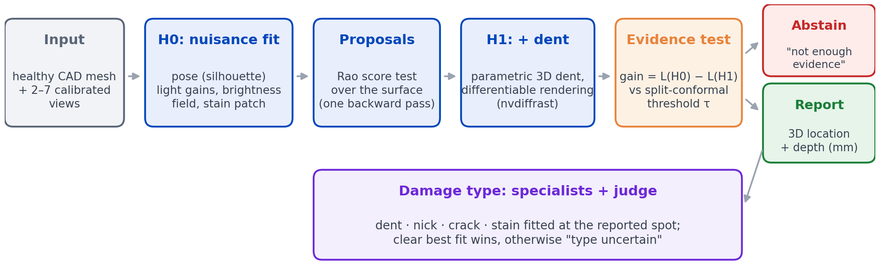
Method: nuisance profiling, score-test proposals and a calibrated decision
▪ Design choices. pose from silhouettes (lighting-independent); evidence on interior, non-grazing pixels; dent and stain searched symmetrically so a stain cannot hide a dent.
METHOD
5
Notes:
The deformation is a parametric dent fitted by Adam through nvdiffrast; neural deformation fields are baselines. The type stage only labels damage already reported, so it adds no false alarms.

Slide 6
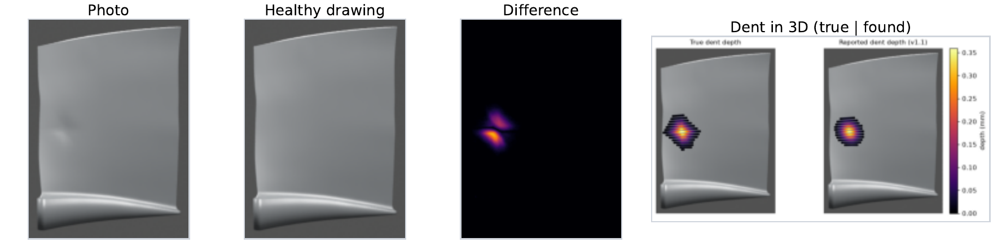
Worked example: the evidence exceeds the threshold by a wide margin
Quantity | Value
L(H0), no damage | 89.3
L(H1), with dent | 19.9
Evidence (gain) | 69.4
Threshold τ | 1.02
Depth found / true | 0.35 / 0.36 mm
Sealed test case test2_0083_3 (Rotor37, unseen blade).
METHOD
6
Notes:
A sealed-test case. The difference image indicates where; the evidence test decides whether; the fitted dent gives location and depth.

Slide 7
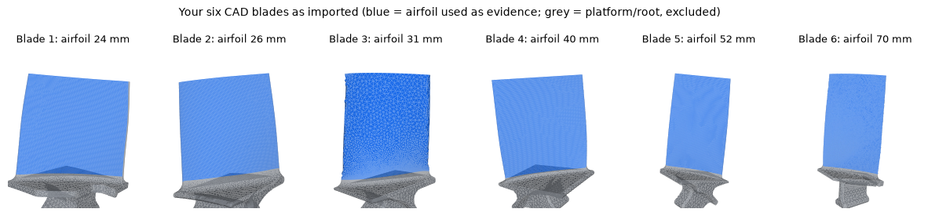
BladeDelta: 1,352 rendered cases with exact ground truth
Split | Cases | Role
Rotor37 dev / calib | 96 / 120 (+300) | Development, calibration
Rotor37 sealed test | 240 (30 blades) | Main result
Rotor37 second test | 240 (30 blades) | Reproduction
Six industrial designs | 456 | Transfer (blades 3–6 held out)
Defect types | 136 + 64 | Nicks, cracks, stains
▪ Blender (Cycles) renders; damage applied to the mesh
▪ Controlled camera error (≤1.5°) and lighting change (±15%)
▪ Damage families differ from the estimator’s model
▪ Test splits sealed until the method was frozen
BENCHMARK
7
Notes:
Exact ground truth is only available in rendering; physical validation follows.

Slide 8
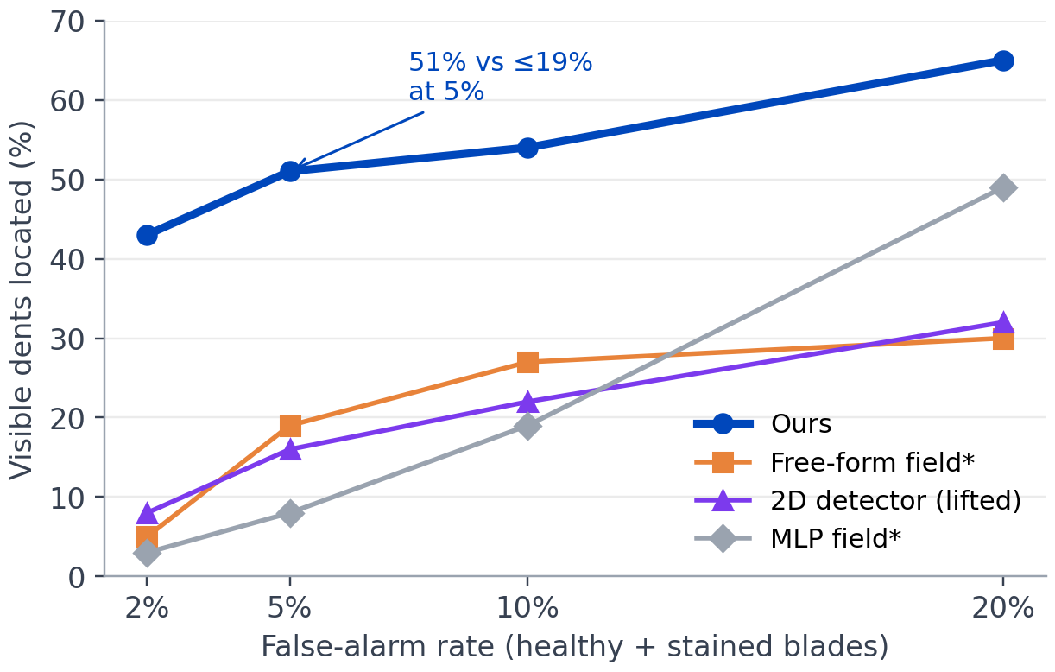
At equal false-alarm rates, the method locates 2.7–6× more dents
Method | AUROC | Located @5%
Ours | 0.82 | 51%
Free-form field* | 0.63 | 19%
2D detector (lifted) | 0.72 | 16%
MLP field* | 0.74 | 8%
▪ Second sealed test reproduces it (46% located, AUROC 0.79)
▪ 12 of 13 visible dents deeper than 0.2 mm found; median centre error 0.7 mm
Sealed test, 240 cases, 30 unseen Rotor37 blades; 90 negatives, 37 visible dents. *Re-implementations of the CADSplat idea.
RESULTS
8
Notes:
Matched false-alarm comparison removes threshold effects. The baselines lack an appearance model, so stains force their thresholds up.

Slide 9
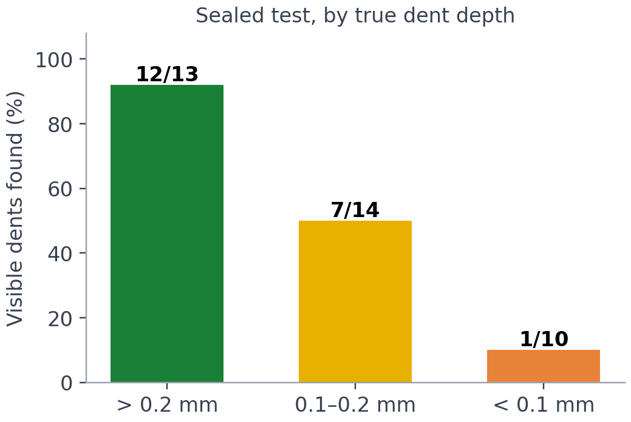
Misses concentrate below 0.2 mm, where the image signal is weakest
▪ Detectability is predictable. The profiled information of a dent predicts found vs missed with AUROC 0.90 / 0.95 on the two sealed tests.
▪ Safety-weighted recall. Weighting misses by depth: 73%; critical defects (> 0.2 mm): 92%.
▪ Per-point maps are optimistic. They imply 49–66% recall below 0.1 mm against 10% observed; reported as an upper bound.
RESULTS
9
Notes:
Most misses are physically small. The detectability predictor works per dent; the aggregated maps are optimistic and are reported as such.

Slide 10
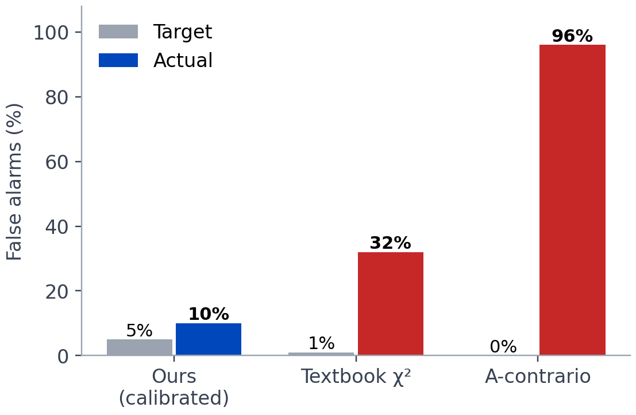
Calibration is necessary: textbook thresholds do not control false alarms
▪ Why. Textbook thresholds assume ideal pixel noise; the residual after the best nuisance fit is dominated by model mismatch.
▪ χ². Nominal 1% → 32% false alarms (≈30×).
▪ A-contrario. Flags 96% of healthy blades.
▪ Ours. Recalibrated on 360 negatives: 2% target → 4% observed.
Same fits on the sealed test.
RESULTS
10
Notes:
Calibration on real negatives is what makes false-alarm control work under mismatch.

Slide 11
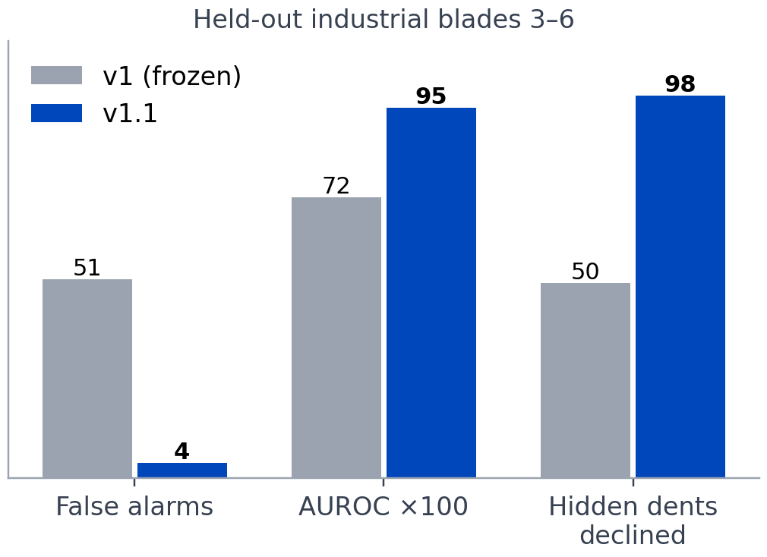
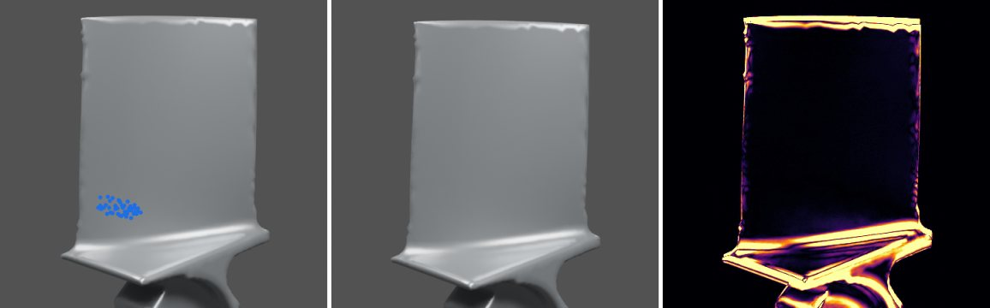
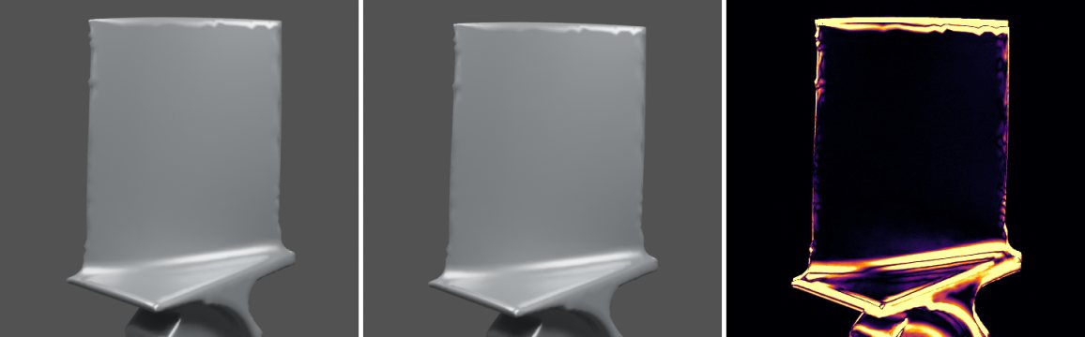
Two corrections restore transfer to unseen industrial designs
v1 (frozen): a false dent on a healthy blade
v1.1: correctly nothing reported
▪ Causes. a silhouette pose bias, and a healthy-reference correction that did not move with the camera. Fixed on blades 1–2, no retraining; evaluated on 3–6.
RESULTS
11
Notes:
Frozen v1 transferred poorly to new designs. Two causes were identified and fixed; held-out results shown.

Slide 12
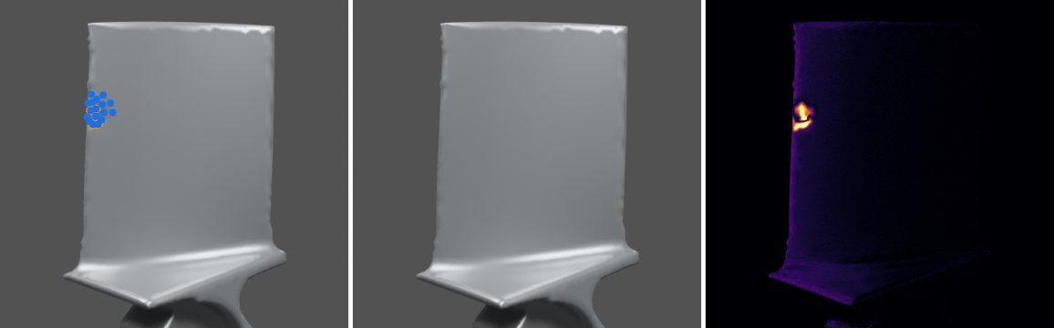
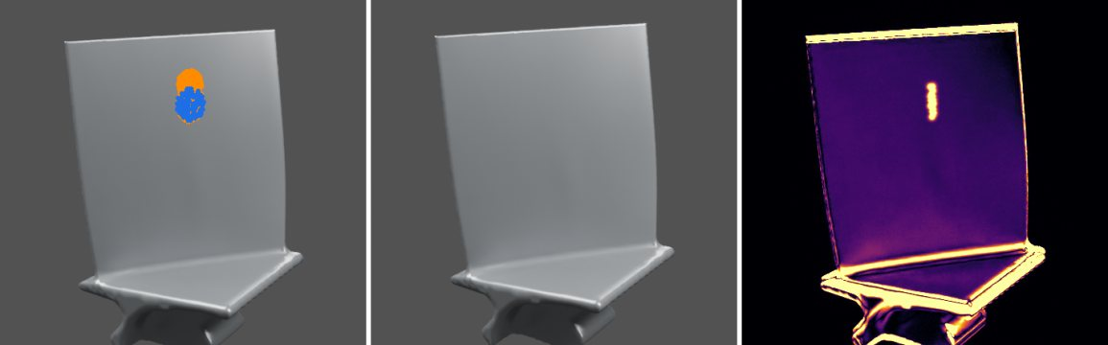
Detection extends to nicks and cracks without retraining
Defect (held-out designs) | Cases | Ours: located | SIFT: reported
Dent | 24 | 23 (96%) | 6 (25%)
Sharp nick (edge notch) | 32 | 21 (66%) | 9 (28%)
Hairline crack (dark line) | 32 | 22 (69%) | 15 (47%)
Stain (should be 0) | 24 | 4 reported | 3
Healthy (should be 0) | 24 | 2 reported | 3
▪ False alarms 6/48 (12.5%) exceed the 5% target set on Rotor37: recalibration on these designs is required.
Sharp nick (top), hairline crack (bottom): orange = truth, blue = found
RESULTS
12
Notes:
Frozen detector, two views, no retuning. Nicks and cracks are not modelled by the detector but produce enough evidence. The elevated false-alarm rate is an honest weakness.

Slide 13
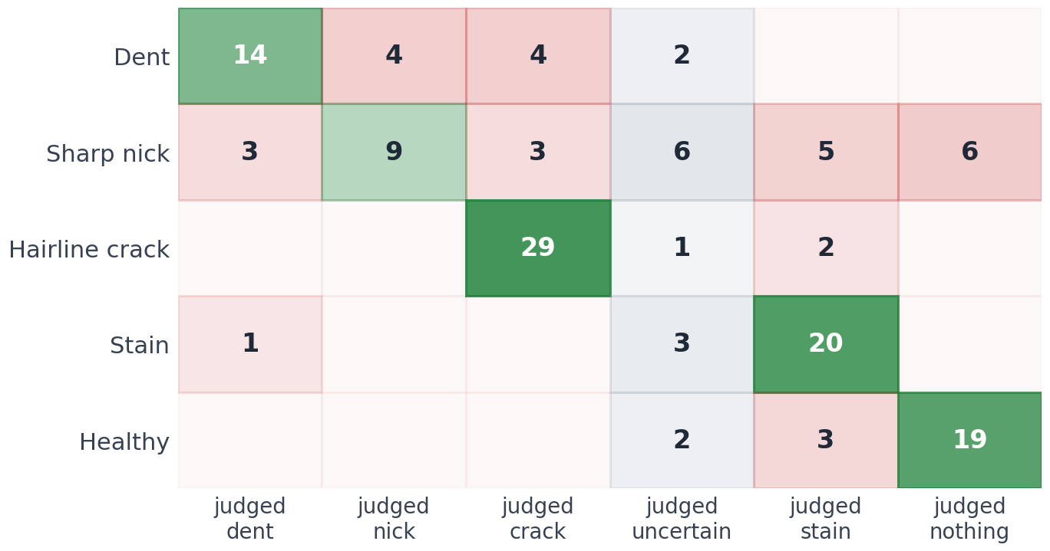
Physical specialists and a judge recognise the damage type
22 / 22
cracks typed correctly
9 / 15
nicks typed; 6 more uncertain
42 / 43
location preserved
2 → 9
nicks recognised, round 1 → 2
▪ Specialists: smooth dent, soft-ellipsoid notch, dark-line crack, colour patch
▪ Judge: lowest loss wins; “uncertain” if within τ. Adapted from MedGuards
Nick and crack: 32 realistic cases each (round 2); dent, stain, healthy: 24 each. Stain/nothing on damage = detector miss.
RESULTS
13
Notes:
The first nick specialist was too smooth; a carved-notch model raised nick recognition from 2 to 9. Uncertain is preferred to a wrong label.

Slide 14
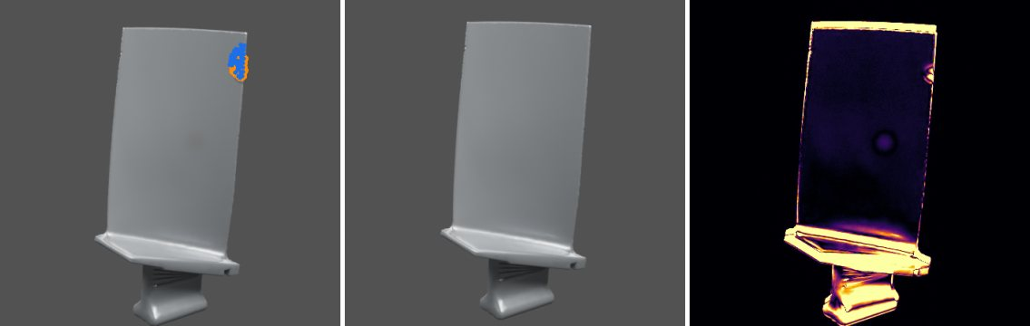
Location is identifiable from two views; depth is not
▪ Not a search failure. Better proposals and restarts at the true location recover ≤ 4 of 42 misses.
▪ Not ambiguity alone. Profile-likelihood depth intervals are narrow yet contain the truth in 36 of 109 cases: a systematic bias.
▪ Implication. Report location; treat depth as unresolved under passive two-view capture. Controlled (grazing) illumination is the next lever.
Unseen design: correct location, depth 0.06 mm for a true 0.64 mm
Depth, measured / true (median)
Rotor37 sealed test | 0.89
Industrial held-out | 0.60
4 views instead of 2 | no change (0.68 vs 0.71)
FINDINGS
14
Notes:
Several fixes were tested and failed, which locates the limitation in the information content of the capture and in the appearance model on new designs.

Slide 15
Limitations
▪ Rendered data only. All positive results use rendered images with known materials.
▪ Real scans fail so far. On SiM3D real objects: AUROC 0.54, 0/22 defects detected; dominated by misregistration and texture.
▪ Depth bias on new designs. Median 60% of true depth; not fixed by views or intervals.
▪ Calibration transfer. 12.5% false alarms on the defect-type set vs 5% target; requires per-design recalibration.
▪ Nicks. 11 of 32 not detected; 6 of 21 located nicks mistyped.
▪ Realism gaps. No sensor noise, blur or material variation in the renders yet.
DISCUSSION
15
Notes:
These are stated in the paper. The SiM3D failure motivates the controlled physical study.

Slide 16
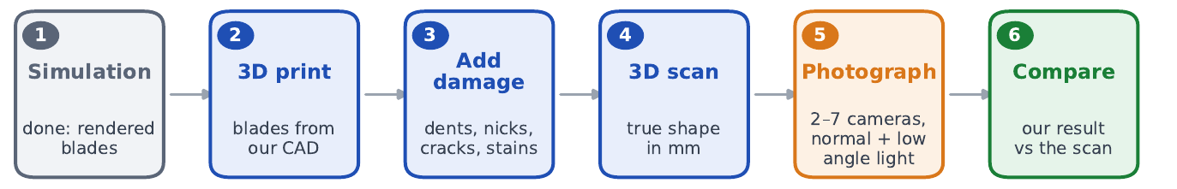
Next: physical validation with measured ground truth
▪ Specimens. 10 stainless-steel printed blades; dents (ball bearings), nicks (files), stains (paint).
▪ Ground truth. Dial gauge and 3D scanner.
▪ Capture. 2–7 calibrated cameras, ArUco markers, fixed and grazing light.
▪ Method. Per-design and class-specific thresholds; grazing-light depth.
▪ Baselines. PatchCore; VGGT + Sim(3) alignment.
▪ Realism. Sensor noise, blur, material variation in the benchmark.
FUTURE WORK
16
Notes:
The frozen pipeline will be compared against metrology on real metal.

Slide 17
Summary of contributions
▪ Formulation. CAD-referenced defect estimation as a calibrated test with abstention, under explicit capture constraints.
▪ Method. Nuisance profiling, score-test proposals and differentiable rendering; 51% vs ≤ 19% at equal false alarms.
▪ Calibration. Shown to be necessary: textbook tests give 32–96% false alarms.
▪ Identifiability finding. Location transfers across designs; depth does not from two passive views.
▪ Defect typing. Physical specialists and a judge: cracks 22/22, nicks 9/15 with explicit uncertainty.
▪ Benchmark. 1,352 rendered cases on public and industrial aero-engine blades.
SUMMARY
17
Notes:
Six points to remember.

Slide 18
Dashboard: afeefaaazam03.github.io/3D-Jetblade/visual_results.html
Notes:
Thank you.

