Slide 1

Can Photos Tell Us What's Wrong With a Jet Engine Blade?
Finding 3D Damage from Just a Few Pictures
[Your Name] · October 2026
Notes:
Title. The question: can a computer look at a few photos of a jet engine blade and tell, in 3D, whether it is damaged? And just as important: can it tell when the photos are not enough?

Slide 2
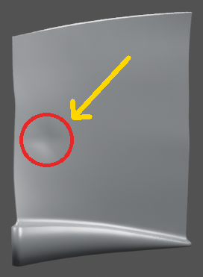
The Problem
• Jet engine blades need regular inspection
• Inspectors look at photos and write reports
• But a dark spot in a photo could be many things
What is this?
Notes:
Blades are inspected regularly from photos. Here a blade has a faint darker patch, circled. Is it damage? That is the question for the whole talk.

Slide 3
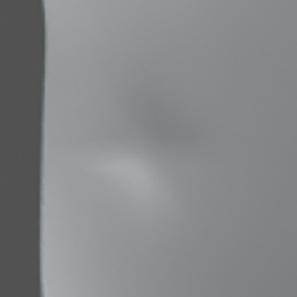
What Could a Dark Spot Be?
DENT
STAIN
LIGHTING
CAMERA ERROR
pushed-in metal: real damage
only the colour changed
a lamp brighter or dimmer
the camera moved 1°
In a photo, all four can look almost exactly the same.
Notes:
The same dark spot has four possible causes. Only the first, a dent, is real damage. The other three are harmless. A computer must tell them apart.

Slide 4
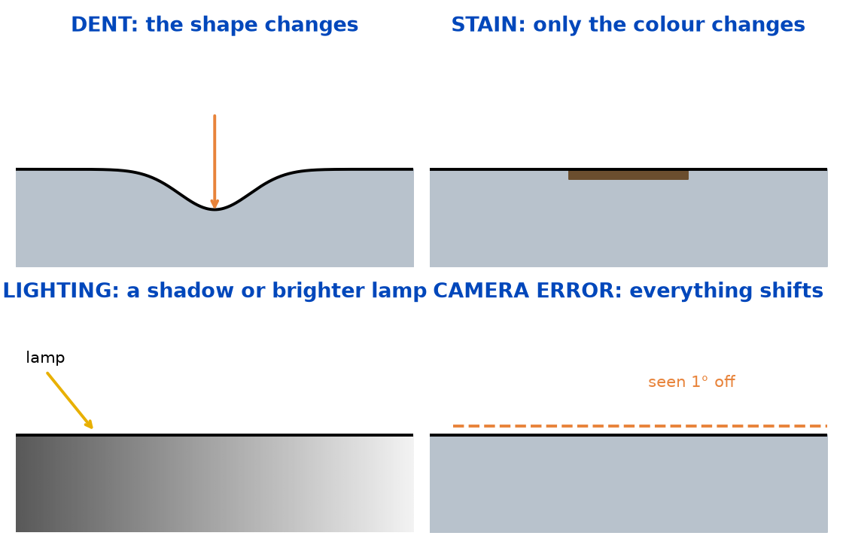
Why This Is Hard
• A dent is a 3D shape change
• A stain is just a colour change
• A lighting artifact is a shadow or glare
• A camera error is a small shift
• A 0.1 mm dent changes the photo by only a few grey levels
Notes:
Only the dent changes the shape. The others change colour, brightness or position. But the dents that matter are tiny: 0.1 millimetre changes the picture by a few grey levels, while a one-degree camera error changes thousands of pixels.

Slide 5
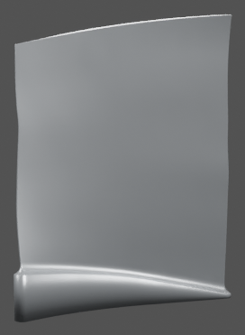
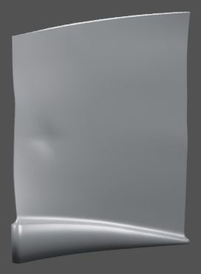
Our Idea: Evidence-Bounded 3D Damage Estimation
Given a healthy CAD model + a few photos, find physical damage in 3D,
but only when the photos actually prove it. If not sure, say "not enough evidence".
DAMAGE FOUND
0.35 mm deep, here
Compare two
explanations
"nothing broke"
vs "plus a dent"
NOT ENOUGH
EVIDENCE
healthy CAD + photos
Notes:
The inputs are the healthy design file and two to seven photos. The method compares two explanations: nothing broke, versus the same plus a dent. Strong evidence: report the dent with its depth and location. Weak evidence: say so.

Slide 6
How It Works
1. Explain without damage
camera · light · stain
2. Find suspicious regions
quick check of the whole surface
3. Estimate 3D shape
fit a smooth dent
4. Test the evidence
beat a calibrated threshold?
If the evidence is strong → report the dent. If it is weak → abstain ("not supported").
Notes:
Four steps. Explain the photos without damage. Find where a dent would help most. Fit a smooth 3D dent there. Then test whether the dent explanation is clearly better than the no-damage one.

Slide 7
System Architecture
OFFLINE (once)
Blade CAD + synthetic damage
Blender renders
Appearance model
trained on renders
Calibrate threshold
healthy + stained blades
Freeze
fingerprint, then test
ONLINE (each inspection)
CAD + 2–7 photos
calibrated cameras
Camera & light fix
v1.1: moves with blade
No-damage fit
pose · light · stain
Dent proposals
score test, 1 pass
Dent fit
differentiable rendering
Evidence vs threshold
report or abstain
Detection-limit map: smallest visible dent per point
Dent: location + depth (mm)
Not supported
Notes:
Offline, once: render blades with known damage, train an appearance model that predicts how a blade looks under the lights, calibrate the decision threshold on healthy and stained blades, then freeze everything. Online, for each inspection: correct the camera and lighting, fit the best no-damage explanation, propose dents with a fast statistical test, fit the best dent by differentiable rendering, and compare the evidence with the threshold. The same fit also gives the detection-limit map.

Slide 8
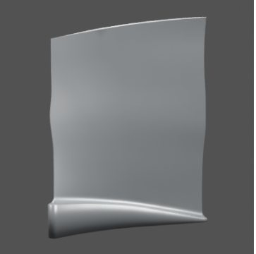
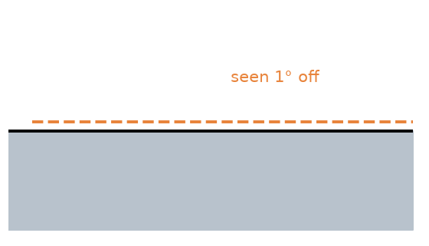
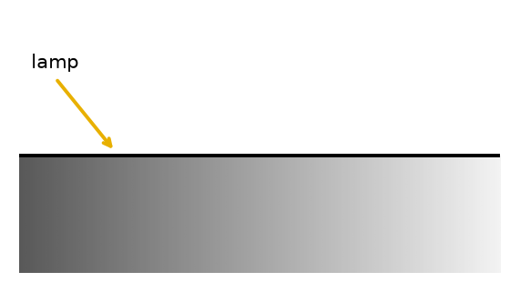
Step 1: Explain the Photos Without Assuming Damage
Fix camera position
Fix lighting changes
Fix stains
This gives us the best 'no damage' explanation.
Notes:
First we explain everything that is not damage: refine the camera pose from the blade outline, the light levels, and a possible stain. What is left over is what damage would have to explain.

Slide 9
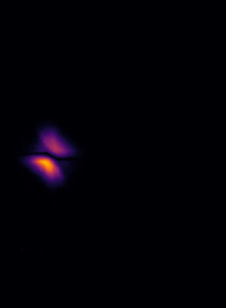
Step 2: Find Where Damage Could Be
−
=
Photo
Healthy render
Difference
Bright = suspicious region
Notes:
Subtract the healthy rendering from the photo. The difference is brightest where something changed; here, the dent. A quick statistical check over the whole surface turns this into a short list of candidate spots.

Slide 10
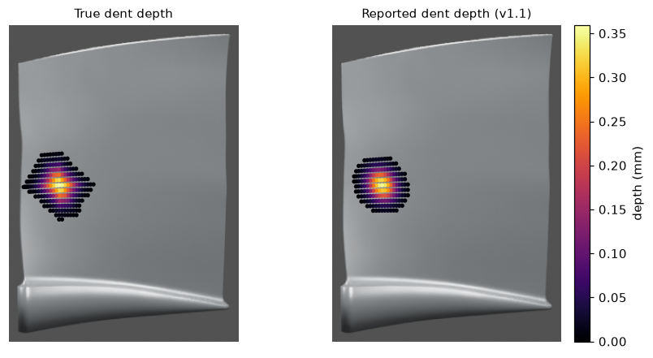
Step 3: Estimate the 3D Shape
Candidate spot
from step 2
Smooth dent
position · depth · size · shape
Render & compare
with the photo, adjust
Optimised via differentiable rendering. Reported 0.35 mm, true 0.36 mm.
Notes:
Starting from a candidate spot, the method fits a smooth dent: where it is, how deep, how big and its shape, by rendering the blade with the dent and adjusting until it matches the photo. Right: the true dent and the measured dent, coloured by depth.

Slide 11
Step 4: The Evidence Test (Our Key Idea)
• Mismatch without a dent: 89.3
• Mismatch with the dent: 19.9
• Evidence (fit gain) = 69.4
• Threshold = 1.02 (set on healthy and stained blades)
69.4 > 1.02 → report the dent
otherwise → abstain
Notes:
A real test case. Without a dent, the best explanation still mismatches the photo by 89. With the dent, 20. The improvement, 69, is the evidence. It is compared with a threshold set on healthy and stained blades so that only about 5 percent of them exceed it.

Slide 12
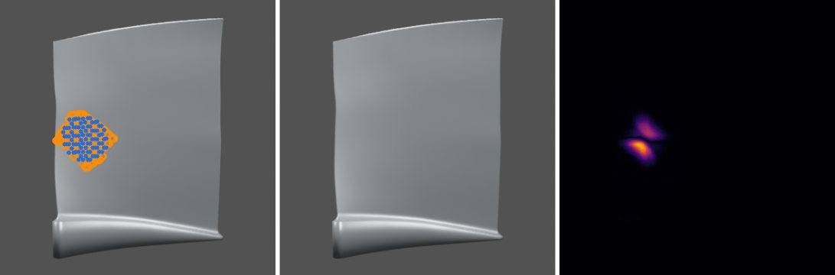
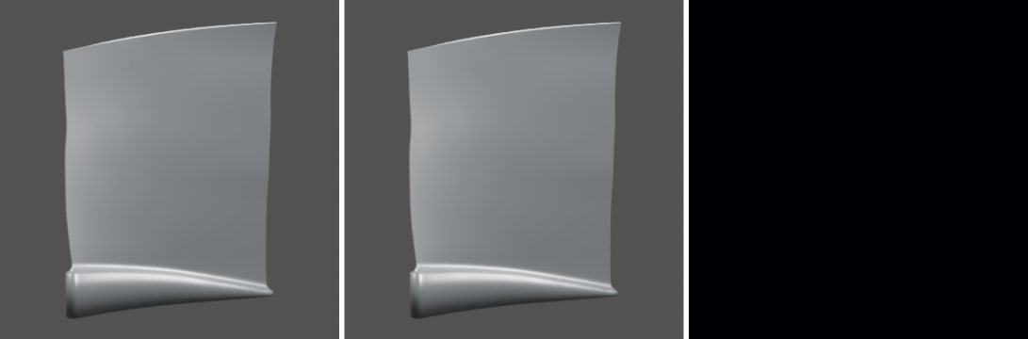
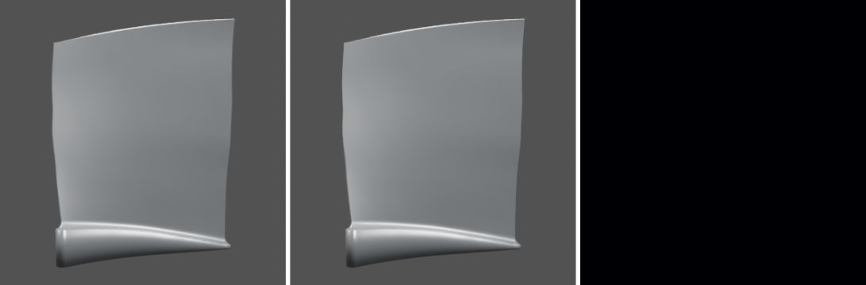
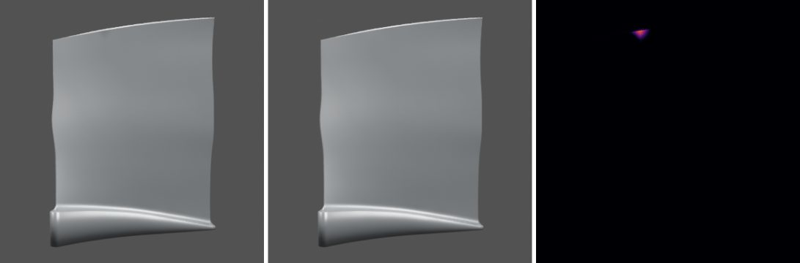
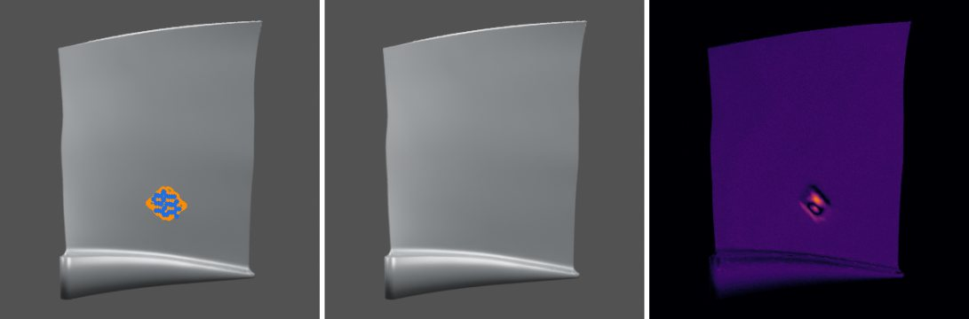
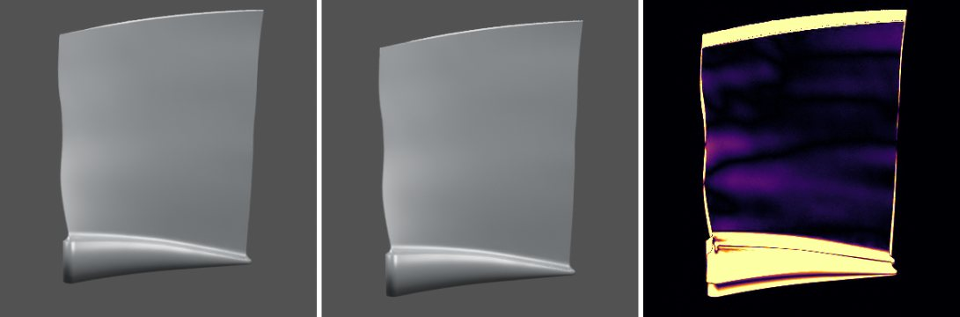
What We Built: BladeDelta Benchmark
696 cases on 84 public blade shapes + 456 cases on 6 industrial blade designs
Sealed test: 240 cases on 30 blades the method never saw
Observable dent
Hidden dent
Healthy
Stain
Dent + stain
Camera error
Notes:
Because no public data has real blade dents with measured depth, we built a benchmark with exactly known answers. Six kinds of cases. Each picture: the photo with the true dent in orange rings and the reported dent in blue, the healthy blade, and the difference.

Slide 13
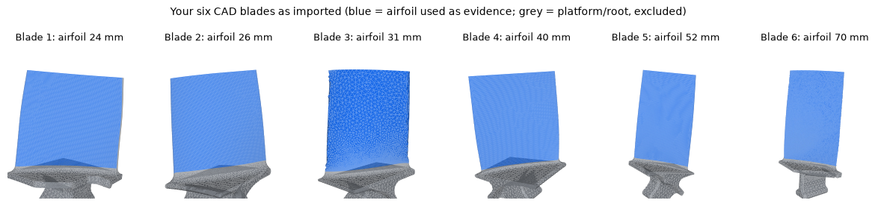
Our Data: Six Industrial Blade Designs
• Your six STEP CAD models (airfoils 24–70 mm), with platform and root
• 456 cases: 30% visible dents, 15% hidden, 20% healthy, 15% stain, 10% dent + stain, 10% camera error
• Real-world dent sizes: 0.1–1.0 mm deep, 1–5 mm radius
A tougher test
The method was never trained or tuned on these designs.
Blades 1–2: develop the fix · 3–6: held out
Notes:
Beyond the public Rotor37 blades, we imported your six industrial blade CAD models. Blue is the airfoil the method inspects; grey is the platform and root. We generated 456 cases with real-world dent sizes. Nothing was retrained on them: this tests whether the method transfers to new designs.

Slide 14
Our Method vs. Baselines
At the same 5% false-alarm rate: ours locates 51% of visible dents; every other method 19% or less.
Notes:
Sealed test, 30 unseen blades. Ours separates dents from healthy blades best and finds more than twice as many dents, all in the right place. MLP and free-form fields reimplement the idea of the recent CADSplat work. Compared fairly at the same false-alarm rate, 51 percent versus at most 19.

Slide 15
What the Evidence Test Buys
We trade some recall for trust: far fewer wrong claims.
Notes:
Same fits, with and without the evidence test. Without it, a third of healthy blades get a false dent and half of the hidden dents are wrongly "found". With it, false alarms drop to 10 percent and wrong claims on hidden dents to 15, at the cost of finding fewer dents.

Slide 16
Recall Depends on Dent Depth
• > 0.2 mm: 12 of 13 found
• 0.1–0.2 mm: 7 of 14
• < 0.1 mm: 1 of 10
• Every reported dent is in the right place
Below what the photos can resolve, it abstains instead of guessing.
Notes:
Almost every visible dent deeper than 0.2 millimetres is found, 12 of 13. Below 0.1 millimetre the photo barely changes, and the method declines rather than guesses.

Slide 17
Does It Work on New Blades?
Six industrial blade designs; results on the 4 held-out blades the fix never saw.
We found two causes, fixed them without retraining, and proved it on unseen blades.
Notes:
On six new industrial designs the frozen method raised false alarms on most healthy blades: 67 percent over all six. Two causes: the camera check nudged correct cameras, and the brightness correction did not move with the blade. Fixed on two blades, tested on the other four: false alarms from 51 to 4 percent.

Slide 18
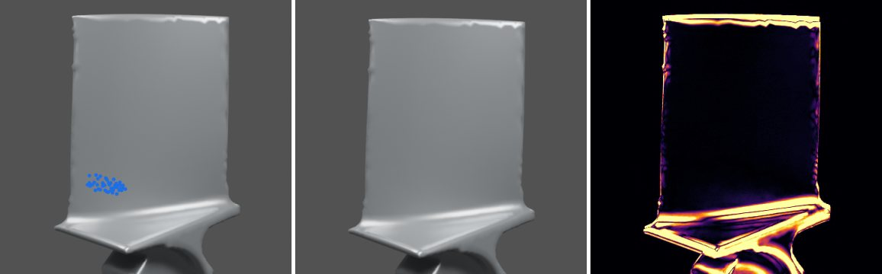
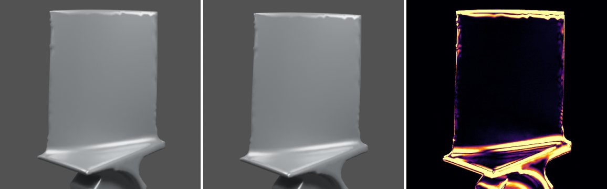
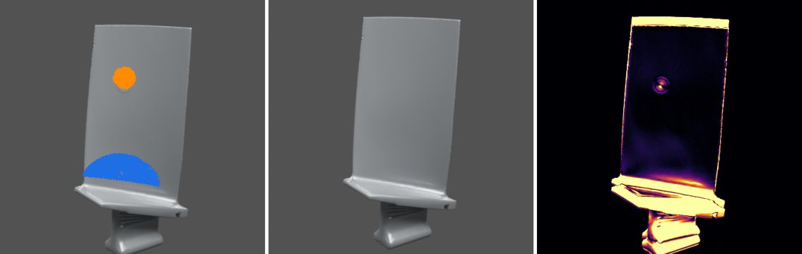
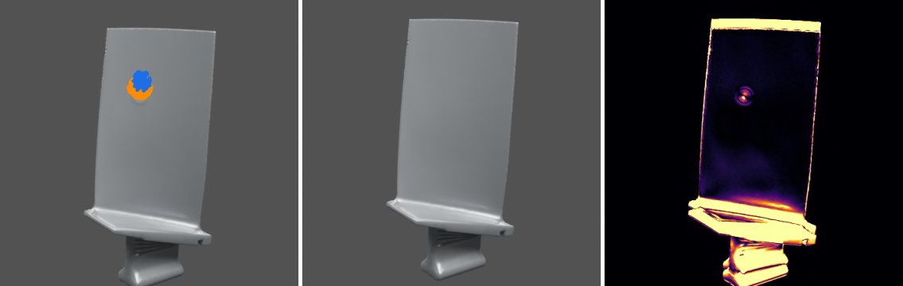
Industrial Blades: Before and After the Fix
Frozen v1
v1.1 (fixed)
• Top: healthy blade, camera moved: v1 invents a dent; v1.1 reports nothing.
• Bottom: real dent: v1 is 37 mm off; v1.1 finds the right place.
• Still open: on new designs depth is underestimated (median 60% of true, vs 89% on Rotor37).
Notes:
Two held-out industrial blades. Top: a healthy blade; the old version reported a dent, the fixed one reports nothing. Bottom: a real dent; the old version put it 37 millimetres away, the fixed one finds it. Honest limitation: on these new designs the measured depth is still too small, about 60 percent of the truth on average, against 89 percent on the original blades.

Slide 19
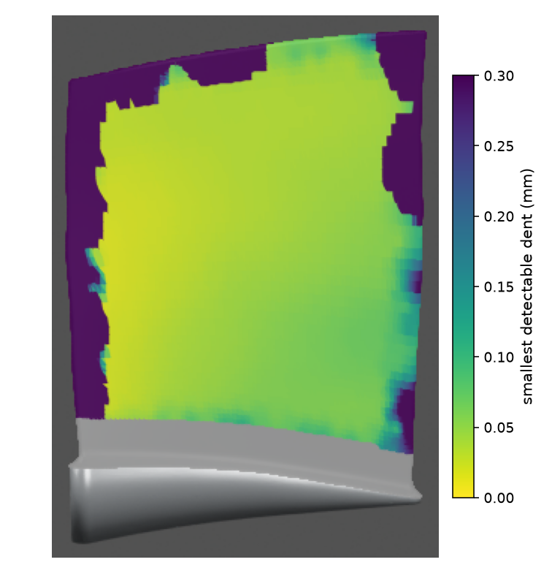
A New Idea: Knowing What the Photos Can Show
• Before searching, predict the smallest detectable dent
• Per-point map: where can we see damage?
• Tested against reality: predicts which dents are found (AUROC 0.90–0.95 on two sealed tests)
We bound our misses, not just our false alarms.
Notes:
New this week. Before searching, we compute the smallest dent each point could reveal. Yellow: tiny dents visible. Dark: only deep dents. Grey: the root, which the method ignores. The per-dent prediction was checked on 300 test dents. The map values in millimetres are still optimistic and need checking against real misses.

Slide 20
From Synthetic to Real Data
Synthetic
rendered blades, exact truth
Compare to healthy
appearance errors cancel
Correction follows camera
v1.1: survives camera drift
Calibrate on negatives
threshold set on data
New designs
6 industrial blades: detection transfers
Real blade
printed, dented, scanned (next)
• Real scanned objects (SiM3D, ICCV 2025): not working yet (separation 0.54)
• Why: healthy and damaged photos 4–18 px apart; textured wood
• Plan: print industrial blade 5 at 2×, dent it, marker-based camera poses, scanner truth
?
real printed
blade
Notes:
How we bridge synthetic and real. Every photo so far is rendered, which gives exact answers. Several design choices are there to survive real data: we always compare with a healthy reference so absolute appearance errors cancel; since v1.1 that correction moves with the camera; the threshold is calibrated on data, not assumed; and we tested on new industrial designs. One real dataset of scanned furniture does not work yet, mainly because its photos are misaligned. Next: a printed, dented and scanned copy of one of your blades.

Slide 21
What's Still Missing
• All results so far are on rendered blades
• One real dataset (scanned furniture) did not work yet
• Next: 3D-print a real blade, dent it, photograph it and scan it
?
real printed
blade
Next step: real validation
Notes:
The honest gap: everything so far is on rendered images. The next step is a real blade: print one of the industrial designs at twice its size, put real dents in it, photograph it, and measure the dents with a scanner.

Slide 22
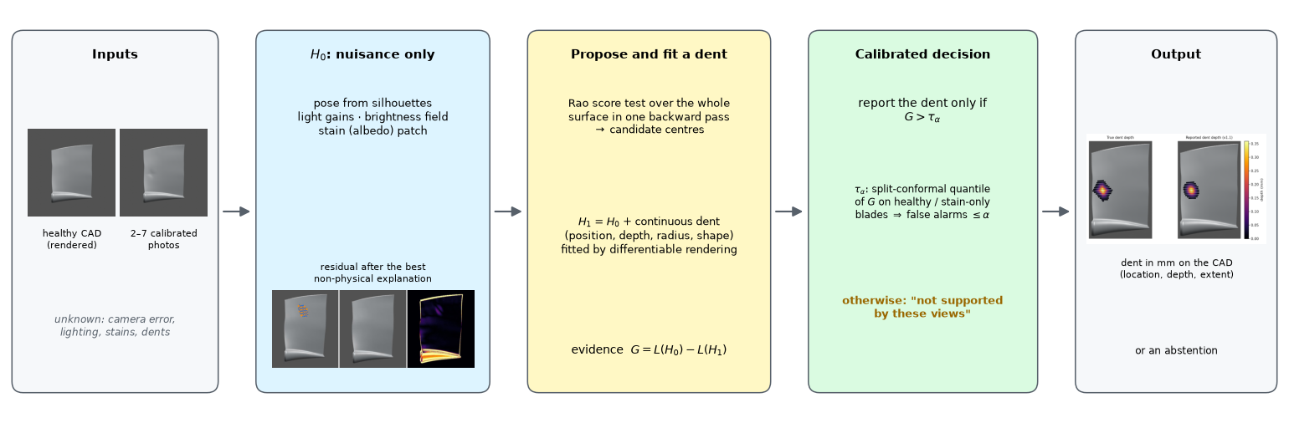
Summary
• We built a method that finds 3D damage on blades from a few photos
• It knows when to say "not enough evidence"
• It controls false alarms and predicts which dents it can see
• Finds damage on new blade designs (after a fix); depth there still ~40% low
• Real validation is next
Notes:
In short: a method that measures dents in 3D from a few photos, says when it cannot tell, keeps false alarms low, predicts what it can and cannot see, and now works on new blade designs. Next: real blades.

Slide 23
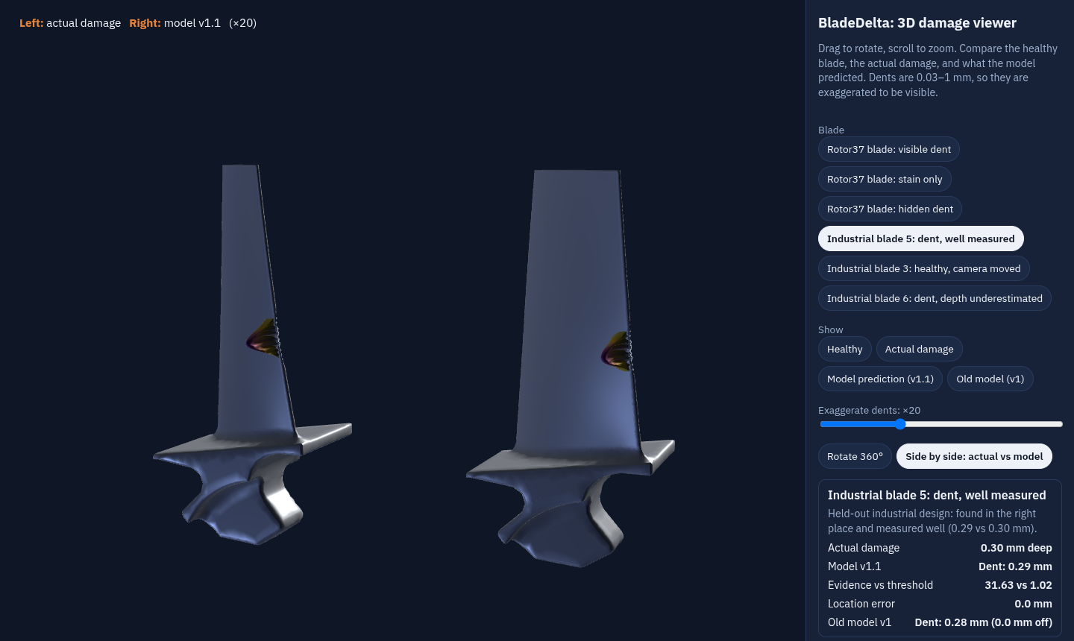
3D Demo: Actual Damage vs Model Prediction
• Rotate the blade 360°
• Switch: healthy · actual damage · model prediction · old model
• Side by side: truth (left) vs model (right)
• Rotor37 and industrial blades
afeefaaazam03.github.io/3D-Jetblade/viewer3d.html
Notes:
The live 3D demo. Here an industrial blade: left the actual dent, right what the model predicts, 0.29 versus 0.30 millimetres, same place. Dents are exaggerated twenty times so they are visible. You can rotate, zoom, and switch between healthy, actual, the new model and the old one.

Slide 24
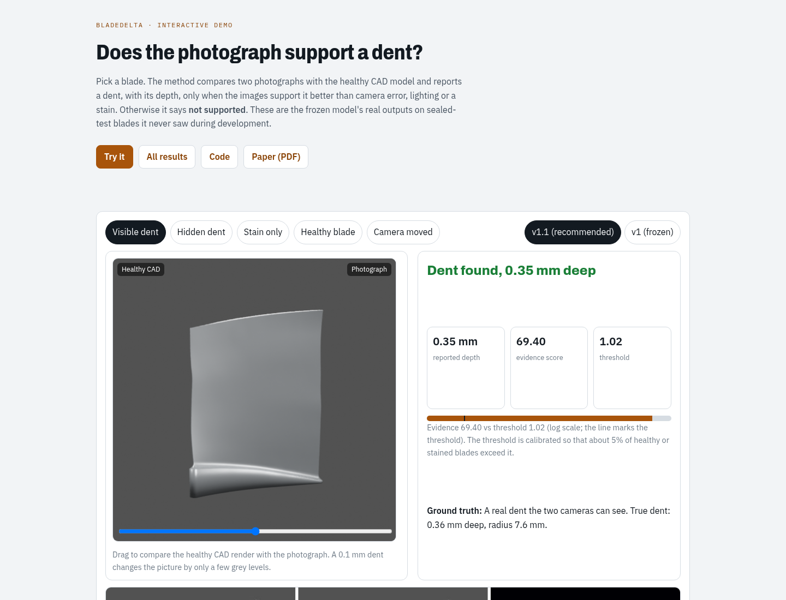
Try It
• Pick a blade case
• See the decision, depth and evidence
• Drag the slider: healthy vs photo
afeefaaazam03.github.io/3D-Jetblade/try.html
Notes:
The interactive demo online: choose one of five test blades, see the method decision, the measured depth and the evidence against the threshold. These are real outputs of the method.

Slide 25
Paper: afeefaaazam03.github.io/3D-Jetblade/paper/BladeDelta_draft.pdf
Code: github.com/afeefaaazam03/3D-Jetblade · Demo: afeefaaazam03.github.io/3D-Jetblade/try.html
Contact: [Your Email]
Notes:
Thank you. Questions welcome.

