Slide 1
h
Sexual Harassment
Afeefah Manzoor
b

Slide 2
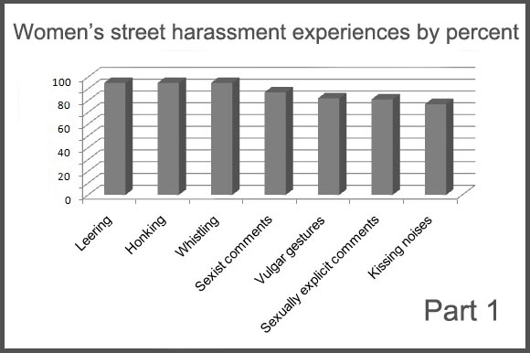
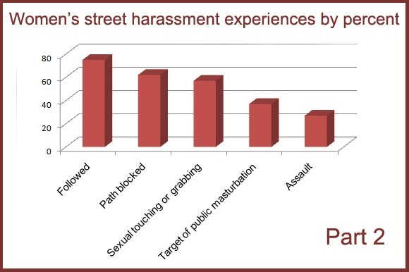

Slide 3
z
z

